Slide 1
Flipped Learning
A Mock Trial

Slide 2
OBJECTIVES & KEY COMPETENCES
do online research, collaborate, organize their time and take responsibility for their work
analyse S. King’s novel “Misery”
compare American and Croatian legal systems
use English legal vocabulary in authentic situations
write ” the script” for the mock trial
role-play a mock trial
transversal skills
English language skills
IT skills
organisational skills
intercultural skills

Slide 3
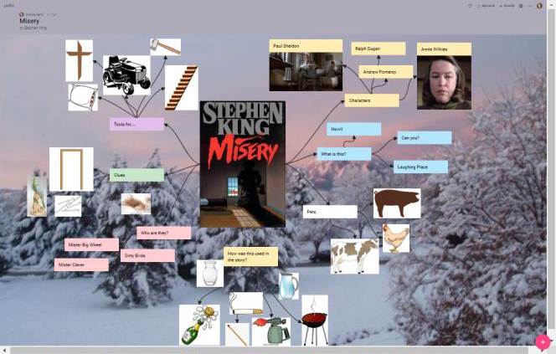
Stephen King: Misery
home: reading and making notes
school: creating mindmaps and discussing

Slide 4
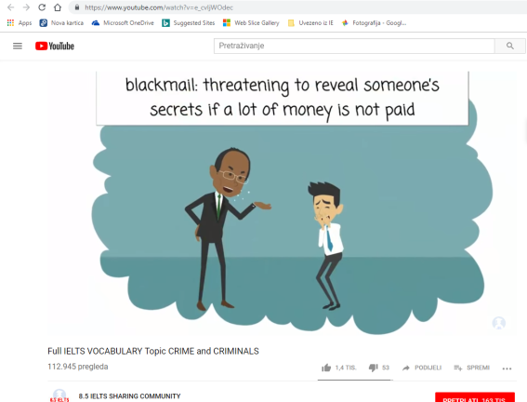
Courtroom Vocabulary
YouTube Video on crime vocabulary

Slide 5
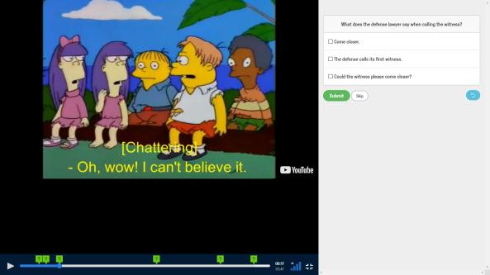
Courtroom Vocabulary
home: the Simpsons and EdPuzzle

Slide 6
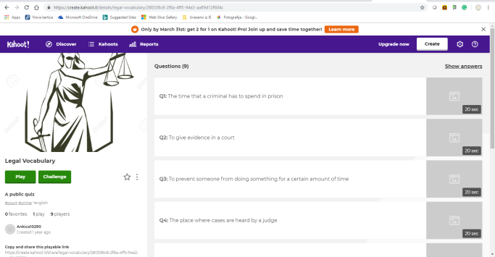
Courtroom Vocabulary
home: Kahoot! on Courtroom Vocabulary

Slide 7
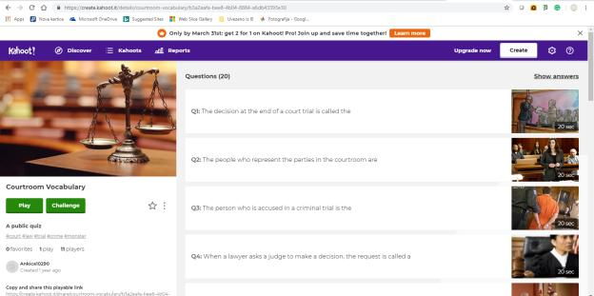
Courtroom Vocabulary
school: Kahoot! on Courtroom Vocabulary

Slide 8
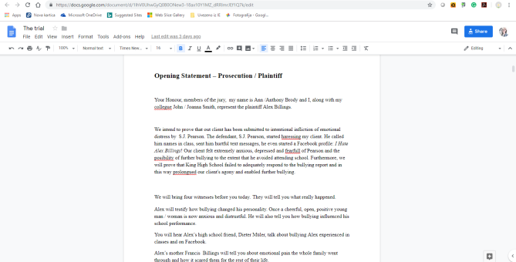
A Mock Trial
home: analysing an example of a mock trial
school: planning a trial, creating teams, distributing roles

Slide 9
A Mock Trial
home: prosecution and defence prepare for the court using Google Disk
school: practicing for the mock trial

Slide 10
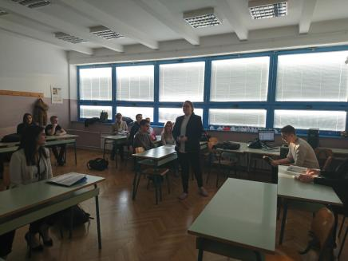
A Mock Trial

Slide 11
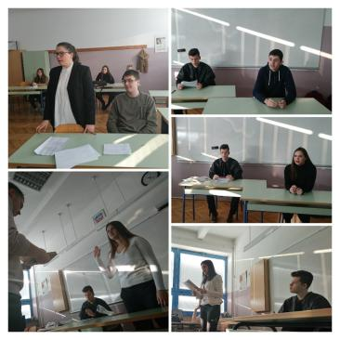
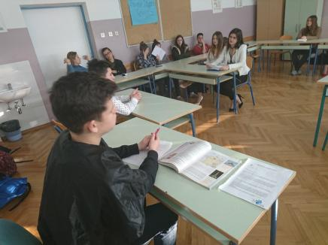
A Mock Trial

Slide 12
Flipped Learning
student centred
teacher the monitor
content-focused & process-focused

Slide 13
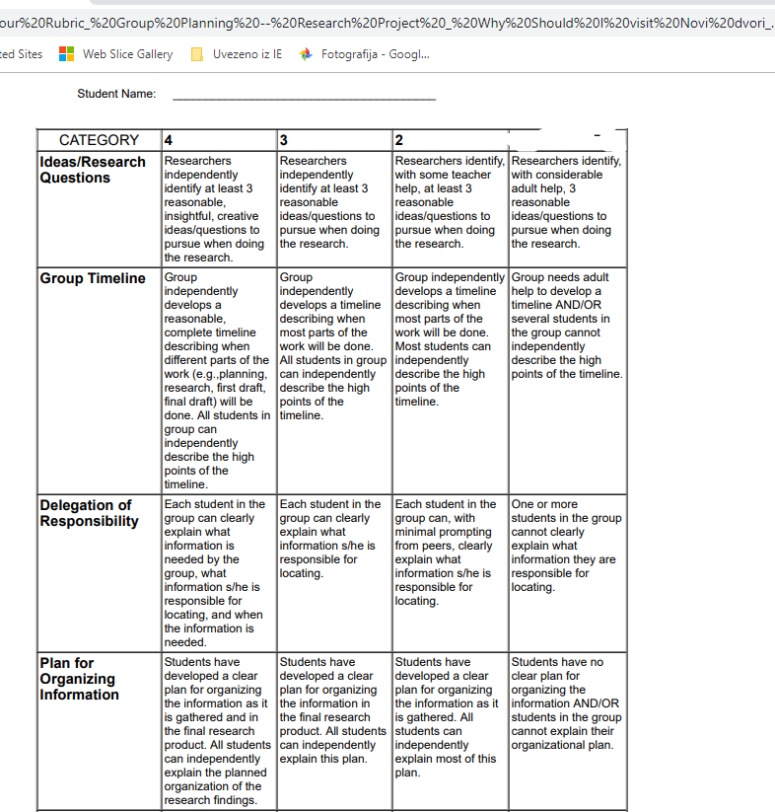
Assessment
formative assessment (rubrics, teacher)
sumative assessment (written and oral production)

Slide 14
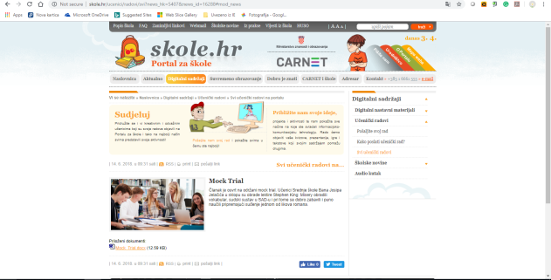
Disemination
school magazine’s web page
skole.hr web page

