Slide 1
TurkIsh KItchen cultere

Slide 3
SOME TURKISH FOODS
İçli Köfte
Köfte (meatball) is a standard yet delicious Turkish dish and içli köfte has a delicious crispy shell made from bulgur filled with seasoned minced meat, onions, parsley, and pine nuts.
Döner
A Turkish classic that has also become a bit of a national dish in Germany, döner kebap comes in many forms including dürüm (döner wrapped in lavaş bread) and iskender kebap (döner on a bed of pide bread with yogurt, tomato sauce, and butter).
Meze
The world of meze (appetizers) is wide and varied and some of our favorites include fava (mashed broad beans), köpoğlu (fried eggplant cubes with a yogurt and tomato sauce), muhammara (dip made from red pepper paste, walnuts, lemon juice, and pomegranate molasses).

Slide 4
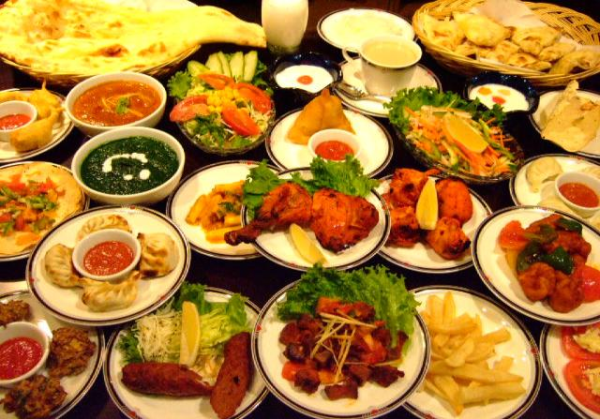

Slide 5
Kebap
There are many varieties of kebap including Adana and Urfa (spicy and non-spicy hand kneaded seasoned lamb meat grilled on skewers), Beyti (ground beef or lamb grilled on skewer, wrapped in lavaş bread and topped with yogurt and tomato sauce), and şiş (skewered and grilled seasoned cubes of lamb or chicken meat).
Mantı
Small handmade dumplings filled with minced meat are boiled and then served with yogurt and a sauce made with oil, paprika, mint, and garlic.
Balık Ekmek
One of Istanbul’s most iconic tourist snacks, balık ekmek is a sandwich containing grilled fish, onions, and salad.
Karnıyarık
A very common dish at Istanbul’s many esnaf (tradesmen) restaurants, karnıyarık is made from whole baked eggplants filled with seasoned minced meat and parsley, then covered in a tomato sauce. Goes great with rice with tomatoes.

Slide 6
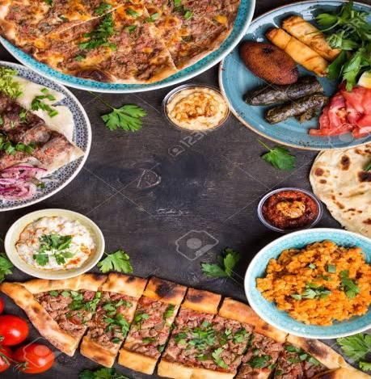

Slide 7
Kadınbudu Köfte
The other version of the famous köfte is made by dipping the meatballs in an egg and flour batter and frying them to perfection.
Hünkar Beğendi
Quite an amazing dish, soft lamb cubes are served on top of eggplant puree, made with butter and melted kaşar cheese.
Kuzu Tandır
An ancient dish that was made by cooking lamb in a tandır (a clay oven in the ground), nowadays kuzu tandır is still made traditionally from extremely tender meat and served with iç pilav (rice with nuts, diced liver and currants).
ızgaraBalık
No visit to Istanbul would be complete without having fresh grilled fish including hamsi (anchovy), levrek (sea bass), çupra (bream), istavrit (saurel), palamut (mackerel), and lüfer (bluefish) depending on the season.
pide
Delicious boat shaped baked dough filled with many different ingredients from minced meat to spinach, eggs and sucuk (spicy Turkish sausage) and kuşbaşı (small cubes of seasoned veal meat).

Slide 8
Lahmacun

Slide 9
Recipe
Combine sugar, yeast, and ³⁄₄ cup water heated to 115˚ in a small bowl; let sit until foamy, about 10 minutes. Combine flour and salt in a bowl and make a well in the center. Add yeast mixture and stir to form a dough. Transfer dough to a lightly floured surface; knead until smooth, about 6 minutes. Transfer dough to a lightly oiled bowl and cover with plastic wrap. Let dough rest until doubled in size, about 1 hour. Punch down dough, divide into 4 portions, and roll each portion into a ball. Transfer dough balls to a floured baking sheet. Cover with a damp tea towel and let rest for 45 minutes.
Meanwhile, make the topping: In a large bowl, combine oil, tomato paste, parsley, cayenne, cumin, paprika, and cinnamon and stir vigorously with a fork. Stir in lamb, garlic, tomatoes, onions, and chiles and season with salt; set topping aside.
Put a pizza stone in bottom third of oven and heat oven to 475°. Working with one dough ball at a time, use a rolling pin to roll dough into a 10" disk. Brush off excess flour and transfer dough to a piece of parchment paper. Spoon 3–4 tbsp. topping onto dough and using your fingers, spread topping evenly to edges. Season with salt. Holding parchment paper by its edges, transfer to baking stone. Bake until dough is golden brown and topping is cooked, 6–8 minutes. Repeat with remaining dough and topping; serve warm or at room temperature.

Slide 10
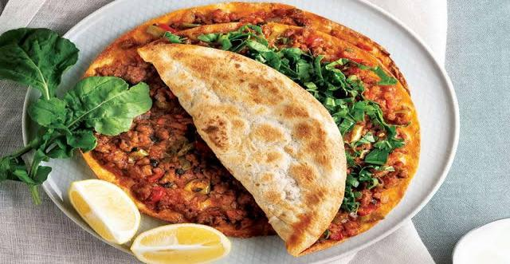
Bon apetit

Slide 11
Yaprak sarma

Slide 12
Recipe
Rinse the rice well.
Heat some olive oil in a pan. Add the rice and fry shortly. Add the tomato and pepper paste and stir everything together well. Fry for about a minute.
Add parsley, paprika powder, mint, pepper, and salt. Use a bit more than you would usually do because in the boiling process, part of the flavor will evaporate. Stir well and take the pan off the heat. You are going to fill the vine leaves with uncooked rice. The rice will be cooked later with the vine leaves. Leave the mixture to cool down.
In the meantime, take the vine leaves from the package and carefully take them apart. Rinse them one by one.
Put all the leaves in a pan with boiled water (not on the stove) and leave them for five minutes. Drain.
Take a large pan and put some olive oil on the bottom. Put a few broken vine leaves on the bottom of the pan. This will stop the yaprak sarma from sticking to the pan.
Now you can start rolling the vine leaves. Use a cutting board to put the vine leaves on. On one side of the board, put the pan with the rice mixture and put a plate with vine leaves and on the other side to put the yaprak sarma in.

Slide 13
Take a vine leave and put it on the cutting board with the veins up. Cut or break the stem off carefully. Put a little bit of the rice mixture onto the bottom of the leaf. Make sure you leave some space between the rice and the end of the leaf. Take the two lowest ends of the leaf and fold them over the rice. Do the same for the left and the right end of the leaf. Then roll up the leaf tightly from the bottom to the top. The first ones will be a bit difficult, but after a few you will know how to do it.
Put the sarma into the pan and repeat the same steps for the other vine leaves. Make sure that you put the yaprak sarma close to each other in the pan. If they are too loose, the rolls can open while cooking. If the bottom of the pan has been filled, you can put the next sarma on top of the others.
When you have finished all the sarmas, cut a lemon into slices. Put the slices on top of the sarmas and put a plate, turned upside-down on top of that. This will prevent the sarmas from opening while boiling.
Mix boiling water with a tablespoon of tomato paste and a stock cube. Pour the water into the pan until the plate is just under water. Put the pan on the stove and bring to boil.
Leave the sarmas to simmer for 45 minutes on low heat. It is important that you use a pan that is big enough because the sarmas will get bigger while boiling. The rice increases in volume when it is cooked.
Turn off the heat after 45 minutes and leave the sarmas in the pan with a lid on (without draining the water) for at least 30 more minutes.

Slide 14
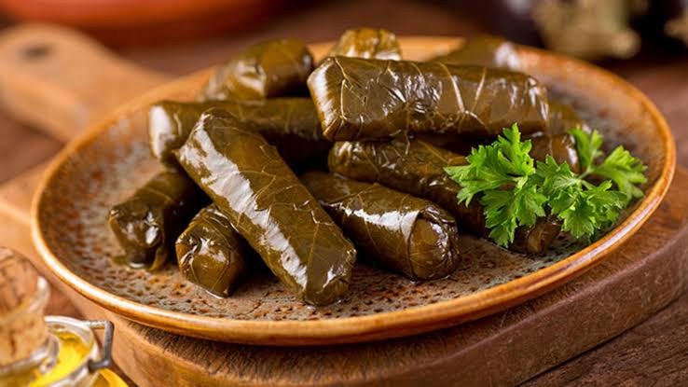
Bon apetit

Slide 15
Baklava

Slide 16
Recipe
Preheat oven to 300 degrees F. On a lightly floured surface, roll all 4 puff pastry sheets to fit a 9 x 11 baking dish; set aside. Grease pan with room temperature butter. Place 1 rolled sheet of puff pastry into pan then grease pastry sheet with butter. Place another layer of puff pastry on top, then grease with butter.
In medium bowl, combine coarsely chopped pistachios, honey, sugar and water and mix. Pour mixture over puff pastry sheets in dish. Place another puff pastry sheet over the top of the mixture, then grease it with butter. Place the last puff pastry on top and pour remaining butter on top. Use a sharp knife to cut baklava in the shape of a diamond or square.
Place baklava in oven and bake for 90 minutes. The top of the puff pastry should be light golden color and the papers should appear crispy. Meanwhile, grind or chop the remaining pistachios into an almost fine dust or finely chopped. Allow baklava to cool then garnish with pistachios.

Slide 17
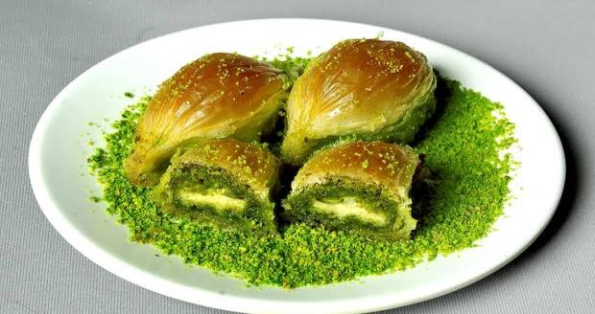
Bon apetit

