Slide 1
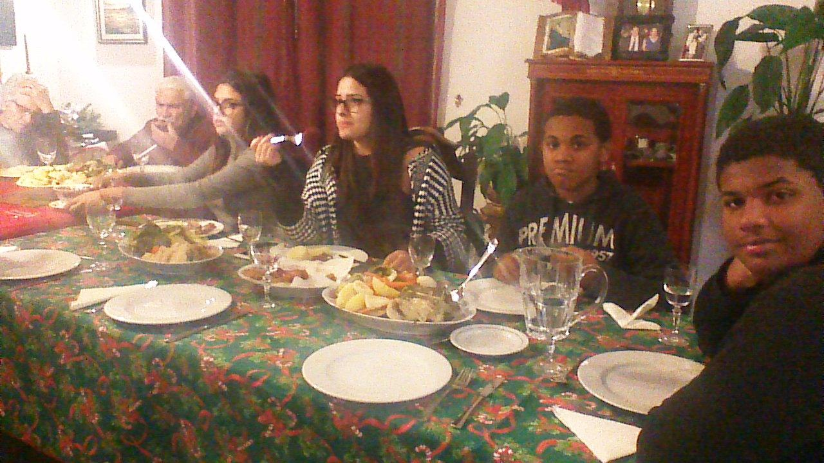
Marco Subida
Escola EB-2,3 Cego do Maio
Póvoa de Varzim
Portugal

Slide 2
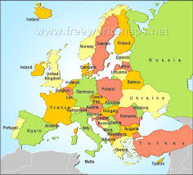
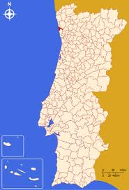
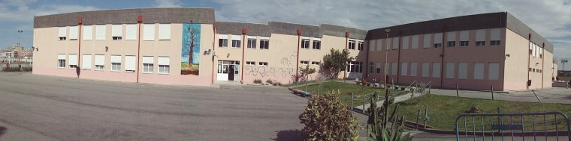
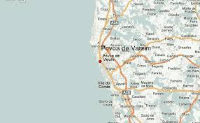
WHO AM I?
I’ m Marco. I’ m 13 years old. I’m a student of the 8th grade, Class 8-A, of the school Cego do Maio, in Póvoa de Varzim, Portugal.

Slide 3

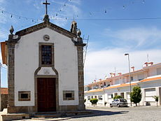
My social activities
I’ m a boy scout
I sing in the church choir in my neighborhood.
I practice sports, I do athletics (throwing weight)

Slide 4
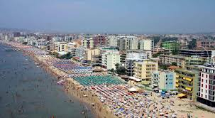
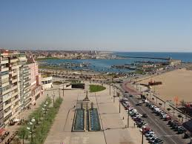
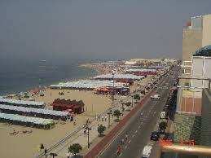
THIS IS THE CITY WHERE I LIVE
Póvoa de Varzim, is a beautiful , tourist city in the north of Portugal.

Slide 5
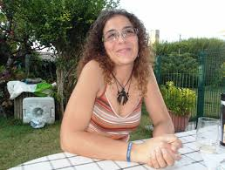

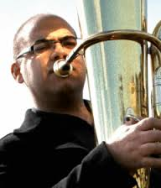
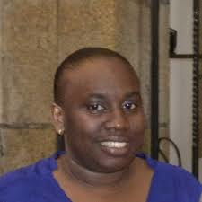
MY FAMILY
I live with my father and his wife.
I have one sister that is marine biologist researcher, and works in the Catholic University of Santiago in Chile
My oldest brother is musician and plays tuba in the orchestra of Oulu in Finland
My other brother is 11 years old and lives with my mother and my youngest brother at Lisbon.
At home we have two cats, a dog, chikens and other birds.

Slide 6


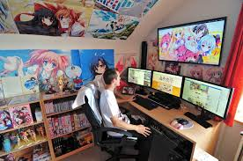

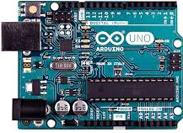
MY HOBIES
I like to read science and technology magazines, like “Quero Saber” ( I want to know) and online “Hypesciense”
I like to watch TV channels: Discovery, National Geographic and History
I like to watch online animes and mangá channels. I define myself as an OTAKU. (animes and mangás fan)
I like to play computer action games and retrogames in my Raspberry PI
I like robotics and I belong to robotics club of my school

Slide 7
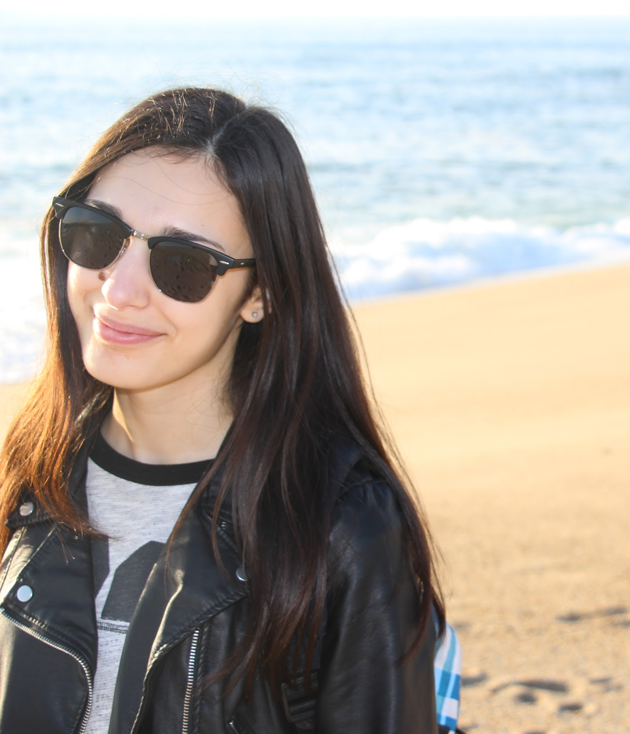
Rita Spínola
Escola EB-2,3 Cego do Maio
Póvoa de Varzim
Portugal

Slide 8
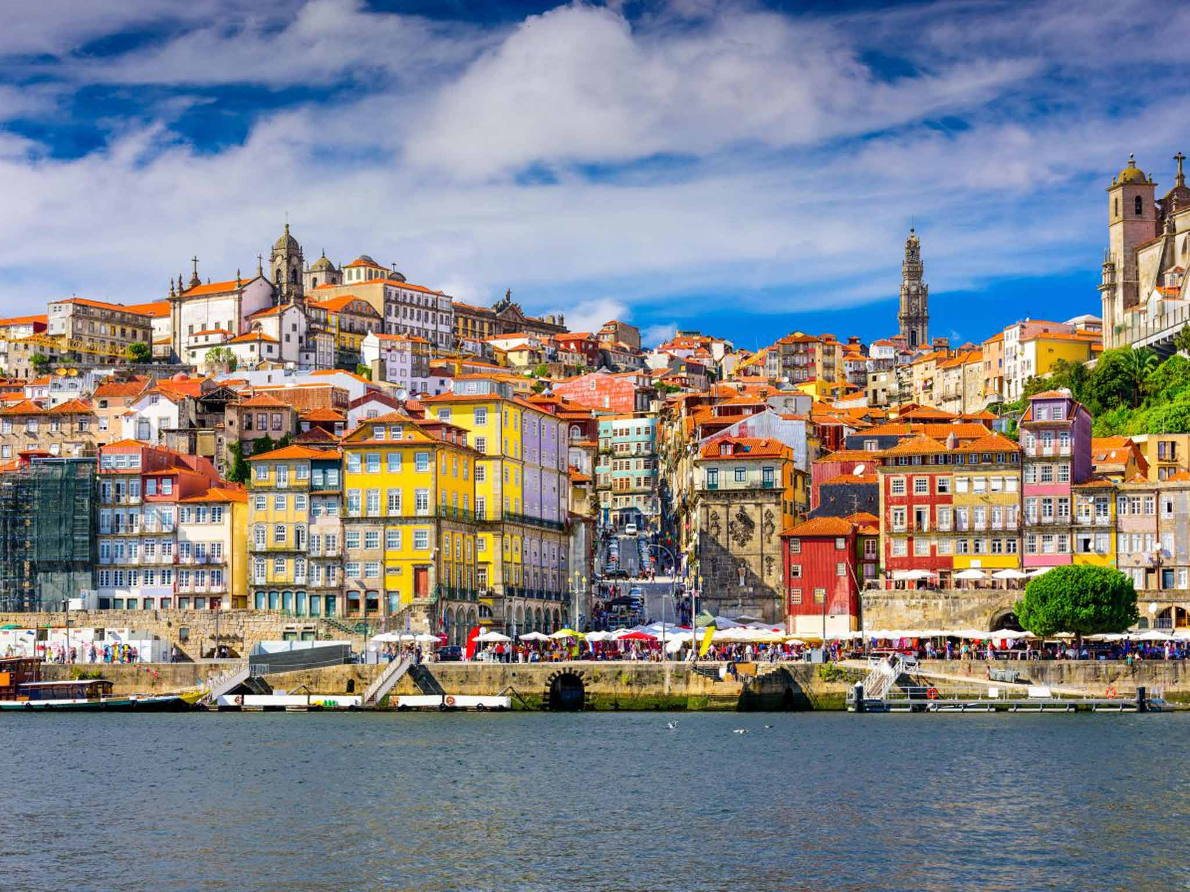
WHO AM I?
I’m Rita and I’m 15 years old. I was born in Porto
which is a beautiful city in Portugal but I live in Vila do Conde.
I’m a student of the 9th grade, Class 9-D, of the school Cego do Maio, in Póvoa de Varzim.

Slide 9
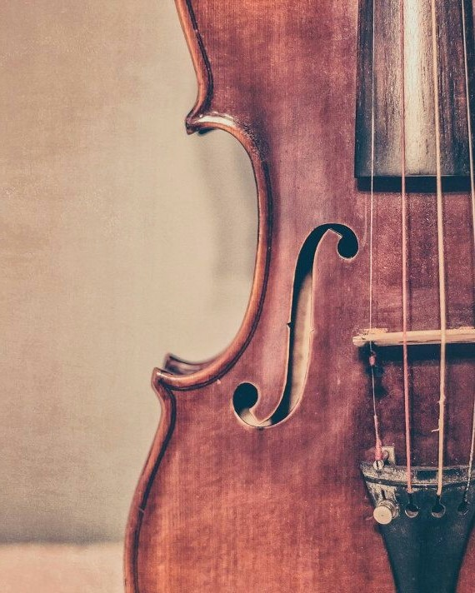

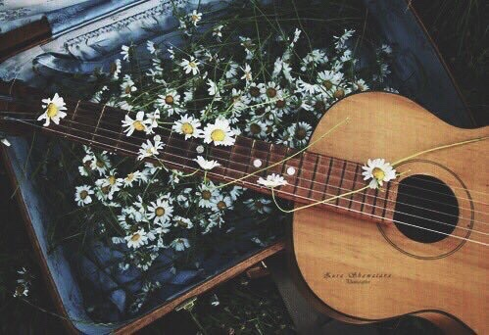
MY HOBBIES
I’m a music student so I play violin since I was 10.
Last year I started a German course, which is such a beautiful language!
I’ve been learning how to play guitar 4 months ago.

Slide 10
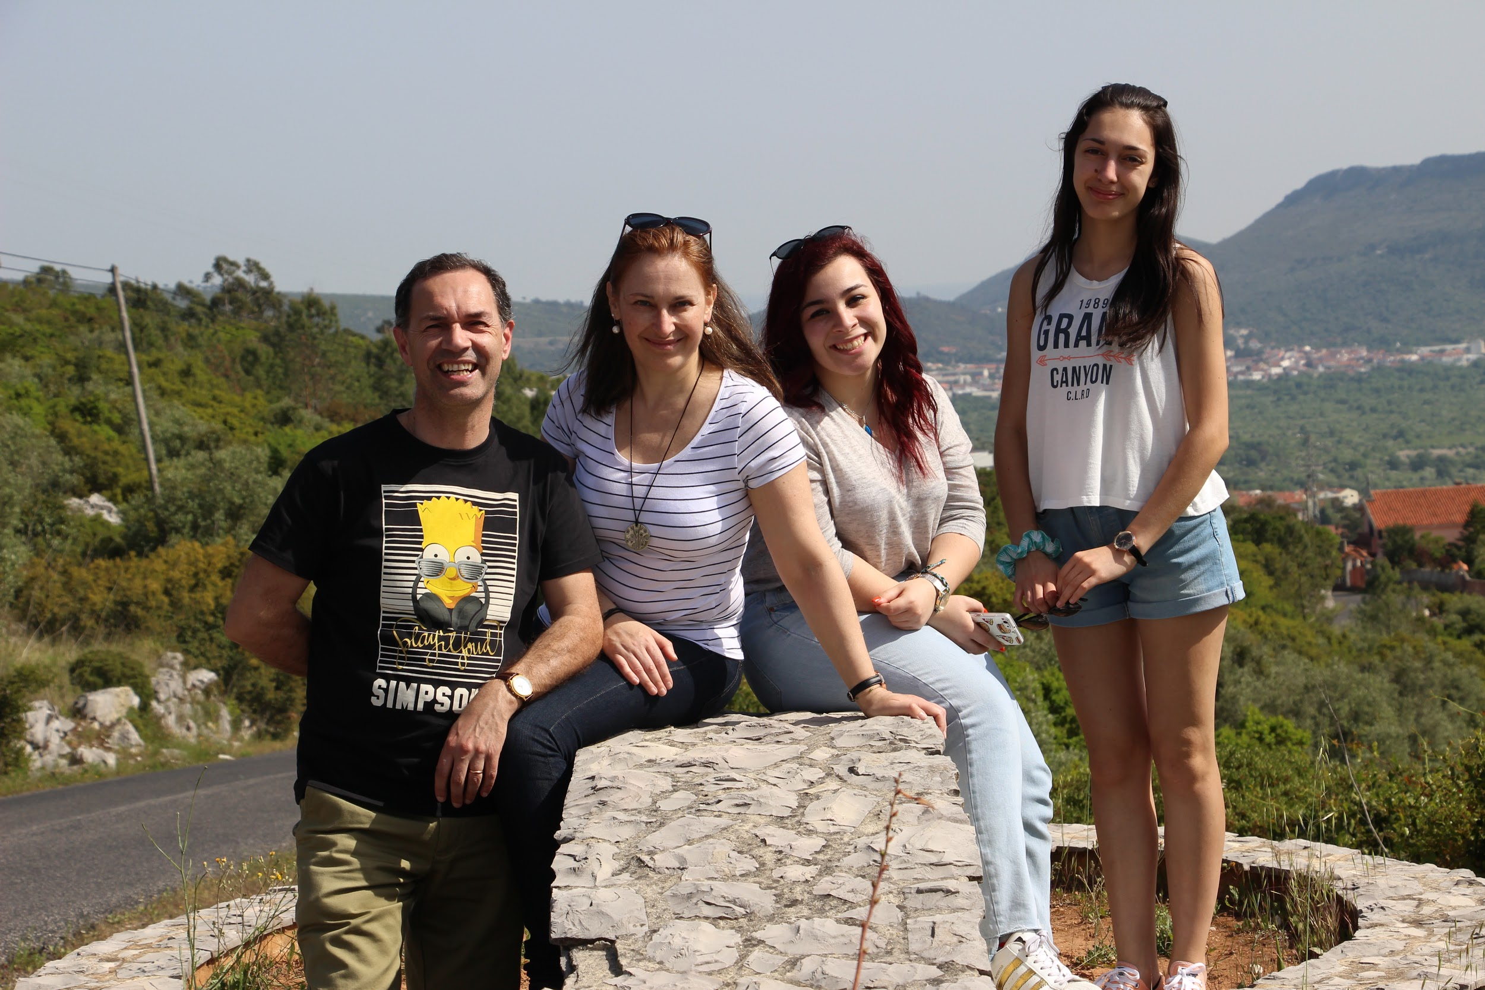
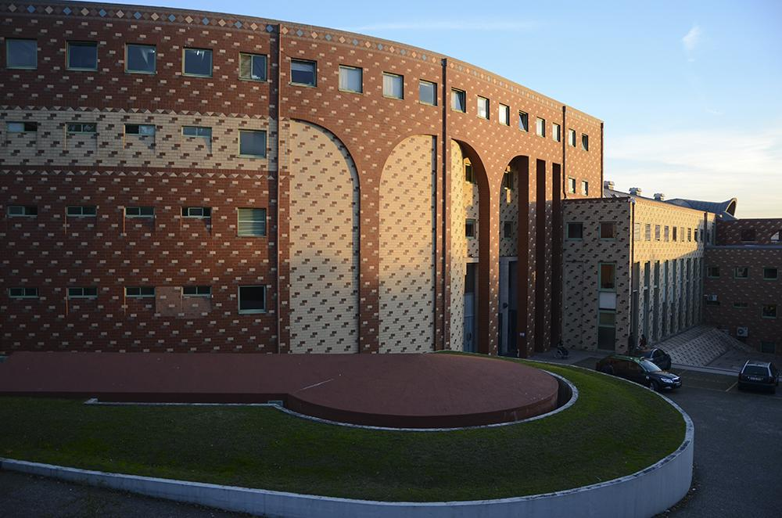
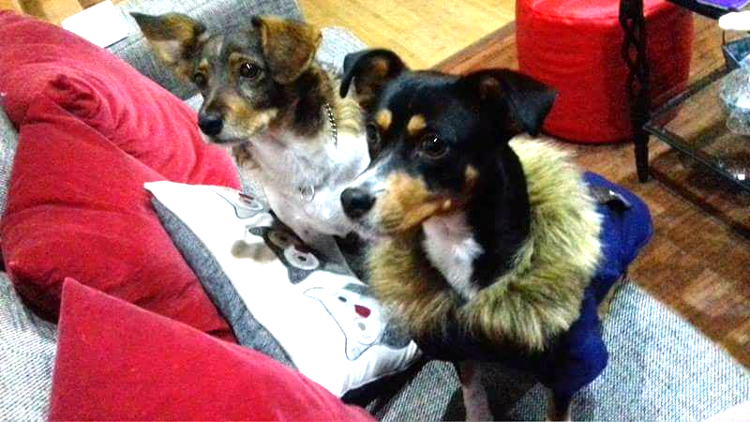
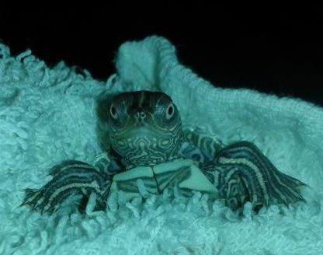
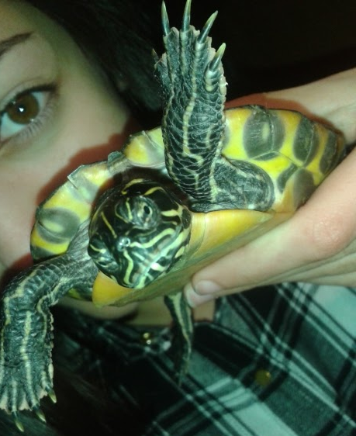
MY FAMILY
Porto’s University
I live with my parents and my sister.
My sister is a 17-year-old high school student and
next year she’s going to Porto’s university to study
Science of Communication.
I have 2 dogs, 2 turtles, 2 guinea pigs, 2 birds and an
aquarius with about 10 fishes.

Slide 11
Ana Pinto
EB 2/ 3 Cego do Maio
Póvoa de Varzim
Portugal

Slide 12
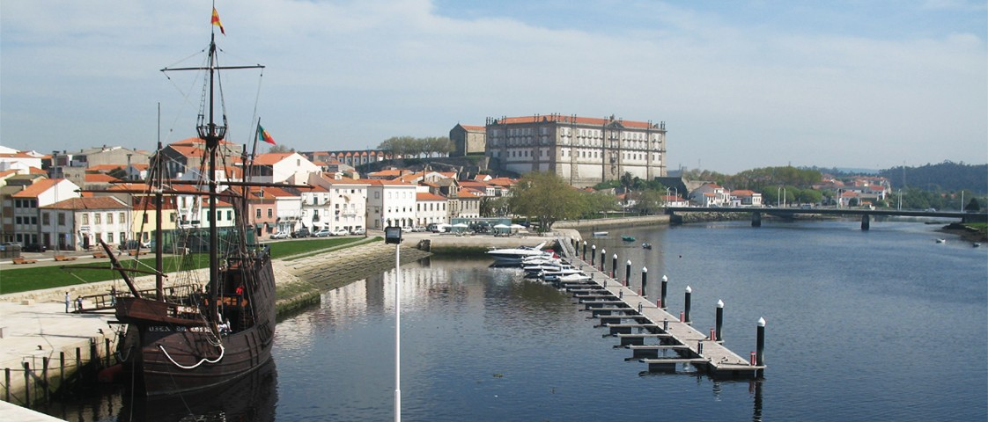
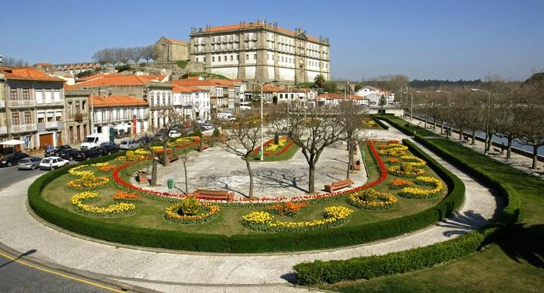
Who I am?
I´m Ana and I´m 15 years old. I was born in Póvoa de Varzim but I live in Vila do Conde which is an amazing city to visit in Portugal.
I´m a student of the 9th grade, class 9D, of the school Cego do Maio, in Póvoa de Varzim.

Slide 13
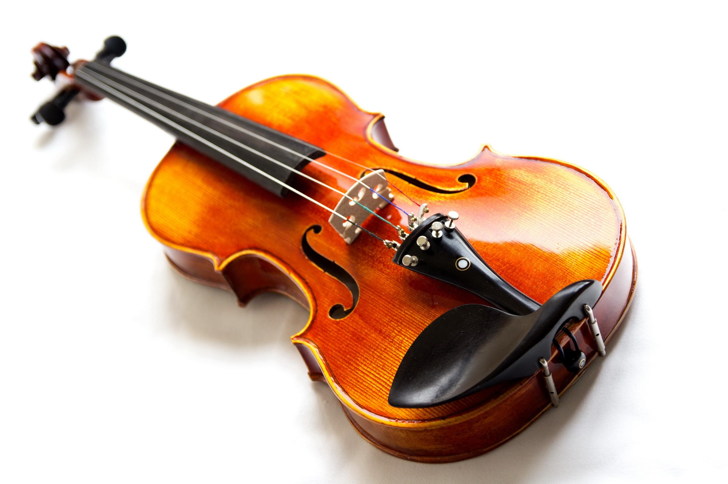
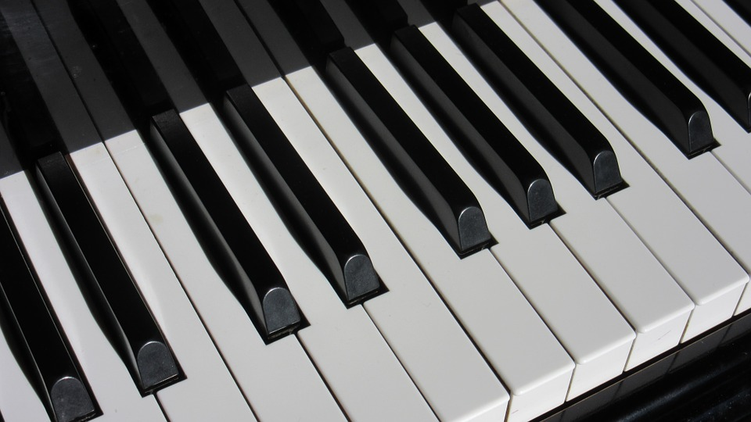
My Hobbies
I´m a music student so I play violin;
I´m also learning how to play piano;
When I have free time I like to run

Slide 14
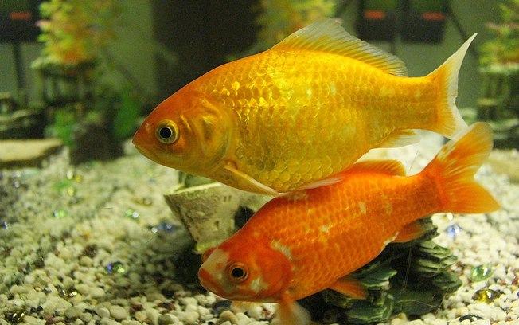
My family
I live with my mother and my stepfather but I am with my father every days.
I don´t have any brothers and sisters. However, I have a stepbrother.
He is 17 years old and he want to be a mechanic.
I have 2 fishes at home.
One day I would like to have a dog.

