Slide 1
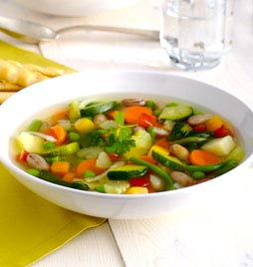
Minestrone, italian soup
I'm back in a new recipe ... "minestrone", a kind of vegetable soup ... it's not typical of our small town, Accadia, but I think it was eaten because being a country of farmers we ate freshly picked vegetables from the fields.

Slide 2
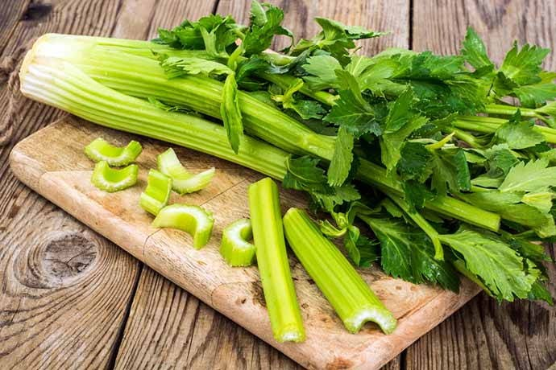
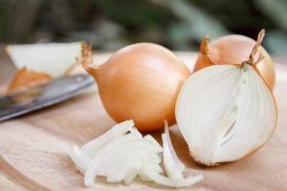
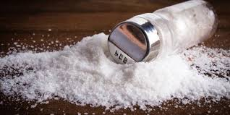
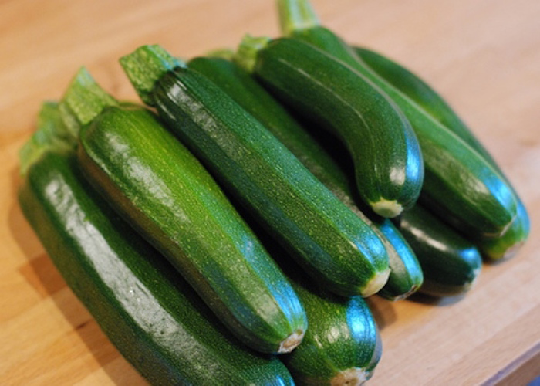
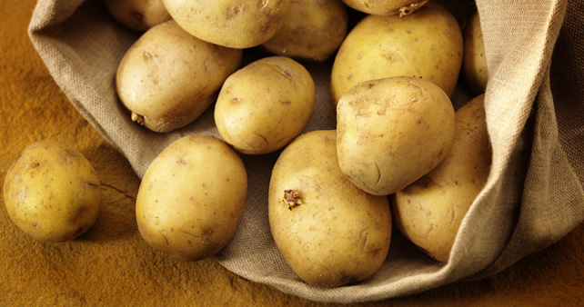
An half of onion
2 carrots
An half a stalk of celery
The ingredients are:
2 zucchine
A pinch of salt
Two potatoes
Water q.b.

Slide 3
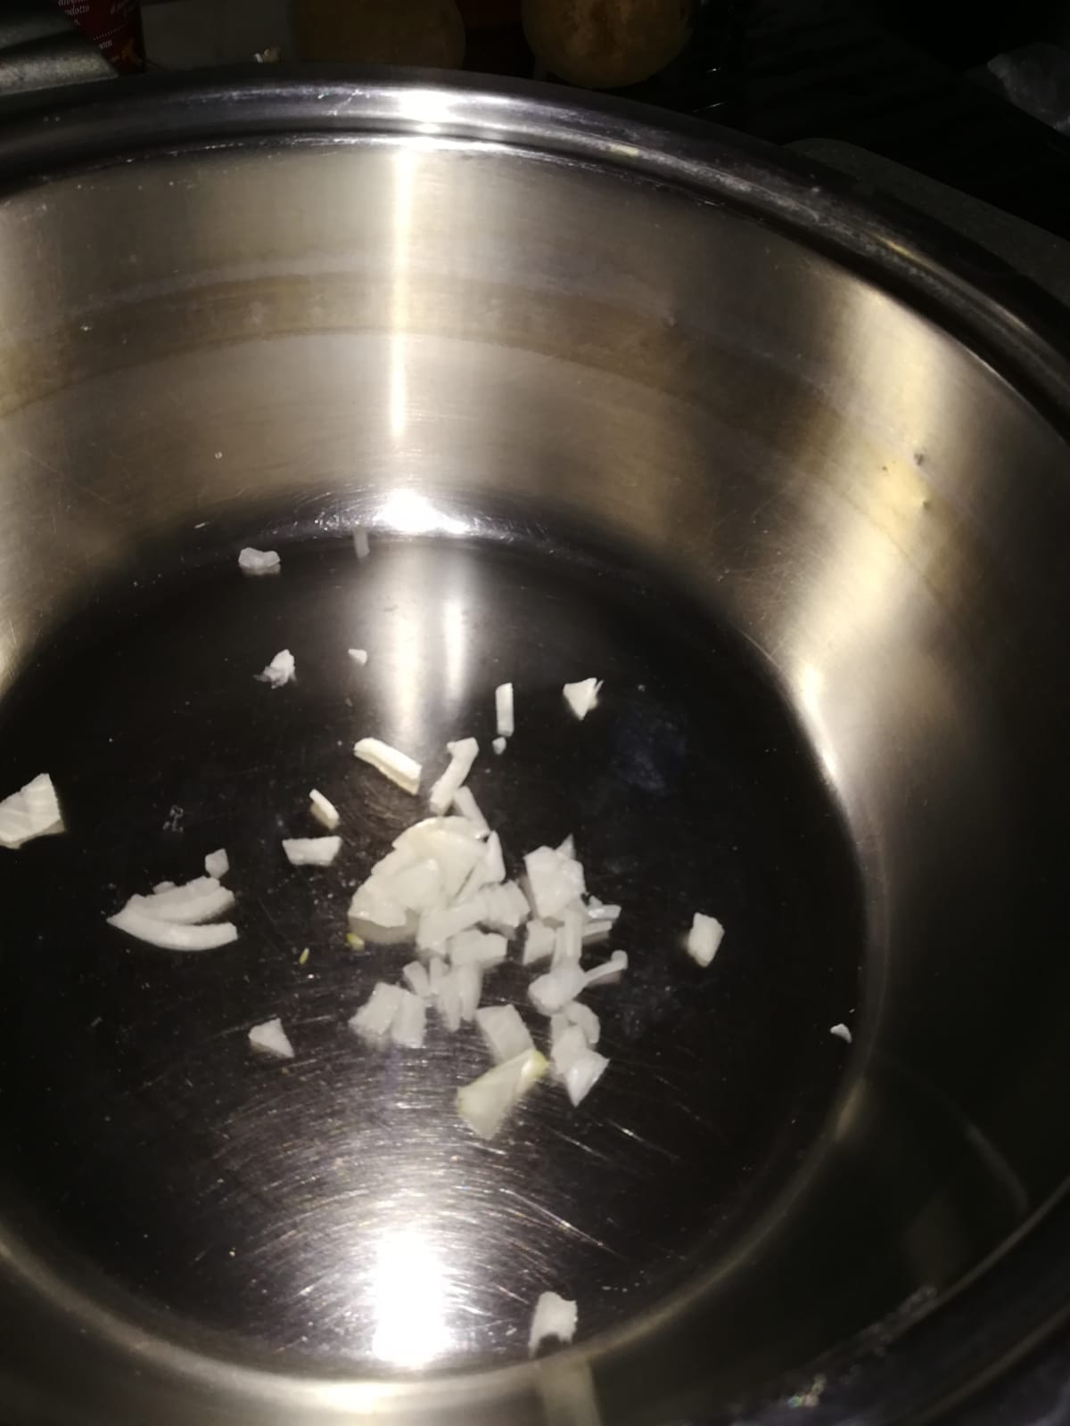
It is a recipe very simple and very fast to prepare…let's go!
First step
Cut the onion and put it in the pot

Slide 4
Second step
Add the zucchine cut,

Slide 5
Thirth step
the potatoes,

Slide 6
Fourth step
and the carrots with the celary…
Add the water q.b. and cook for about 40 minutes.

Slide 7
The last step… eat!!!
here is that the “minestrone” is ready to be eaten! I hope you enjoyed the recipe and I greet you.

