Slide 1
Italian omelette with potatoes
Here I am in a new recipe… today I will prepare italian omelette, a simple food for who want fast dinner…

Slide 2
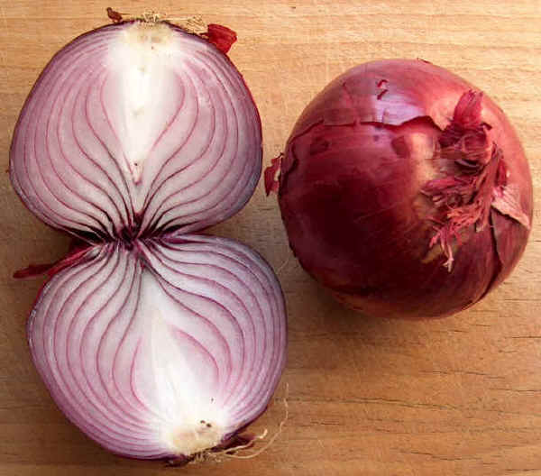
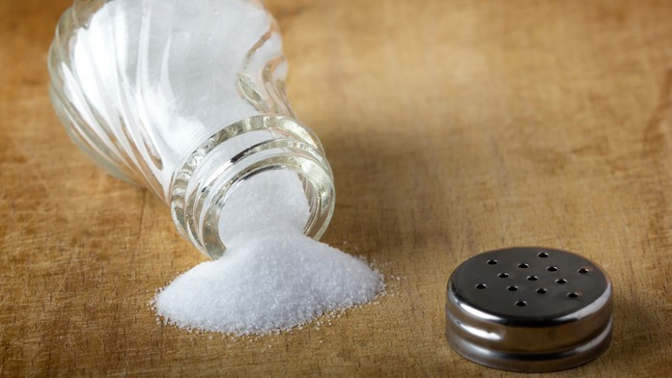
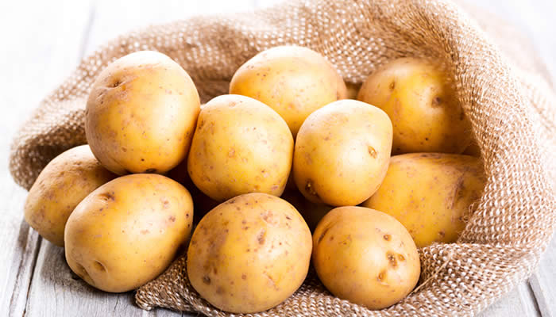
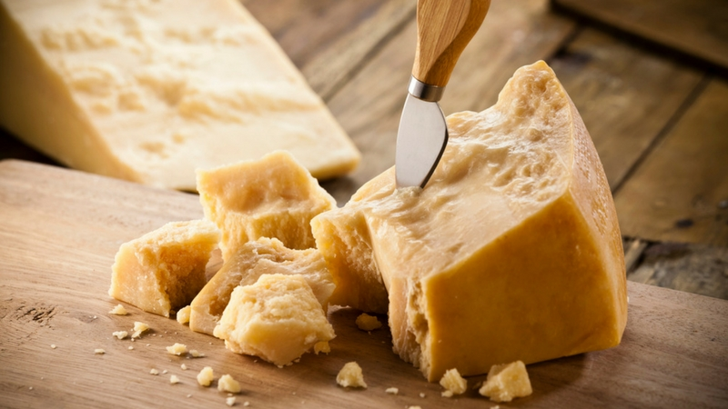
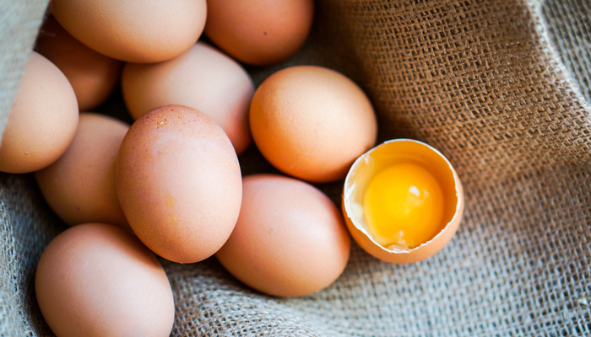
THE INGREDIENTS ARE:
half onion
A little salt
A little oil
A little Parmesan cheese
6 eggs
2 potatoes

Slide 3
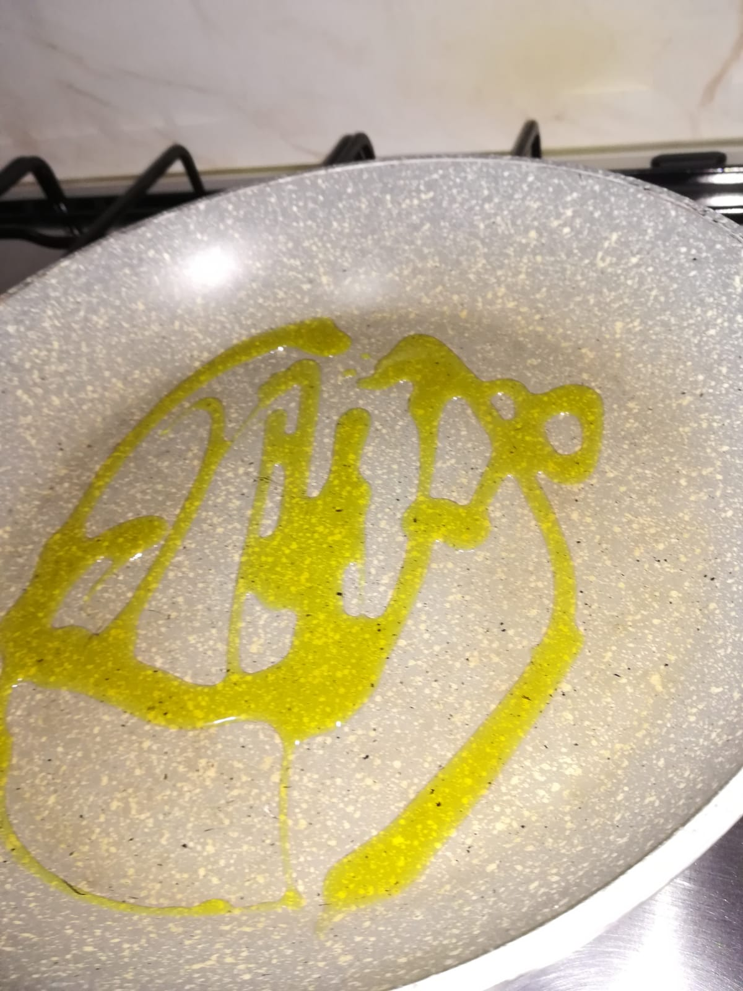
First step
Put a little oil in the pot

Slide 4
then add half onion and fry until it becomes golden

Slide 5
cut the potatoes and place them in the pot

Slide 6
cook until they become golden

Slide 7
Meanwhile, put the eggs in a bowl,

Slide 8
Add the salt and the Parmesan cheese and mix everything

Slide 9
Add the mix formed by egg, cheese and salt and cook for a few minutes

Slide 10
Turn the omelette and… we are ready to eat!

Slide 11
I decided to cook the omelette as it is a simple and fast food, so I hope I have given you some ideas ...

