Slide 1
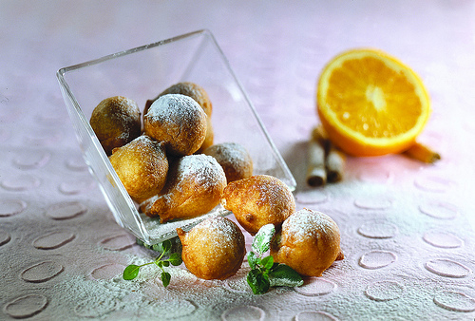
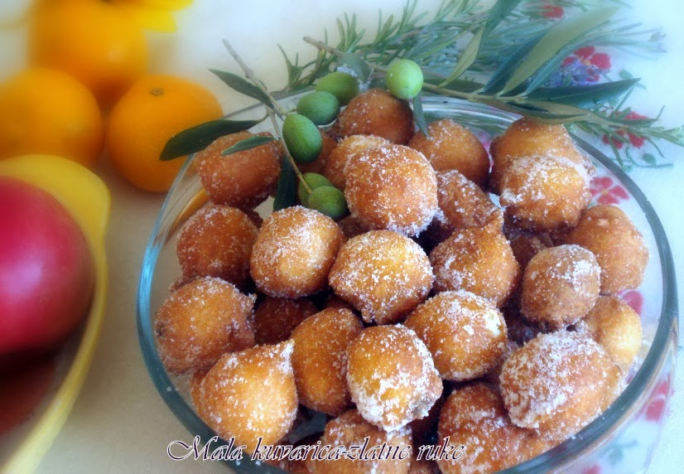
Fritule
This is the recipe for 10 people.
Ingredients:
1 cup of fresh yeast (50 g)
800g of flour,
2 eggs,
2 tablespoons of sugar,
2grated apples,
3 dL of milk,
2dL of hot water,
a small amount of salt,
grated lemon peel

