Slide 1
Italian meatballs
I decided to cook some meatballs, as they are a poor food; made of soaked bread, they are very simple to make and very tasty ... So, what are we waiting for? Let's work !!

Slide 2
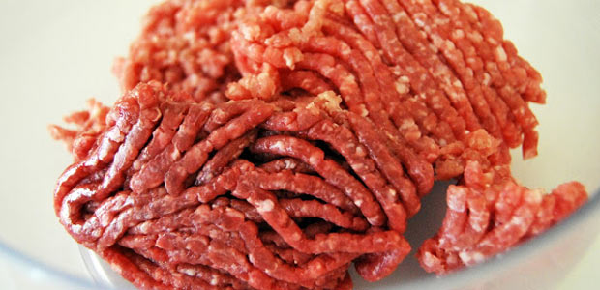
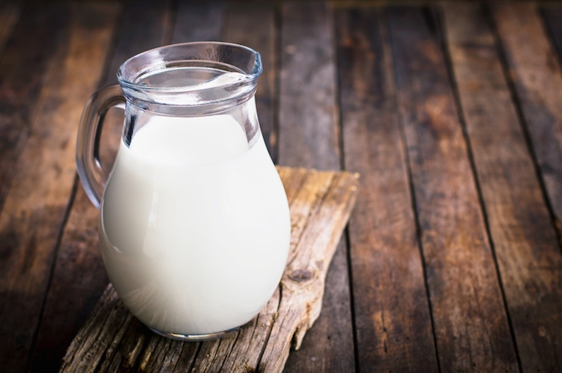
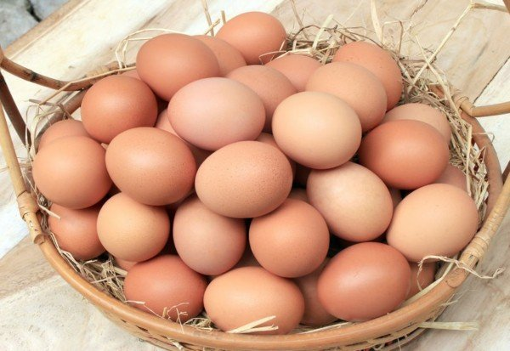
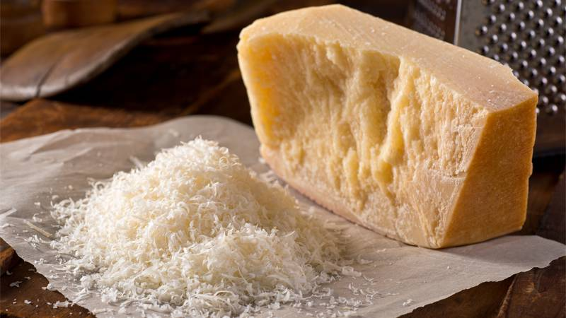
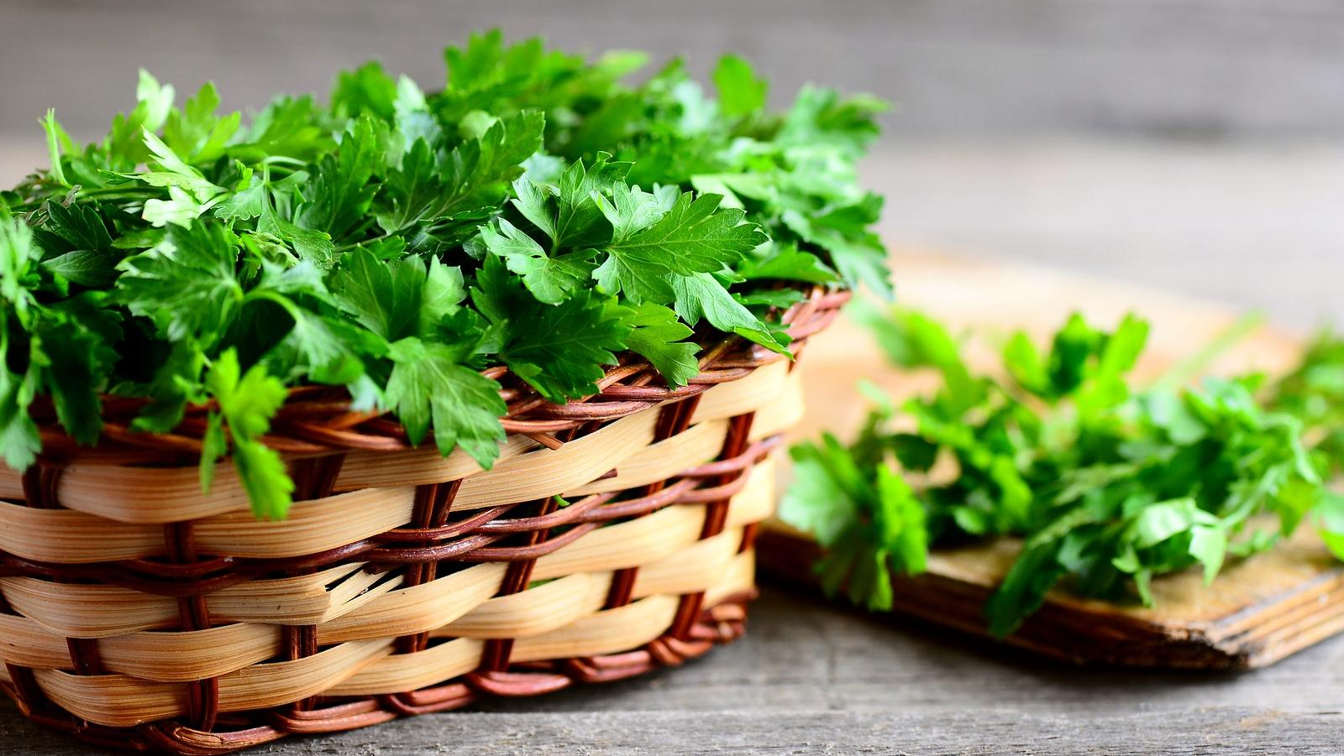
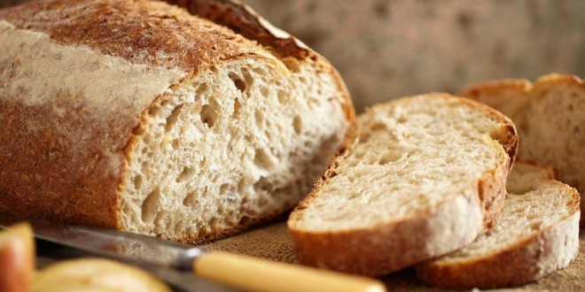
The ingredients are:
For the meatballs…
1 egg
500 g of minced meat
enough milk to wet the bread
50 g of grated Parmesan cheese
120 g of stale bread
3 g of salt
a little parsley

Slide 3
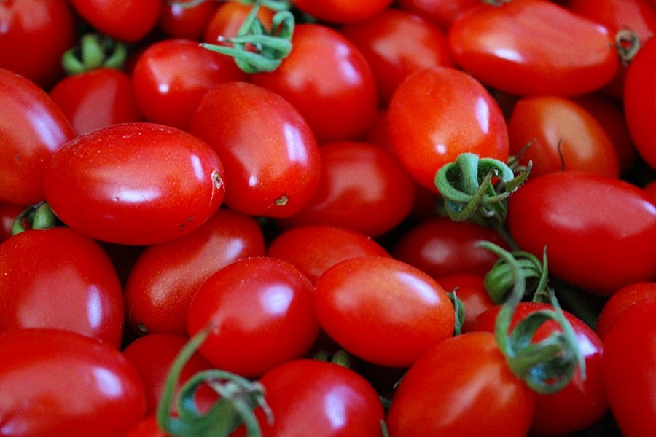
For the sauce…
half onion
A little salt
350 g of peeled tomatoes
a little oil

Slide 4
First step
Put a little oil in the pot

Slide 5
Second step
then add half onion and fry until it becomes golden

Slide 6
Third step
add the tomatoes,

Slide 7
Fourth step
add the salt and

Slide 8
Fifth step
Cook for 30 minutes

Slide 9
First step for the meatballs
Put minced meat in a bowl

Slide 10
Second step
Add 1 egg and…

Slide 11
Add salt and a little parsley

Slide 12
Fourth step
It’s time for Parmesan cheese!

Slide 13
Insert the bread previously soaked in milk

Slide 14
Sixth step
mix everything and form the meatballs

Slide 15
Seventh step
pass the meatballs in breadcrumbs and brown them well until they are golden

Slide 16
Eighth step
finally insert the meatballs in the sauce previously prepared

Slide 17
I hope you enjoyed the recipe and ...
Bye!!!!!

