Slide 1
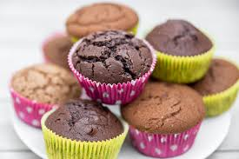
Muffinis
This is the recipe for 15 muffins.
Ingredients:
2 eggs
125 ml of oil
250 ml of milk
200 g of sugar
400 g of smooth flour
1 baking powder
5 g of salt

