Slide 1
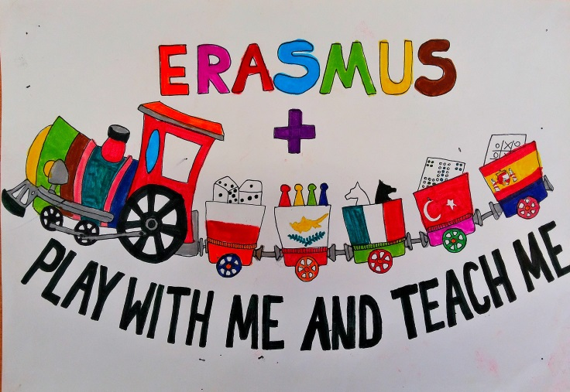
BUZZERS
Erasmus+ KA2
Dimotiko Scholeio Germasogeias
Teacher: Christi Demetriou
May 2016

Slide 2
Buzzers
Subject: Greek
Grades: 1
Goal: The students to match the picture with the right word. The words are from their text book.

Slide 3
Teaching method
Pairs
Up to six words per student
We can use less words for students that have learning difficulties

Slide 4
Activity
This exercise is for the first trimester of class 1. The pictures are placed on the board. Two students are holding the words. With the mark of the teacher they start to match the pictures with the words they are holding. The first student that finishes can push the buzzer. The exercise can be repeated with other pupils.

Slide 5
Assessment
It’s a quick and fun way to check if the students learned the vocabulary of the lesson.

