Slide 1
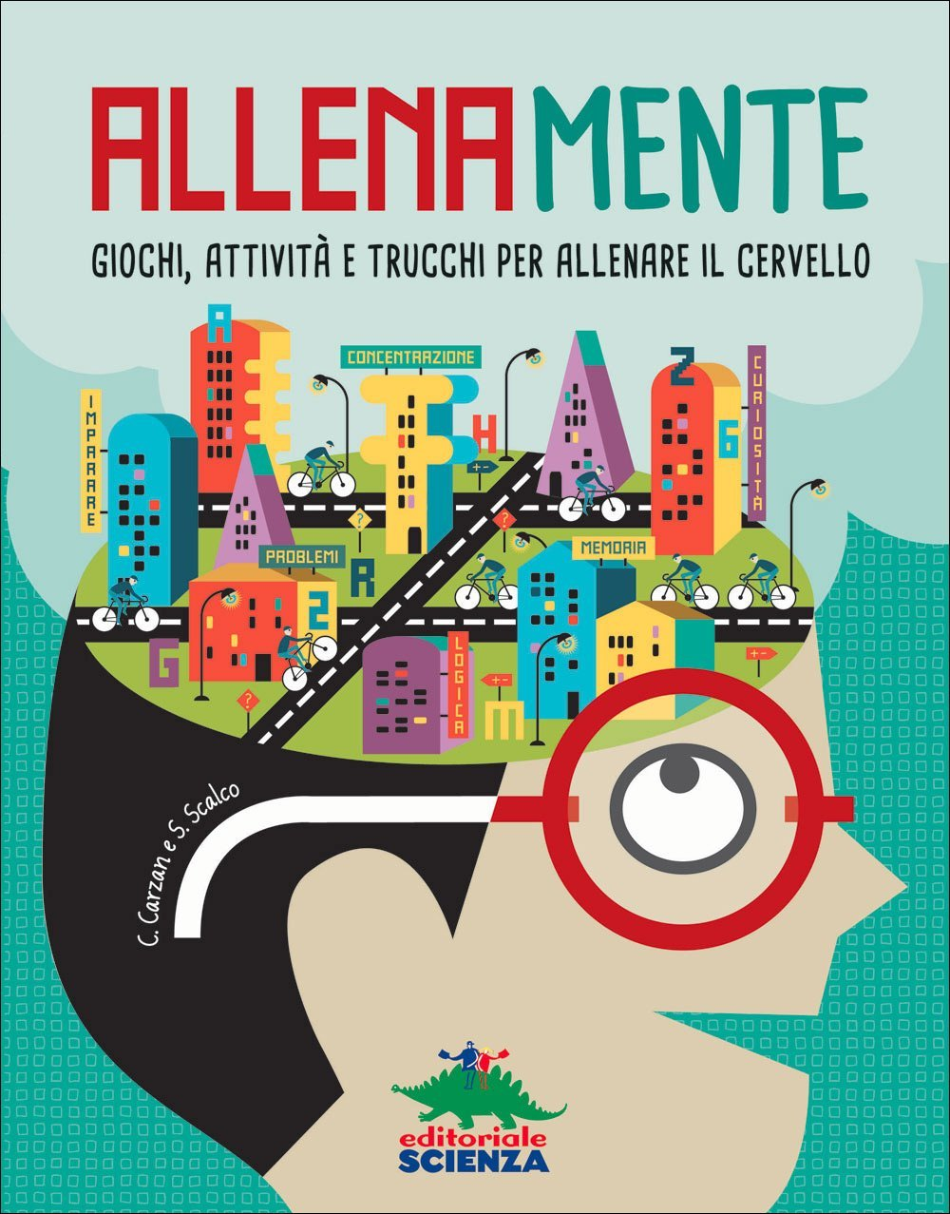
TRAINING

Slide 2
TEACHERS’ TRAINING
In April, May and June the teachers involved in the project have taken part
in a training course taught by C. Carzan, master of games in didactics.
The course lasted 20 hours. It was focused as the following themes:
How to increase motivation in young learners
How to train our brain
Tools to be used
Learning to learn – learning strategies
How to help students concentrate
How to enhance relationship among students and students-teachers
How to create a mind map and feedback tecniques
key words
9) Problem solving and cooperative learning

Slide 3
