Slide 1
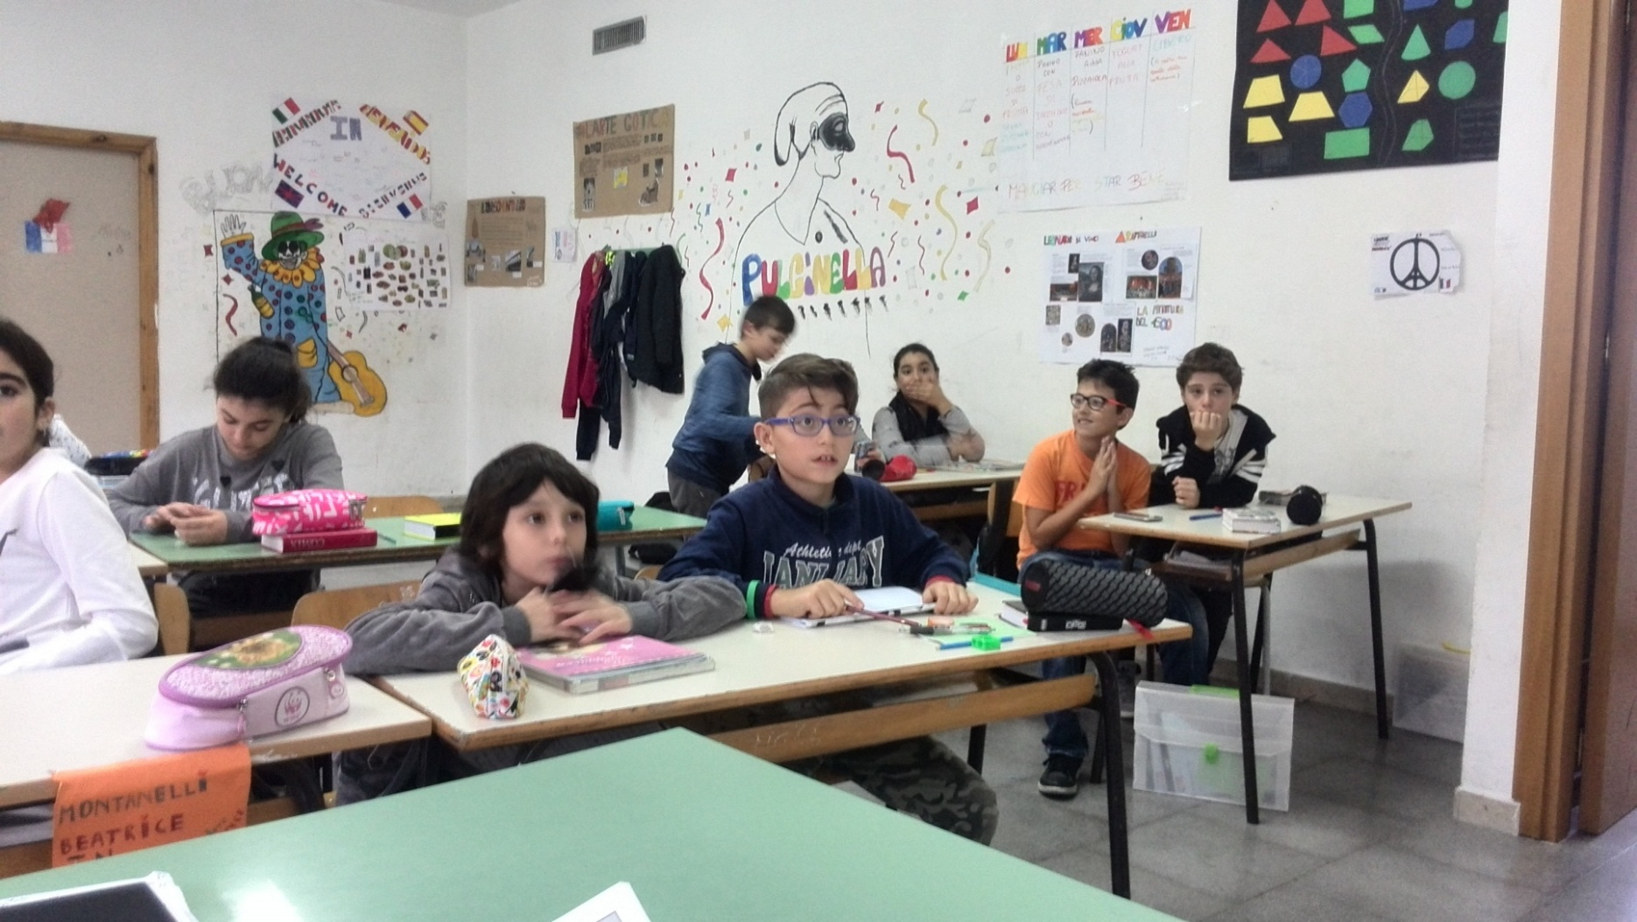
KAHOOT
MAKING LEARNING AWESOME

Slide 2
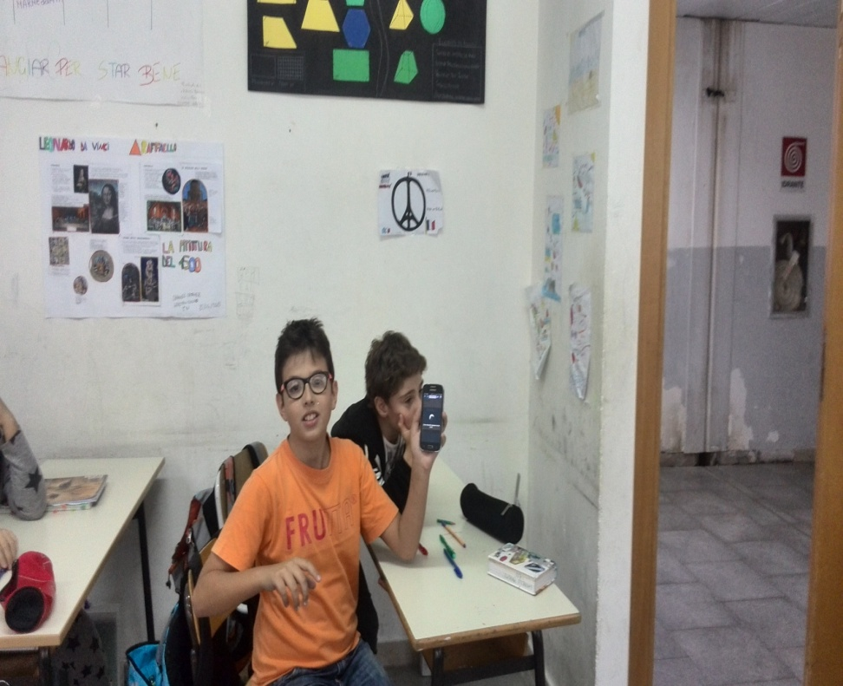
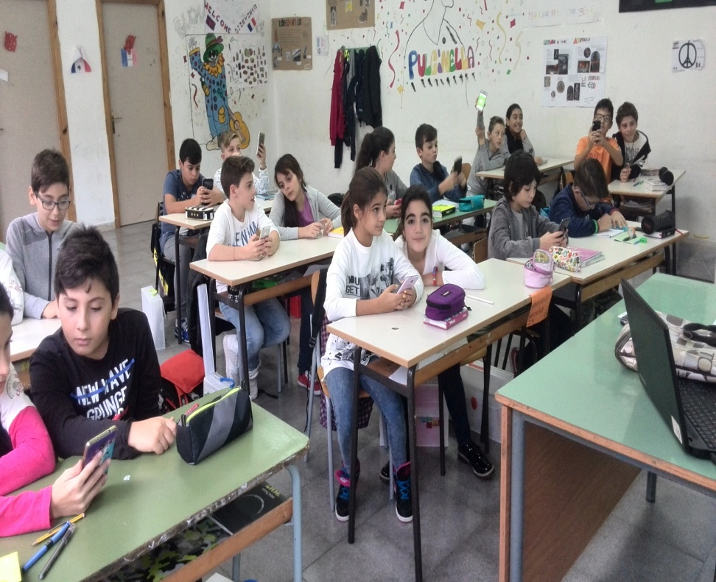
PLAYERS ANSWER ON THEIR OWN DEVICES WHILE GAMES ARE DISPLAYED
ON A SHAREDSCREEN TO UNITE THE LESSON ENCOURAGING PLAYERS TO LOOK UP

Slide 3
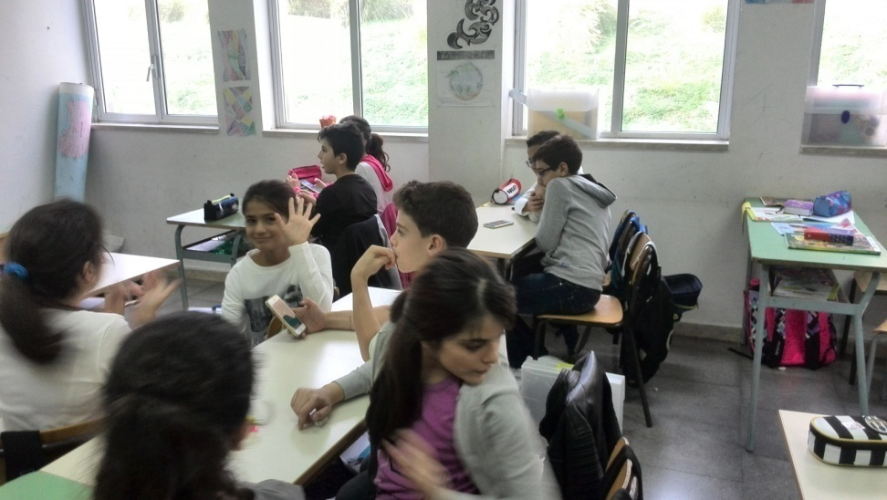
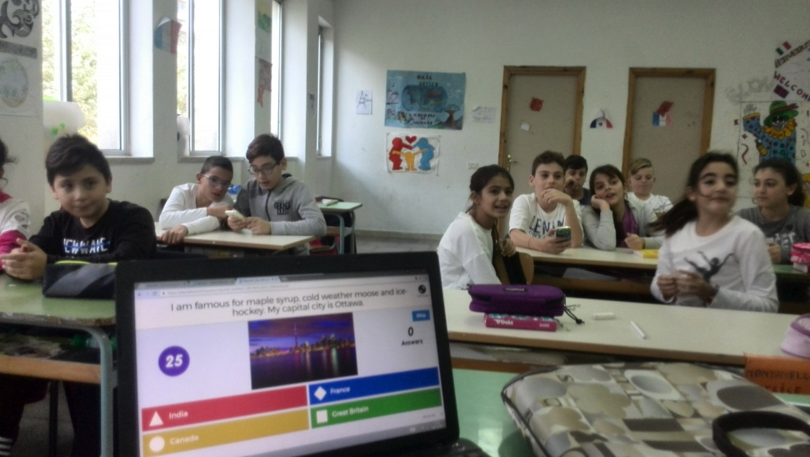
EVALUATE UNDERSTANDING OR CREATE KAHOOT TO ASSIST FORMATIVE ASSESSMENT
FACILITATE DISCUSSION AND INITIATE DEBATE.
TEST PERSONAL KNOWLEDGE

Slide 4
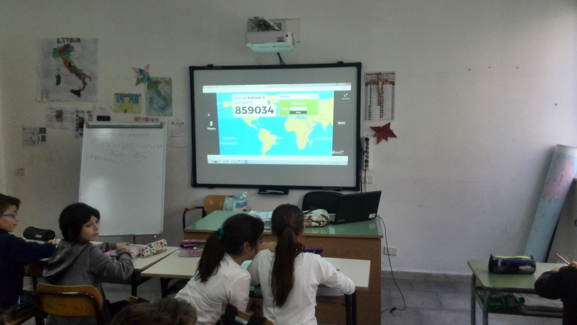
IT PRODUCES DISCUSSION AND PEDAGOGICAL IMPACT

Slide 5
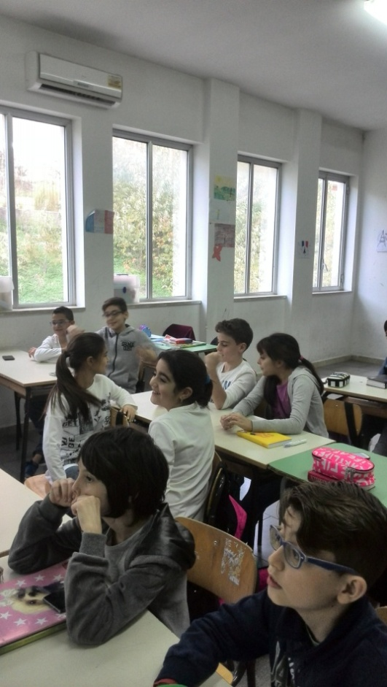
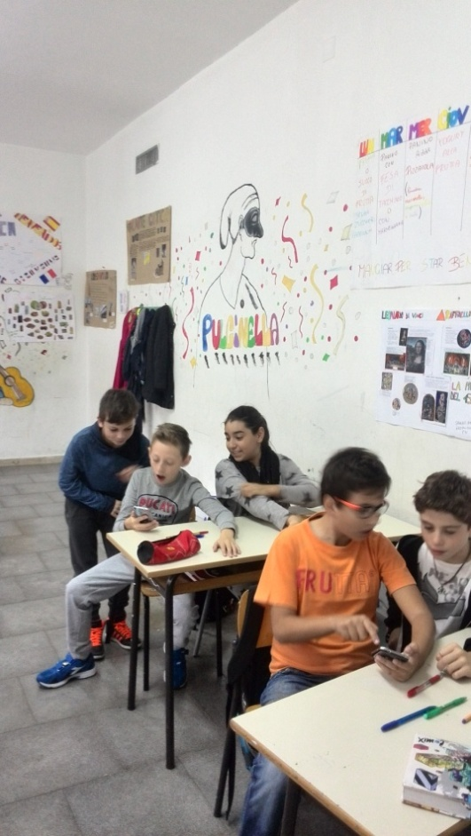
AFTER A GAME, PLAYERS CAN BE ENCORAGED TO CREATE AND SHARE THEIR OWN KAHOOTS TO DEEPEN UNDERSTANDING, MASTERY, AND PURPOSE.

Slide 6
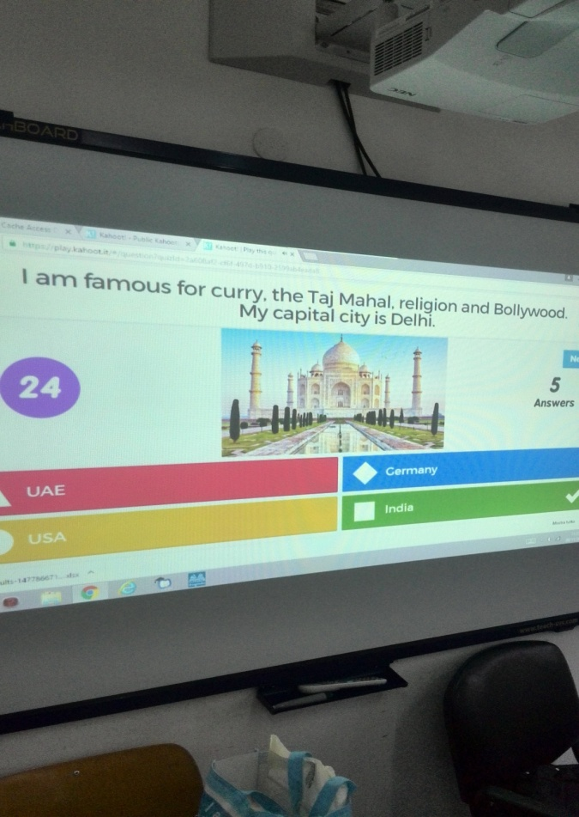
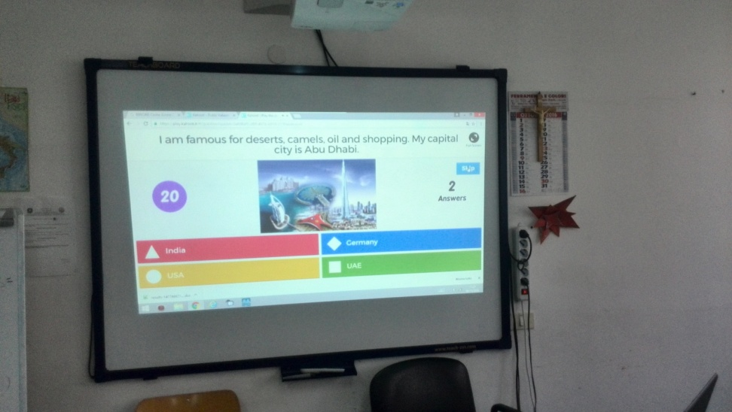
TO INTRODUCE NEW TOPICS
REVIEW REVISE AND REINFORCE
RE- ENERGIZE AND REWARD
Create a kahoot to break the ice, re-energize a room, reward good behavior or just have a little fun.

Slide 7
THANKS FOR YOUR ATTENTION!
SCUOLA SECONDARIA DI I GRADO
COSMO GUASTELLA
MISILMERI- ITALY
Didactic game 2017
Antonietta Cimo’
English teacher

