Slide 1
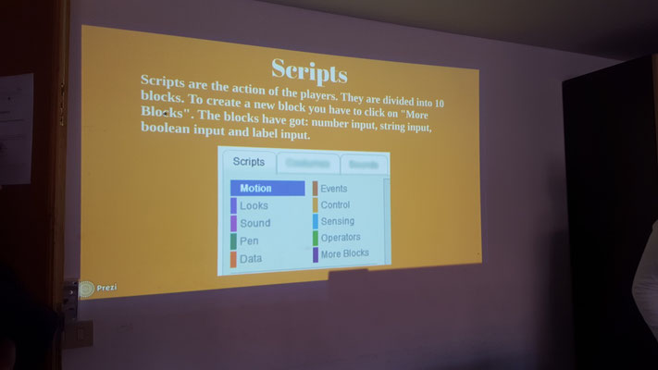
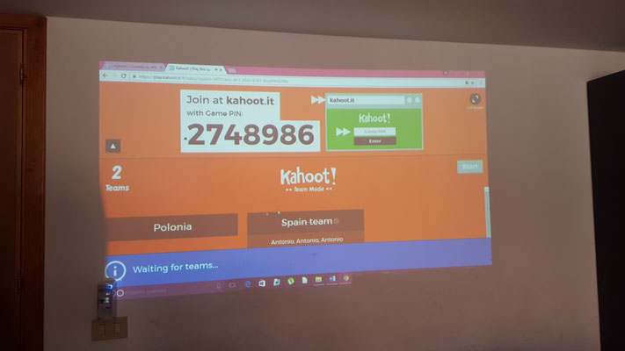
TIME FOR CODING!
STUDENTS’ CODING WORKSHOP

Slide 2
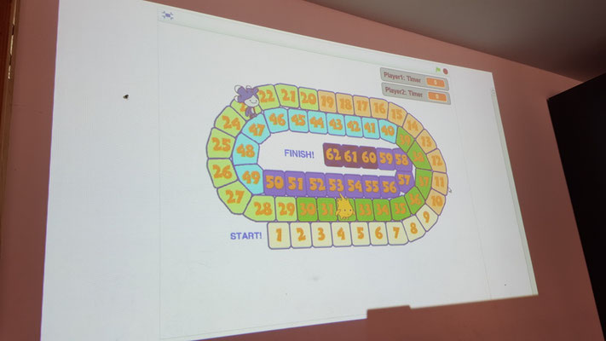
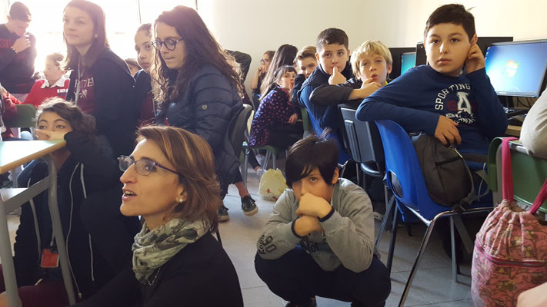
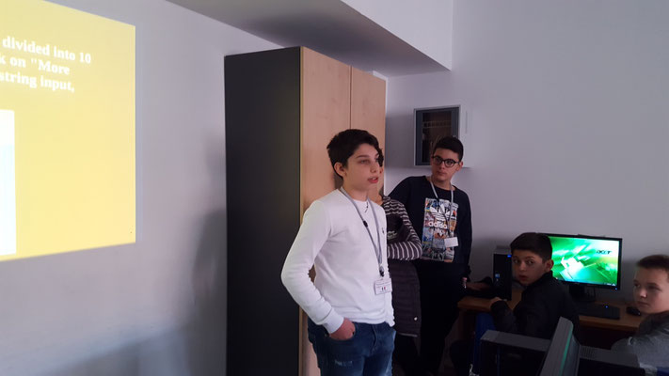
AIMS:
-learning to learn
-solving problems
- acquiring digital and coding competences
-analyzing software
-creating a scratch and playing kahoot quizzes
-

Slide 3
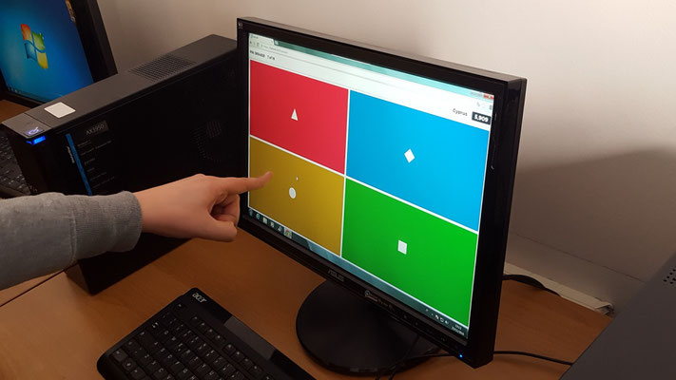
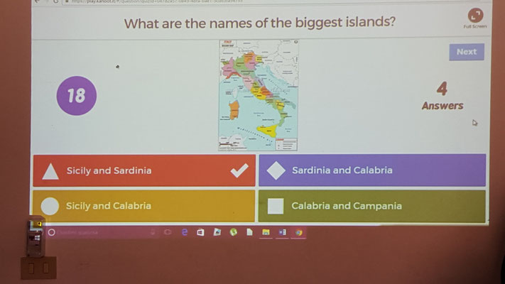
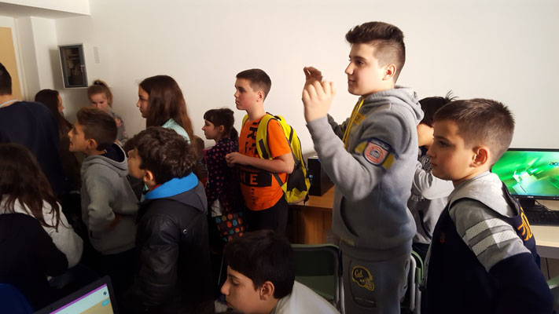
Lots of fun playing Kahoot quizzes!

