Slide 1
Δημοτικό Σχολείο Γερμασόγειας Germasogeia Primary School
Play with me and teach me - tradition and modernity in active teaching
Erasmus+ KA2

Slide 2
Cyprus

Slide 3
Our School - Location

Slide 4
Our town – Our school - Location
https://www.google.com/maps/@34.7157616,33.0828039,237m/data=!3m1!1e3

Slide 5
Information
Our school is situated in Paniotis area at Germasogeia Municipality. We are 5km away from the centre of Limassol (the 2nd biggest town in Cyprus).
We have 275 students in 13 classes. Also we have a class for children with special needs.
Our school has 24 teachers.
We have special classes for Art, Computers, Music, Technology and Housekeeping.
Also, our school has a Play Room and a big Hall that is used for our celebrations and Physical Education.
In our school yard there is a Road Safety Park.

Slide 6
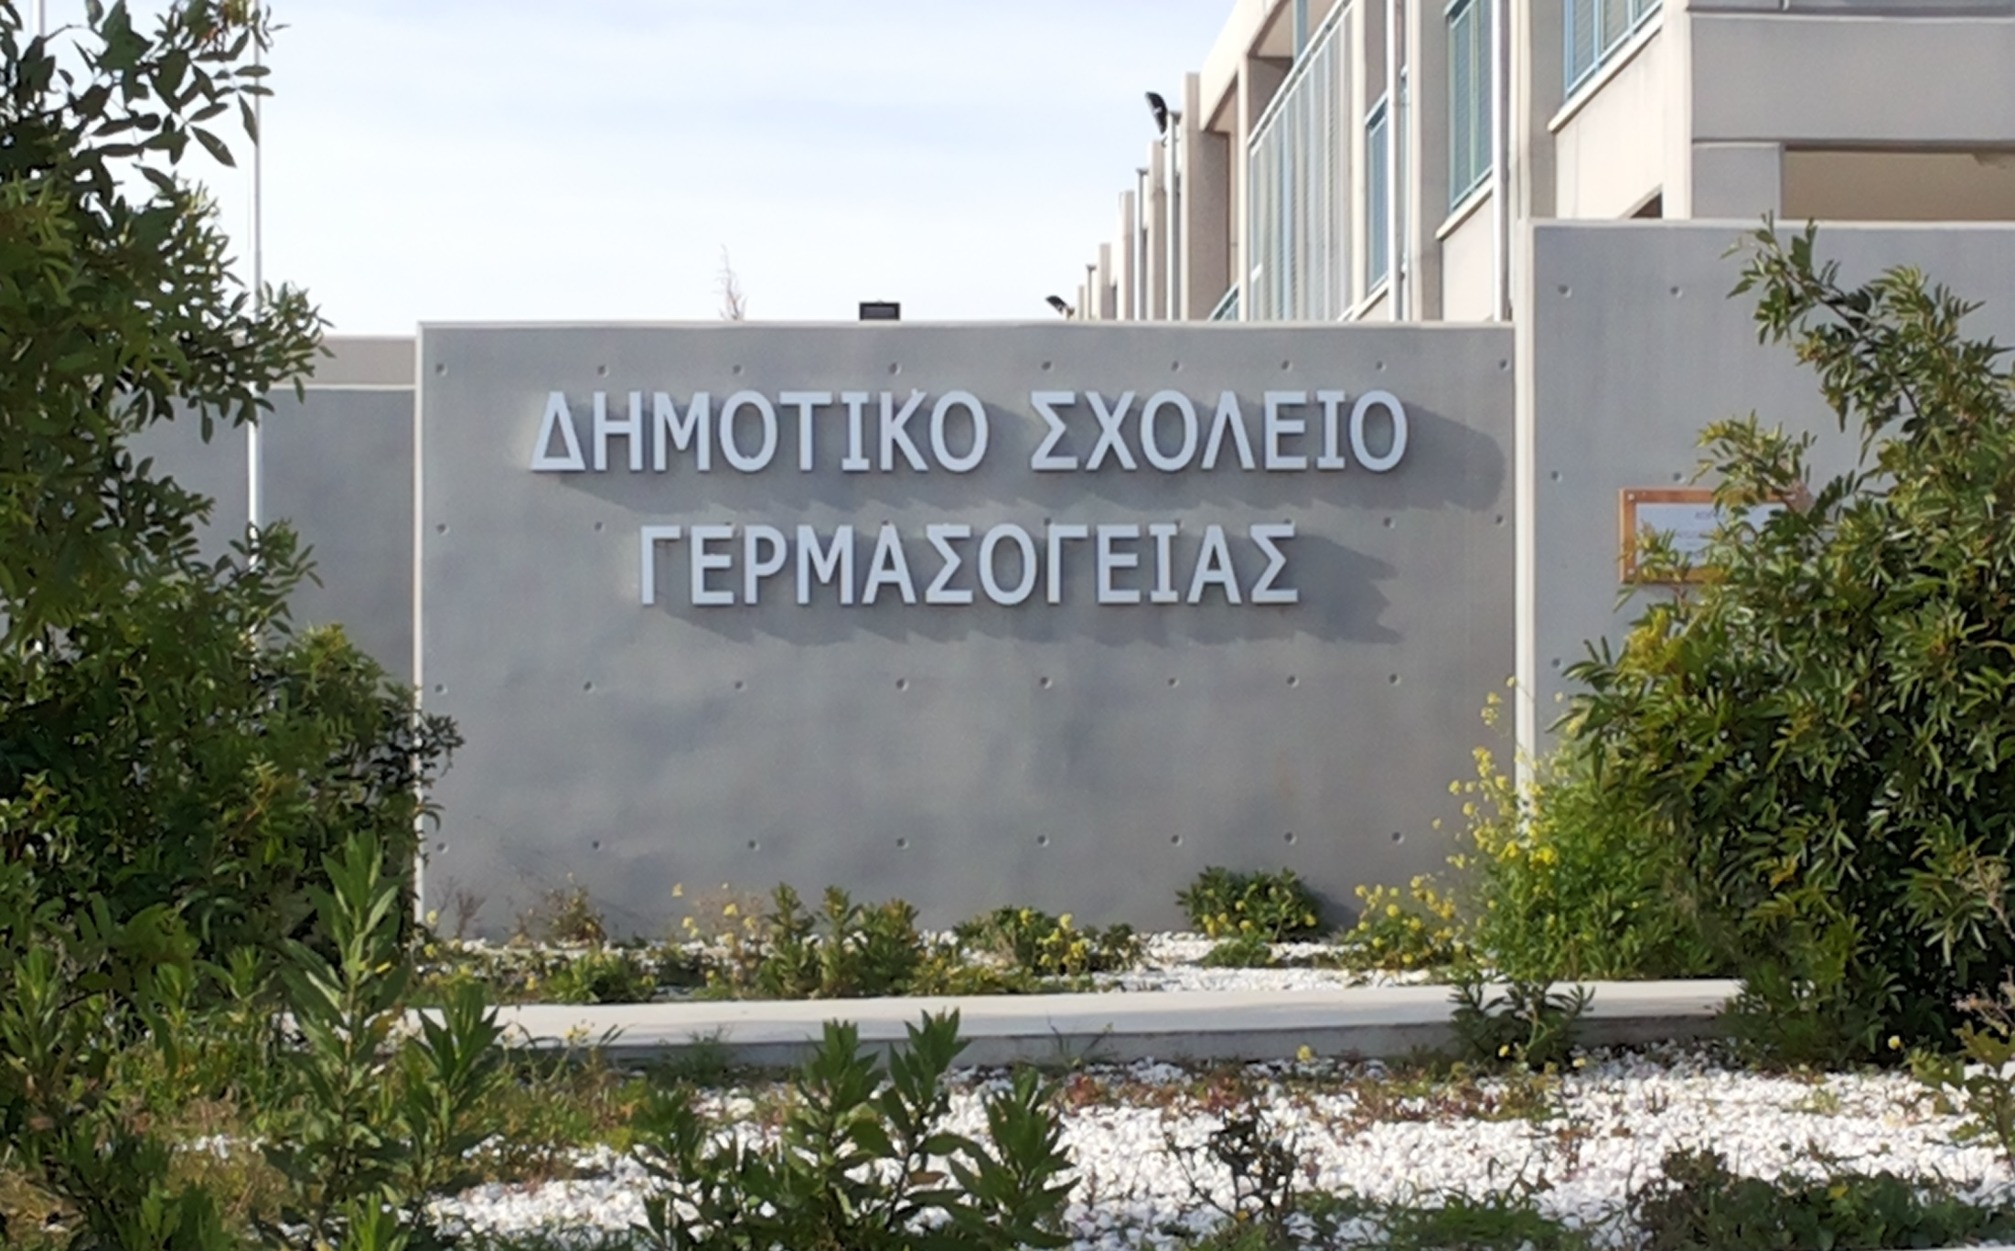
School Building

Slide 7
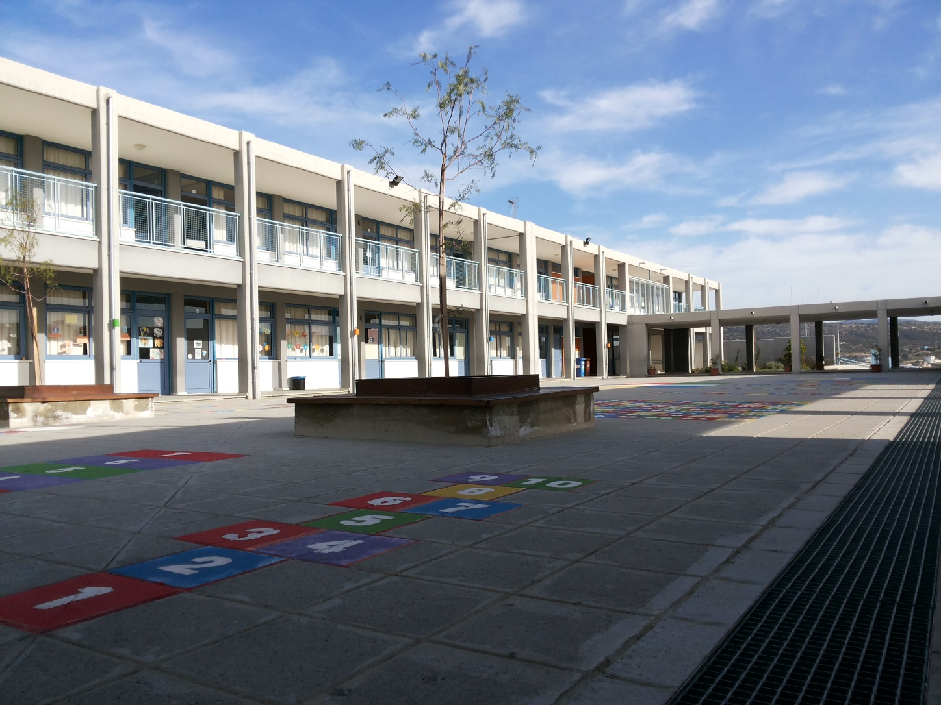
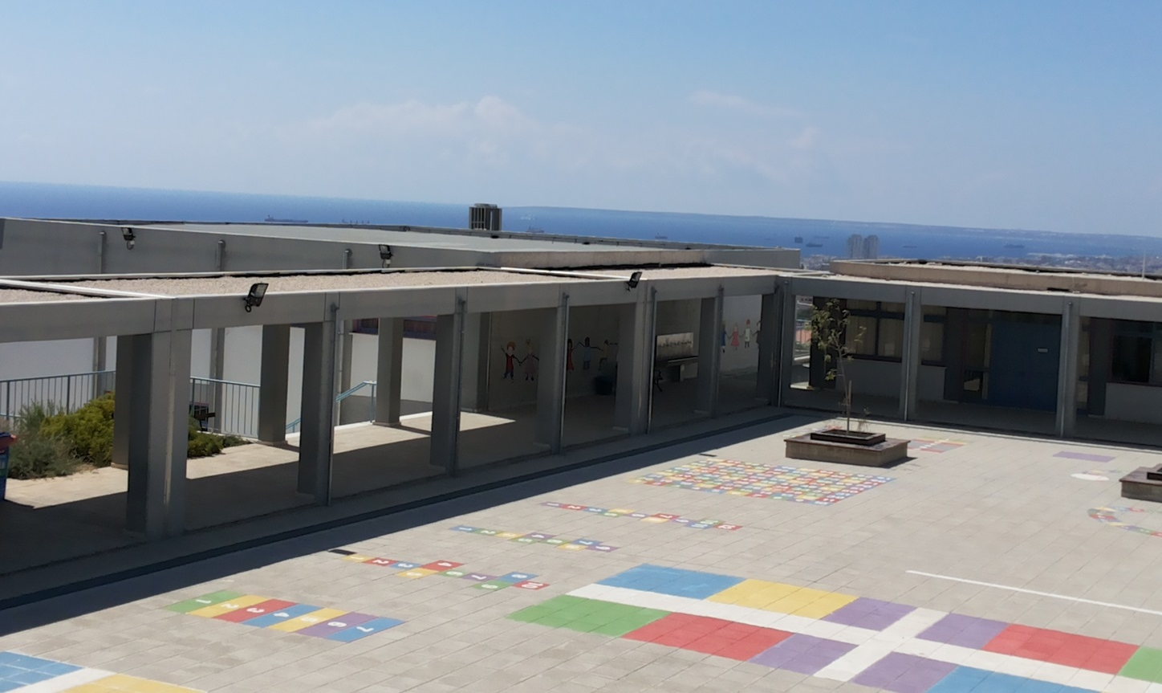

Slide 8
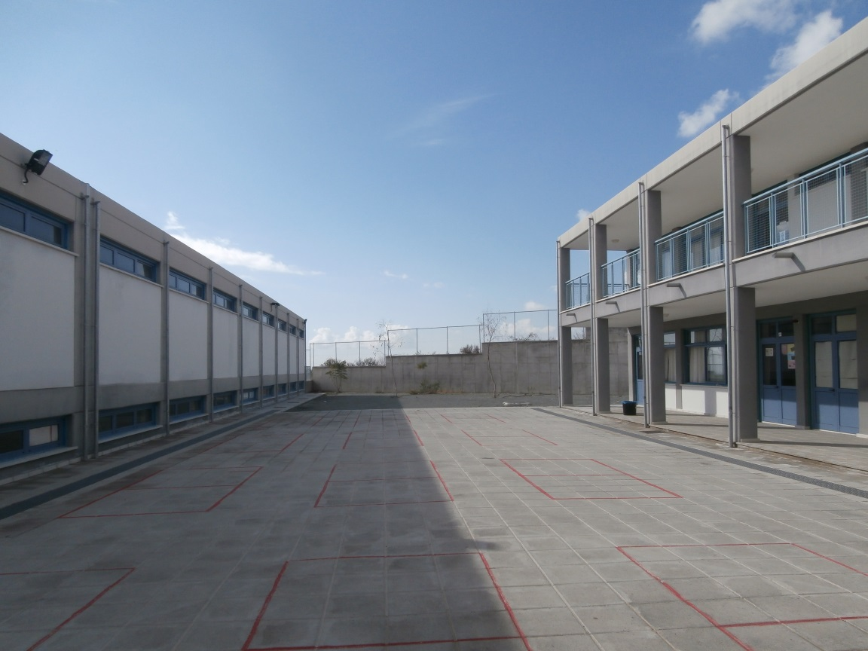
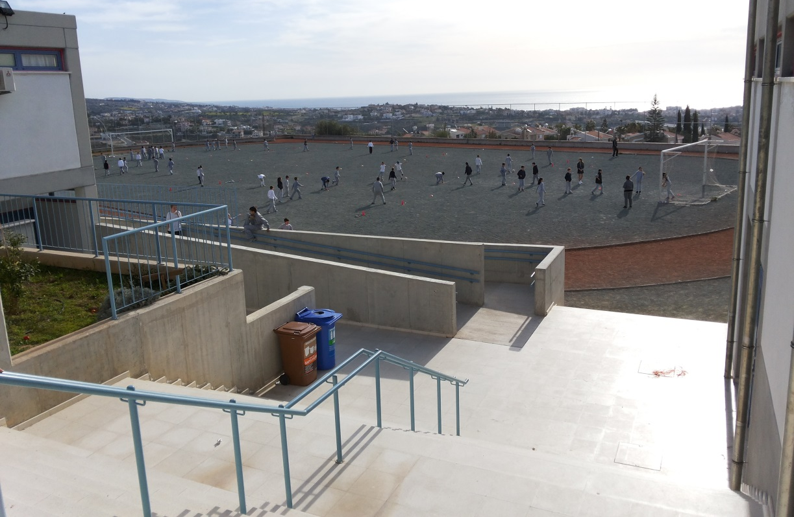

Slide 9
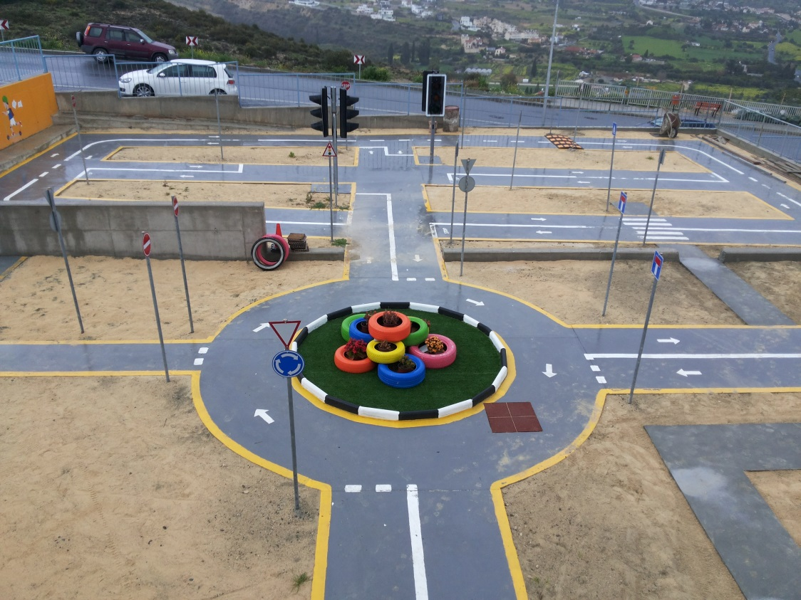
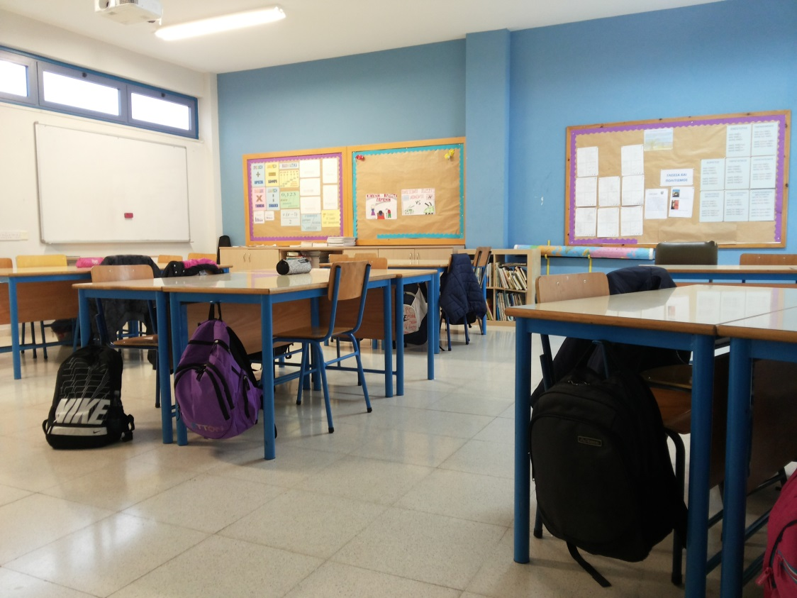
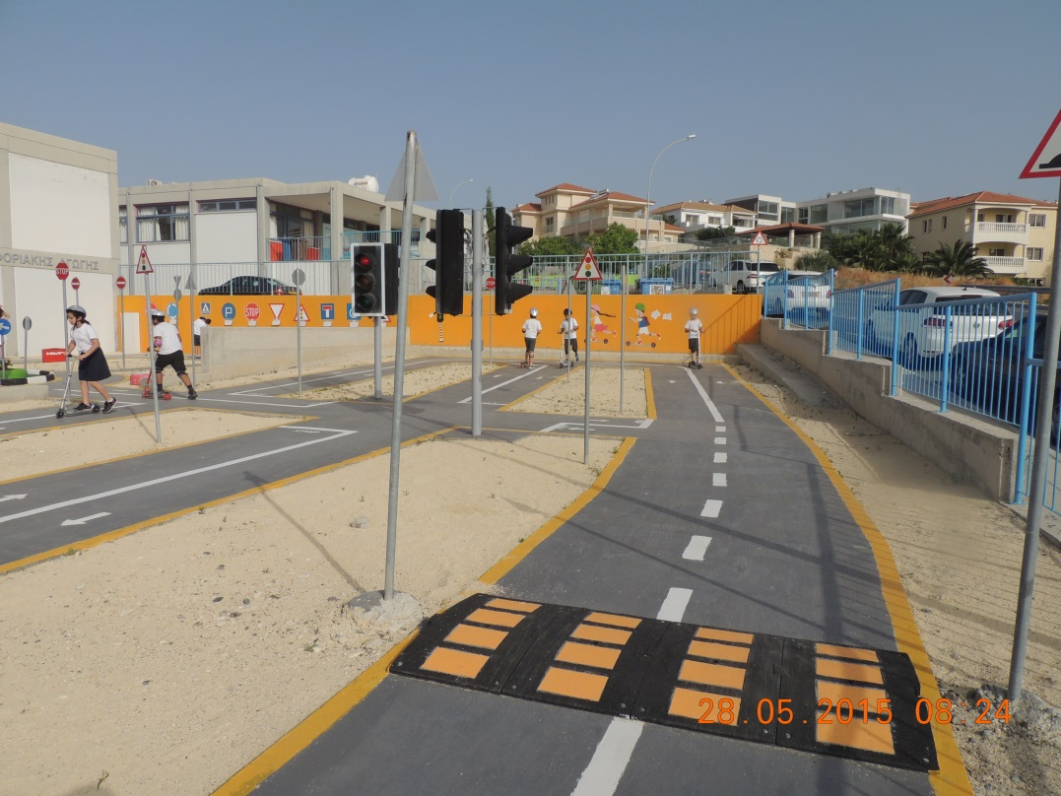

Slide 10
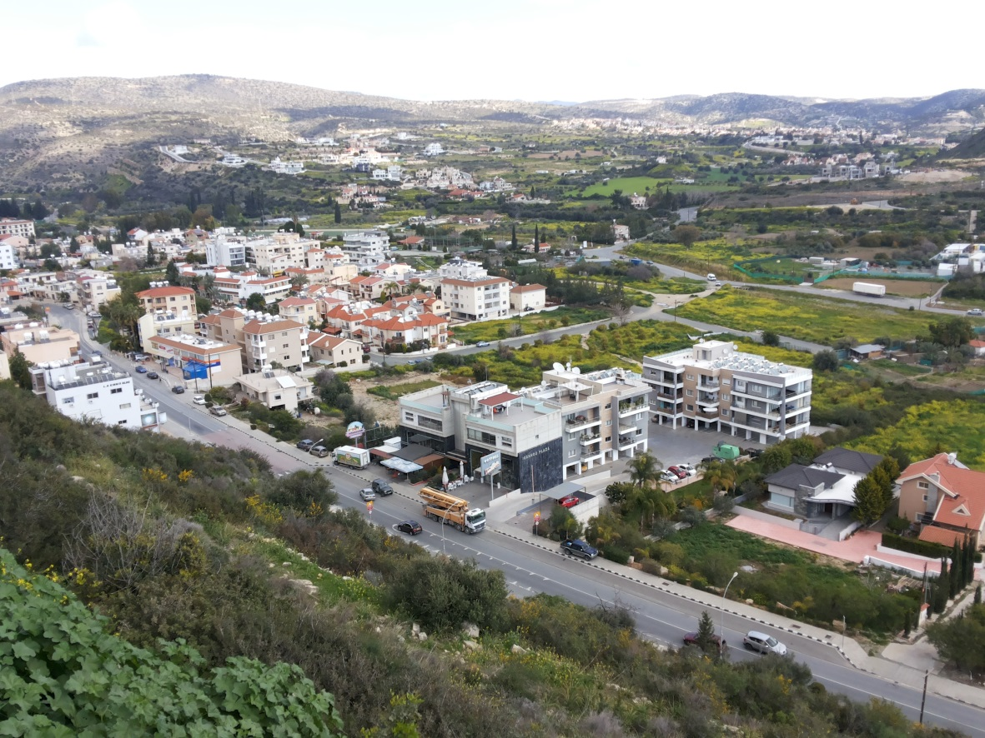
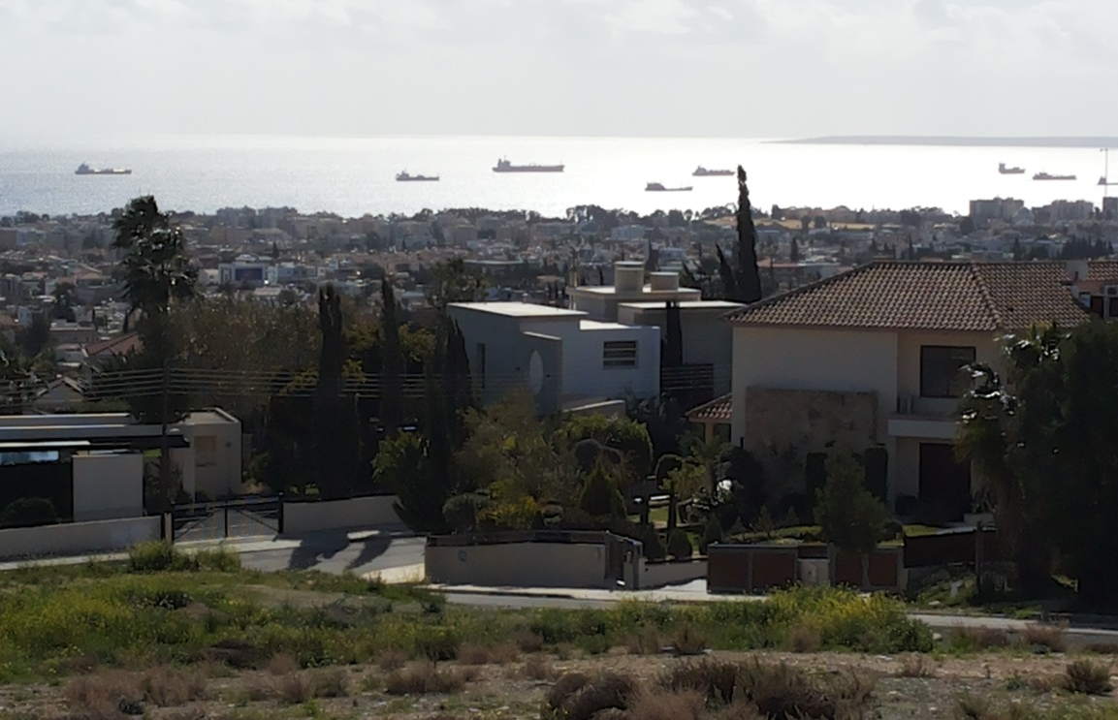
Our school’s surroundings

Slide 11
Cyprus Education System
Structure
Primary school curriculum – Subjects
Greek language
Maths
Science and Technology
History
Religious Education
Geography
Physical education
Arts
Music
Design and Technology
English language
Environmental education, health education, promoting life attitudes, values and social education

