Slide 1
CYPRUS
ERASMUS +
PLAY WITH ME AND TEACH ME

Slide 2
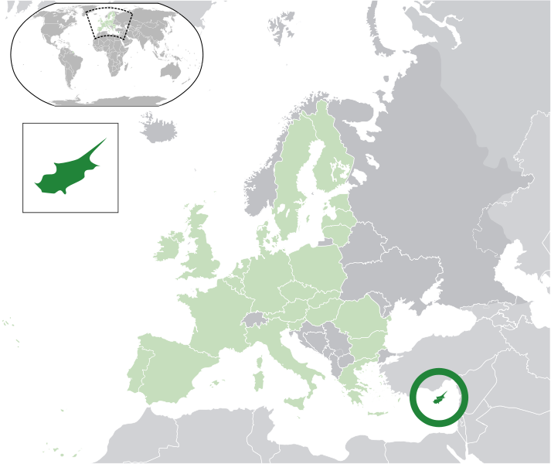
Cyprus is an island situated in the eastern part of the Mediterranean coast of Turkey, Syria and Lebanon.

Slide 3
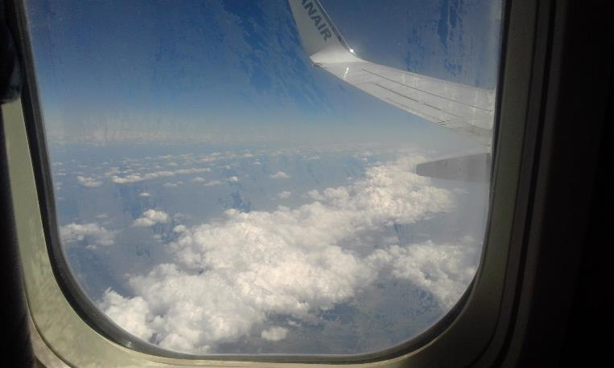
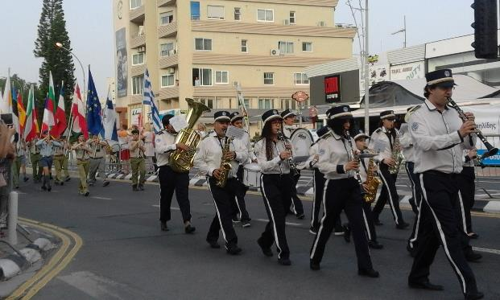
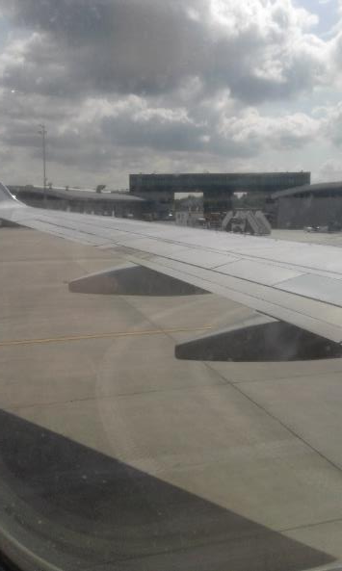
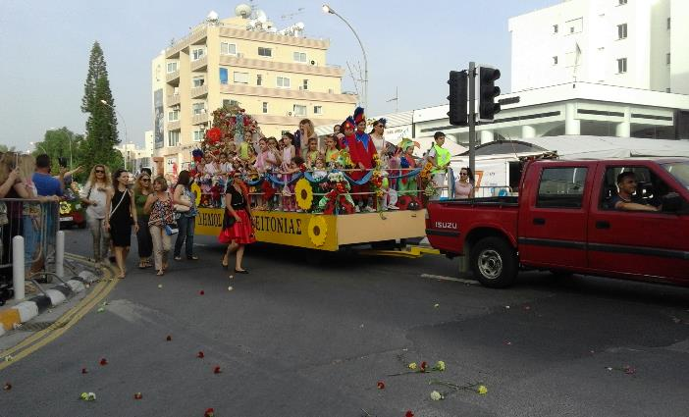
Day 1 travel and flower parade
SUNDAY 15.05.2016

Slide 4
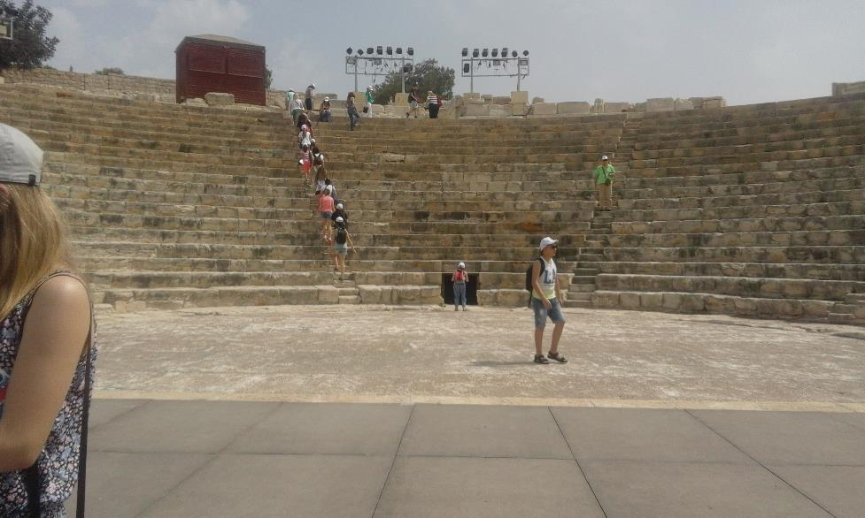
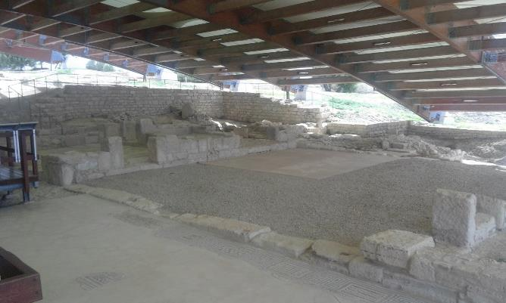
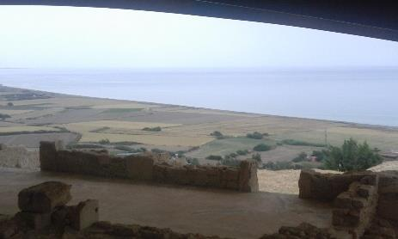
Day 2 trip to archeologICAL EXCAvaTion
MONDAY 16.05.2016

Slide 5
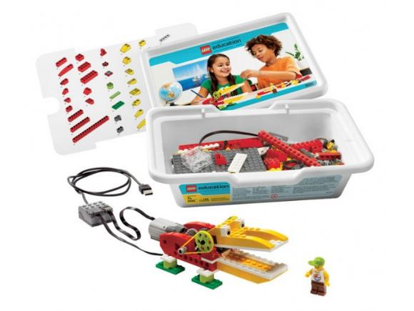
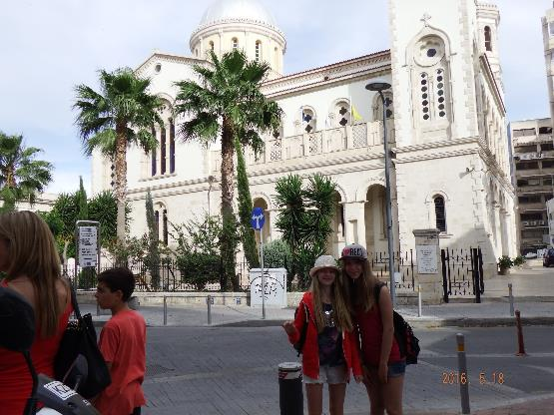
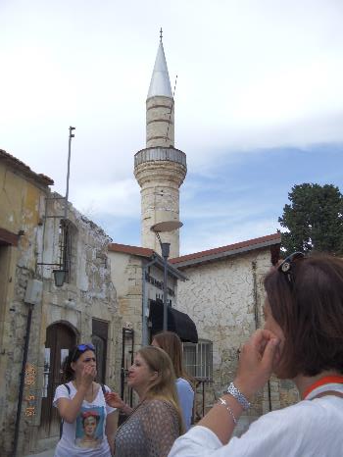
Day 3
ROBOTICS: construction and programming lessons.
TRIP to Limassol old town.
TUESDAY 17.05.2016

Slide 6
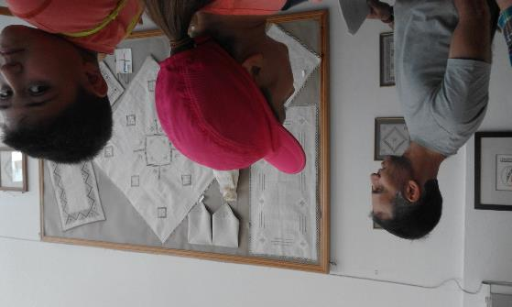
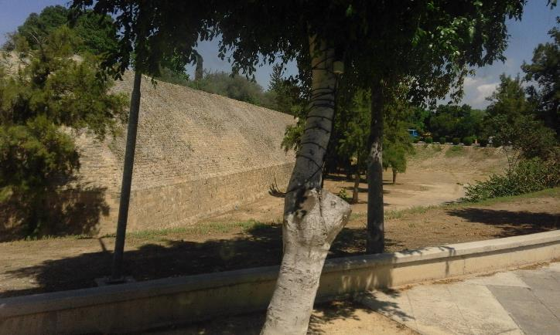
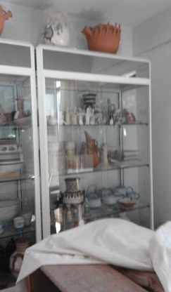
Day 4
VISIT TO NICOSIA
CYPRUS’ CAPITAL
WEDNESDAY 18.05.2016

Slide 7
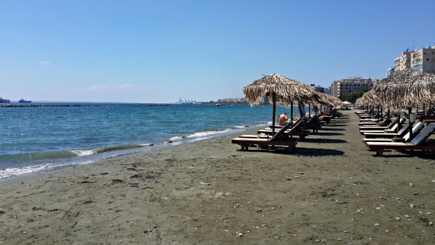
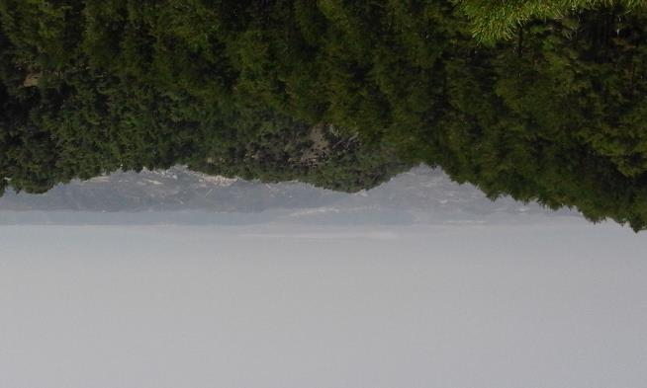
Day 5
Day 7
MOUNTAINS
SEA SPORTS
THURSDAY 19.05.2016
Day 6
FAREWELL
Notes:
7

