Slide 1
BINGO
CLASS IVC IS PLAYING BINGO

Slide 2
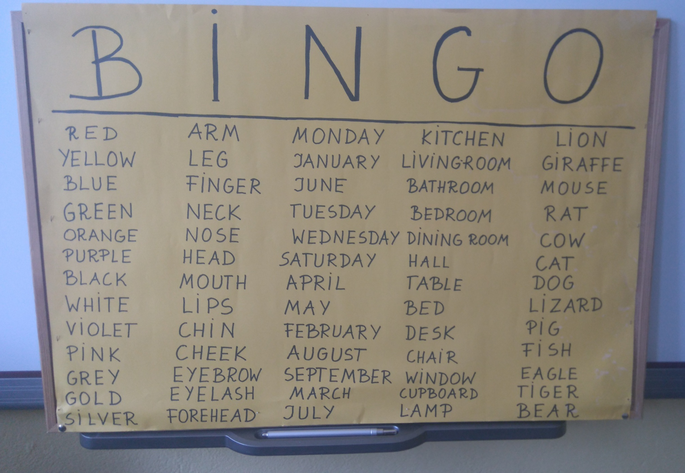

Slide 3
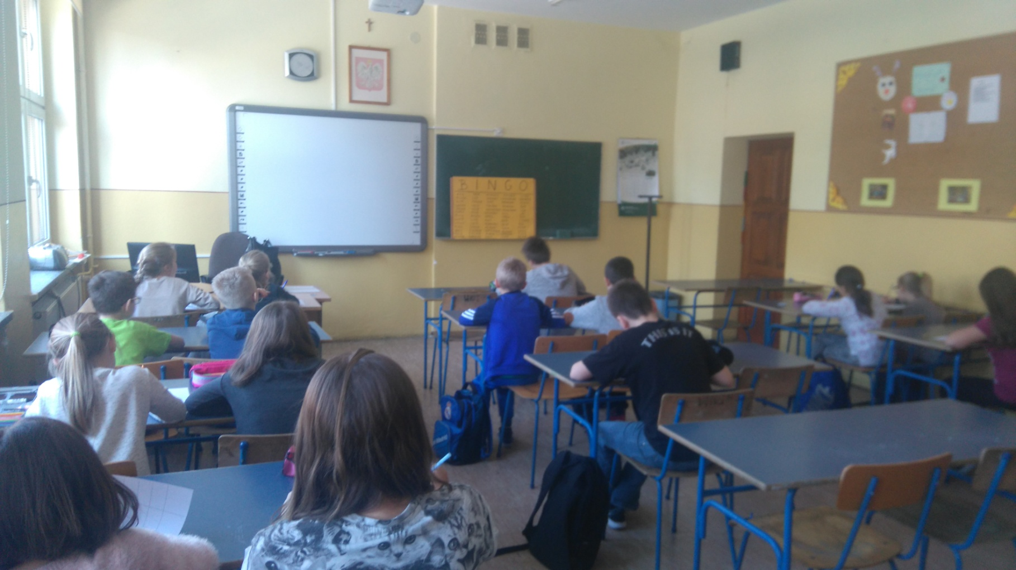
Children choose 5 words from each category(colours, parts of the body, months and days, furniture and rooms, animals).

Slide 4
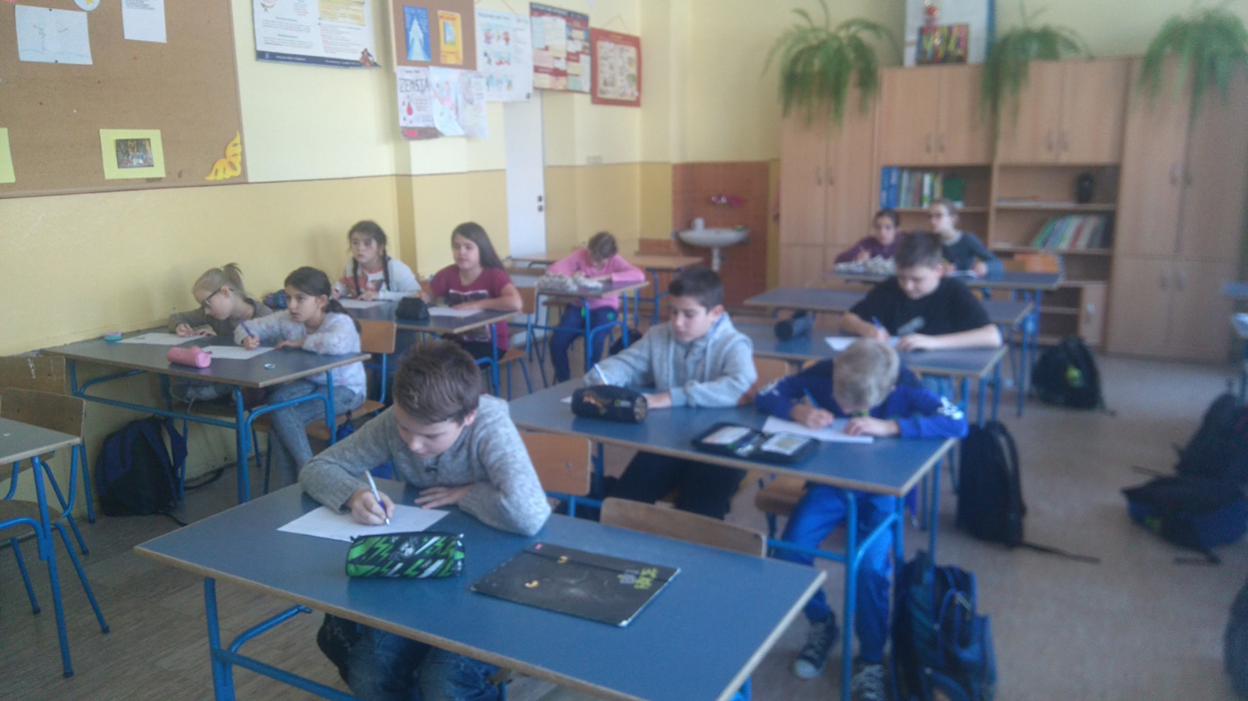
They write them on the paper

Slide 5
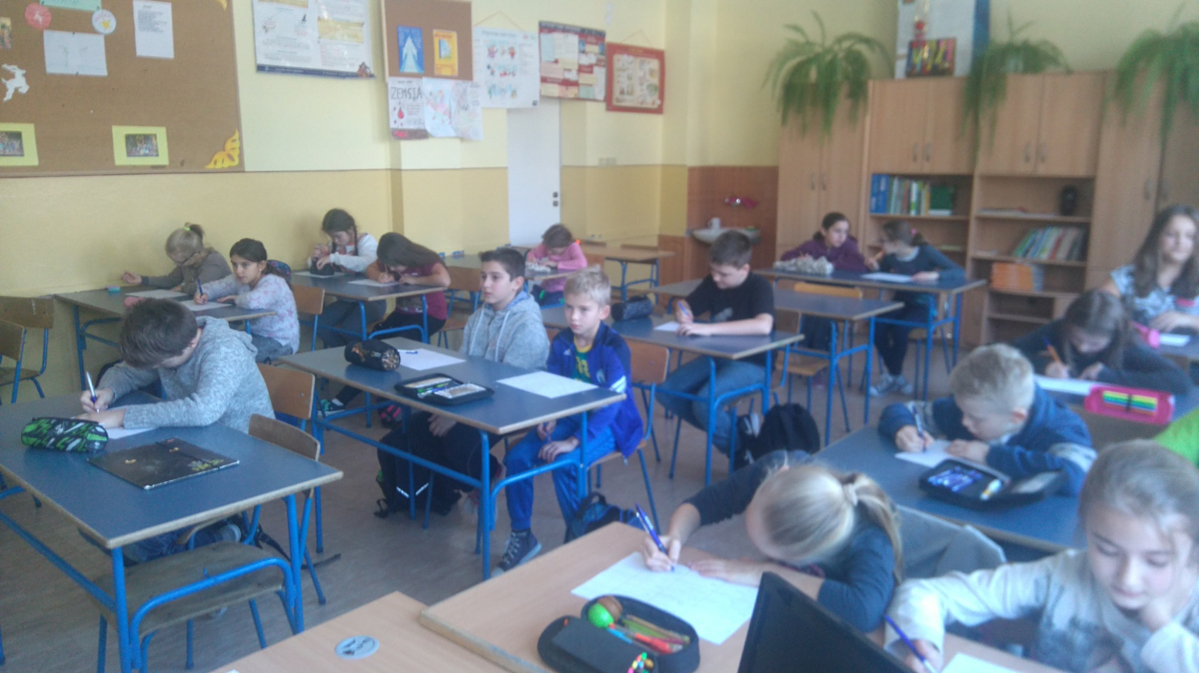
The teacher calls 5 words ( he/she has chosen) from every category

Slide 6
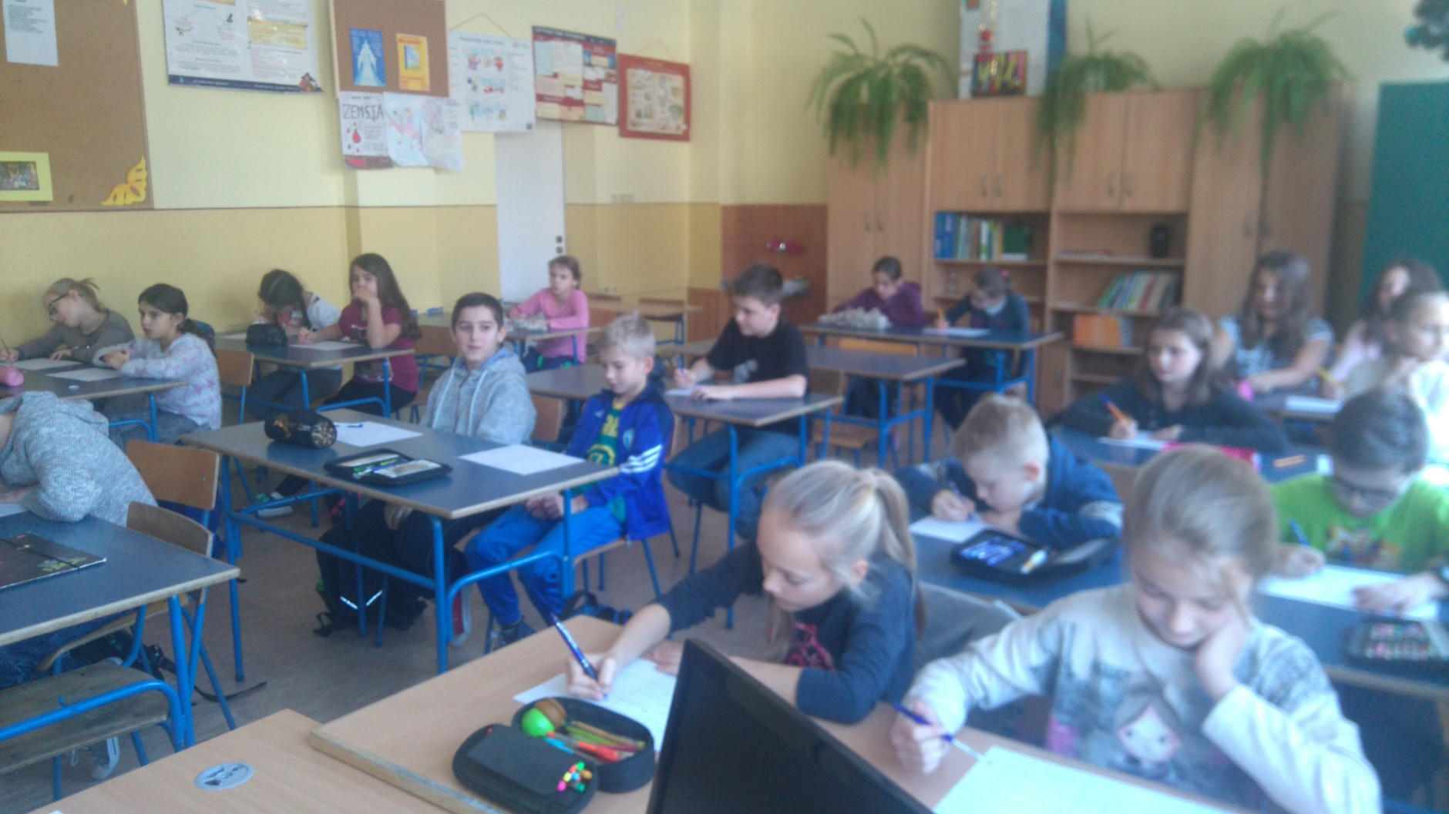
The children cross out the words he/she calls

Slide 7
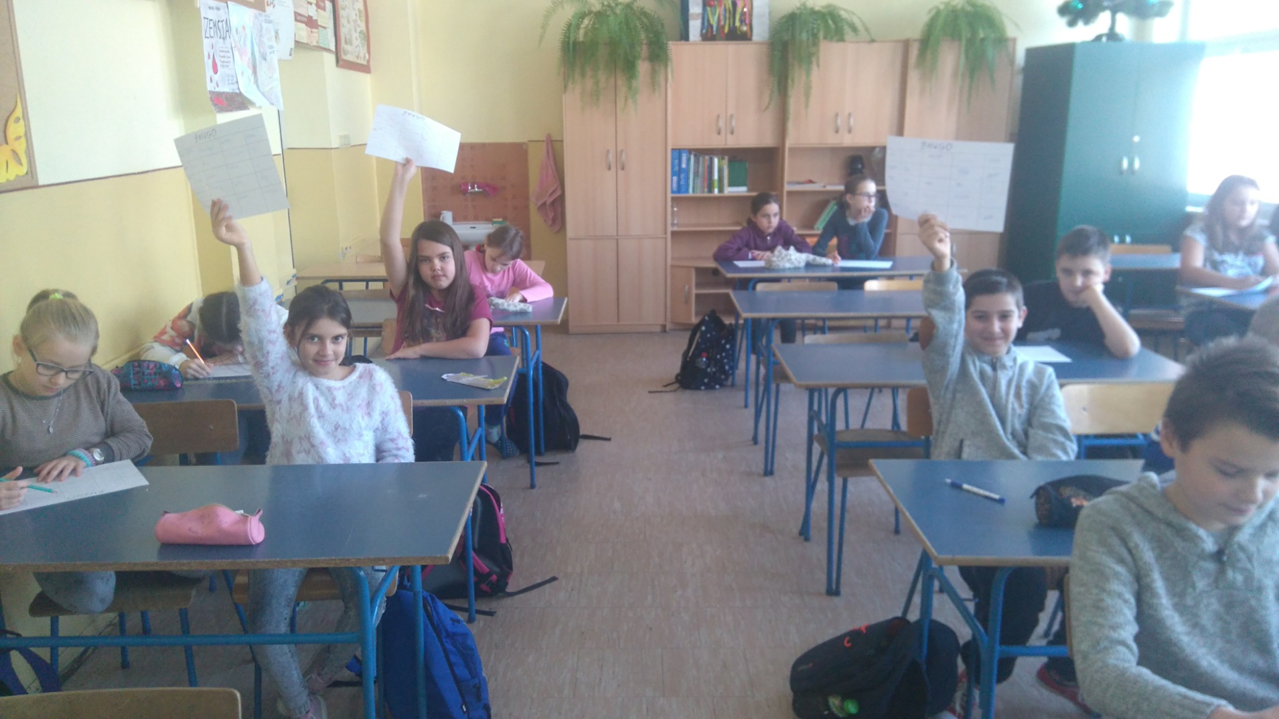
The first person who crosses out 5 words (across, horizontally or down) calls BINGO and is the winner

Slide 8
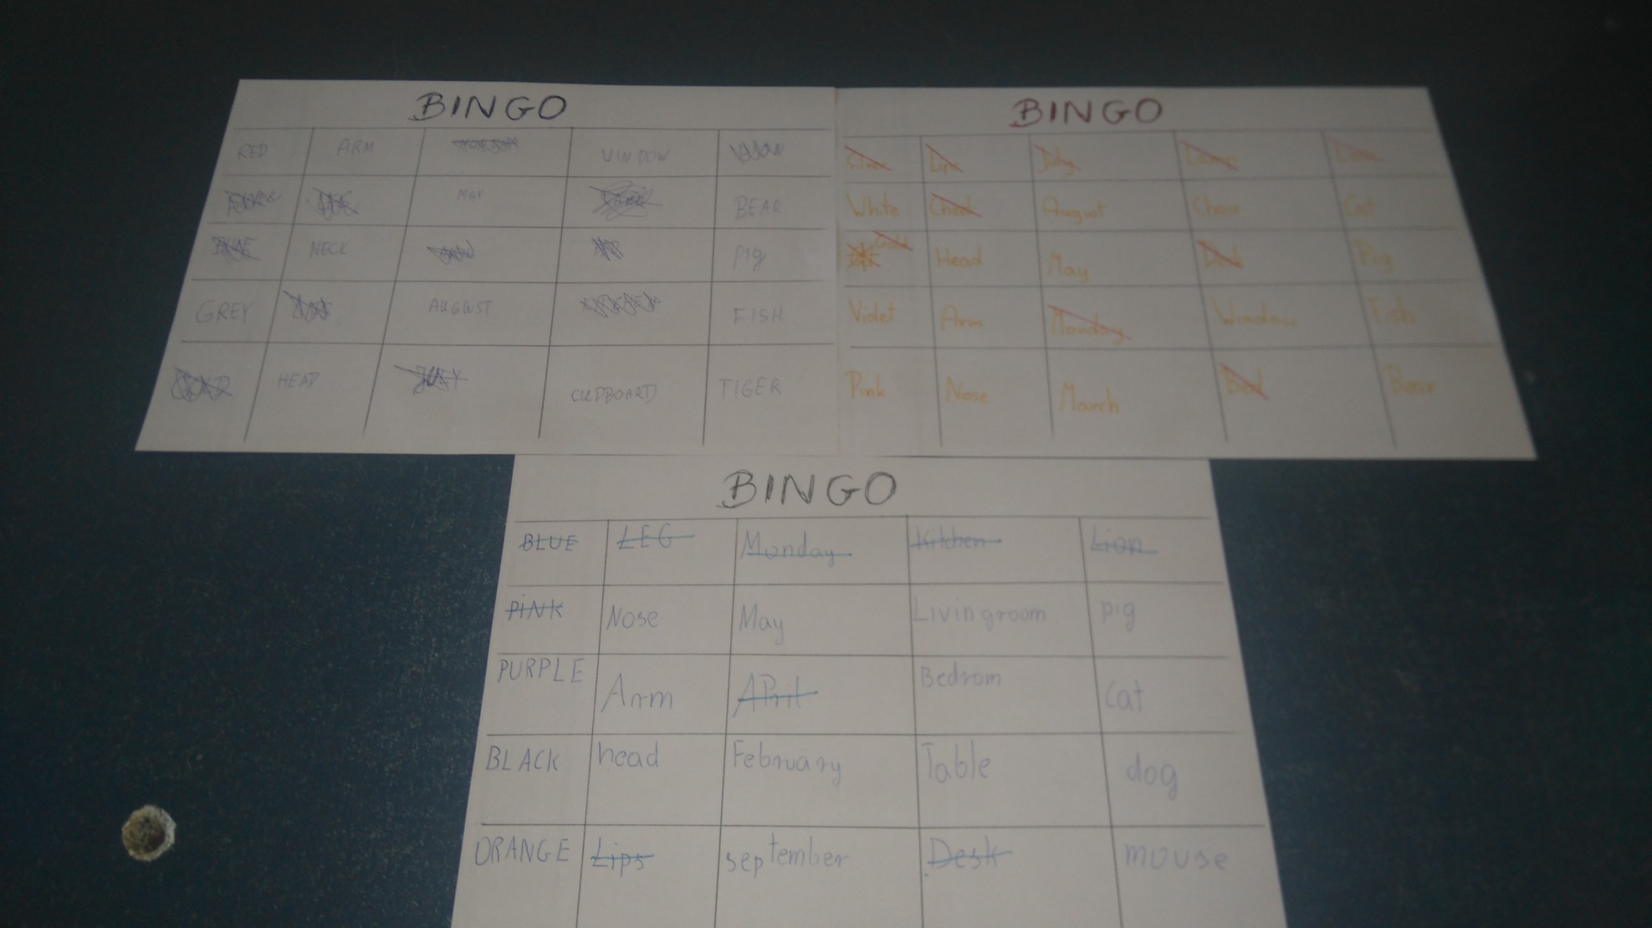
Three children in the class called BINGO at the same time- so there were 3 winners

