Slide 1
Methodologies in teaching
“PLAY WITH ME
AND
TEACH ME”
CEIP JOSÉ RODRÍGUEZ CRUZ
VILLAFRANCA DE LOS BARROS (BADAJOZ)
SPAIN

Slide 2
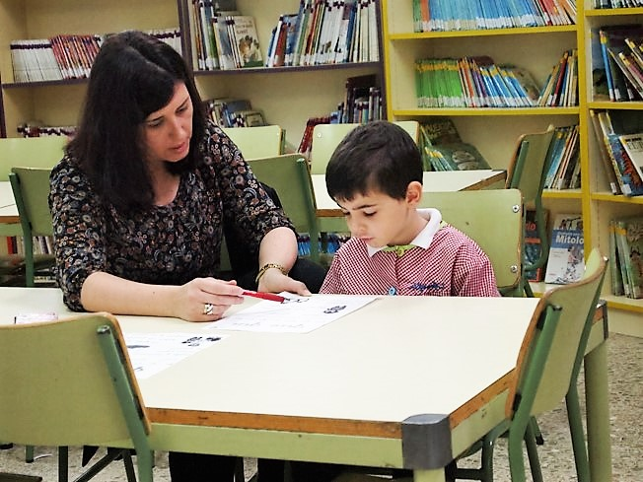
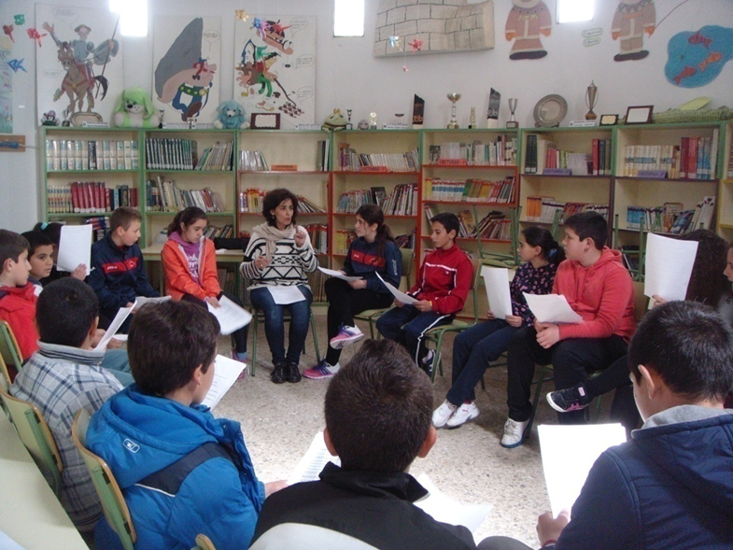
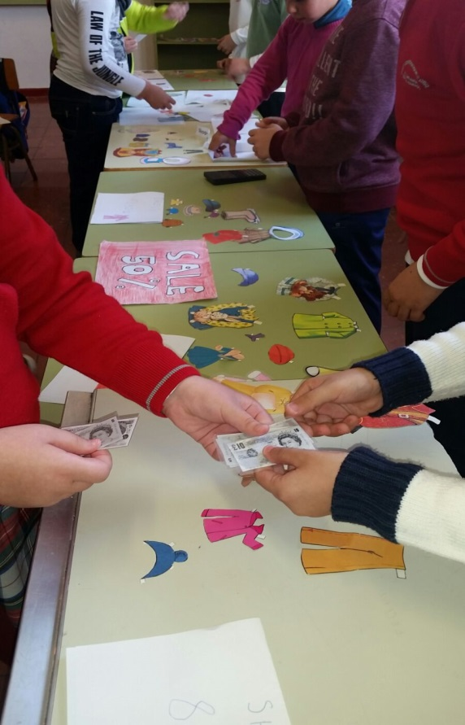
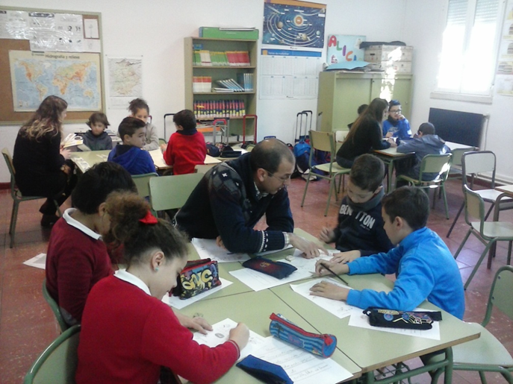
Summary
1.-Guided Reading
2.-Dialogical literary chats
3.-Project Based learning
Interactive groups

Slide 3
1.- Guided Readings
The objetive of this practise is:
Helping to children
Lear to read

Slide 4
1.- Guided Readings
Parents/Volunteers guide students to improve comprehension.
These actions include:
Asking questions about a text while reading.
Identifying main ideas.
Using prior knowledge to make predictions.

Slide 5
1.- Guided Readings
The tutor guide children´s reading practice, and encourage them to improve their reading skills.

Slide 6
1.- Tutored Readings
One hour, one day a week,the mothers come into the class and pick up one, two or three pupils in other part of the school.Then the pupils read with them.

Slide 7
1.- Guided Readings
Help to improve practice oral reading.
Practice reading aloud.
The role of tutor are
Practice decoding specific letters and their sounds.
Practice comprenhension readings.

Slide 8
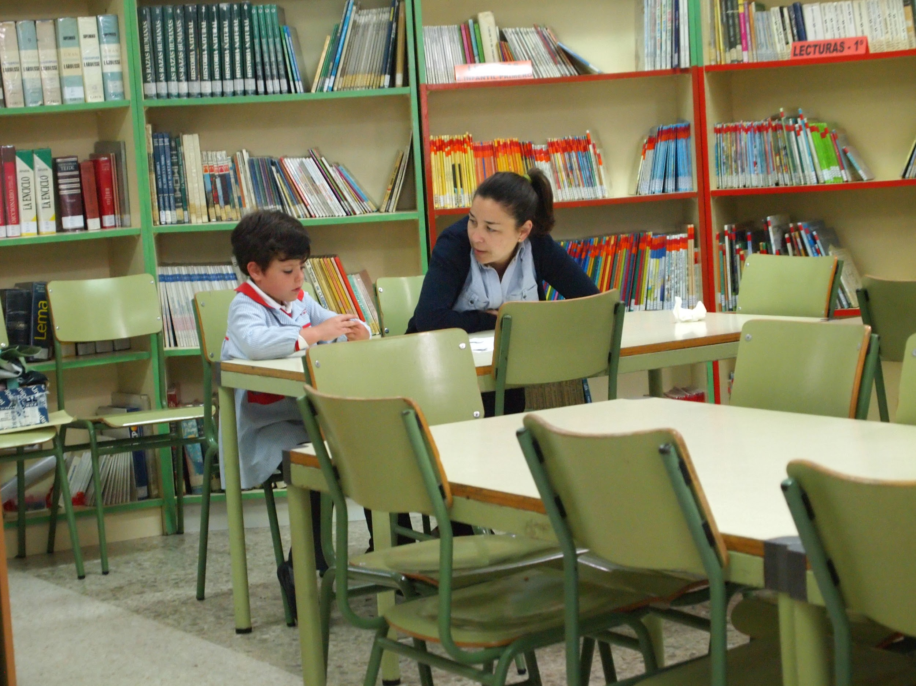
1.- Guided Readings
At the end:
Children improve the reading capacities.
And it the good relations between the family-school get better a lot.

Slide 9
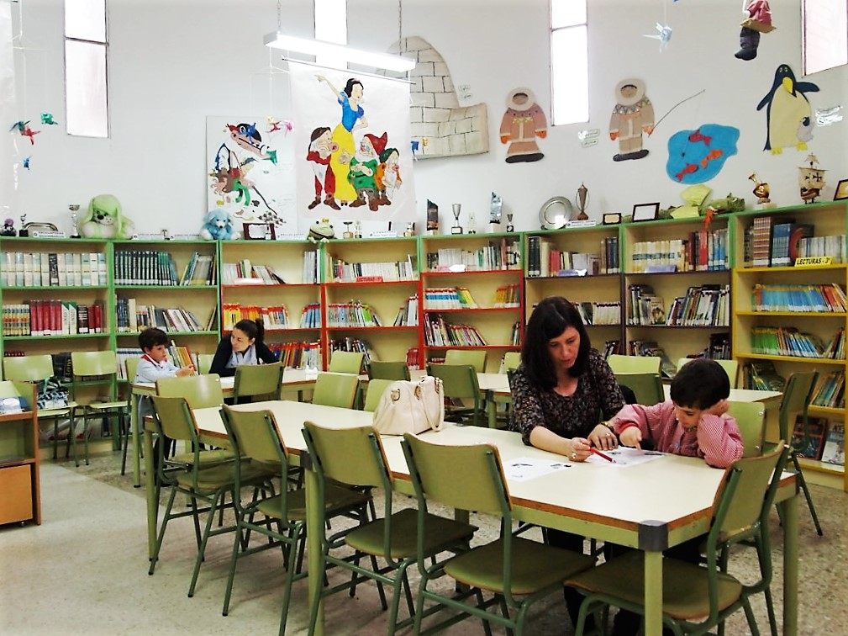
1.- Guided Readings

Slide 10
2.- Dialogic Literary circles
They are reading activities to build self-determined behavior based on classics of world literature.

Slide 11
2.- Dialogic Literary Cicle
HOW DO THEY WORK ?
Teacher and students decide the book they want read and discuss. Books are based on classics of world literature.
- Students read at home agreed pages and select a paragraph and an idea to share.
-The Mediator gives the right to speak and ensures the participation of all voices and equal dialogue.
- Students discuss passages of the text, try to understand other viewpoints, practise arguing, but do not search for the definitive truth of the text.

Slide 12
2.- Dialogic Literary Cicle
The essential question is:
“What meaning does this message or story have for my life or for me personally?”

Slide 13
2.- Dialogic Literary Cicle
AIMS:
- Help expand knowledge of events, feelings, language, culture.
Provide the opportunity to link learning in the book to a higher level of learning.
Help students develop crucial self-advocacy skills such as:
Public speaking
Assertive behavior
Leadership and
teamwork
Active listening
Decision-making
Problem resolution
Teacher should facilitate a discussion of each role and ask students to think about the responsibilities and encourage participation by all.

Slide 14
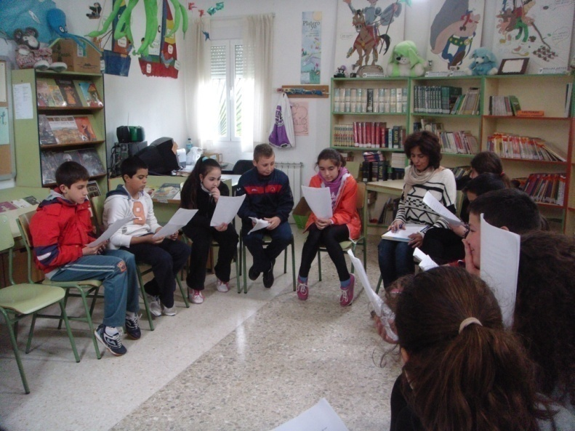
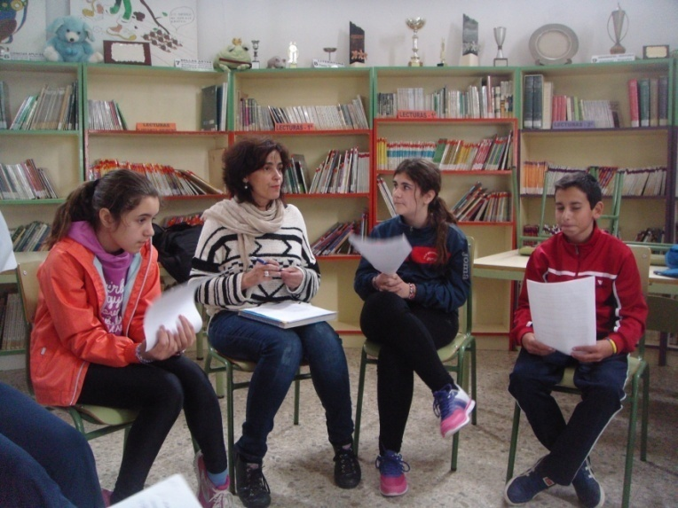
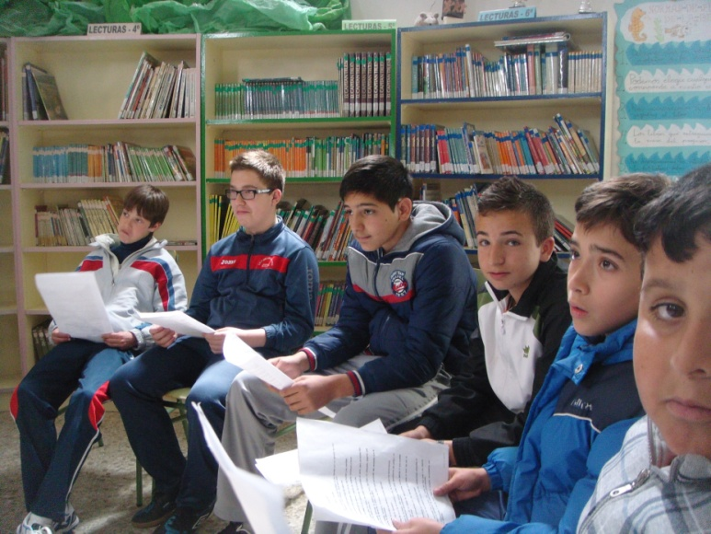
2.- Dialogic Literary Cicle
WORKING IN DIALOGIC LITERARY CIRCLES IN OUR SCHOOL

Slide 15
2.- Dialogic Literary Cicle
RESULTS
- Dialogic Literary Circles generate an understanding of the text to which you can not reach individually.
Increasing vocabulary.
Improving oral expression and comprehension
Develop critical thinking and reasoning ability
Public speaking , Assertive behavior.
Leadership and teamwork and Active listening
Decision-making and Problem resolution
Discussion groups must be carefully thought through.
Groups can’t be too large.
-Don’t use a circle to solve other classroom problems.
- Roles should be assigned the first time.

Slide 16
3.- PROJECT BASED LEARNING
It is a dynamic classroom approach in which students actively explore real world problems and challenges and acquire a deeper knowledge

Slide 17
3.- PROJECT BASED LEARNING

Slide 18
3.- PROJECT BASED LEARNING

Slide 19
3.- PROJECT BASED LEARNING
Topic: “Clothes”
Aims:
To find out about clothes
To make a roleplay about “go shopping”.
To learn about shopping
Realization:
To present the vocabulary by using flashcards and word cards.
Doing some communicative activities
Role play “go shopping”

Slide 20
Presentation of new vocabulary
3.- PROJECT BASED LEARNING

Slide 21
Role play “go shopping”
3.- PROJECT BASED LEARNING
We are shop assistants and customers.
This activity allows us to develop our communicative competence in English, learn more vocabulary having fun and develop all the aspects we have mention

Slide 22
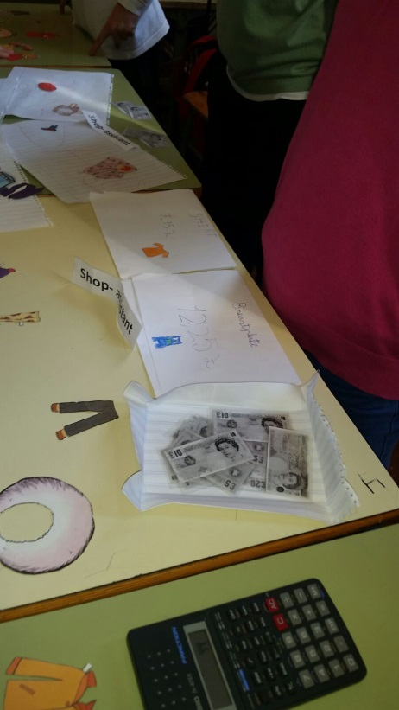
3.- PROJECT BASED LEARNING
Other curricular areas
Literature
Maths
Social sciences
PE
Arts
Multiple intelligences
Verbal linguistic
Mathematical
Spatial
Kinaesthetic
Interpersonal
Skills:
Listening
Speaking
Reading
Writing

Slide 23
4.- INTERACTIVES GROUP

Slide 24
INTERACTIVE GROUPS ARE…
Proposed organization of the classroom in heterogeneous groups with volunteers plus the teacher. It is based on educational successful actions.
How do they work?
The professor prepares and organizes the activities of the groups. He addresses individual needs.
- Students rotate jobs every 15 minutes.
- Community volunteers streamline interactions each group.
- The activities helping students solve and explaining each other.

Slide 25
AIMS:
1. Increase the interactions between students, teachers and volunteers.
2. Attend to diversity
3. Accelerate student learning. 4. Intensify instrumental learning and development of values. Solidarity, respect for diversity, teamwork, initiative,...

Slide 26
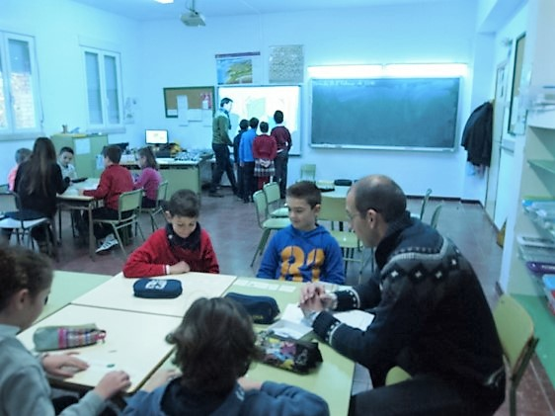
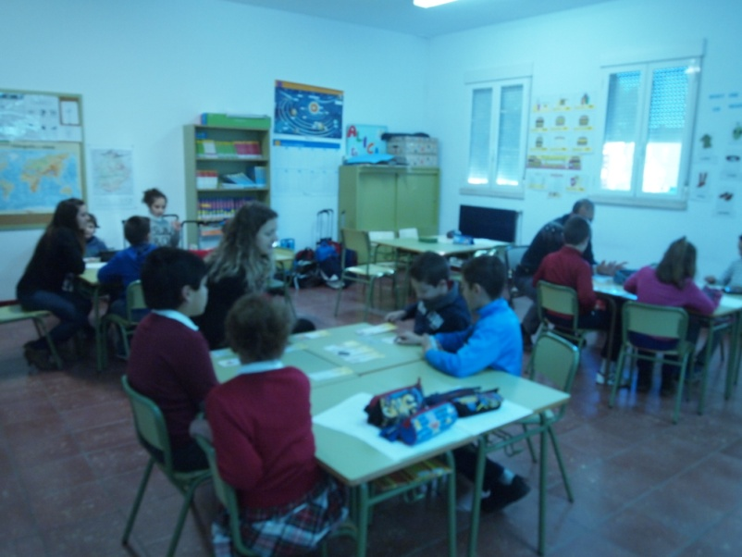
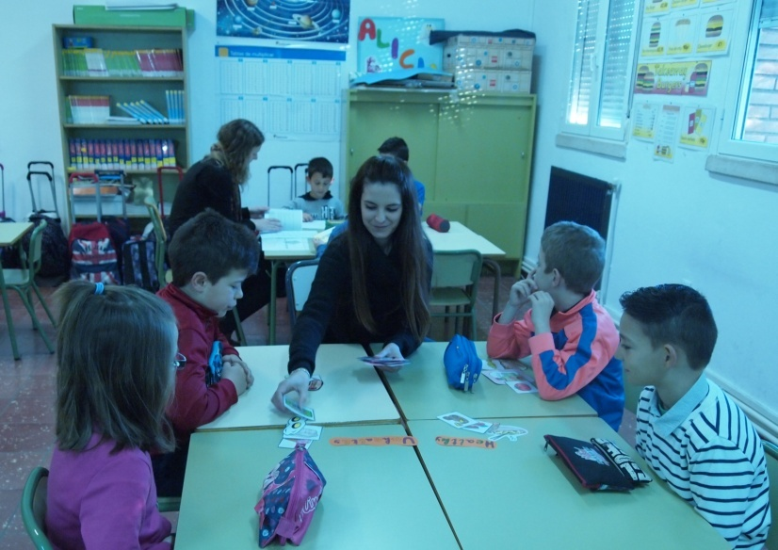
WORKING IN INTERACTIVE GROUPS

Slide 27
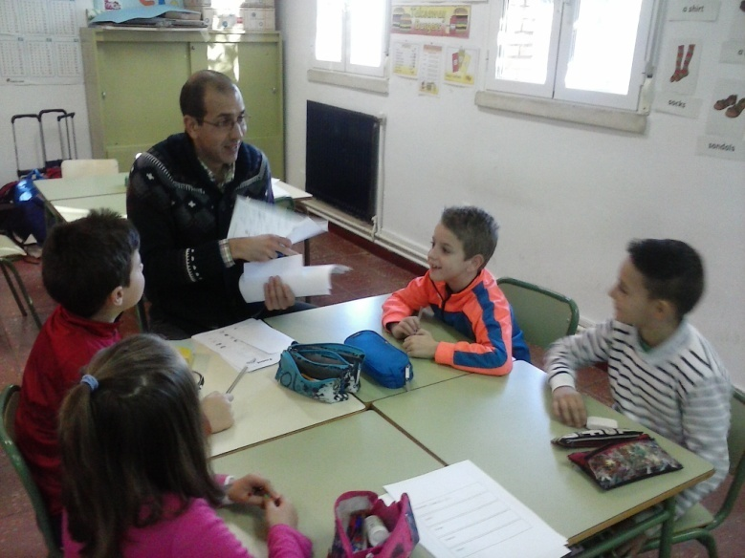
Heterogeneous groups:
Boys and girls, different levels and learning speed, different cultural origin.
+ instrumental learning + solidarity

Slide 28
Classroom organization
ADULT 1
ADULT 4
Activity 1
15 min
Activity 4
15 min
ADULT 5
ADULT 2
ADULT 3
Activity 2
15 min
Activity 3
15 min

Slide 29
classroom organization
4 groups
4/5 students / group
1 hour session
4 changes/activities per session
15 minutes session time per activity

Slide 30
Interactive group 1:
ACTIVITIES: building sentences and crossword
AIMS:
-To develop habilities of building sentences.
-To practice grammar and vocabulary

Slide 31
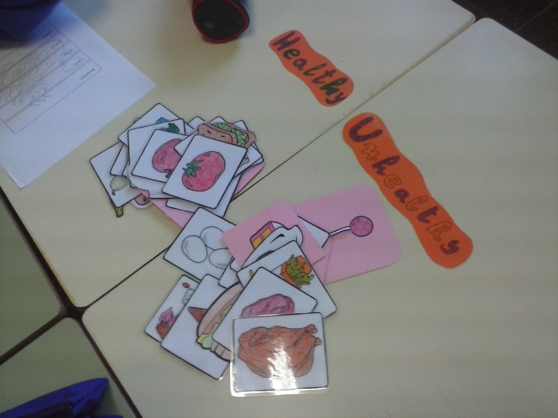
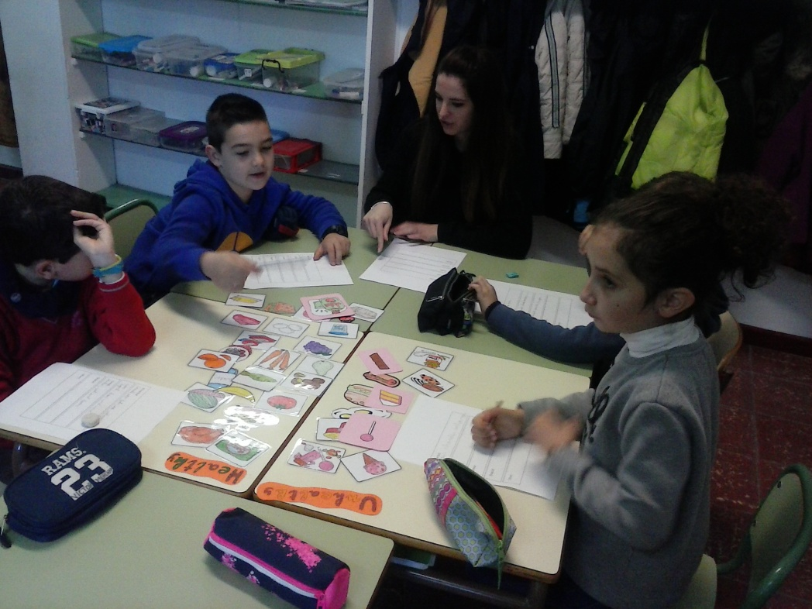
Interactive group 2:
ACTIVITIES:
Design Menu and classify healthy and unhealthy food
AIMS:
- To practise reading and writing.
-To distinguish between healthy and unhealthy food

Slide 32
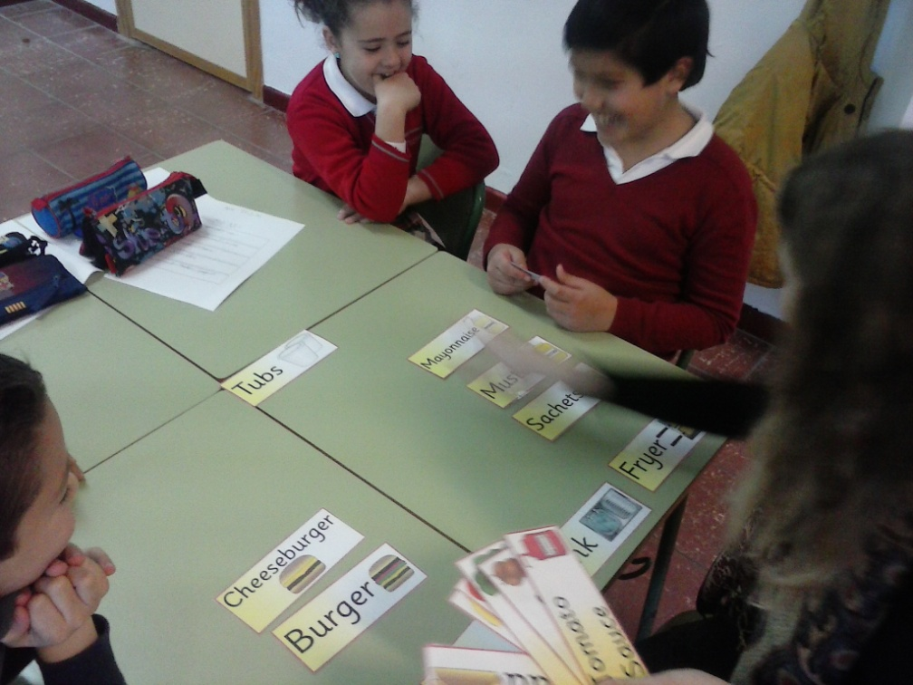
Interactive group 3:
ACTIVITIES:
Burguer Role play and
a restaurant dialogues
AIMS:
-To practise the skills of speaking and listening .
- To develop the commnunicative,
mathematical and learning how to learn competence.
-To learn in real context.
-WAITER: CAN I HELP YOU?
- COSTUMER: A TABLE FOR TWO, PLEASE.

Slide 33
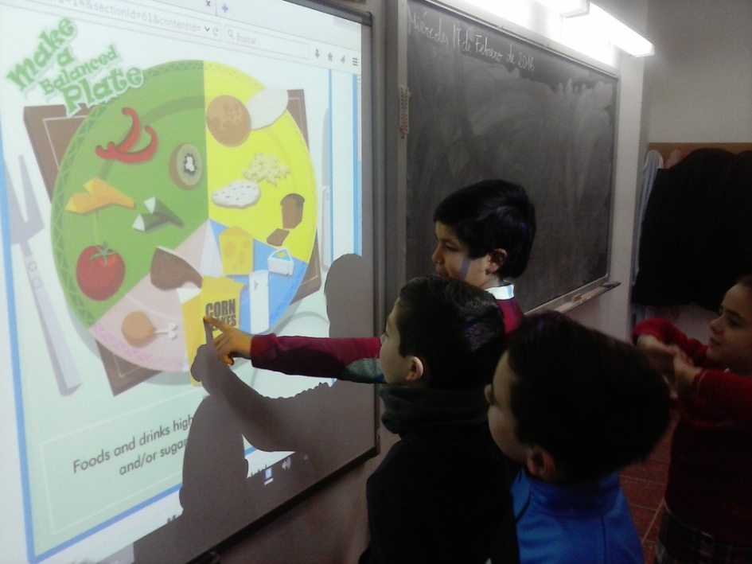
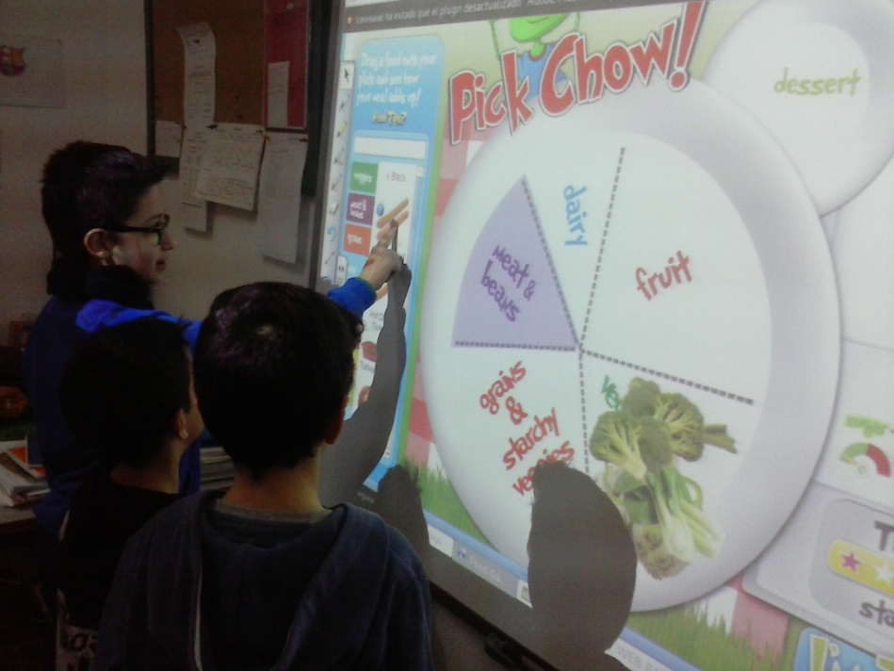
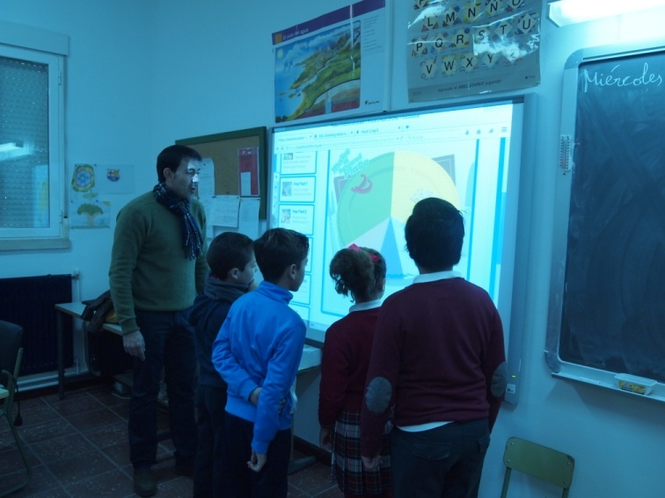
Interactive group 4:
ACTIVITIES:
Food wheel activity
Listening exercise.
AIMS:
- To review unit contents.
- To practice the Listening skill.
- To use the interactive whiteboard
- To develop the digital competence

Slide 34
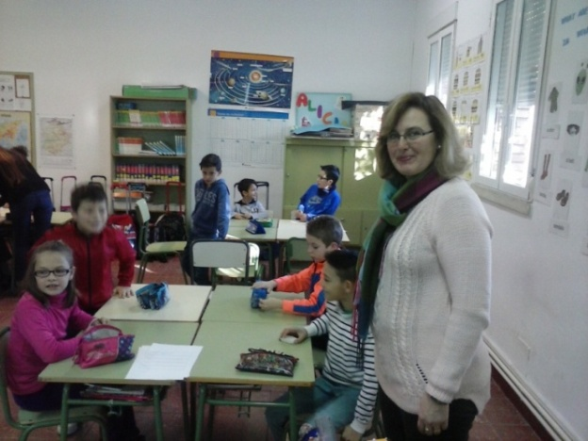
Tutor teacher’s work
To prepare the activities and the materials for every group work.
To organize students in groups.
To help volunteers and students when necessary.
To follow up group and individual work.
To assess children.

Slide 35
Volunteer’s work
To explain activities.
To help students while working.
To help students to work cooperatively.
To promote self-esteem.
To help the teacher with the individual and group assessment.

Slide 36
Our volunteers or group tutors
English teacher.
Parent.
Speech therapist.
Tutor teacher.
Our Native speaker volunteer.

Slide 37
Results
Less ratio
More motivation and interchange.
Good classroom atmosphere
More communicative and social skills (team work, initiative)
More cooperation, solidarity and respect towards diversity.
Classrooms more dynamic and interactive.
Warranty learning of all students. Transformation context (real context).
More personalized teaching.
Better use of time.
It encourages critical thinking
It optimizes resources.
It increases learning through interactions.

Slide 38
SOURCES AND WEBS USED IN INTERACTIVE GROUPS:
http://www.foodafactoflife.org.uk/QuickLinks.aspx?contentType=2 (5-8 years, healthy eating, make a balanced plate) (food wheel, interactive whiteboard)
http://www.zisboombah.com/pickchow (food wheel)
http://www.mes-english.com (crossword)
http://www.123listening.com (what are you eating?)
http://www.sparklebox.co.uk (role play materials)
Materials elaborated by us

Slide 39
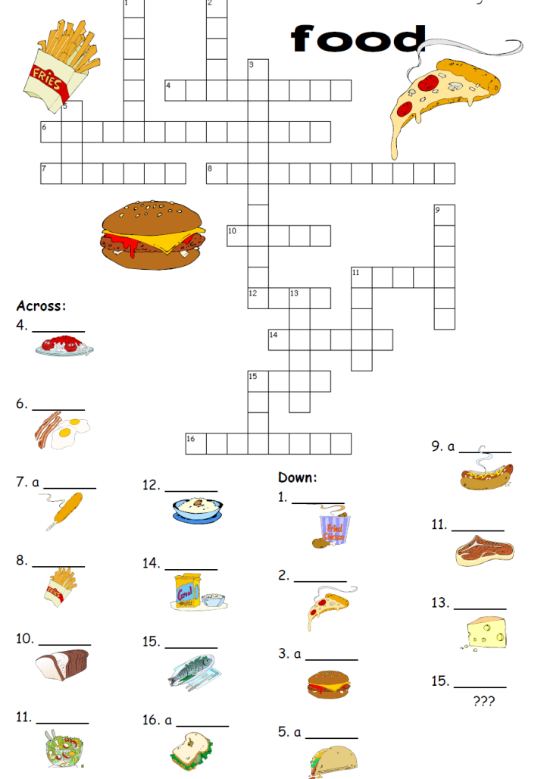
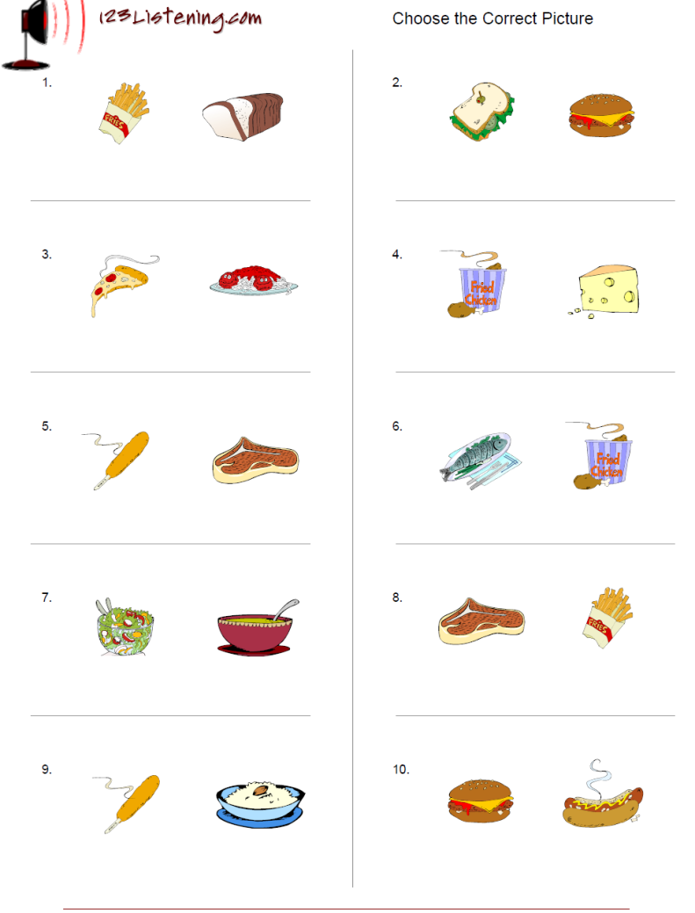
CROSSWORD
TEST LISTENING

Slide 40
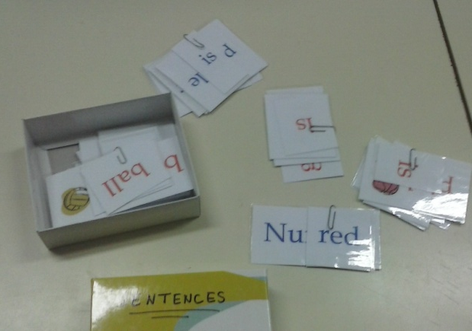
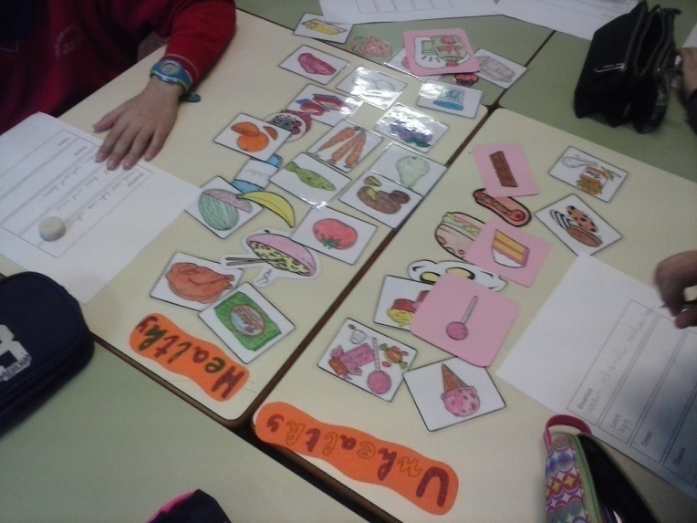
SENTENCES CARDS
RESTAURANT DIALOGUE
Waiter
CAN I HELP YOU?
ANYTHING FOR DRINK?
WHAT IS YOUR FAVOURITE FOOD?
DO YOU WANT A SALAD?
HERE YOU ARE
Costumer
A TABLE FOR TWO , PLEASE
I WANT TO DRINK WATER , PLEASE
MY FAVOURITE FOOD IS SOUP
STEAK FOR ME, PLEASE
THANK YOU.
IT IS DELICIOUS.
CARDS AND FLASH CARDS

Slide 41
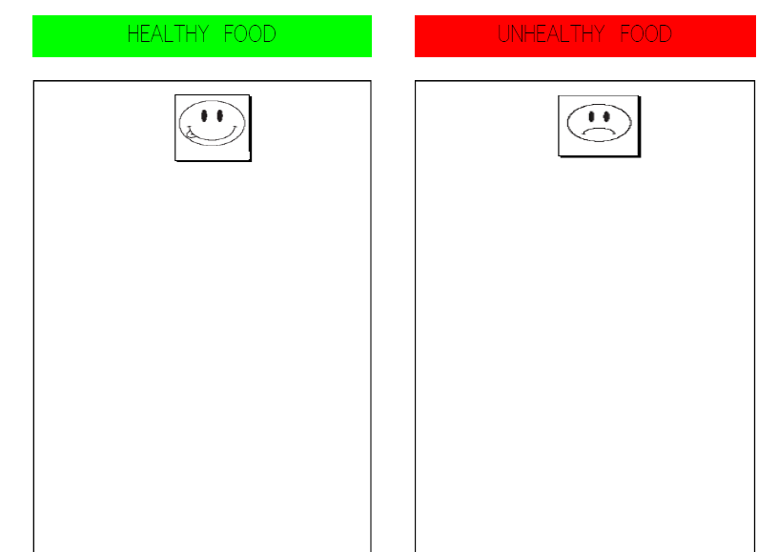
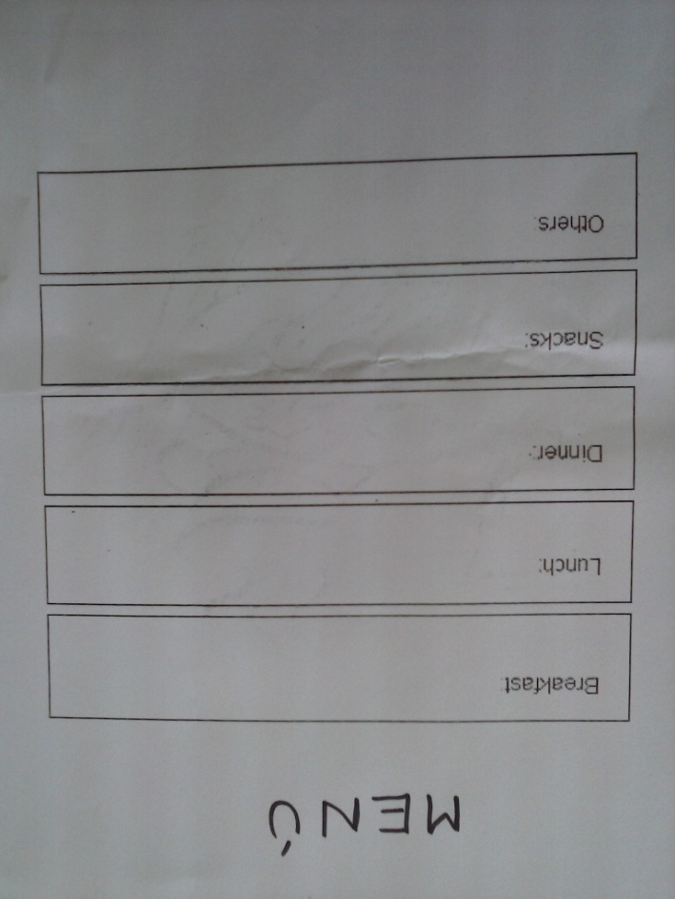

Slide 42
YOU CAN WATCH MORE VIDEOS AND PHOTOS HERE:
http://cpjrodriguezcruz.juntaextremadura.net/index.php/galeria-de-fotos/category/79-roleplaying-clothes-2016
http://cpjrodriguezcruz.juntaextremadura.net/index.php/tablon/3-destacamos/348-grupos-interactivos-programa-de-exito-educativo
http://cpjrodriguezcruz.juntaextremadura.net/index.php/galeria-de-fotos/category/82-grupos-interactivos-2016
February 2016
AUTHORS: RAIMUNDO CUÉLLAR ZAMBRANO
RAQUEL RUÍZ ALCALÁ

