Slide 1
Play with me and teach me
Activating teaching methods

Slide 2
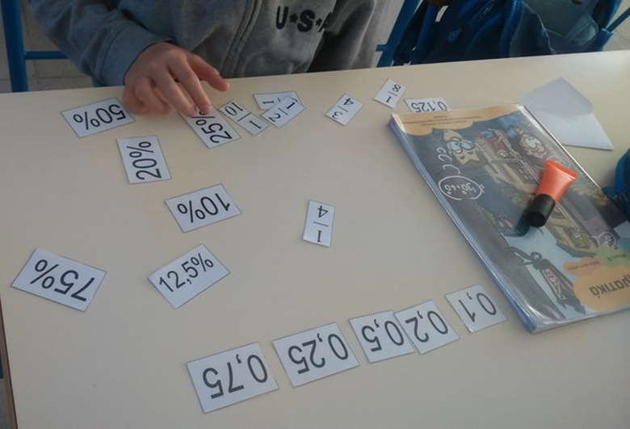
1. MATHS: Comparing fractions, decimals, percentages (Maria Pavlidou)
Grade: 6th
Time: 40’
Aims of the activity:
To compare fractions, decimals and percentages
To work cooperatively in pairs
To exchange knowledge and activities

Slide 3
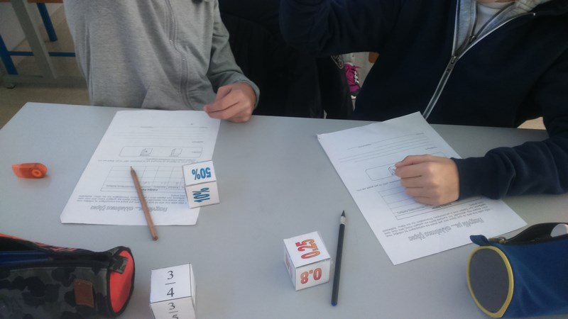
Activities
Activity 1: The teacher gives dices to various kids to throw and convert, from percentage to fraction, from decimal to fraction etc.
Activity 2a: Cubes in three different colours, writing various kinds of fractions, decimals and percentages. Half of the children get three cubes in each pair, throw them and write down in a table what they see. Afterwards, they compare the three shows and write down the bigger one.

Slide 4
Activities
Activity 2b: The rest of the children take envelopes with cards of fractions, decimals and percentages. The children should match three cards of each and make equalities.
Activity 3: Announcements of the results and correcting our answers
Effects/ evaluation of the activity
Pupils liked the activity, especially the cubes. The were devoted to the activity and work very good togerther. They had to justify their answers and revise their knowledge about this unit.

Slide 5
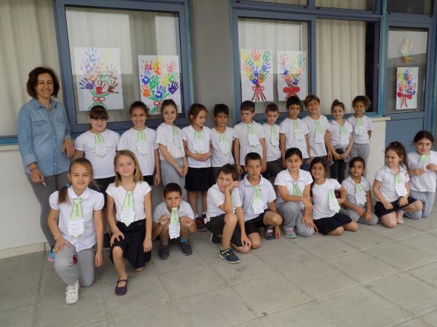
2. Greek Language & Life Education: Individual ties (Koula Kyriakou)
Grade: 2nd
Time: 3X40’
Aims of the activity:
To learn the meaning of various adjectives.
To strengthen their self-esteem through self-knowledge.
To report their feelings when they come in contact with their defects.
To distinguish how strictly they consider themselves.

Slide 6
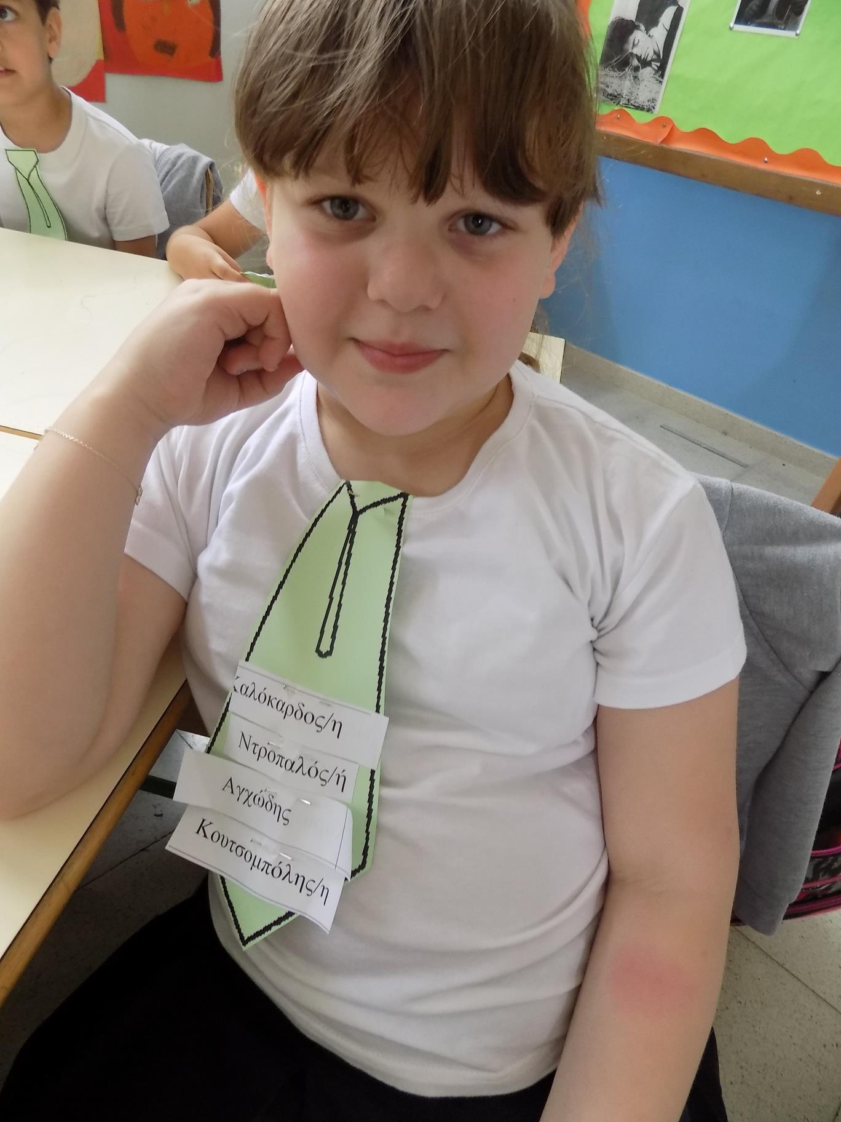
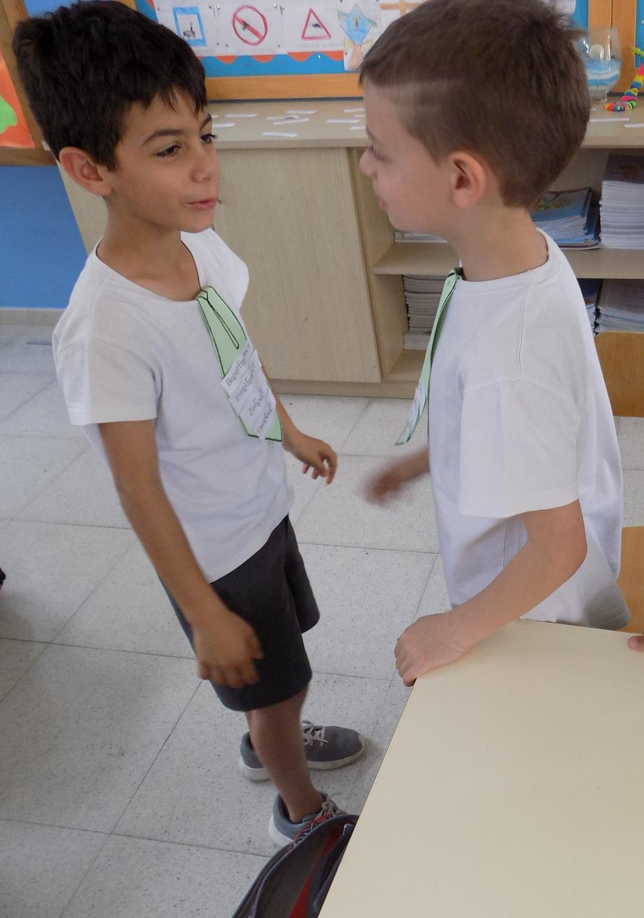
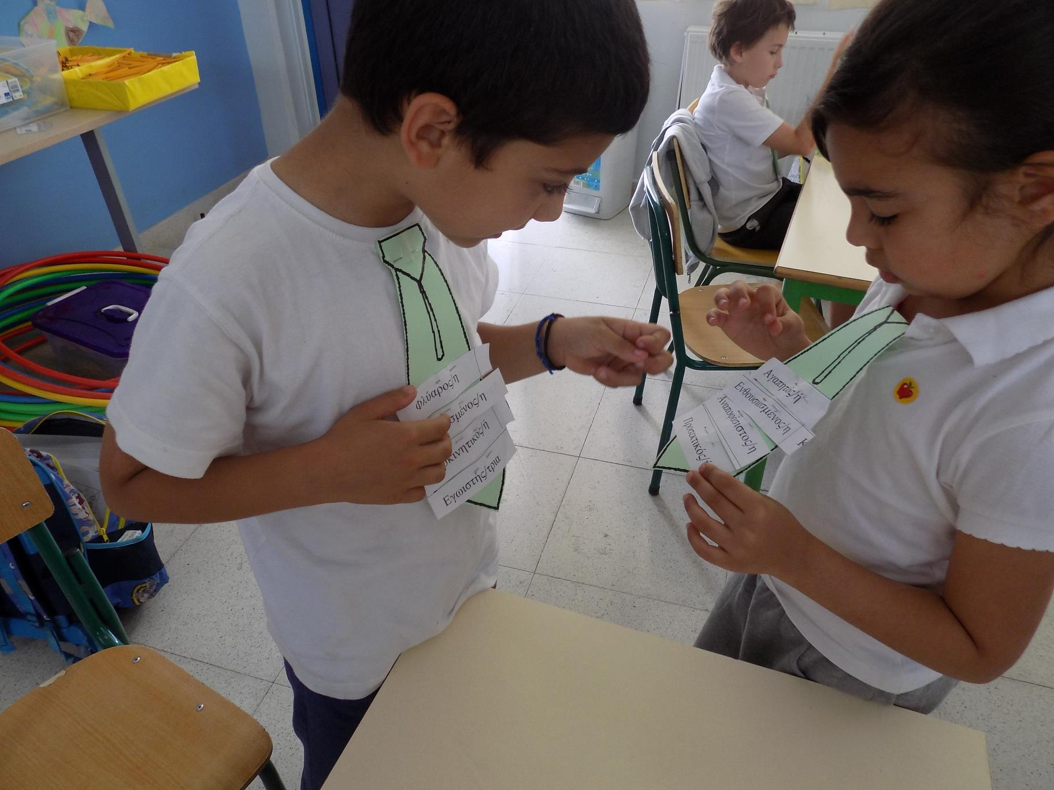
Activities
Students wear a tie made by cardboard. The teacher gives three adjectives written on slips of paper to everyone to stick them to their tie.
If they believe that any of the adjectives is not expressing them, they raised from their position, wander in the classroom and exchange the adjectives that they do not want with other students or with an adjective that is on the teacher’s desk.
Effects/ evaluation of the activity
A prerequisite for achieving this activity is that students are well aware of the adjectives and their meaning. If they don’t know anyone, at least they have to understand whether it’s positive or negative. Students are active, there is vitality in the classroom and everyone is trying to get rid of negative adjectives from her/his tie!

Slide 7
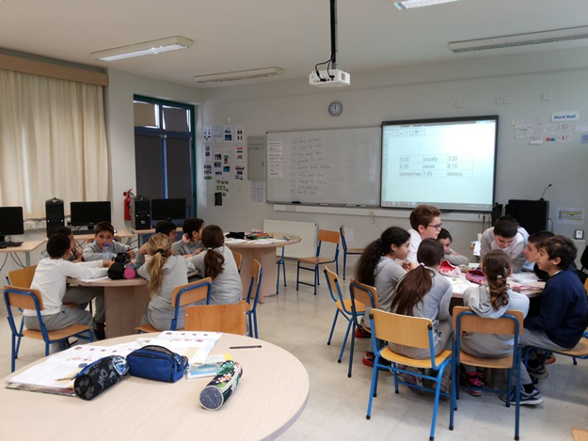
3. English: Telling the time and using adverbs of frequency (Constantinos)
Grade: 5th
Time: 10’
Aims of the activity:
To recognize and tell the time.
To recognize and use properly the adverbs of frequency (never, sometimes, usually, always)

Slide 8
Activities
Noughts and Crosses game
1. The teacher draws on the board the squares and writes time in various forms and the adverbs of frequency.
2. The pupils are divided in 2 groups (X&O).
3. They take their turn and say sentences using the time or the adverb in a square.
4. If the sentence is correct they put their sign (X or O) in the square.
5. The group that completes a line (horizontally, vertical or diagonal) wins the game.
Effects/Evaluation of the activity
Students were very excited, because they had to use both the knowledge they took from the lesson and strategic. It’s a good way to recapitulate the lesson in a playful way.

Slide 9
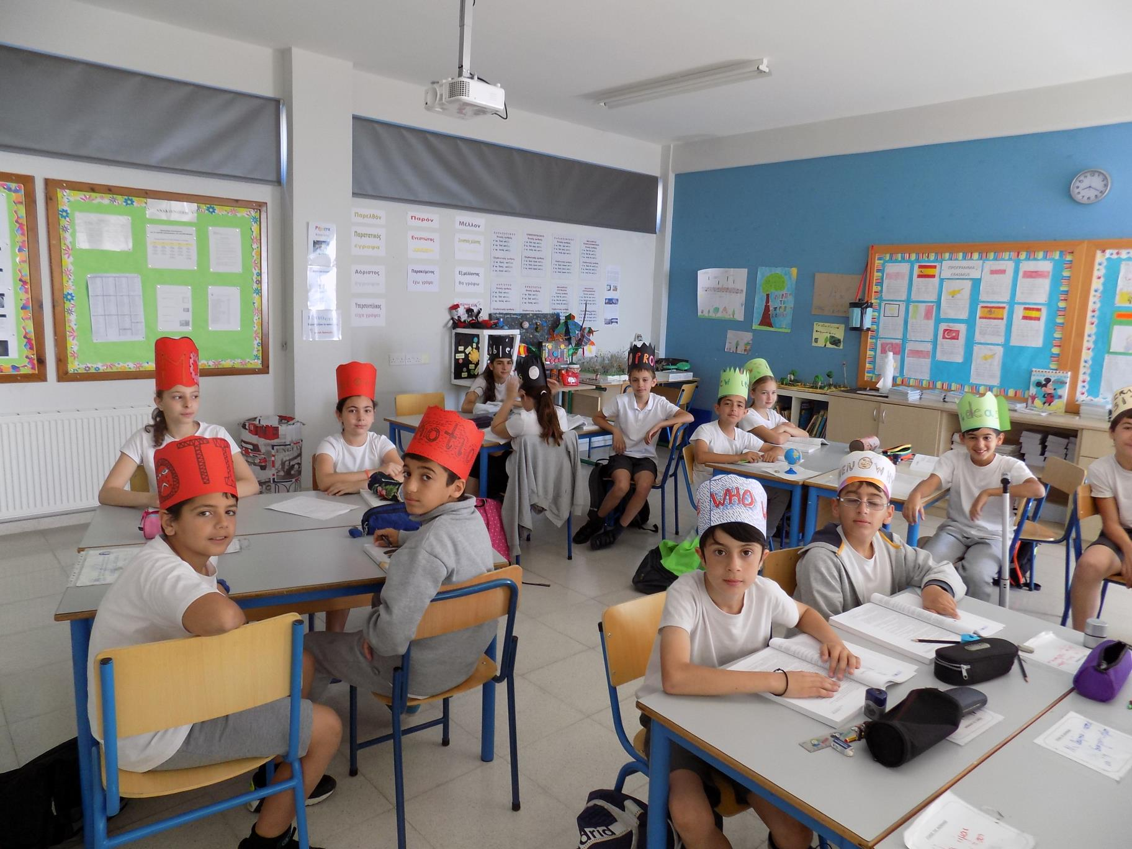
4. Greek Language & Life Education: The 6 hats of De Bono (Panayiota Michael & Sotiroulla Zakou)
Grade: 5th
Time: 2X80’
Aims of the activity:
To understand and analyze a text
To identify the impacts of a decision, while viewing it from different angles.

Slide 10
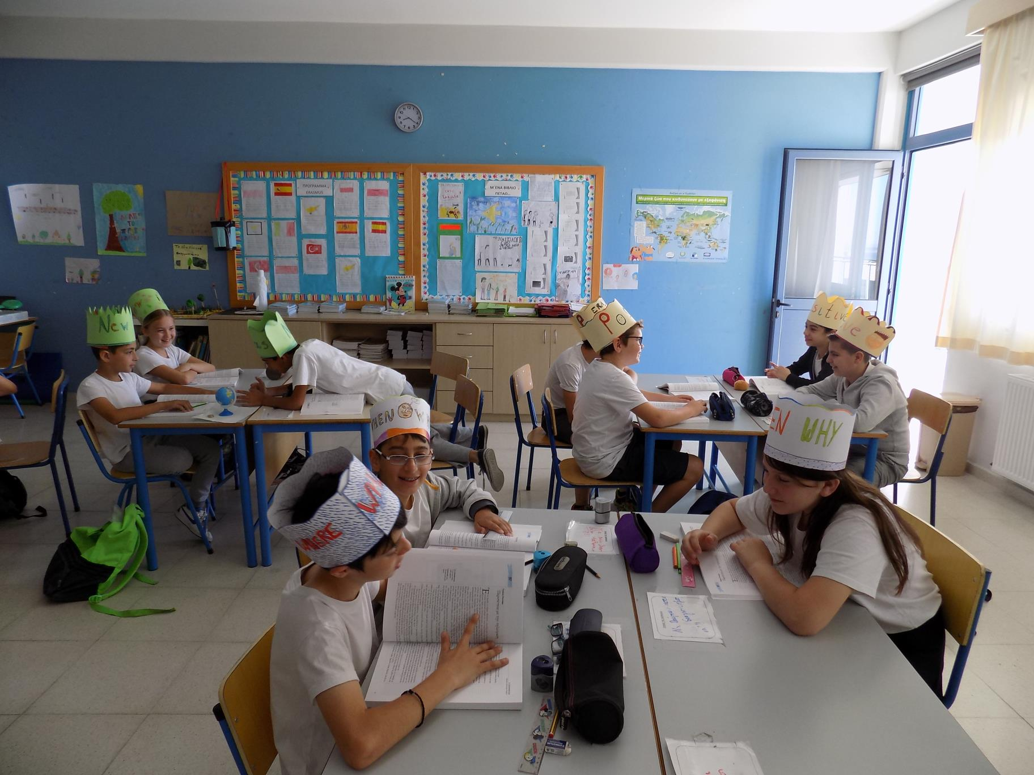
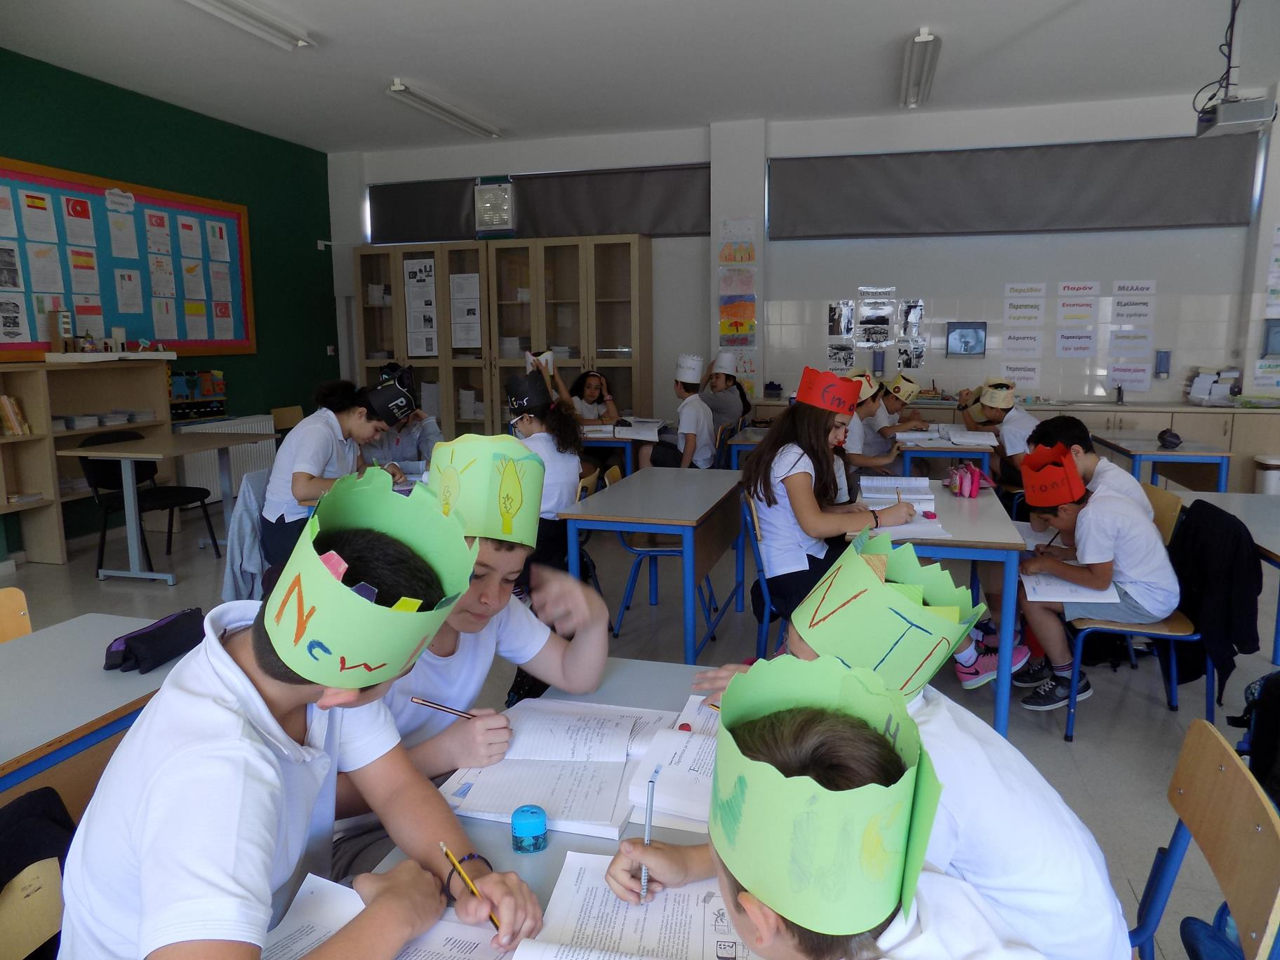
Activities
Pupils are divided in 6 groups. Each group wears a different colour of hat. The colour of the hat will determine the way they will work in their groups.
White Hat: They examine the information they have and see what they can learn from them.
Black Hat: They try to find the weak points of the text and what can go wrong.
Green Hat: They think creative solutions to a problem and suggest ideas.
Red Hat: They try to identify emotions in the text.
Yellow Hat: They identify the positive sides and the benefits of a decision.
Blue Hat: They collect and announce the results of the groups.
Effects/Evaluation of the activity
Students worked with excitement. They cooperated and analyzed the text by examining all aspects in depth.

Slide 11
5. Greek language: Use of the imperative (Panayiota Kyprianou)
Grade: 3rd
Time: 30’
Aims of the activity:
The children are expected to:
present a recipe
use proper verbs
be creative
use the imperative in their language
use the right verb tense

Slide 12
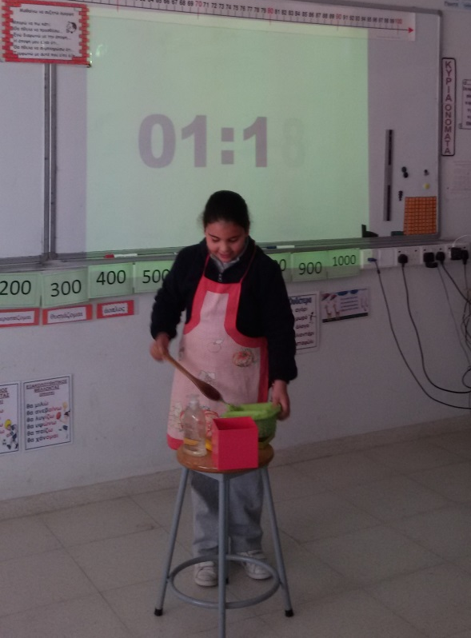
Activities
We ask the children to present a recipe for a T.V. show. Each child has 2 minutes to present the recipe by using some kitchen utensils and his/her imagination to use ordinary classroom objects as well, for the same cause.
Effects/Evaluation of the activity
Children love the pretend play while at the same time they develop their spoken language skills. They practice the use of the imperative in different forms (singular- plural) in a playful, yet meaningful way that has excellent learning results.

Slide 13
6. Music: Tell a story by using rhythm instruments (Elena Agrotou)
Grade: 1st
Time: 80’
Aims of the activity:
The children are expected to:
learn the concept of rhythm
listen to music and play instruments to represent actions
be creative
learn how to keep a beat with the music and choose the instrument that they think best suits for the story
Instruments:
shakers, maracas, rainstick, woods, wood block, finger cymbals, triangles

Slide 14
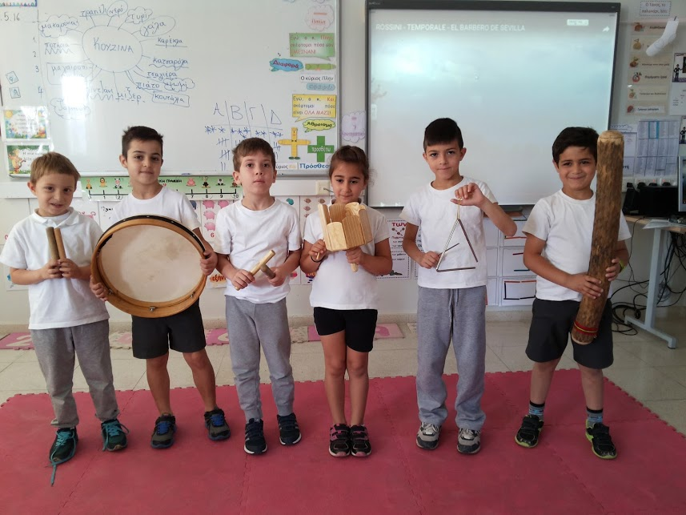
Activities
1. Pupils watch “The 3 Little Pigs” and talk about how each character is represented by a certain instrument.
2. Pupils are divided in groups of 5.
3. We play the song “Temporale” by Cioacchino Rossini. Pupils close their eyes to imagine the “weather”.
4. We ask them to do some sounds without instruments that represent the weather (hands, feet, fingers etc).
5. Each group practice in the instruments and choose what they think represent the sound in the story/song.
Effects/Evaluation of the activity
Pupils explain why they choose each instrument. Each group create its own story and put some instruments/sounds in it that represent the action that happens in their story.

Slide 15
7. Maths: Guess the number “Ziziros” (Christa Papaevagorou)
Grade: 1st
Time: 10’
Aims of the activity:
The children are expected to:
To identify the secret two digit and three digit number
To identify if a number is odd or even
To mentally assess if a number is greater-equal-or less than another number
To identify if a number is a multiple of 5,2 or 10.

Slide 16
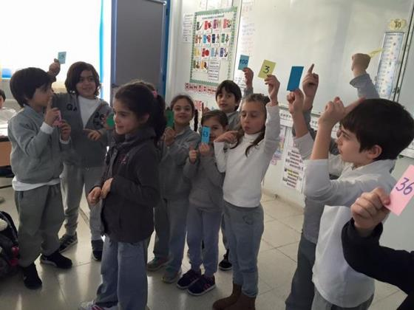
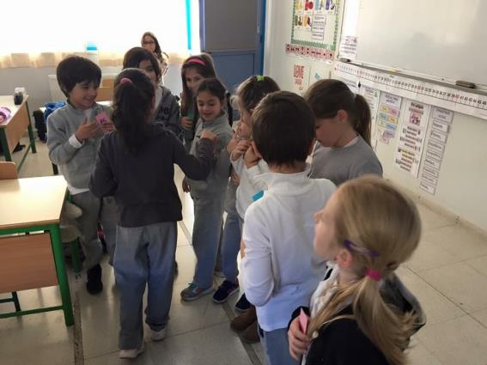
Activities
1. The children are divided into 2 groups. One group comes in front of the classroom. They choose who will be the “ziziros”.
2. All of the children, except from the ziziros, are given one number (from 10-150) to hold.
3. The students decide which of them will “hit” ziziros at the back. Ziziros turns around (his back facing the students) and one student “hits” him/her gently at the back and at the same time all of them change places as to confuse ziziros. Finally, ziziros turns around and tries to guess who the student that hit him/her was. To make his guessing easier he/her asks one questions at a time. At the beginning, the questions could be written at the white board to make it easier for the students. Questions could be like: “Is the number/student that hit me greater than 25?” The group of students’ answers with a yes or a no, and ziziros eliminates the numbers/students by turning their cards around.

Slide 17
4. He once again turns his back and the assigned student “hits” him/her again. Ziziros turns around and asks: “Is the number that hit me even or odd, again eliminating the numbers/students accordingly. Some other helpful questions could be: “Is the number that hit me one digit or two digit number?” or I “Is the number a multiple of 5?”
The game goes on like this until ziziros guesses correctly the assigned student that hit him/her and change place.
Effects/Evaluation of the activity
The students really liked the game. With this game, the students practice different mathematical concepts without realizing it. They did this by playing and having fun.

Slide 18
8. Greek language: The web (Panayiota Kyprianou)
Grade: 3rd
Time: 20’
Aims of the activity:
Narration of a story
Developing spoken language skills
Following the narration of a story
Enriching their vocabulary

Slide 19
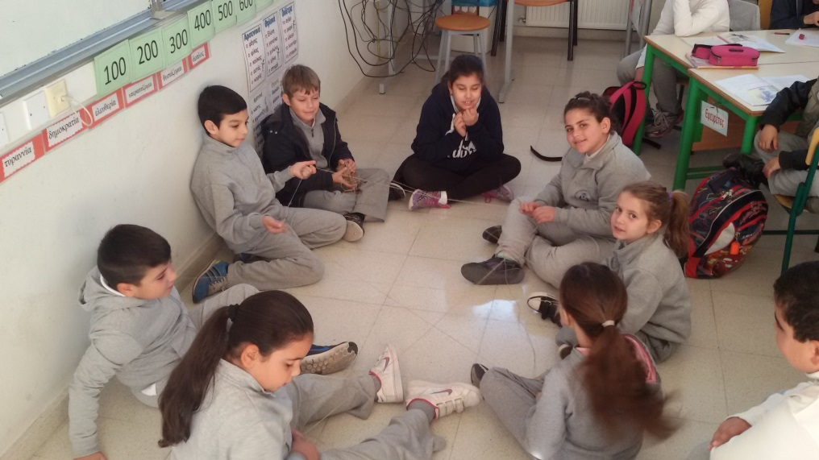
Activities
Children sit at a circle. The first child to speak holds a skein. While saying his/her first sentence of the narration, he passes the skein to another child. The first child still keeps hold of the beginning of the thread. The second child continues the narration holding the thread and passes the skein to the next child and so on, until all children have talked and the narration reaches the end of the story. In the end a web has been formed.
Effects/Evaluation of the activity
Children feel excited leaving their desks and sitting at a circle . They like the shape of the web they are creating. Most importantly though, the activity motivates them to form spoken language that narrates a certain story, developing their language skills.

Slide 20
9. Maths: Multiplication (Panayiota Kyprianou)
Grade: 3rd
Time: 10’
Aim of the activity:
Working on multiplication tables

Slide 21
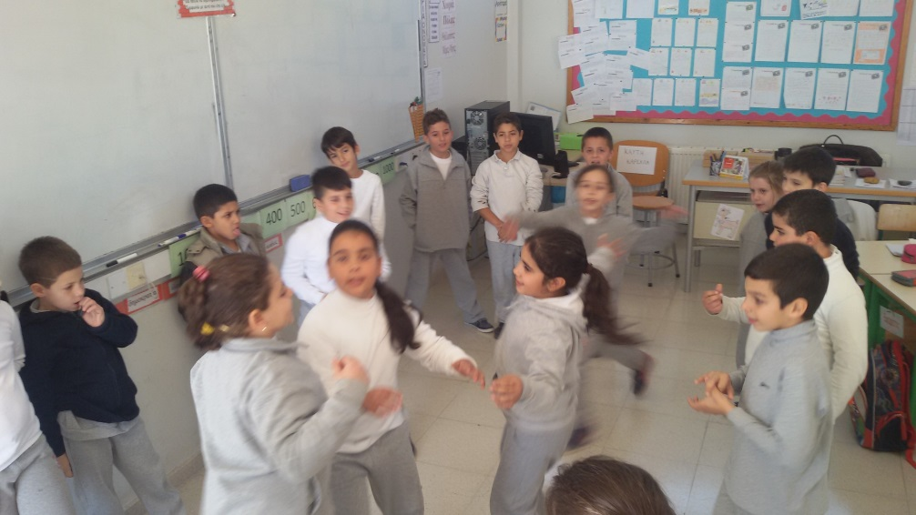
Activities
Children stand at a circle. The teacher tells the students that we imagine there is a fire burning in the middle of the circle and we can’t let it cool down. The way this will happen, is by having the first child that thinks that he has the right answer to the multiplication equation announced by the teacher, running in the middle of the circle, where the imaginary fire is, and shouting the answer. The child then goes back to his/her place and another question is being raised.
Effects/Evaluation of the activity
Children feel excited leaving their desks and being able to move, let alone to run in the classroom! The activity keeps them alert and motivates them to work out the multiplication answers as quickly as possible so they will be the one to run in the circle.

