Slide 1
ERASMUS +
CYPRUS

Slide 2
DAY 1 meeting our families
Our room
Nicole’s house

Slide 3
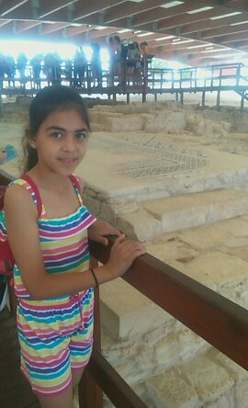
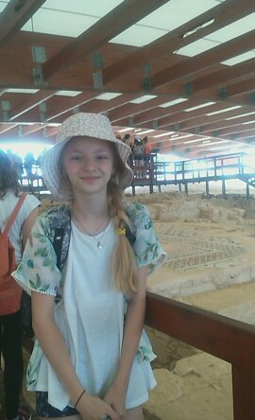
DAY 2
On Monday we had a trip after school. Then we went to museum. At 8 p.m. we went to a welcoming dinner.
Photos from museum
It’s me
This is Nicole

Slide 4
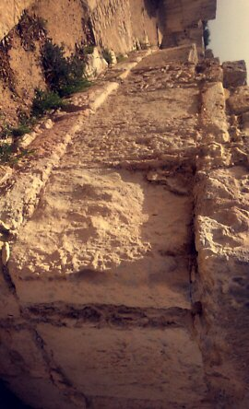
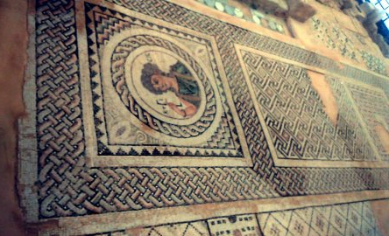
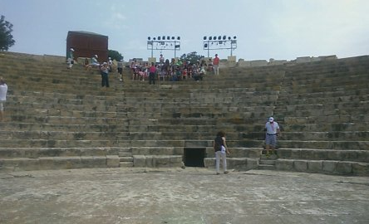
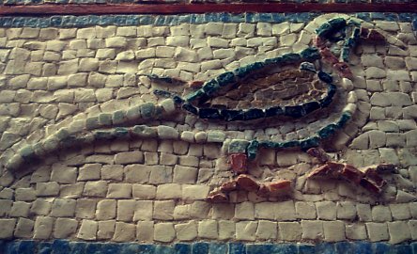
Photos from museum and we were in an ancient theatre

Slide 6
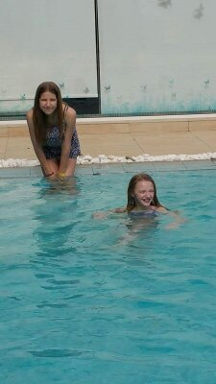
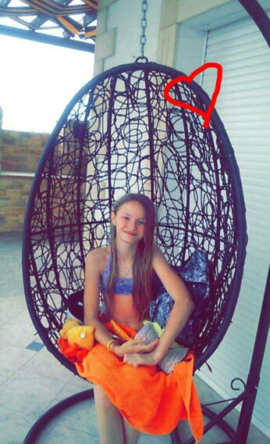
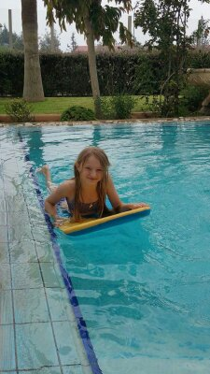
DAY 3
On Tuesday we learnt how do to robots. Then we went to Nicole’s grandma’s swimming pool.

Slide 7
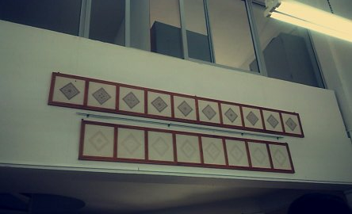
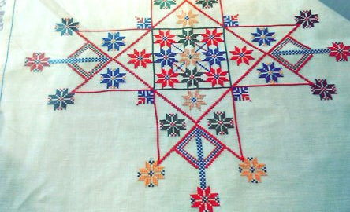
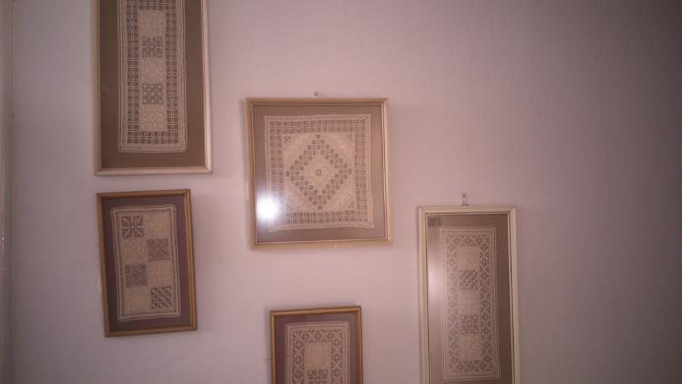
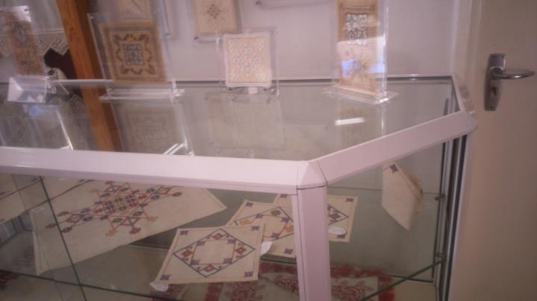
DAY 4
On Wednesday there was a tour to Nicosia . We were in a museum of hand made things.

Slide 9
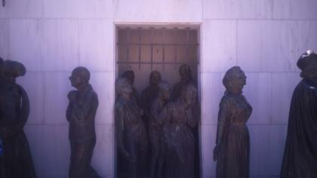
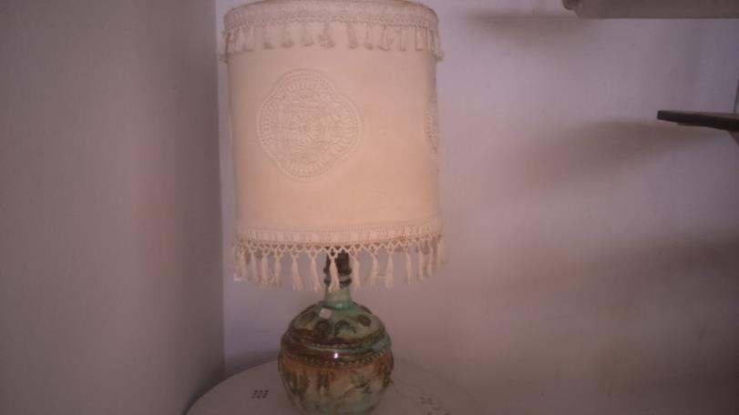
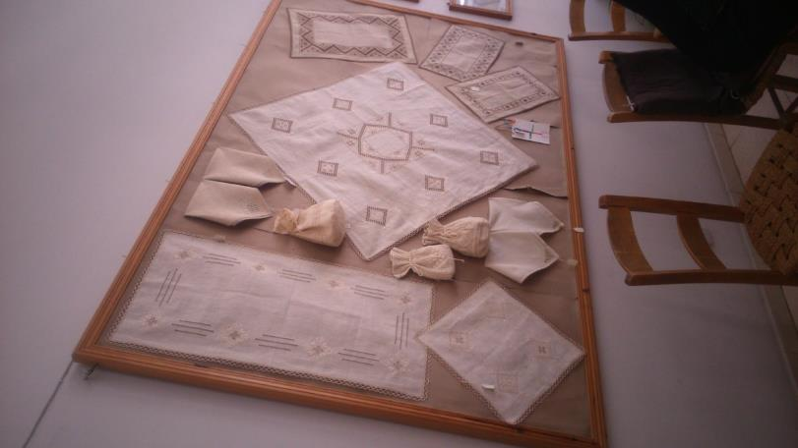
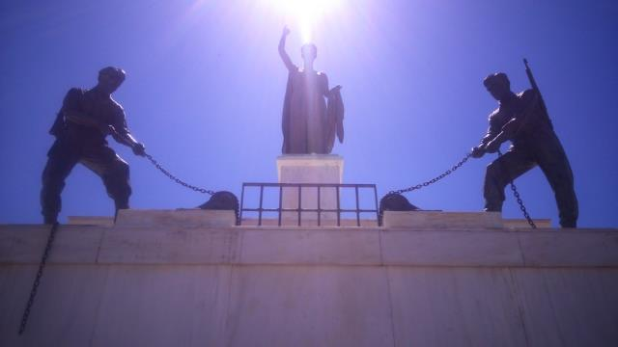
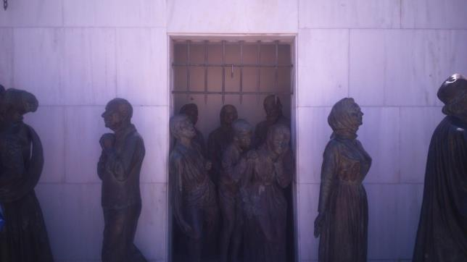
Robiłam zdjęcia po kolei każdej sali, do której wchodziłam.

Slide 11
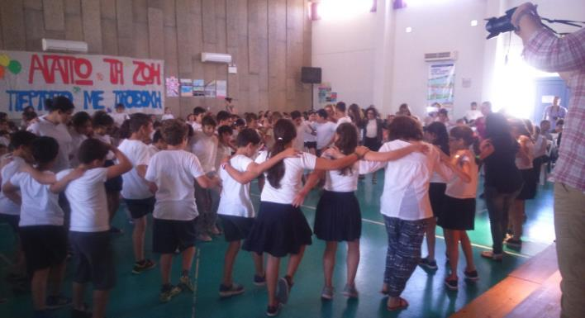
DAY 5
On Thursday we were on the beach. After we went to JUMBO.
6 DAY
On Friday we taught other students how play our games. There was Greek music, too.

Slide 12
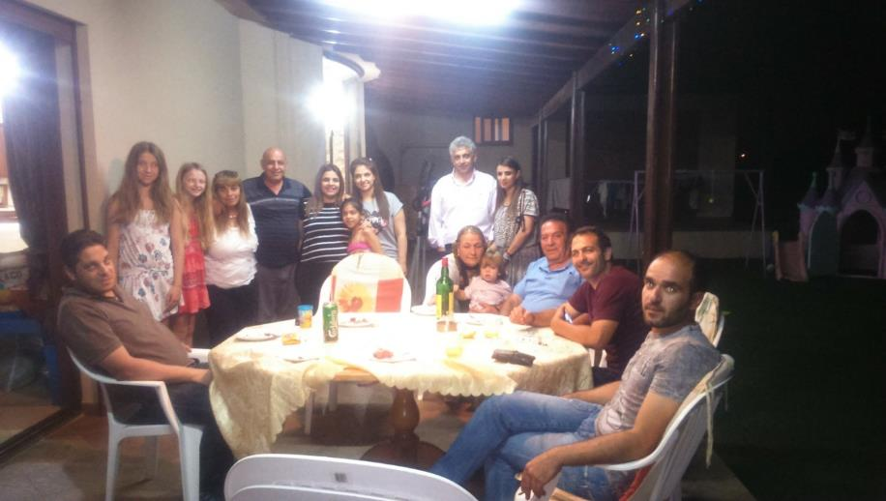
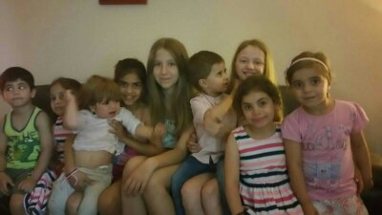
DAY 7
On Saturday it was Constantino’s birthday, he is Nicole’s brother.

Slide 13
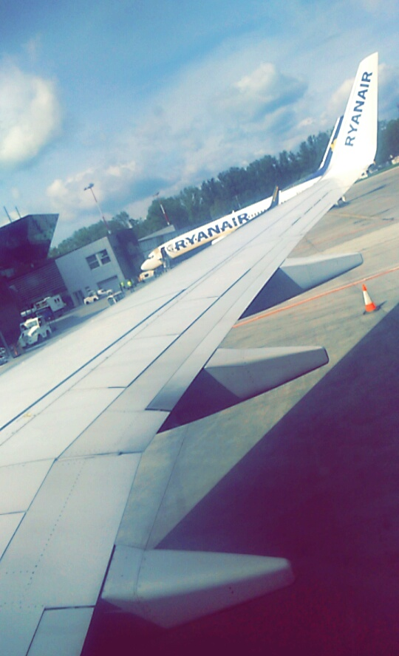
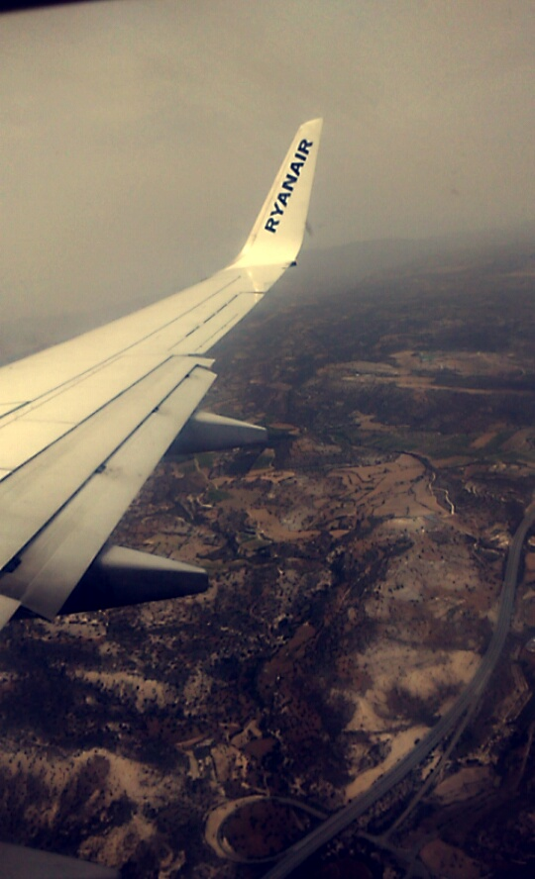
DAY 8

Slide 14
THANK YOU FOR WATCHING
Amelia Stapińska

