Slide 1
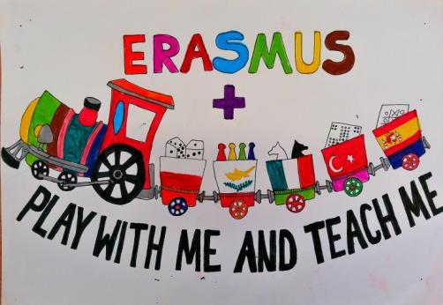
Multiplication Domino
Erasmus+ KA2
Dimotiko Scholeio Germasogeias
Teacher: Elena Prodromou
May 2016

Slide 2
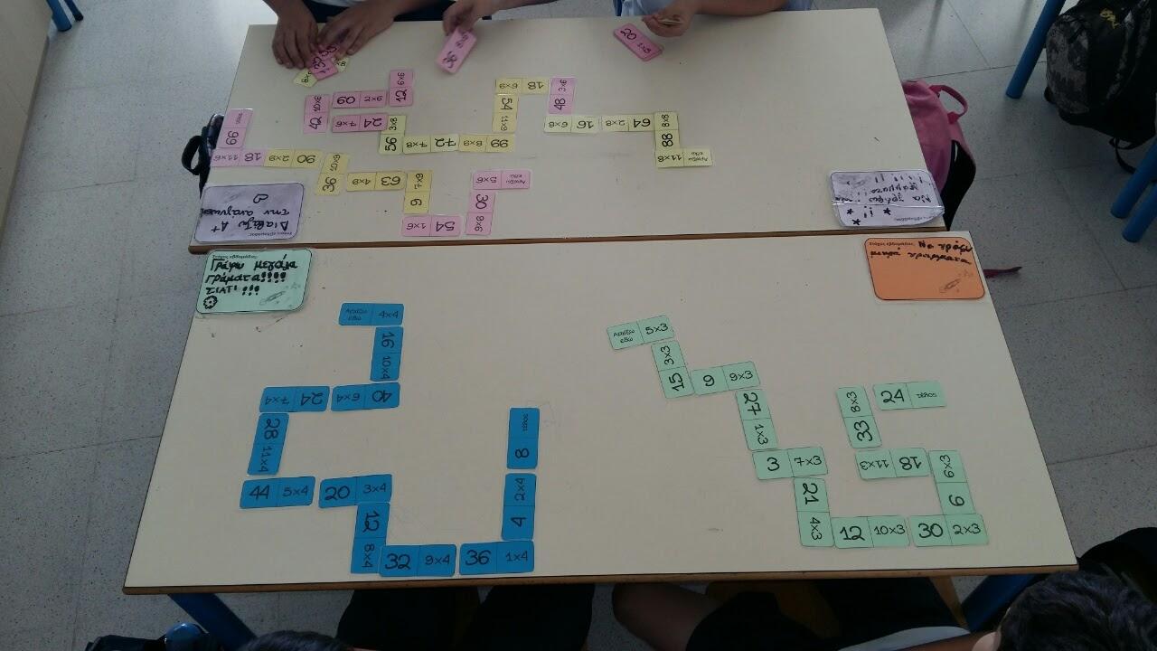
Multiplication Domino
Subject: Maths
Grades: 3-4-5
Goal: The students to learn the multiplications

Slide 3
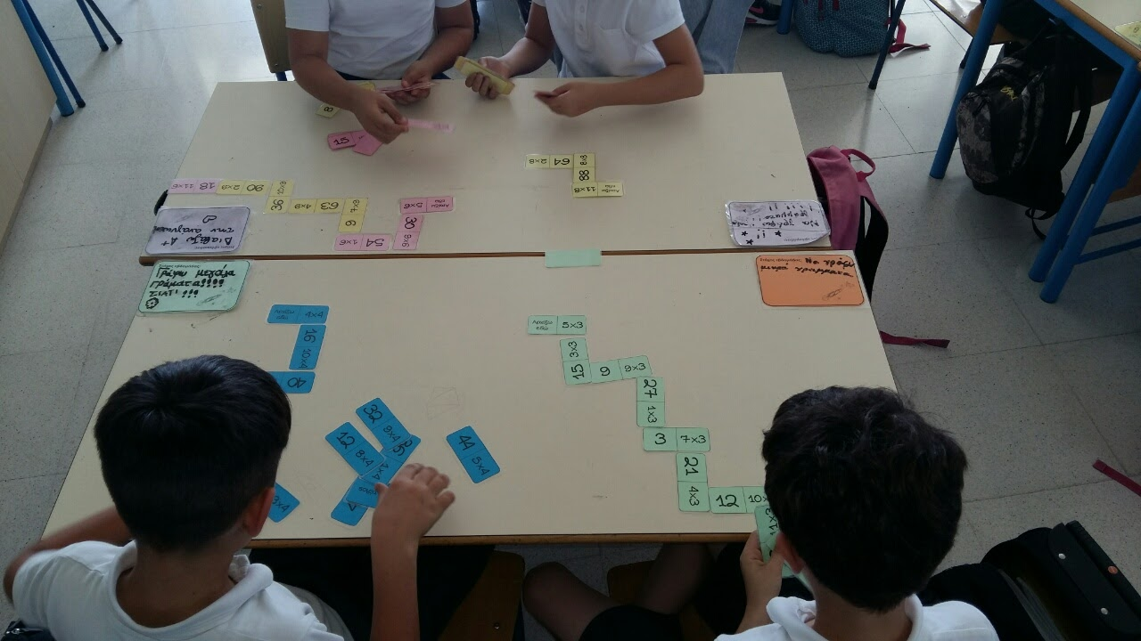
Activity
Each player gets a starting card.
The card has two parts: a Number and a Multiplication.
Then each player has to select another card that will fit to his/her starting card. By fit, we mean the Multiplication on his starting card to be equal to the Number on the other card selected.

Slide 4
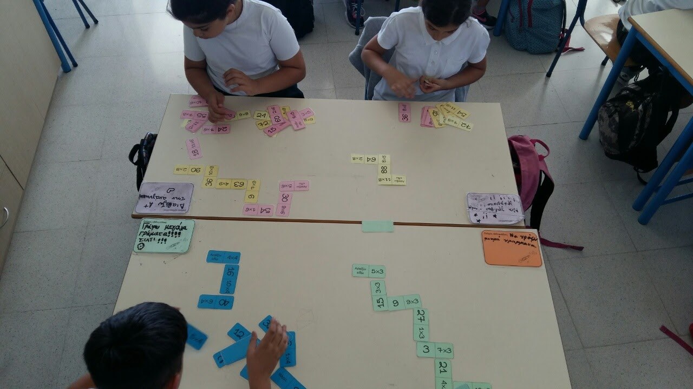
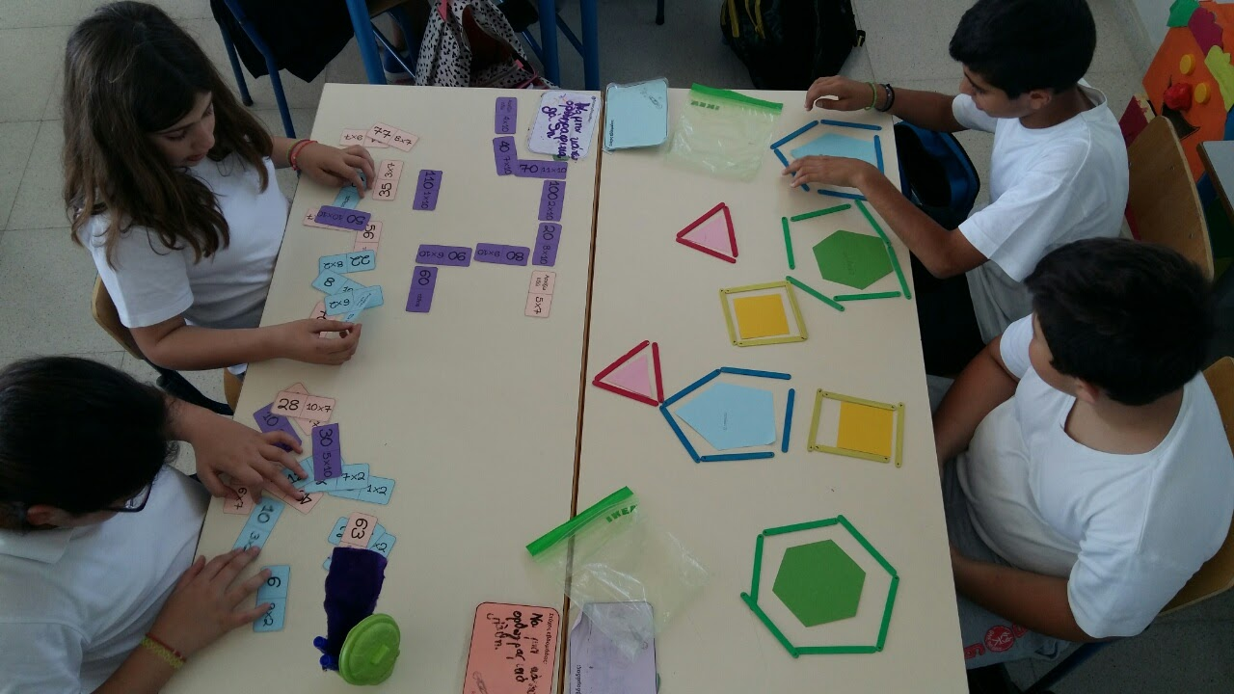
Activity
Then the player should continue to select more cards following the above rule
The aim is to build the biggest domino.

