Slide 1
" Play with me and teach me – tradition and modernity in active teaching”
DIDACTIC GAMES
REPORT

Slide 2
Type of the activity : Didactic game.
A working group at school has developed this game aimed at students in grade 6º .
The questions are related to the topics they study during the school year.
The question cards are in spanish and in english so we can play and learn in two languages.
Title: Are you good at Science?
Aims of the activity:
To reinforce Science skills through play.
To incentive the cooperative working.
To stimulate mental agility.
To respect and accept the rules of the game.

Slide 3
HOW TO PLAY
This is a game for 4 players (or four teams).
In this game there is a person asking questions.
You can play in spanish or in english.
RULES
Pupils roll the dice to start.
Roll the dice , move forward and answer the question.
The questions are related to different Science topics
If you land on blue box and you answer wrong, move back two spaces ;
If it is green ,three spaces; if it is brown , lose your turn.
At the final box you have to pass a test.
If you answer three wrongs questions you have to return to the beginning.
YOU NEED
Question cards, a game board , a dice , a place marker for each player

Slide 4
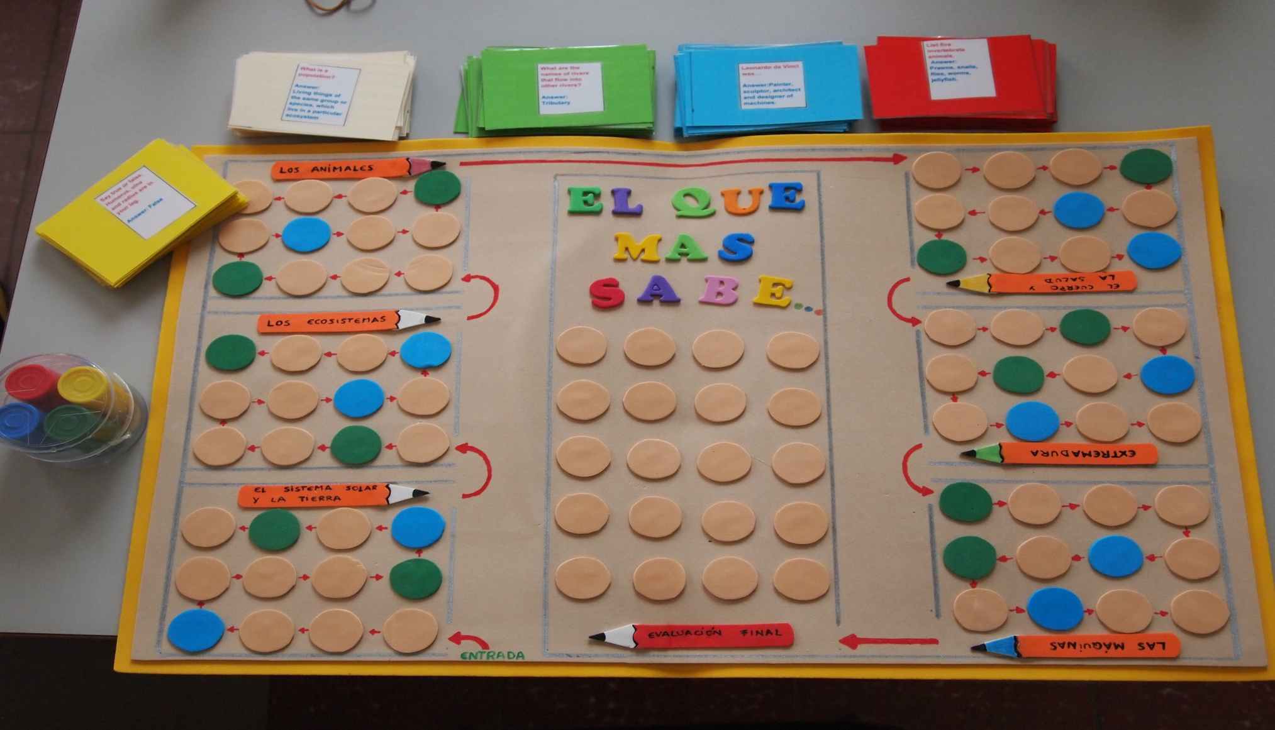

Slide 5
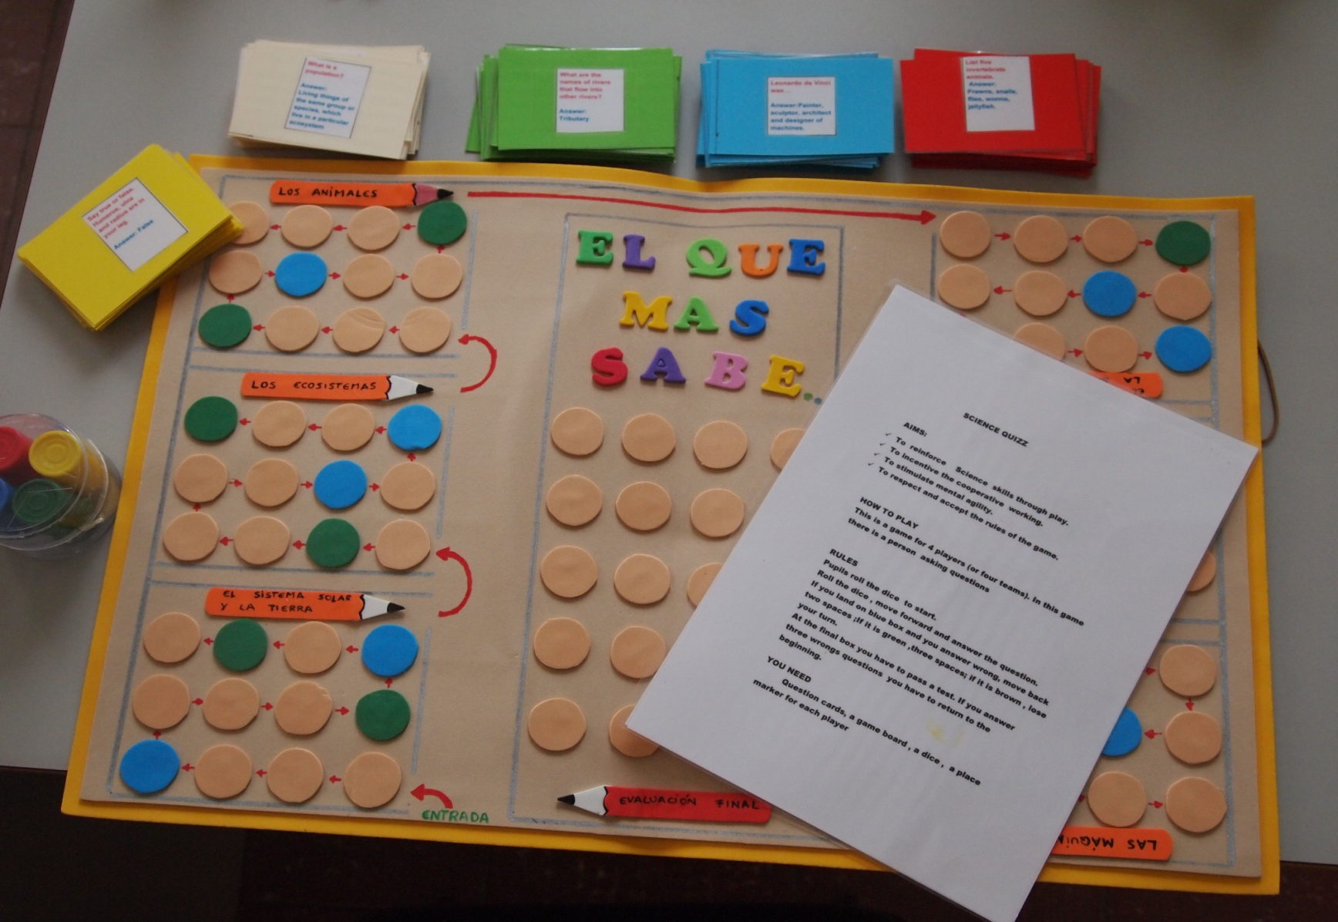

Slide 6
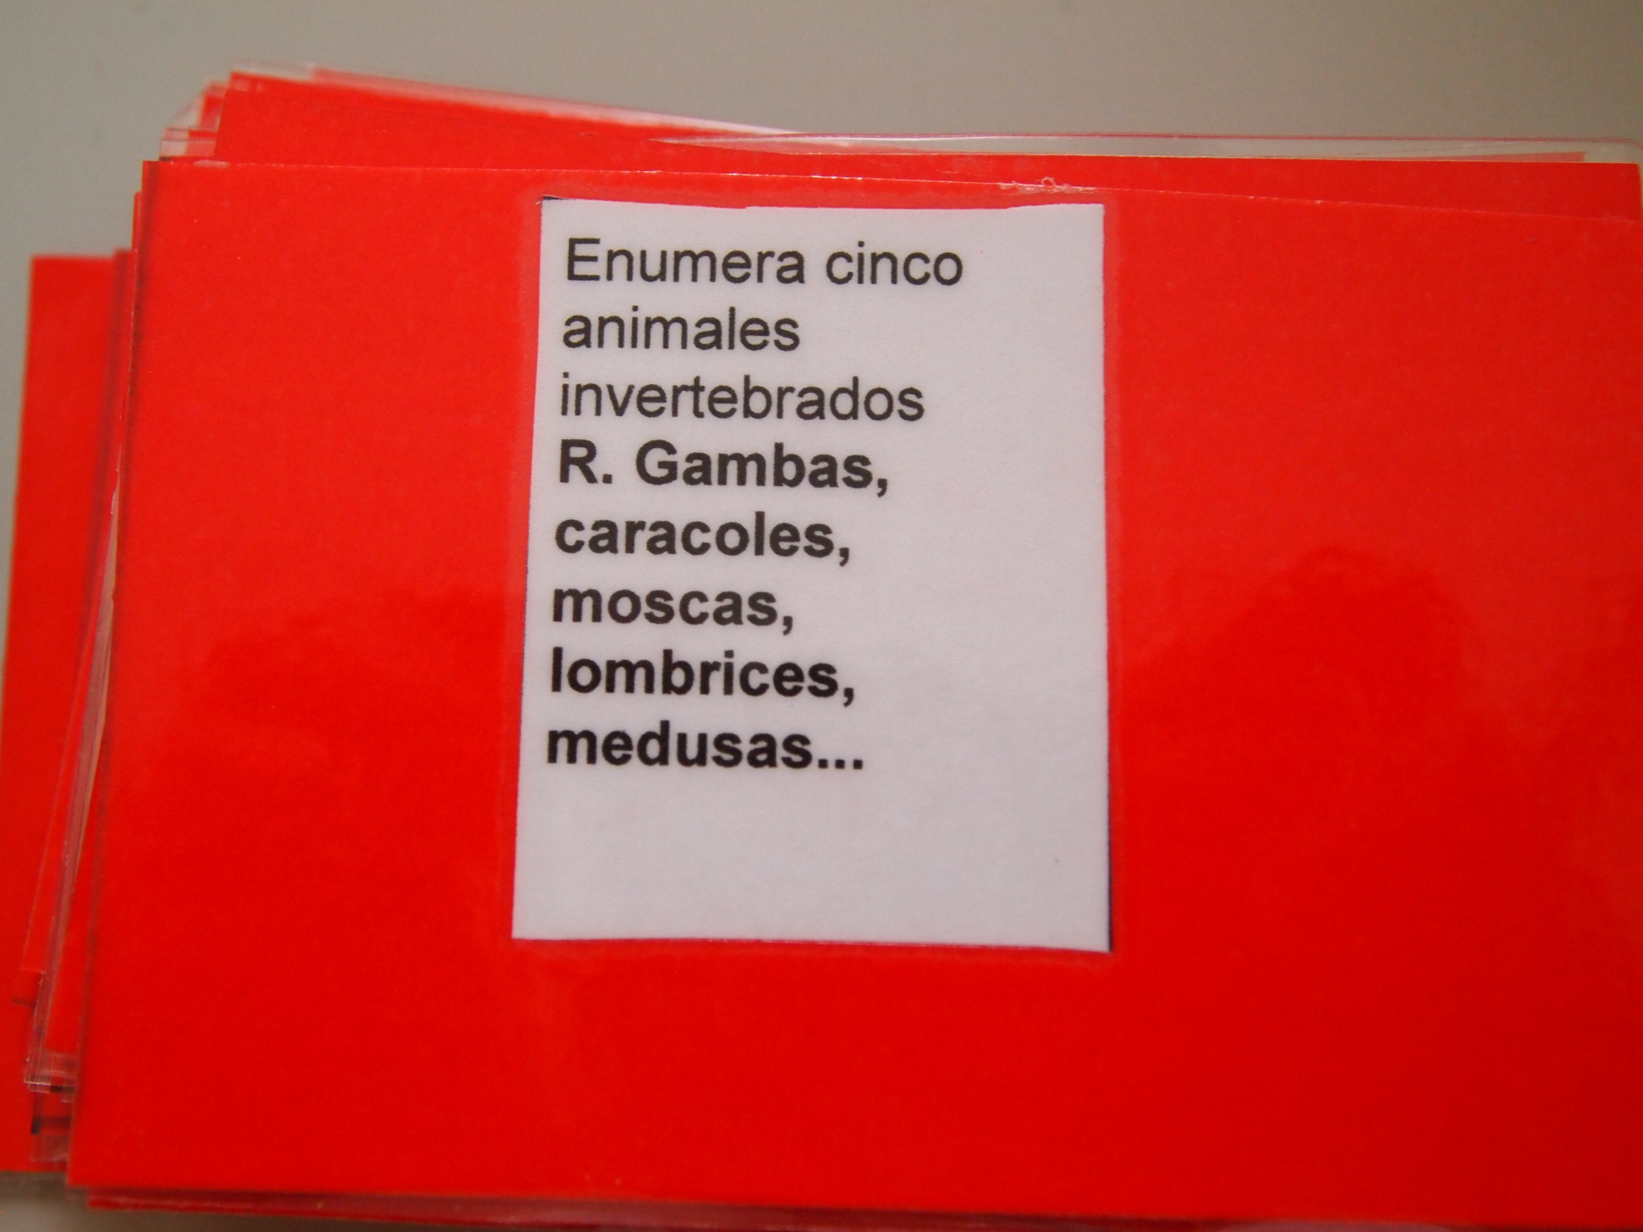
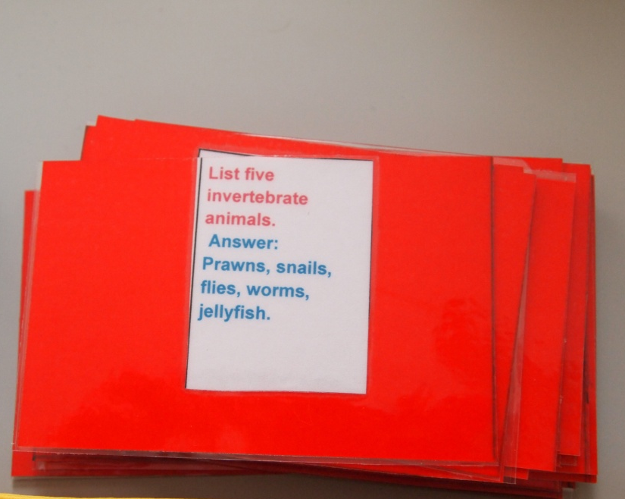
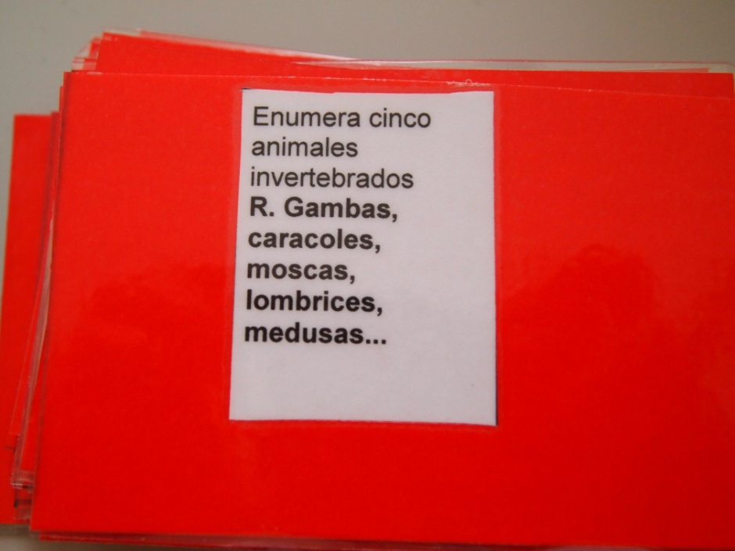
You can play the game in english or in spanish

Slide 7
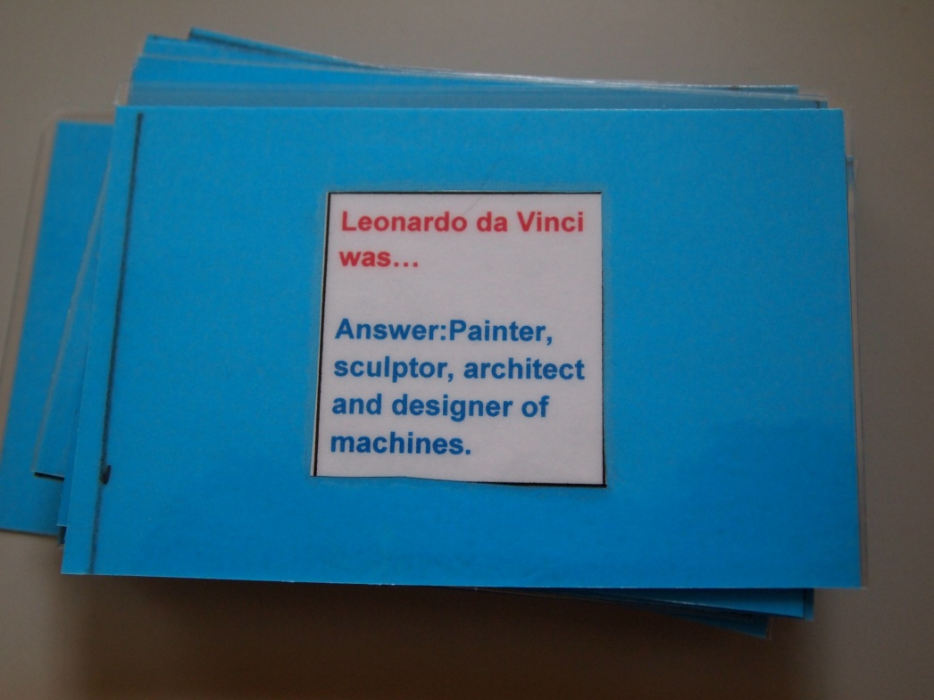
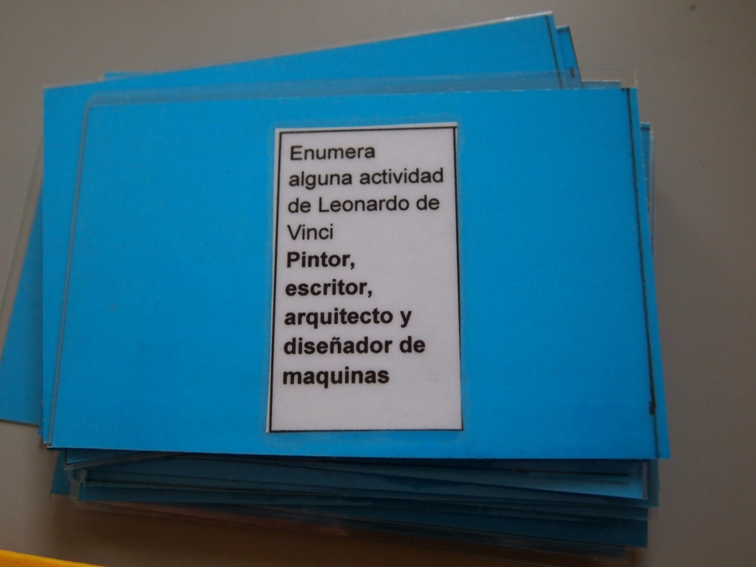

Slide 8
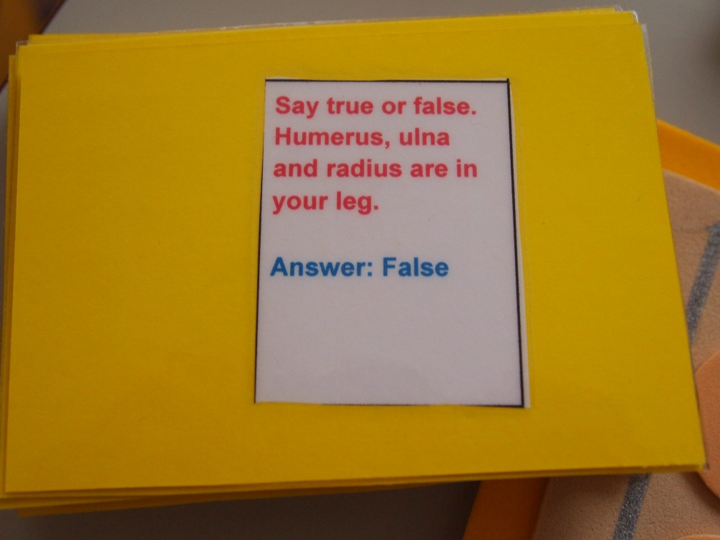
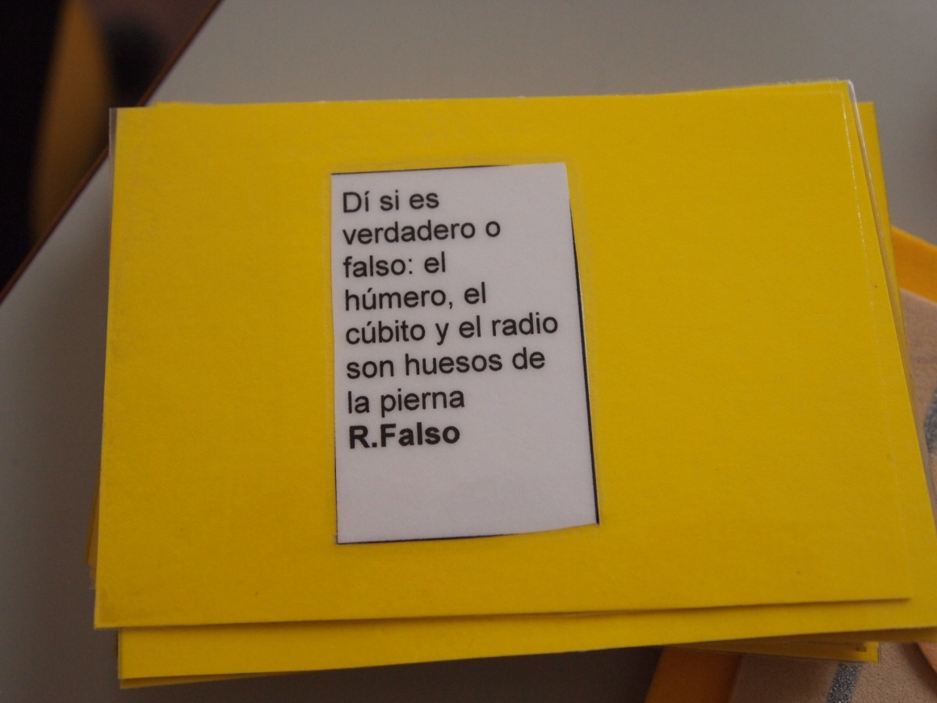

Slide 9
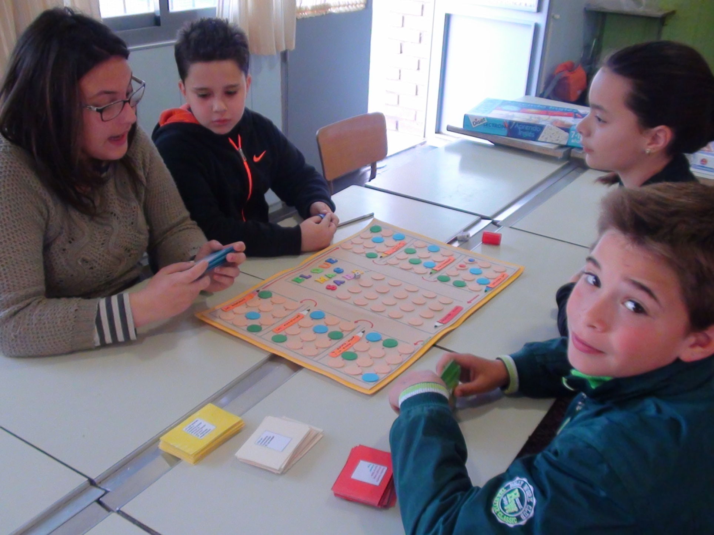

Slide 10
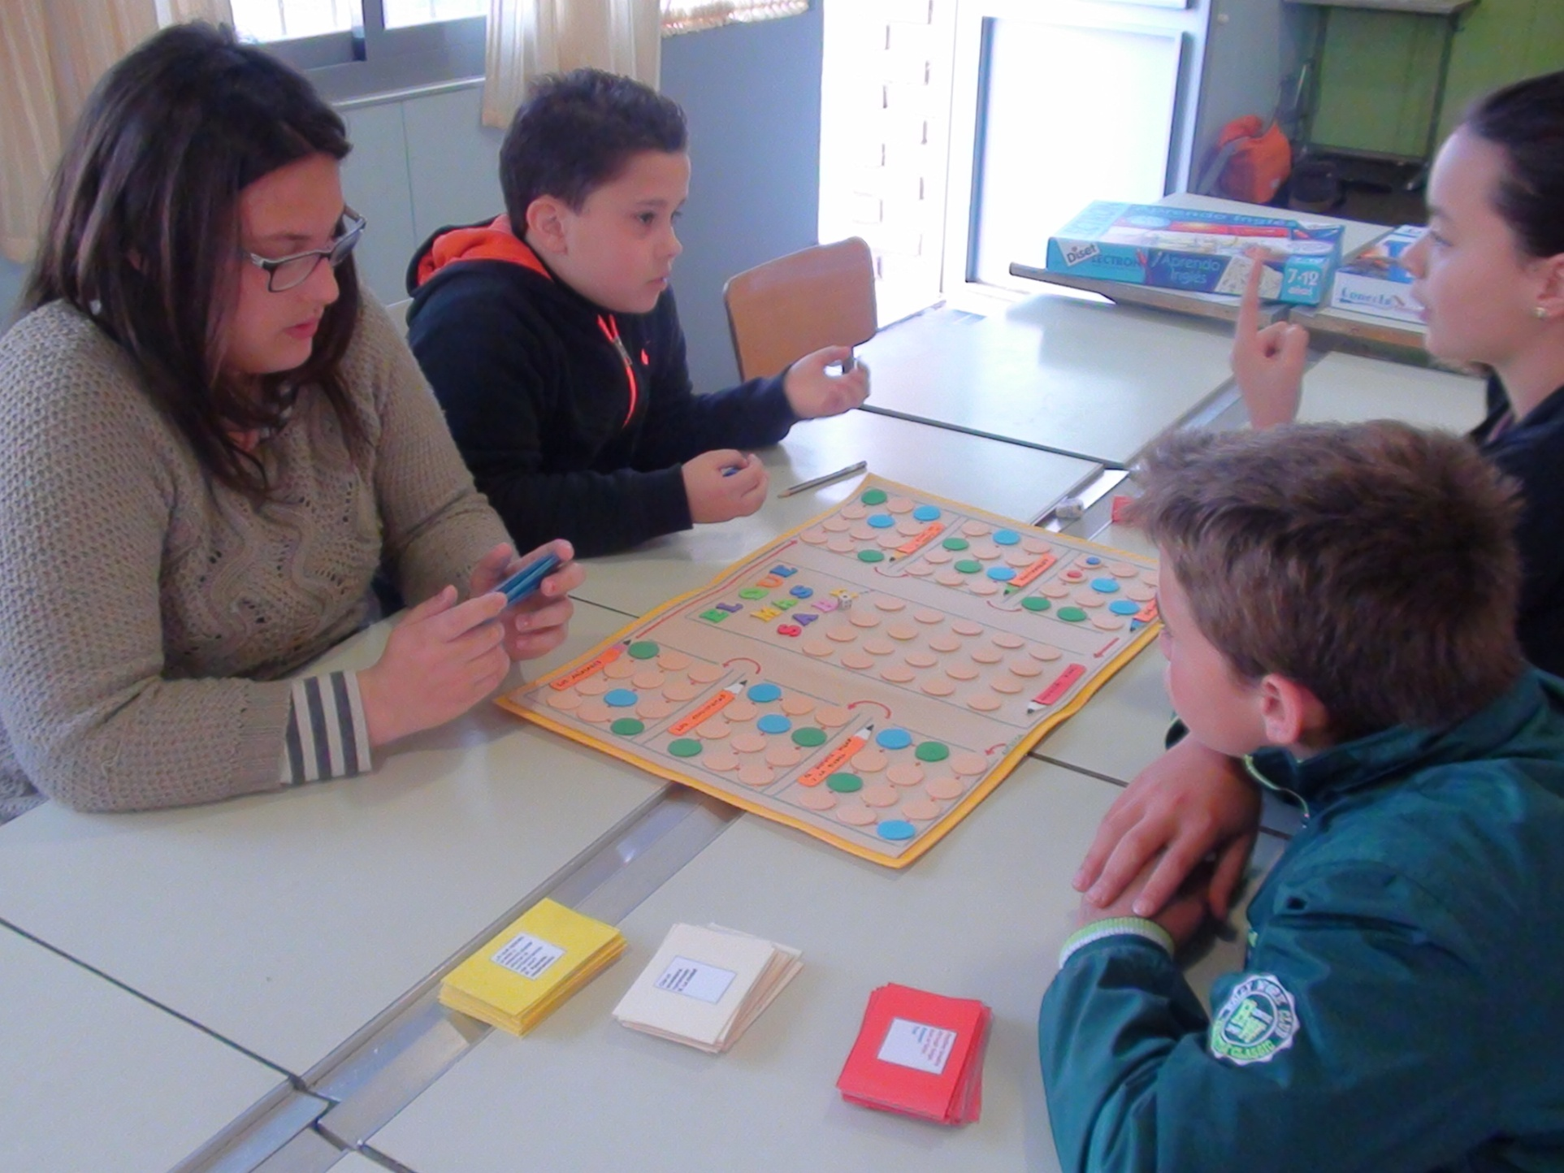

Slide 11
C.E.I.P. JOSÉ RODRÍGUEZ CRUZ
VILLAFRANCA DE LOS BARROS
SPAIN
SCHOOL YEAR 2015/2016

