Slide 1
" Play with me and teach me – tradition and modernity in active teaching”
DIDACTIC GAMES
REPORT

Slide 2
Type of the activity : Didactic game
Title: ABC WORD HUNTER
Aims of the activity:
To reinforce English skills through play.
To practice names of animals, foods and drinks, the house , the town .
To incentive the cooperative working.
To accept the rules of the game.

Slide 3
Description of the activity:
This is a spelling game for 2 or more players (or teams). Shuffle, and spread all the ABC cards out face down on the table between the players. Select a card at random. Pupils, as fast as they can, write down a wild animal, something to eat or drink, something at home and something around the town that starts with the selected letter.
You need:
A game board for every player or team, a set of abc cards.

Slide 4
How to play
1.- Shuffle and spread all the ABC cards out face down on the table betwwen the players.
2.- Select a letter at ramdom.
3.-Now , you must , as fast as you can, write down a wild animal, something to eat or drink, something at home and something around the town.
4,. The one that finish first counts: 5,4,3,2,1 then sjhout “Stop”.
5.- 10 points are awarded for each correctly spelled word.
If you or your opponent have the same word under one of the heading, only 5 points will be awarded if the word was correctly spelled.

Slide 5
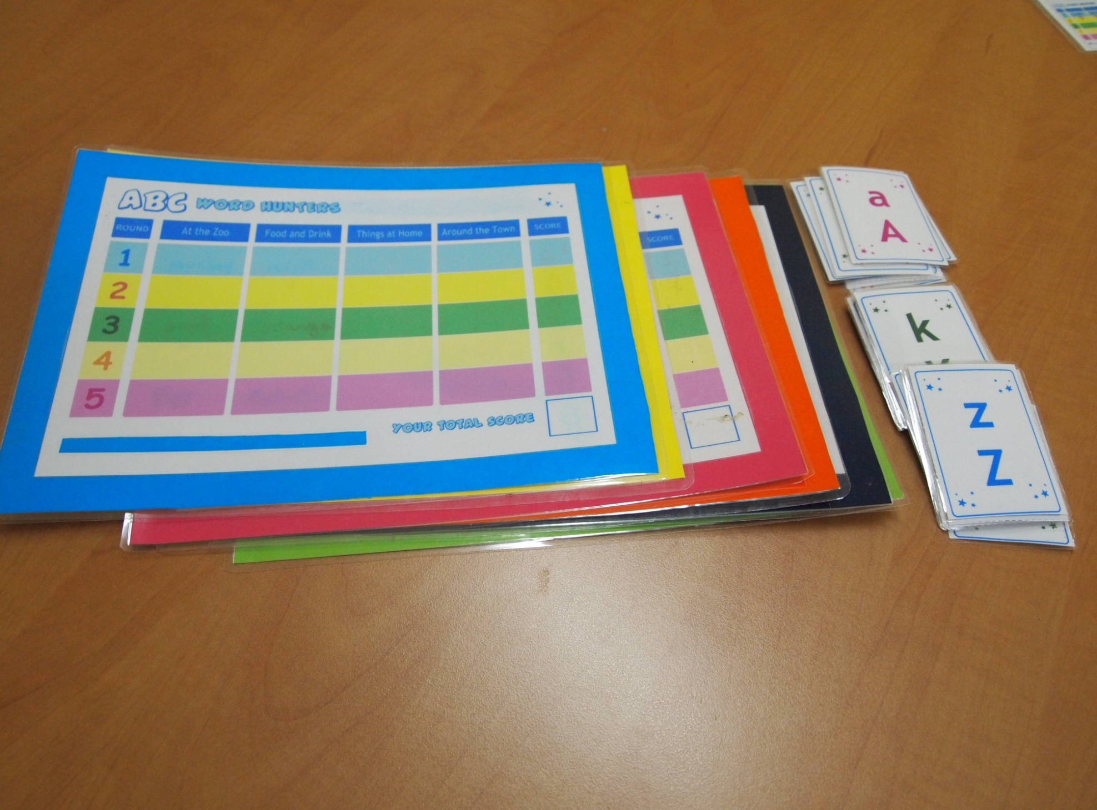

Slide 6
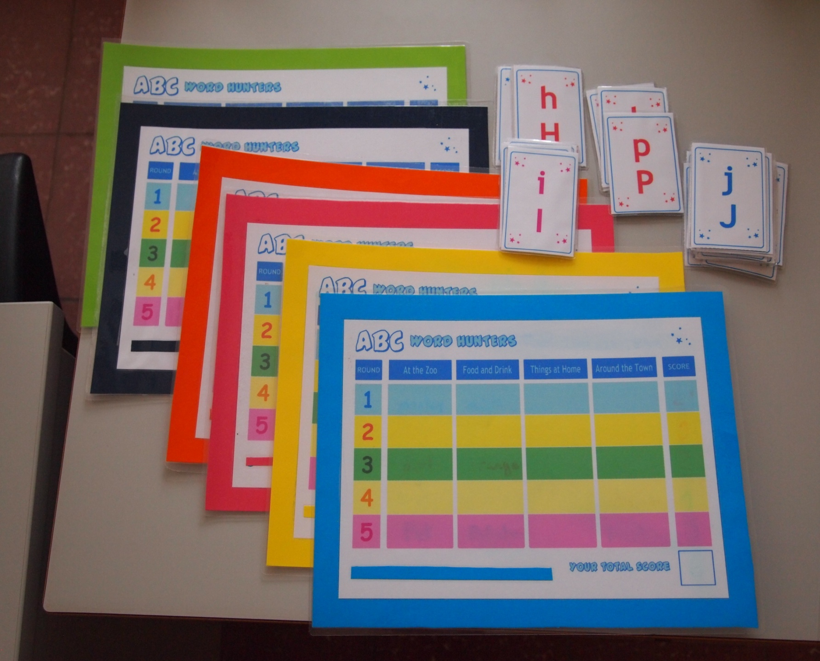

Slide 7
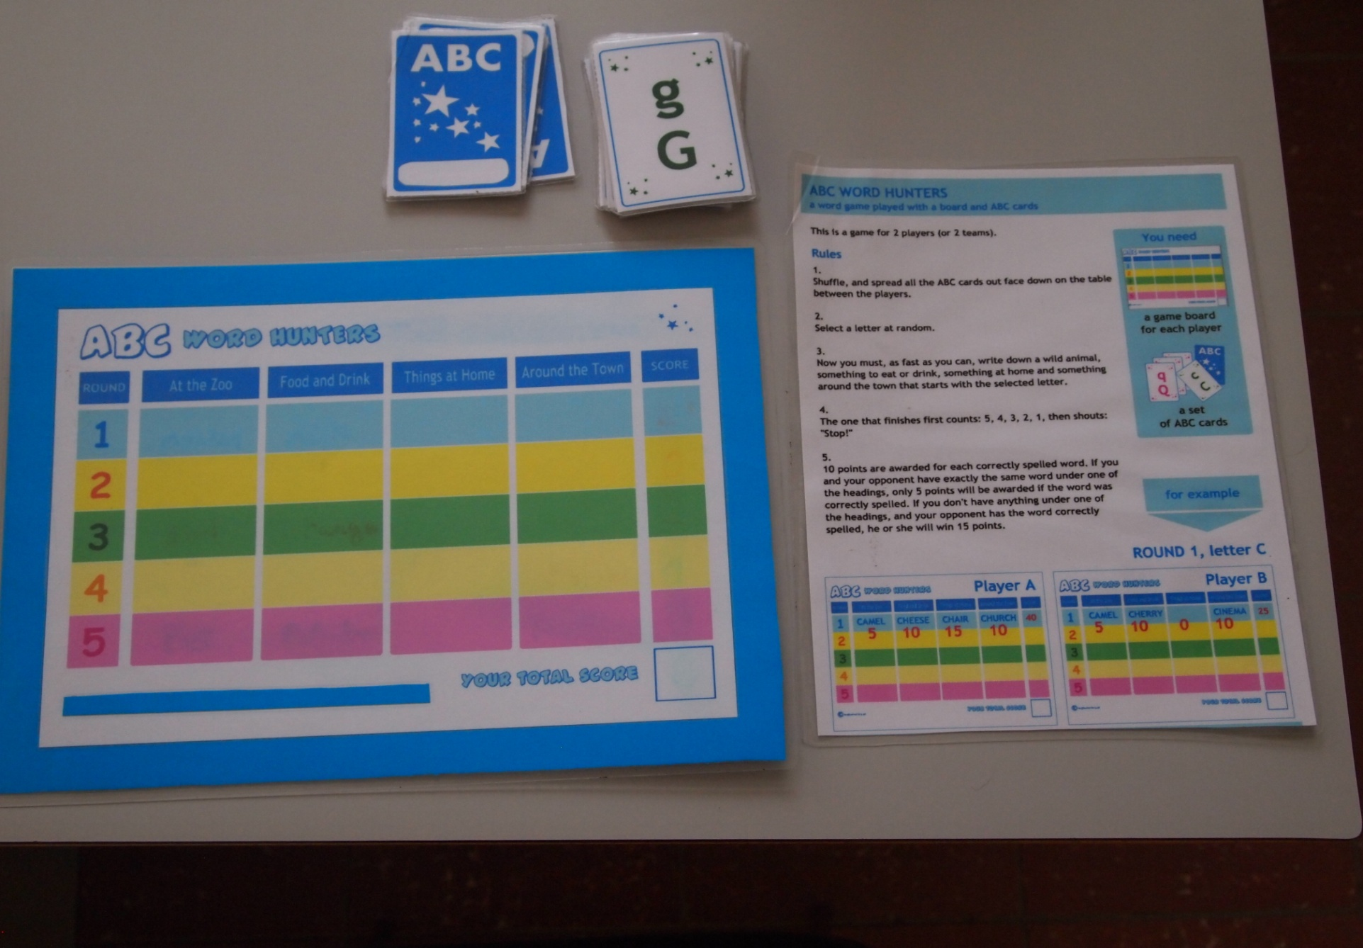

Slide 8
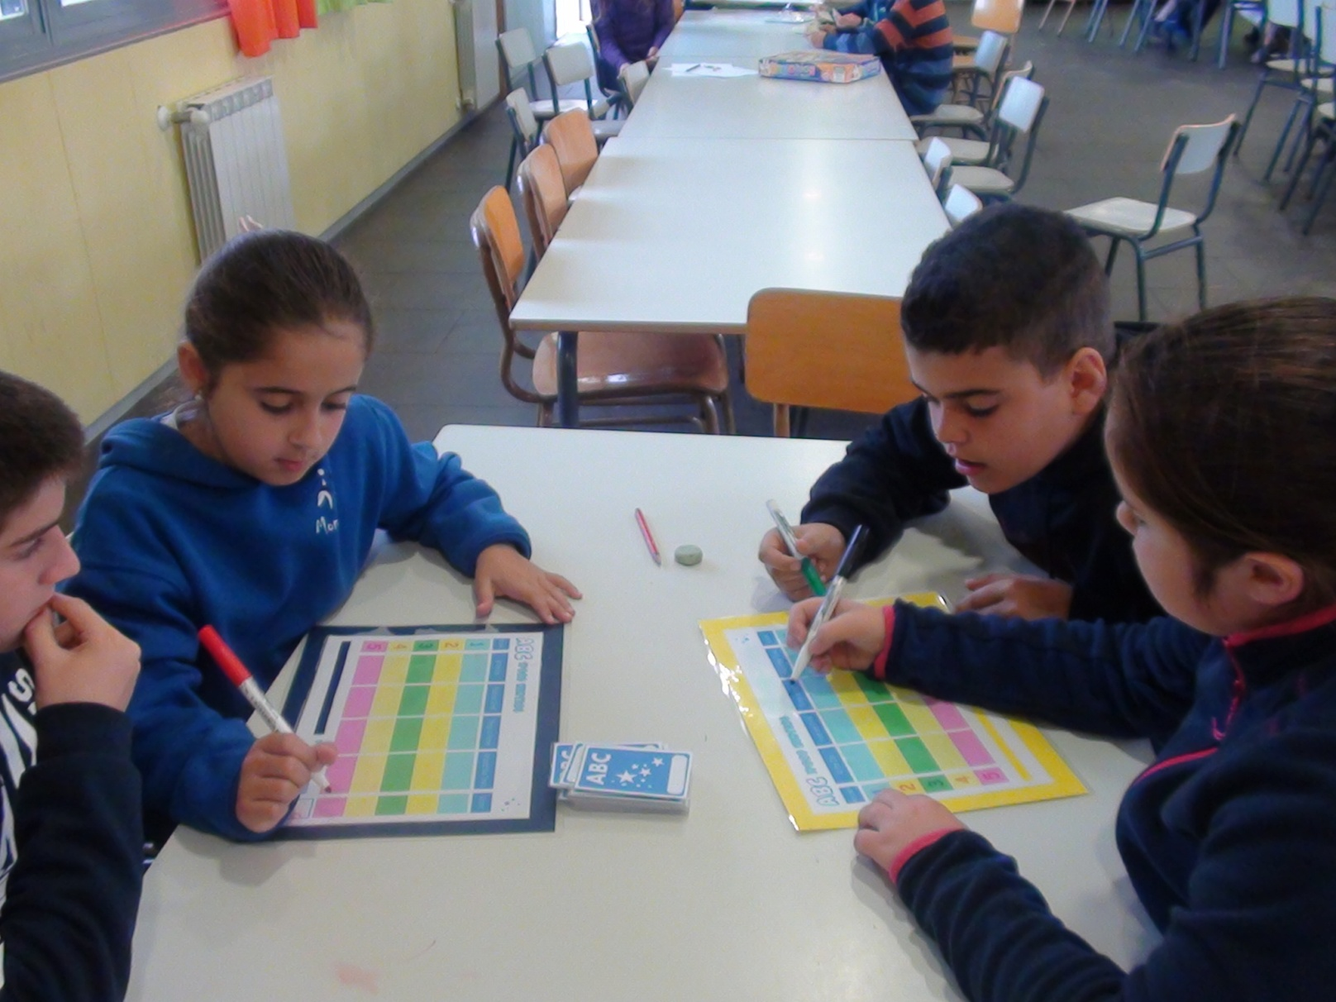

Slide 9
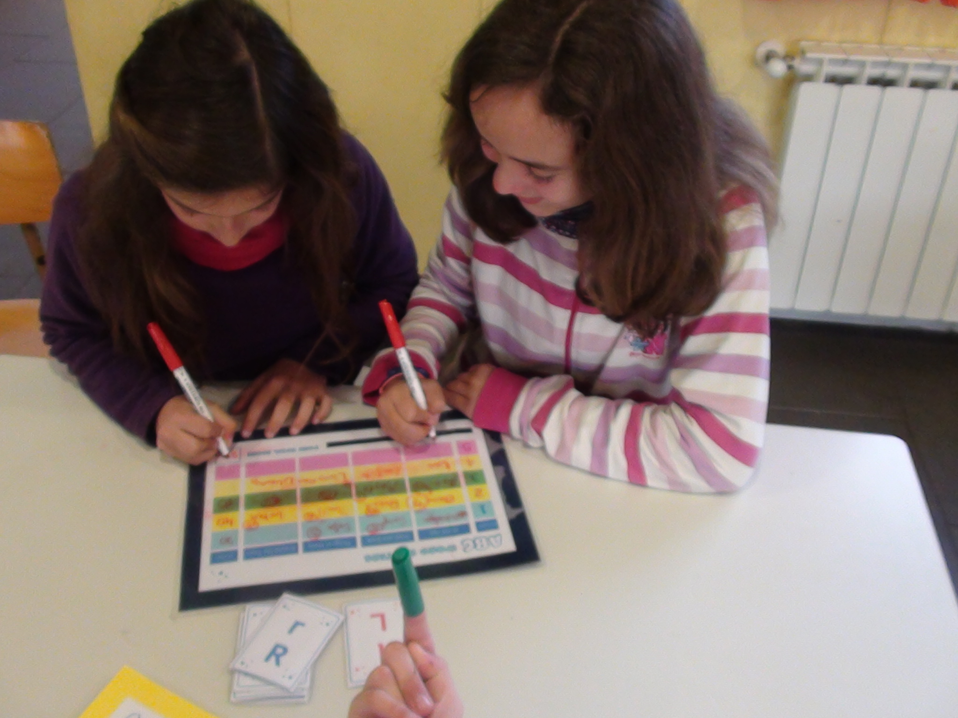

Slide 10
C.E.I.P. JOSÉ RODRÍGUEZ CRUZ
VILLAFRANCA DE LOS BARROS
SPAIN
SCHOOL YEAR 2015/2016

