Slide 1
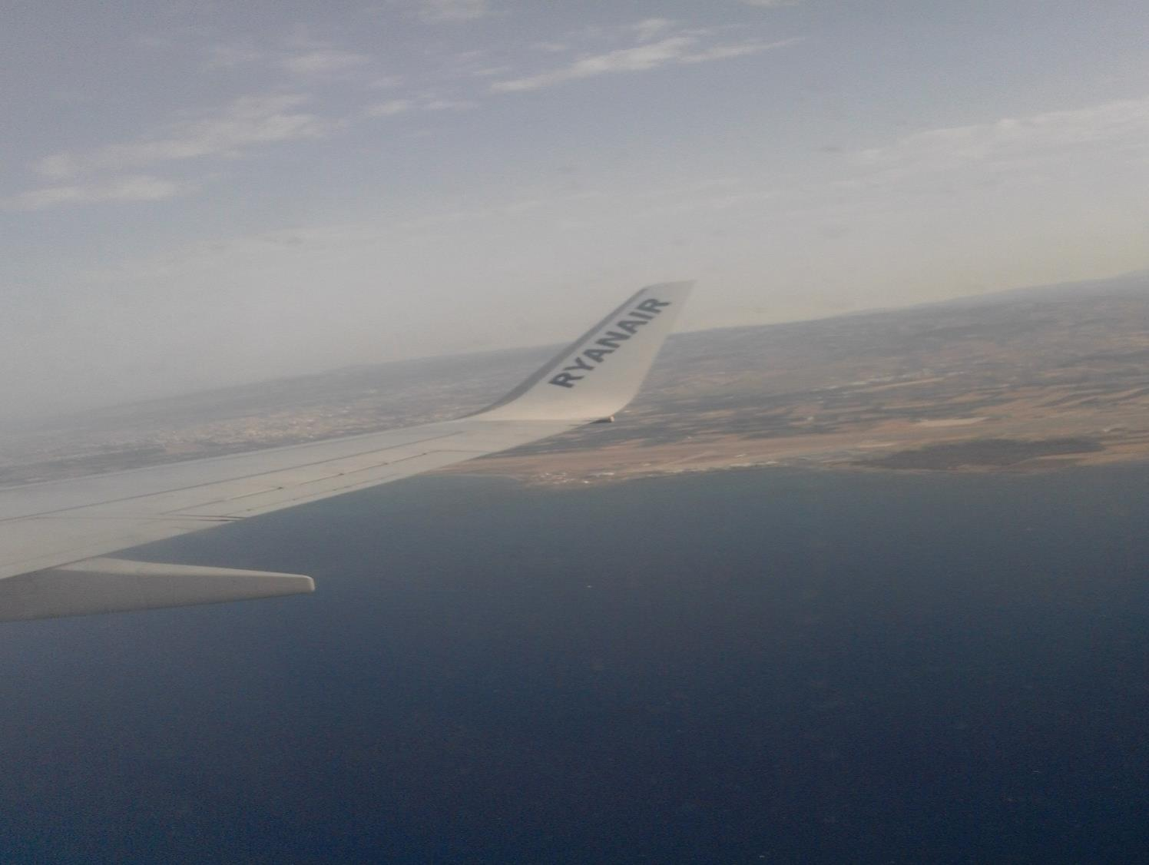
School trip to Cyprus

Slide 2
15th May, we arrived safely and we met our rommate.

Slide 3
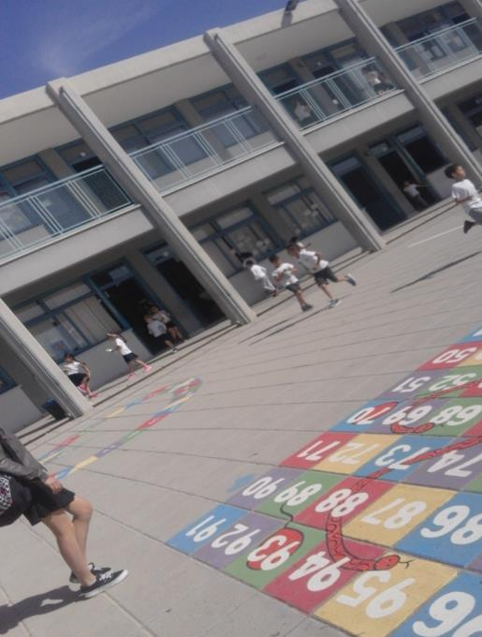
On Monday we went to school and we got to know the culture of Cypriots.

Slide 4
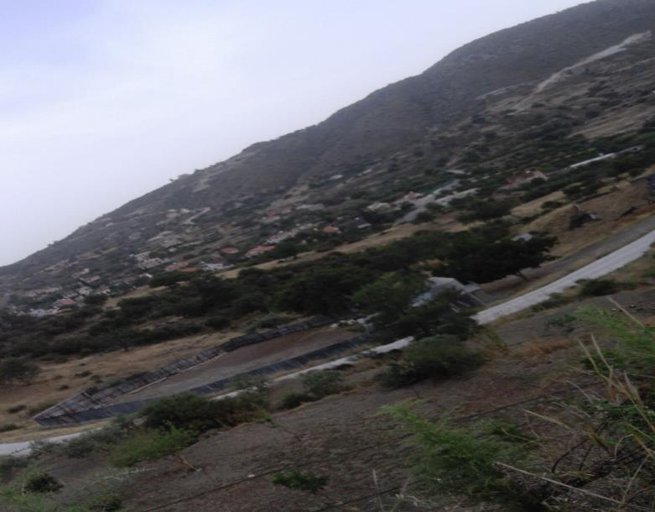
Here's mountainous landscape of Cyprus

Slide 5
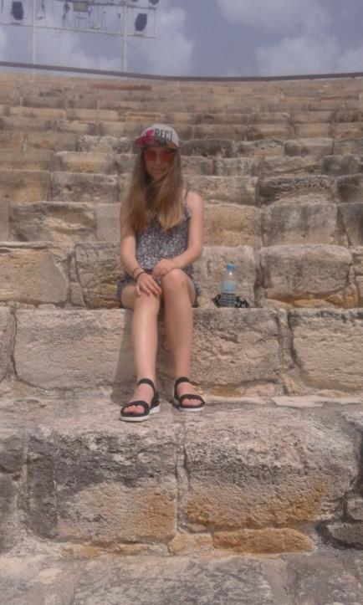
On Tuesday we visited monuments

Slide 6
On Wednesday we went to the school to construct robots with LEGO

Slide 7
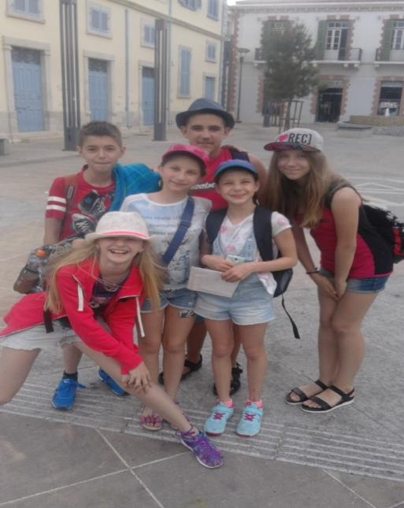
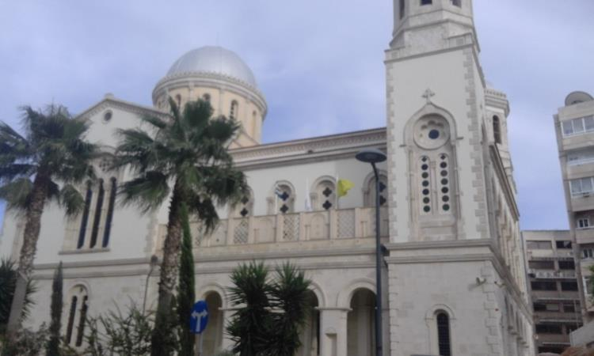
When we finished doing work, we went on a tour of the old Limassol

Slide 8
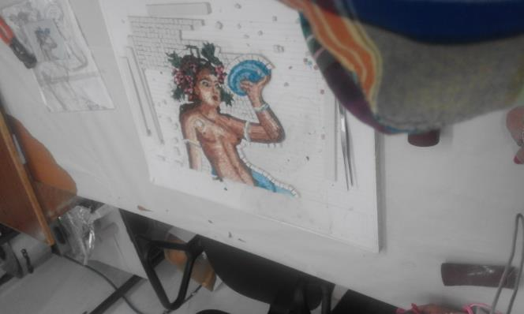
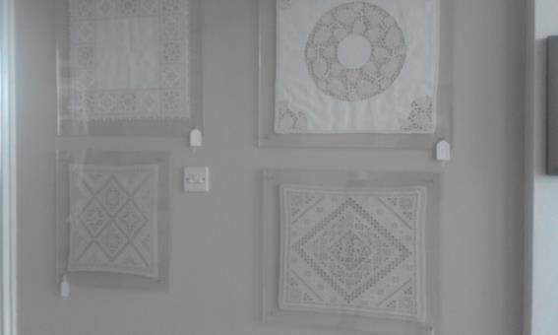
On Friday we again visited monuments

Slide 9
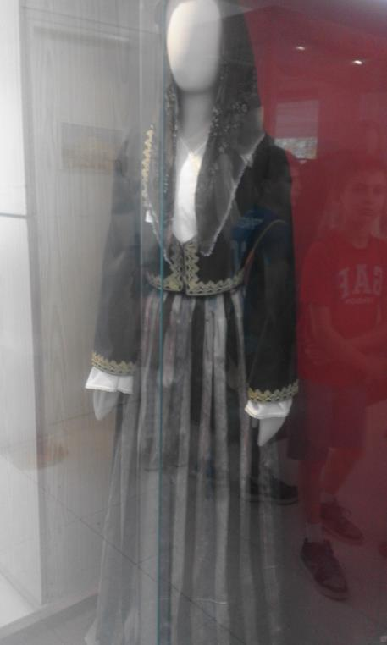
These are old regional costumes in Cyprus

Slide 10
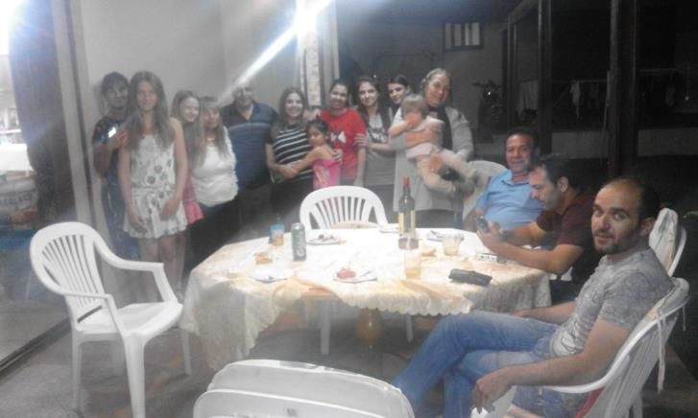
On Saturday we had a barbecue with family

Slide 11
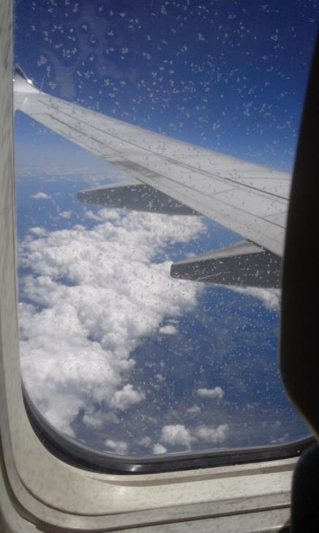
On Sunday we had to go back to Poland

Slide 12
Thank you for watching the presentation. MAJA PRAJSNAR

