Slide 1
CHESS TRAINING !
ARNETTA A.
Chess master of the world chess federation - FIDE

Slide 2
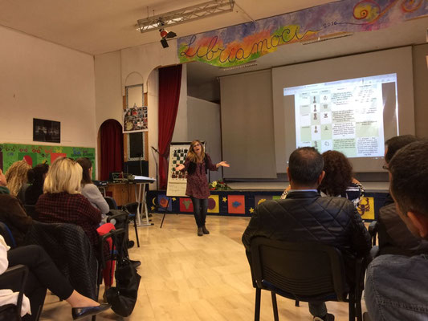
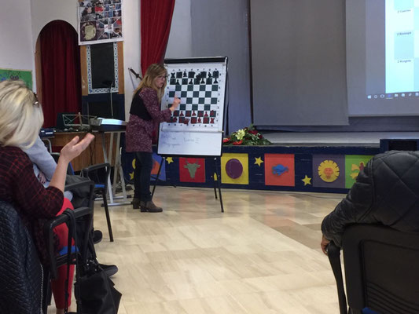
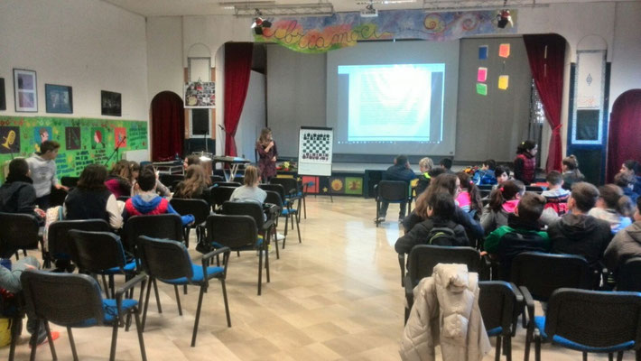
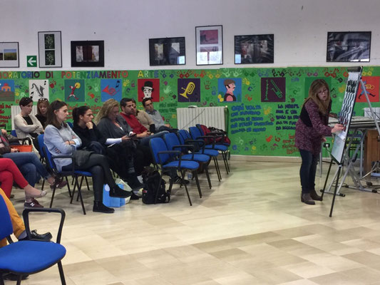
LET’S PLAY CHESS !

Slide 3
AIMS
learning to learn
learning by doing
problem solving
developing deductions and reasoning on it
working on lexical awareness on chess rules and moves

Slide 4
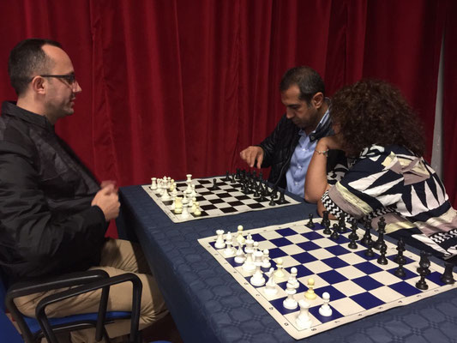
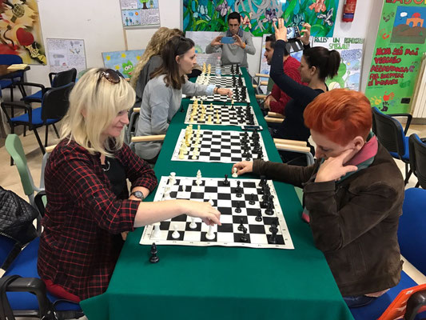
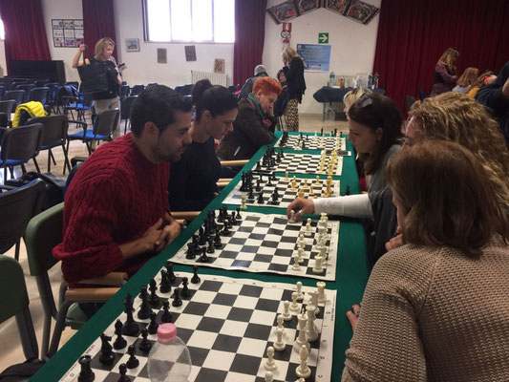
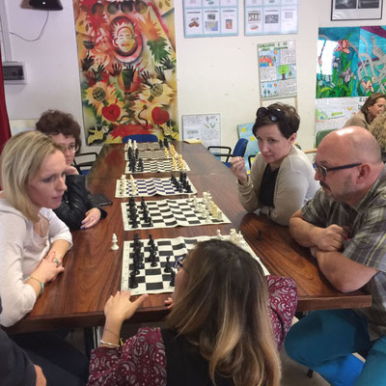
KING, QUEEN, ROOK, BISHOP, KNIGHT OR PAWN !!!
What is your next move??

Slide 5
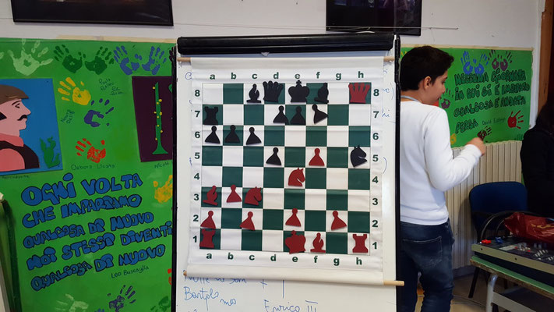
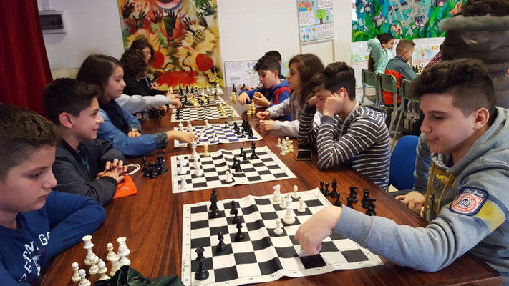
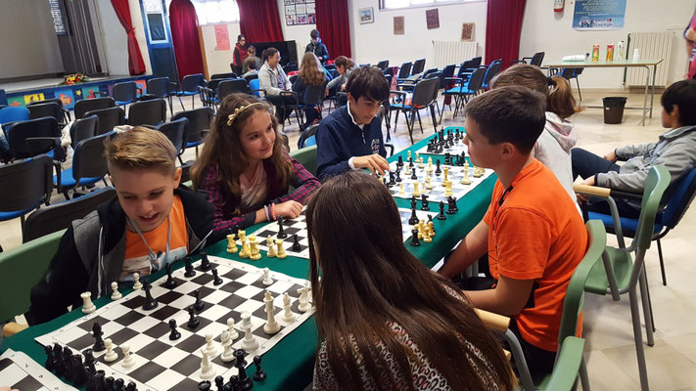
STUDENTS’ CHESS WORKSHOP

Slide 6
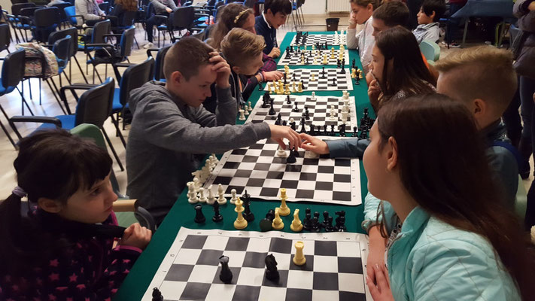
Improve your skills and challenge your friends!

