Slide 1
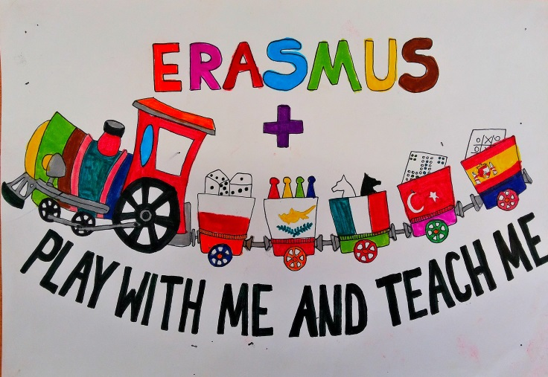
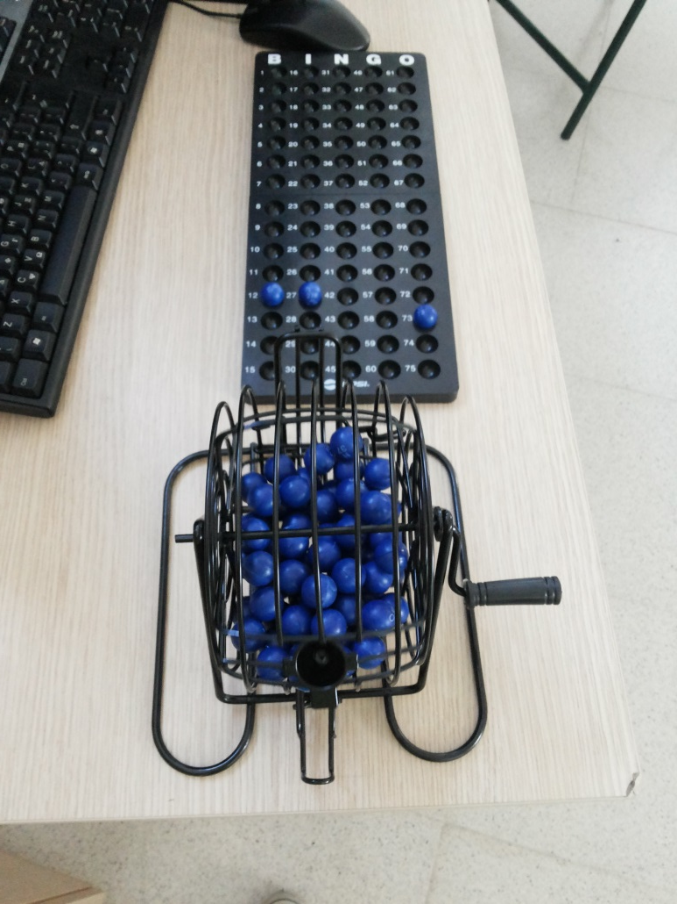
BINGO
Erasmus+ KA2
Dimotiko Scholeio Germasogeias
Teacher: Constantinos Constantinou
May 2016

Slide 2
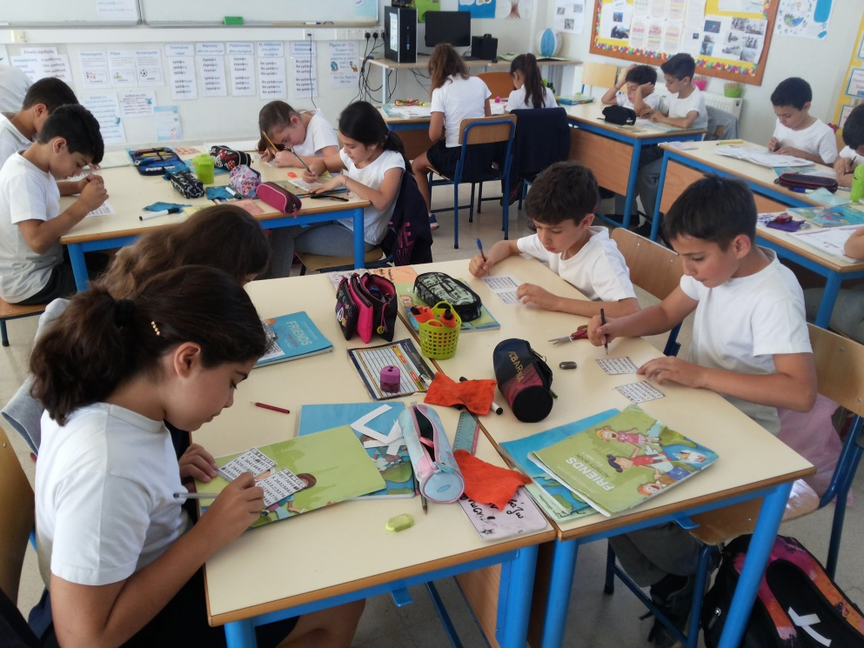
Bingo
Subject: English
Grades: 4-5
Goal: The students to learn the numbers up to 75. To recognize the numbers they hear and to say the numbers they see.

Slide 3
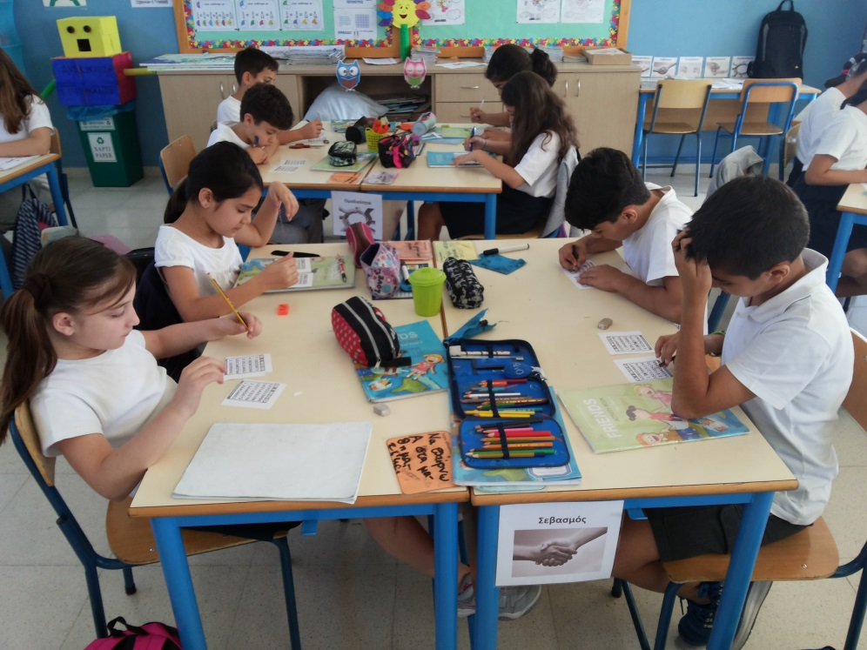
Activity
1. Every student has one or more cards with a 5X5 grid. Each card has 24 numbers which are random from the limits of 1 to 75. The center of the card is an empty space.
2. After that the game begins, and the caller selects numbers at a random and calls them. As soon as the caller calls one number, all the players mark it on their cards. The winner is determined when one or several of the players complete the winning bingo pattern. The pattern can be different. It can be a line, vertical, horizontal or diagonal or a full house depending on how much time we have.

Slide 4
Notes: The caller can be the teacher or a student.
Extension: Instead of calling the number, the caller (teacher or student) can call various math operations or even problems to indicate the number that came out.

