Slide 1
GAMES IN DIDACTICS
A kit that will make you play with your brain…
Host: Mr. Carlo Carzan
Translators: Mr. Antonello Saeli & Mrs. Mary Sancataldo

Slide 2
INSTRUMENTS
CONCENTRATION.
MOTIVATION.
GATHERING IDEAS.

Slide 3
METHODS
PLAYFUL TEACHING.
LEARNING TO LEARN.

Slide 4
ABILITIES
MEMORY.
LOGIC.
OBSERVATION.
ATTENTION.

Slide 5
MEMORY
THERE ARE TWO INTERCONNECTED MENTAL FACULTIES IN OUR BRAIN, THAT NEED TO BE TRAINED:
MEMORY: stores any information, and gives it back when needed.
INTELLIGENCE: elaborates the information.

Slide 6
LOGIC
LOGIC IS A BRANCH OF LEARNING THAT DEALS WITH THE WAY PEOPLE SHOULD THINK RATIONALLY.
WE NEED LOGIC TO SOLVE ANY KIND OF PROBLEMS IN OUR EVERYDAY LIFE. FOR EXAMPLE, WE NEED IT TO UNDERSTAND HOW VIDEOGAMES, SMARTPHONES OR COMPUTERS WORK.

Slide 7
OBSERVATION
PEOPLE USUALLY DECODE IMAGES AND FORMS IN DIFFERENT WAYS.
OUR BRAIN IS ABLE TO IDENTIFY THINGS, BY USING JUST A FEW CLUES.

Slide 8
ATTENTION
WHY IS IT SO HARD TO STAY FOCUSED?
FIRST OF ALL, MOTIVATION: IT IS QUITE NORMAL TO GET BORED OF SOMETHING AFTER A WHILE, AND LOOK FOR AN ALTERNATIVE. THIS MAY HAPPEN NOT ONLY WHILE STUDYING, BUT ALSO WHILE DOING SPORT, PLAYING AROUND, OR READING A BOOK.

Slide 9
Ruzzle
Quadro
Picasso
Elenco distrattori
Immagine
Sport
Allegra fattoria
Zip zap
Lettura
regola
mento
MAP OF DIDACTIC GAMES, USED DURING OUR COURSE WITH MR. CARZAN.
Treno cotto
Schiaccia
Mosche
Acrostico
Parole
colorate
Passeg
giata
Looney quest
Contare da 1 a 100
Racconto in coppie
Sei parole
abbinate
Monster
Gala
Disturba
tore
bottoni
Raffica di parole in un testo

Slide 10
LOONY QUEST
Number of players: 2 – 5
Playing time: 20 minutes
Age: 8+

Slide 11
IN THE WONDERFUL LAND OF ARKADIA, A VERY OLD KING HAS NO HEIR. HE ORGANIZES A TOURNAMENT TO OFFER HIS THRONE TO THE BRAVEST ADVENTURER OF THE KINGDOM. UP TO FIVE FINALISTS WILL WANDER SEVEN WORLDS FULL OF SURPRISES...

Slide 12
IN THE DRAWING GAME LOONY QUEST, PLAYERS STUDY CHALLENGING LEVEL CARDS, THEN TRY TO REPLICATE THE OUTLINE TO MEET TARGETS AND AVOID OBSTACLES ON THEIR TRACING SHEETS. ONCE FINISHED, PLAYERS PLACE THEIR SHEETS ON TOP OF THE LEVEL CARD TO SEE WHETHER THE DRAWINGS LINE UP WITH THE TARGETS THEY MEANT TO HIT — OR AVOID.

Slide 14
DIXIT
Number of players: 3 – 6
(up to 12 in the “Odyssey” version)
Playing time: 30 minutes
Age: 6+

Slide 15
PICK A CARD AND DESCRIBE A PHRASE, A SENTENCE OR A FEELING. OTHER PLAYERS MUST THEN CHOOSE ONE OF THEIR OWN CARDS THAT BEST FITS WHAT YOU’VE SAID. ALL CHOSEN CARDS ARE SHUFFLED AND REVEALED, WITH EACH PLAYER THEN GUESSING WHICH CARD WAS ORIGINALLY YOURS. IF THEY ALL GET IT, YOU WERE TOO OBVIOUS – NO POINTS FOR YOU! IF NONE OF THEM GET IT, YOU WERE TOO OBSCURE – NO POINTS HERE EITHER! GET AN EVEN BALANCE BY CLEVERLY APPEALING TO SOME PLAYERS’ MINDS BUT NOT ALL.

Slide 16
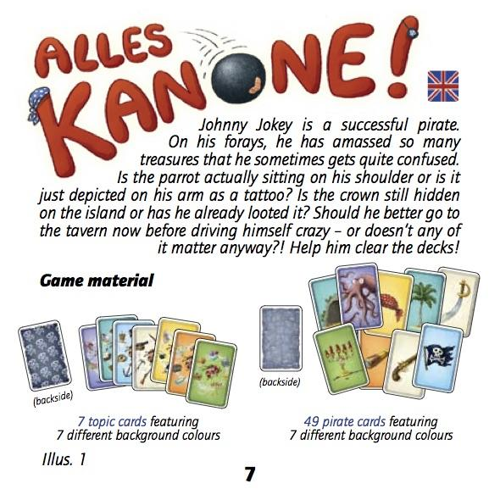

Slide 17
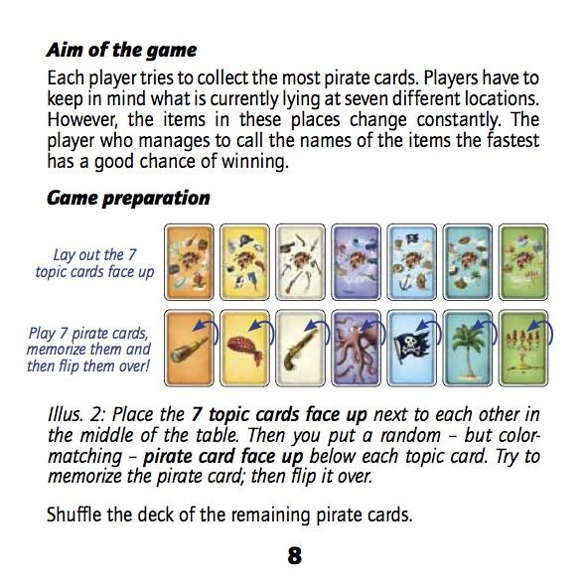

Slide 18
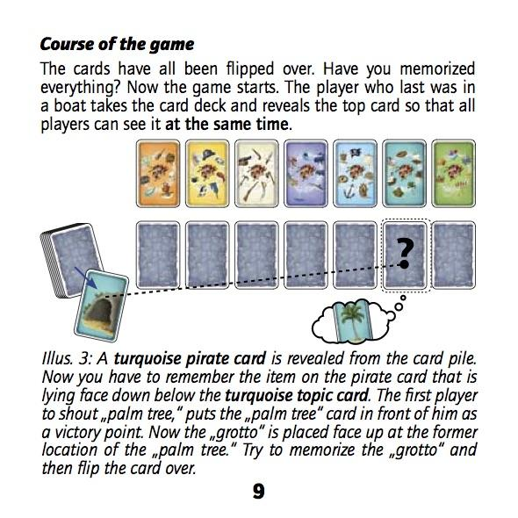

Slide 19
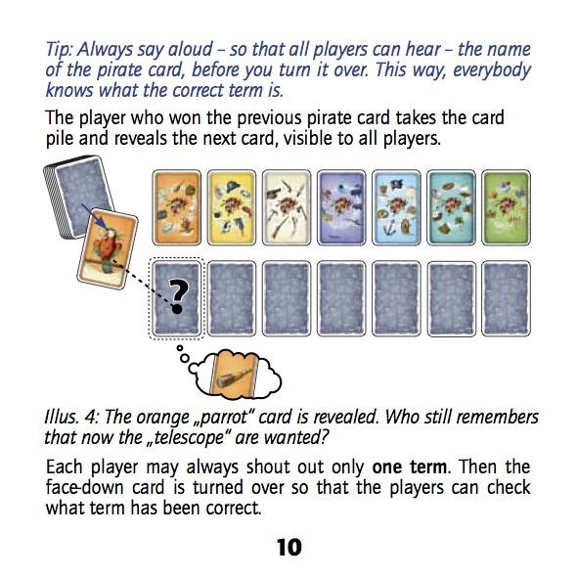

Slide 20
