Slide 1
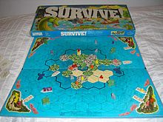
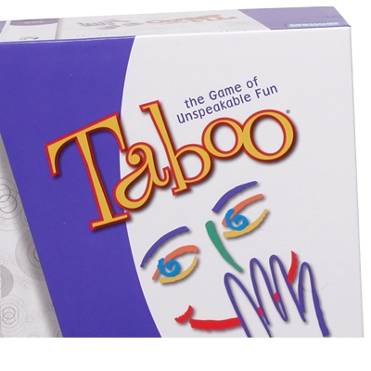
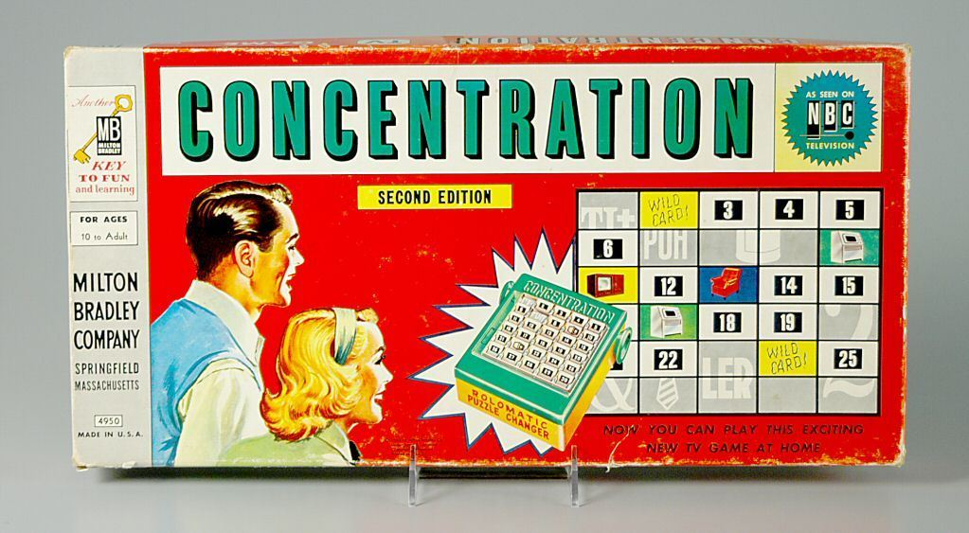
READY MADE GAMES
BOARD GAMES
Inserire testo

Slide 2
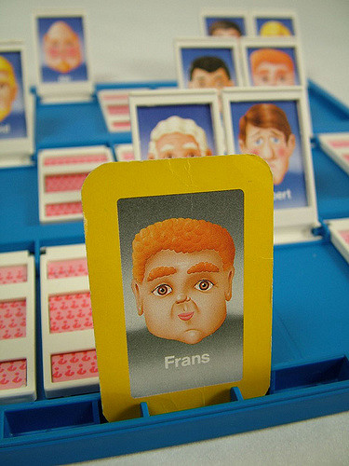
GUESS WHO?
.
The aim of the game is guessing the thief setting yes/no questions about physical appearance. It is very useful:
-to improve lexical and grammar knowledge;
-to learn how to select and process data;
-to make hypothesis;
-to compare information.
If played in a team the game enhances
cooperative skills such as: sharing and
negotiating ideas and strategies.

Slide 3
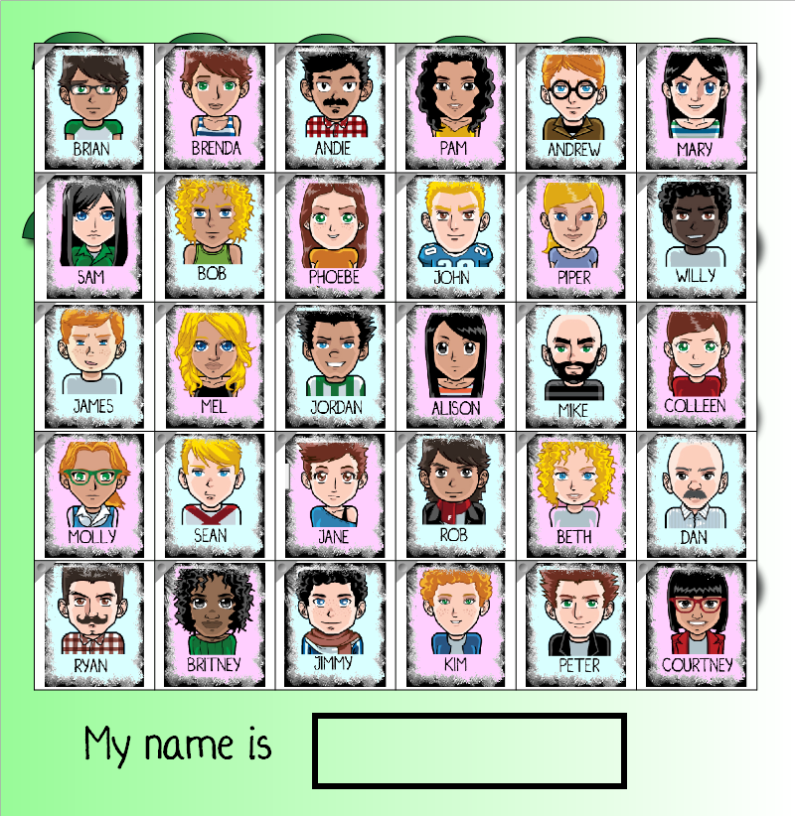
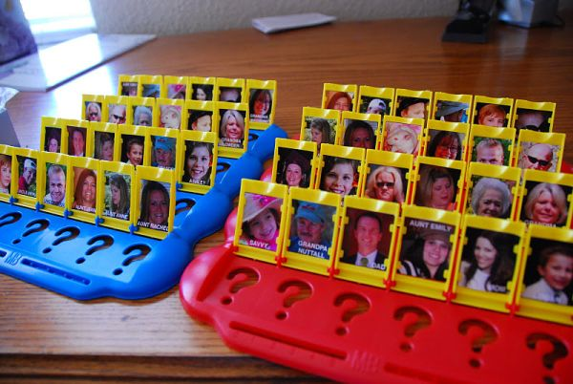

Slide 4
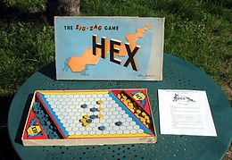
ZIG ZAG
This game is entertaining and stimulates imagination, making students think strategically, encouraging and stregthening social interaction. The game enhances learner motivation as it improves group skills and allows the teacher to assess the progress and learning needs of each student. It has proved especially effective as a teaching instrument for students learning English as a second language, because it makes dynamic use of basic words that enrich students’ vocabulary.
The first team to reach the finish point, following a zig zag route, wins

Slide 5
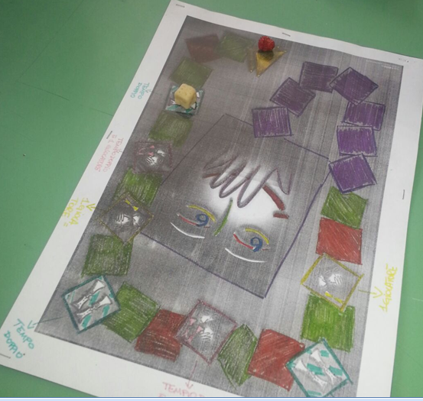

Slide 6
IL GRAN PROVERBIERE
THE GREAT GAME OF
PROVERBS
The aim of this game is completing a path . To go forward students have to complete a proverb.
It is very useful:
-to improve lexical and grammar mother tongue knowledge;
- to compare information
-to recover folk traditions.
If played in a team the game enhances cooperative skills such as: sharing and negotiating ideas and strategies.

Slide 7
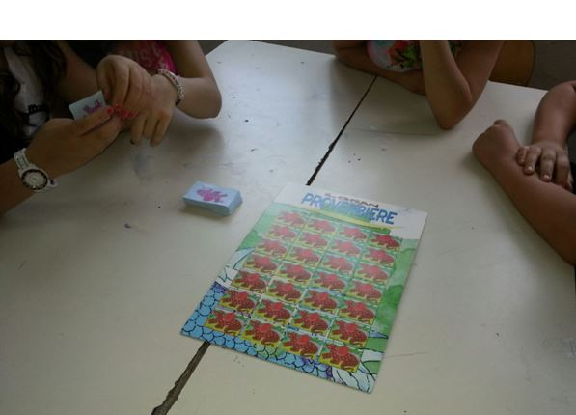

Slide 8
ONLINE GAMES
WORD GAMES to improve lexical and
grammar knowledge;
www.britishcouncil.org /www.gamerstolearnenglish.com
www.hangman.learningtogether.net
GAME OF GEOGRAPHY to improve the
geographical knowledge (cities, regions,
States, flags etc);
www.giochi-geografici.com
GAMES OF ITALIAN, SCIENCE, MATHEMATICS, ENGLISH
AND LOGICS to increase the learning of all these subjects;
www.atuttalim.it

Slide 9
