Slide 1
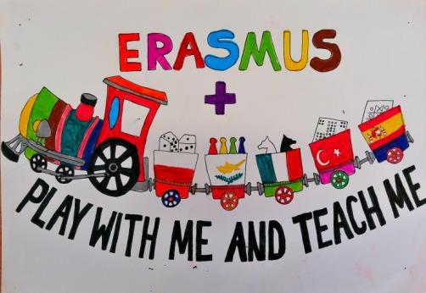
History Taboo
Erasmus+ KA2
Dimotiko Scholeio Germasogeias
Teacher: Elena Prodromou
May 2016

Slide 2
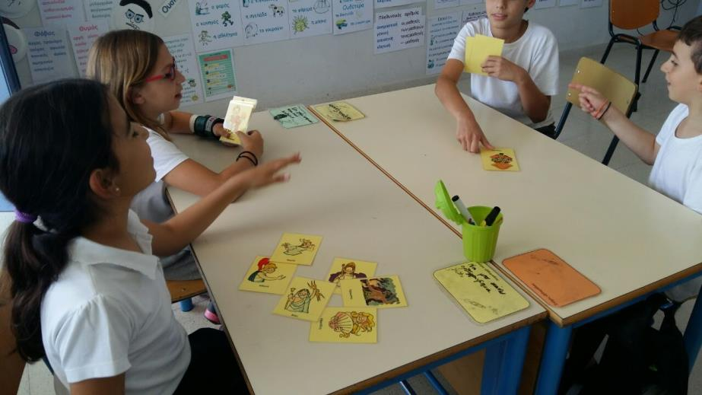
Taboo
Subject: History
Grades: 3-4
Goal: The students to learn the meaning of the main history vocabulary.

Slide 3
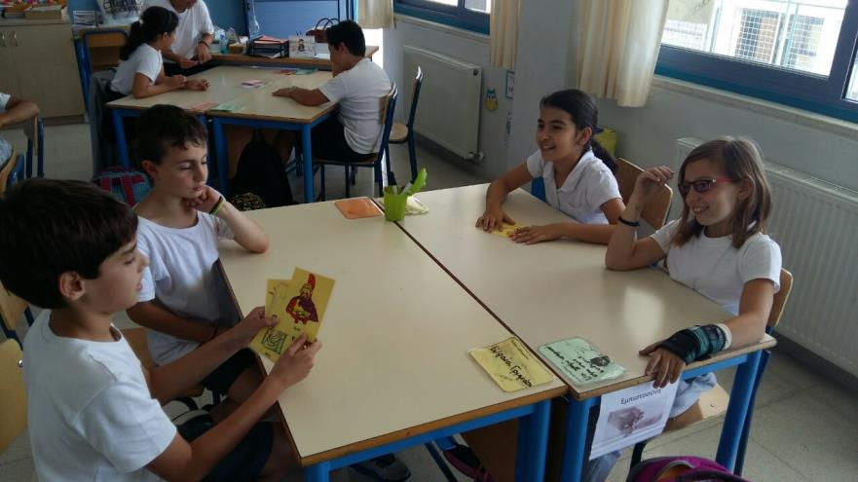
Activity
The players are divided into two groups.
One player takes a card and describes the first word written on the card to his group. He can use also the other words written on the card.
The rest of the group has to guess the word.

Slide 4
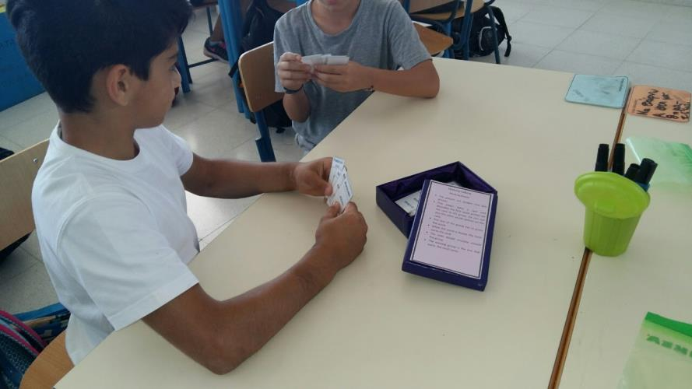
Activity
When the word is found, the team earns the card.
The roles should circulate around the group.
The winning group is the one that earns the most cards.

