Slide 1
PLAY WITH ME AND TEACH ME
Poland –Turkey- Cyprus –Italy- Spain

Slide 2
Game:
NAME THE GROUP

Slide 3
GAME : Name the group
AIM: To engage the students in communicative activities
to develop the oral skill.
PROCEDURE: Break the students into small groups..
Tell the students they are going to see in every slideshare a few images and they have something in commom.
They have some minutes to guess the theme of the group of pictures.
After time has passed, one speaker from each group, will give the answer.
Encourage the pupils to use the language written on the board.
Example: It could be… , I think they are….
Give a point to every group that was correct.
Repeat this process for the other series of photo and at the end find out who the winner is.

Slide 4
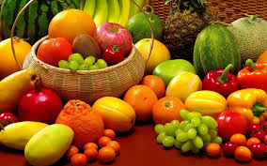
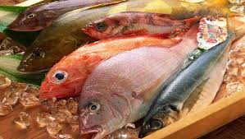
Look at these pictures for one minute
What do they have in common?
They are healthy food

Slide 5
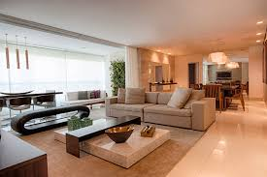
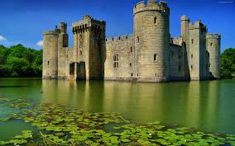
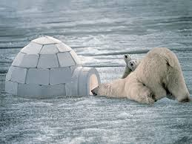
Look at these pictures for one minute
What do they have in common?
They are different types of houses

Slide 6
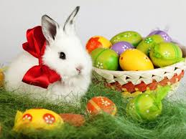
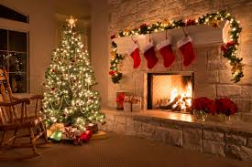
Look at these pictures for one minute
What do they have in common?
They are festivals

Slide 7
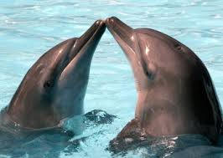
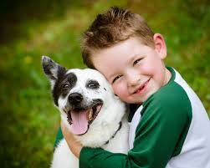
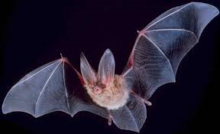
Look at these pictures for one minute
What do they have in common?
They are mammals

Slide 8
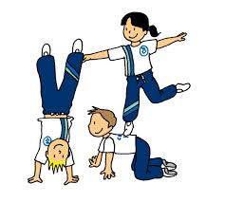
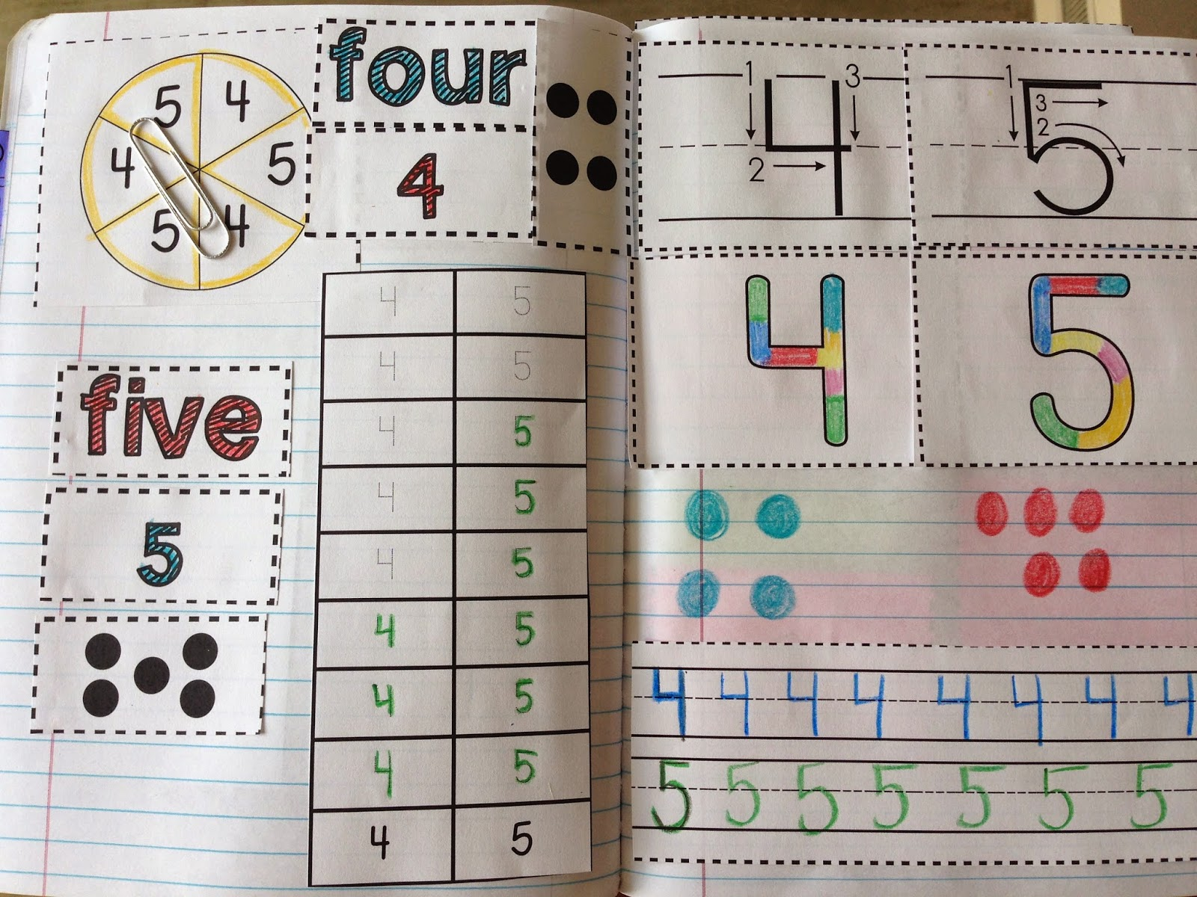
Look at these pictures for one minute
What do they have in common?
They are school subjects

Slide 9
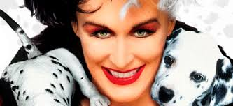
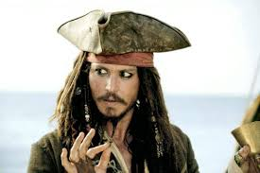
Look at these pictures for one minute
What do they have in common?
They are film characters

Slide 10
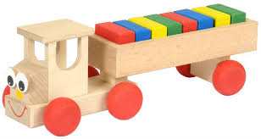
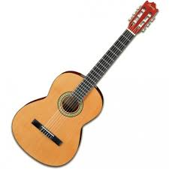
Look at these pictures for one minute
What do they have in common?
They are made of wood

Slide 11
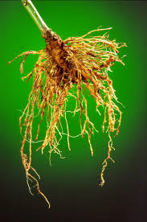
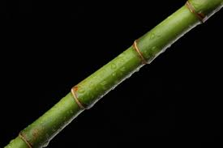
Look at these pictures for one minute
What do they have in common?
They are different parts of a plant

Slide 12
Look at these pictures for one minute
What do they have in common?
They are different types of transports

Slide 13
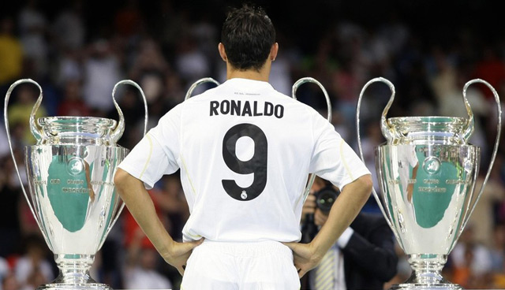
Look at these pictures for one minute
What do they have in common?
They are a multiple number of three

Slide 14
SCORE:
9-10 Points EXCELLENT
7-8 Points VERY GOOD
5-6 Points GOOD
0-5 Points YOU NEED IMPROVE

Slide 15
THANKS!
Any questions?
Mª Angeles Peña
CEIP José Rodriguez Cruz
06220 Villafranca de los Barros
Badajoz

