Slide 2
PROJECT BASED LEARNING

Slide 3
Project based learning is a cooperative learning method where students explore and work in collaborative groups which have a vision of the result. It is student centered, self directed and gives importance to communication, based on yhe responsability of the working group. It develops the student’s organizational and research skills and emphasizes the ability to work together in addition problem solving, decision making, investigative skills.

Slide 4
Project-based learning is very closed to problem-based learning. It is student centered, encouraging them to search information and proceeed in different ways in groups. It is more time consuming and comprehensive. It is a move from classical class teaching method to group work. Teacher isn’t an expert but a coach. As a result standardization isn’t a goal but the differentation.

Slide 5
JIGSAW SUBJECTS

Slide 6
The students are diveded into 5 or six persons jigsaw group One of them is the group leader.

Slide 7
The subject is divided into 5 or 6 segments. one to each

Slide 8
Each student has the access for his/her own segment They do not memorize.

Slide 9
The group leader is in charge to lead the group.
Each member evplain his/her own segment while others ask questions for clarification.

Slide 10
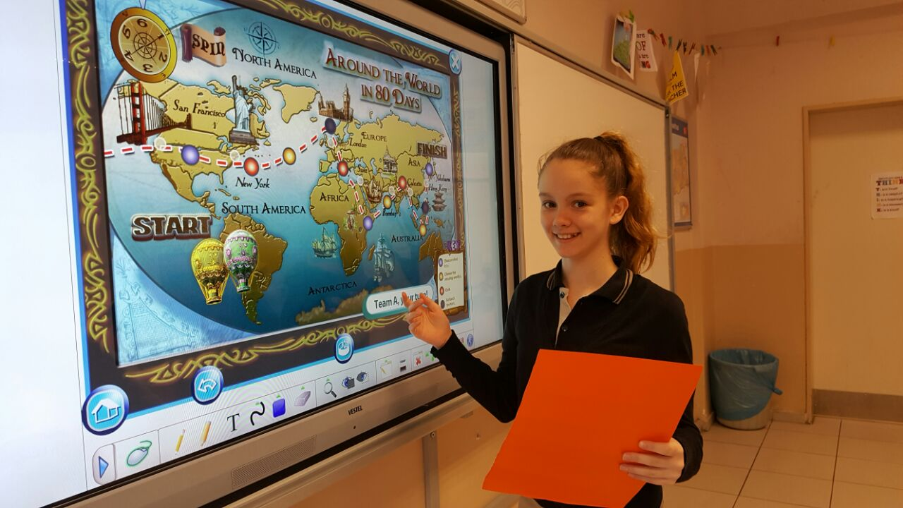
This activity facilitates the students’ accountability and responsabilities, mutual acceptance, discussion and exchange. It encourages studying efficiently, listening to eachother and facilitates interaction of all the students in class.

