Slide 1
" Play with me and teach me – tradition and modernity in active teaching”
DIDACTIC GAMES
REPORT

Slide 2
Type of the activity : Didactic game
Title: Story Cubes
Aims of the activity:
To reinforce English skills through play.
To practice new vocabulary .
To de
To develop the child’s imagination and creativity . To improve the speaking and writing skills.
To incentive the cooperative working.
To accept the rules of the game.

Slide 3
Number of participants:
This game is for any number of players
You need:
A set of story dices,paper and pens

Slide 4
Description of the activity:
The first player rolls all 9 cubes. . Start with the first image to grab his/her attention. Begin a story with “Once upon a time”.
Taking turns, each consecutive player adds a chapter to the story.
The last player must tie up all the loose ends and bring the story to the conclusion.
There is one rule: there are no wrong answers.

Slide 5
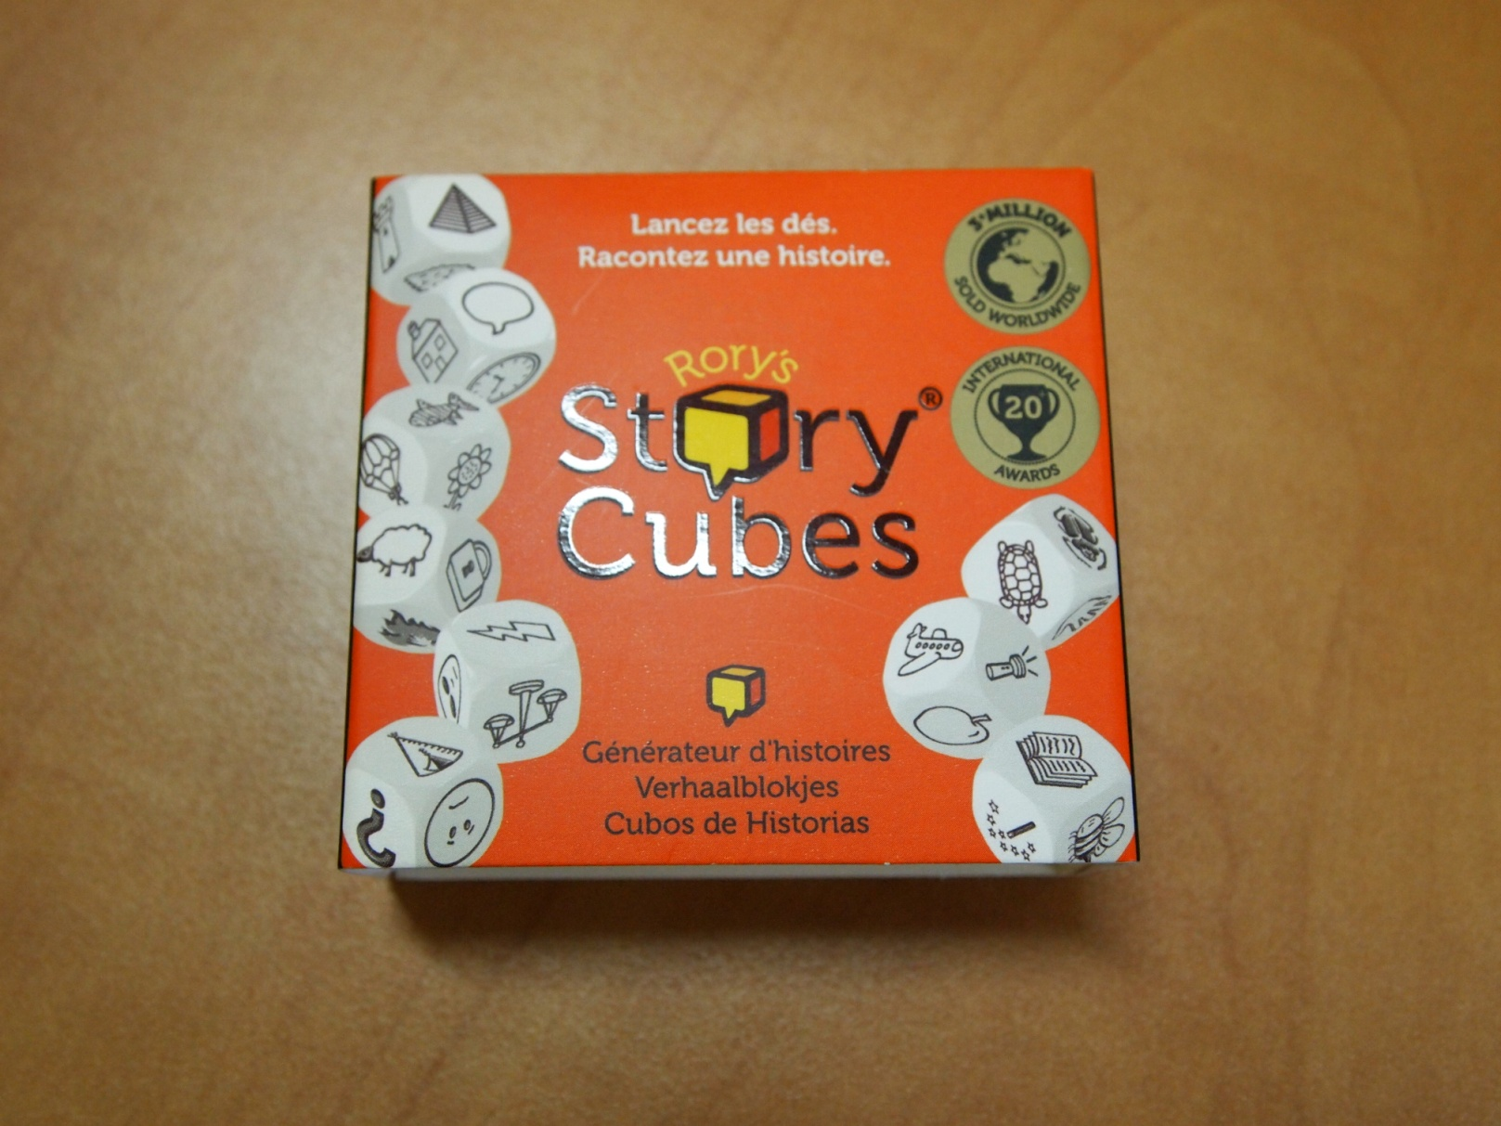

Slide 6
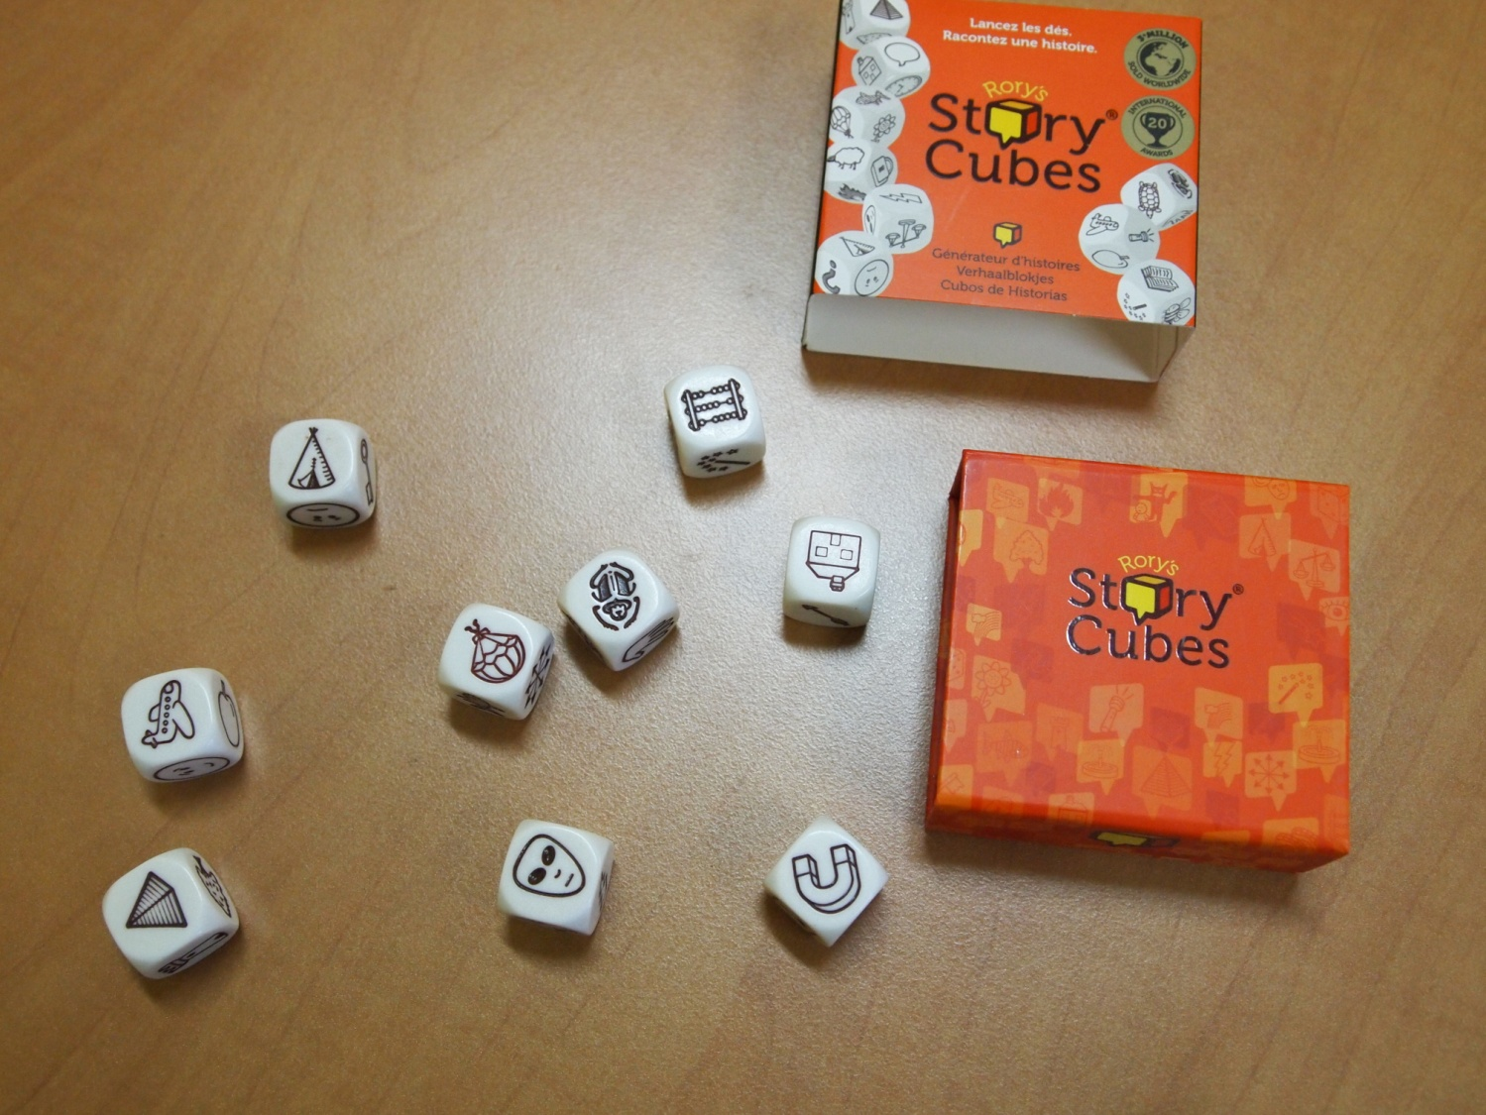

Slide 7
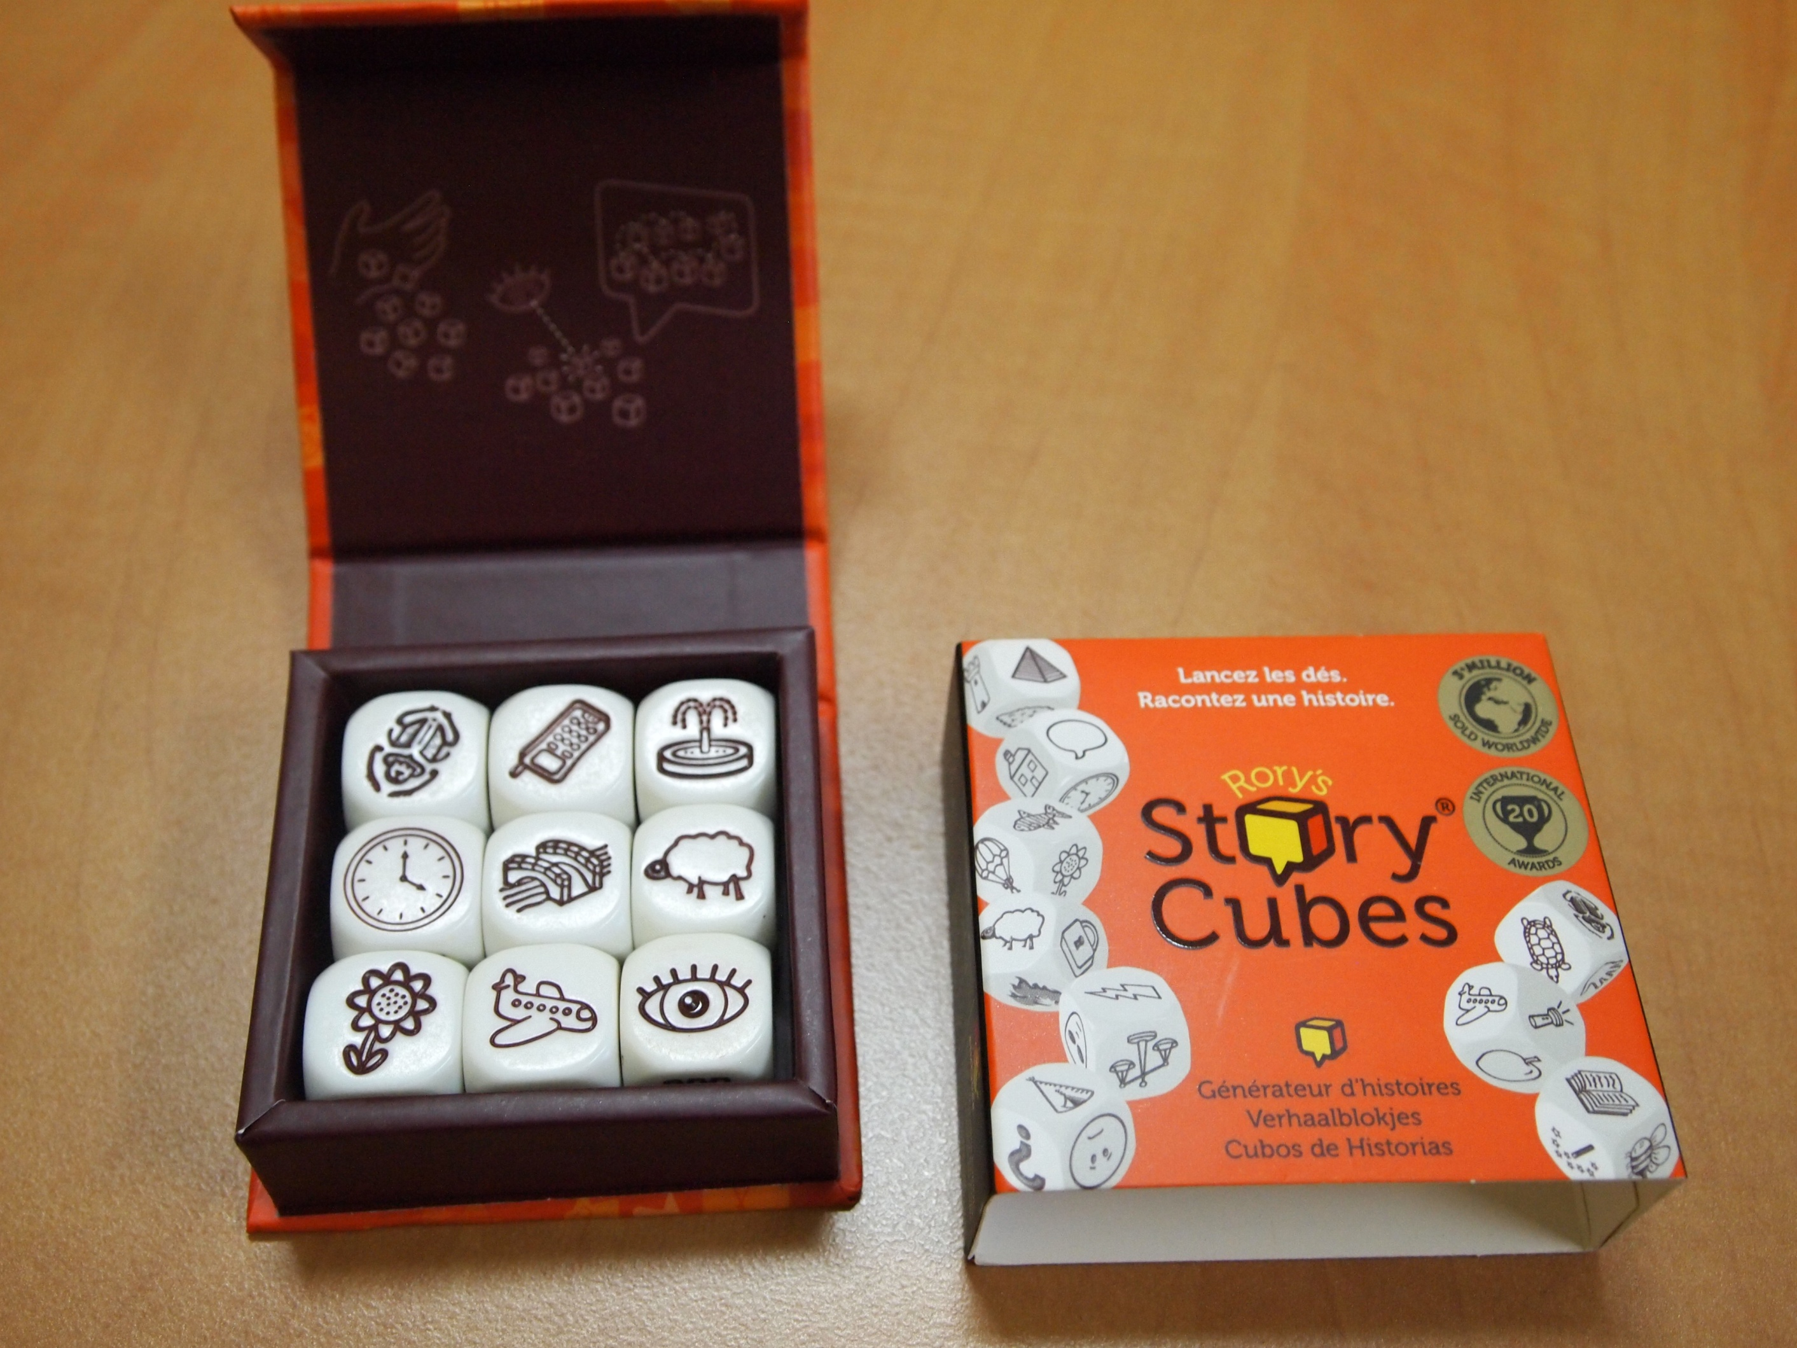

Slide 8
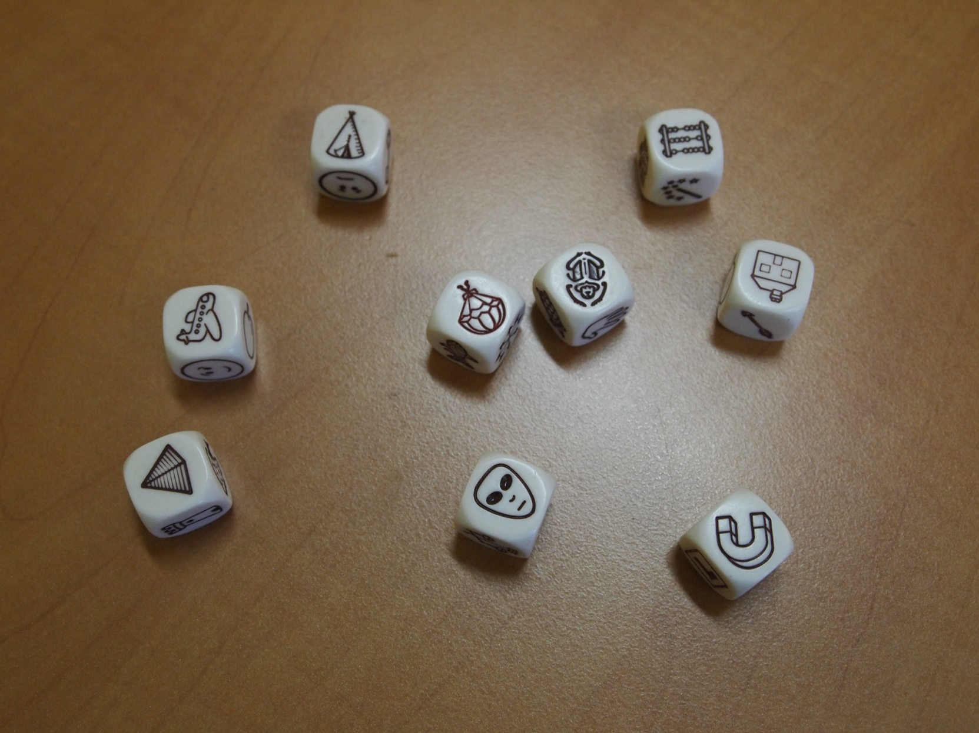

Slide 9
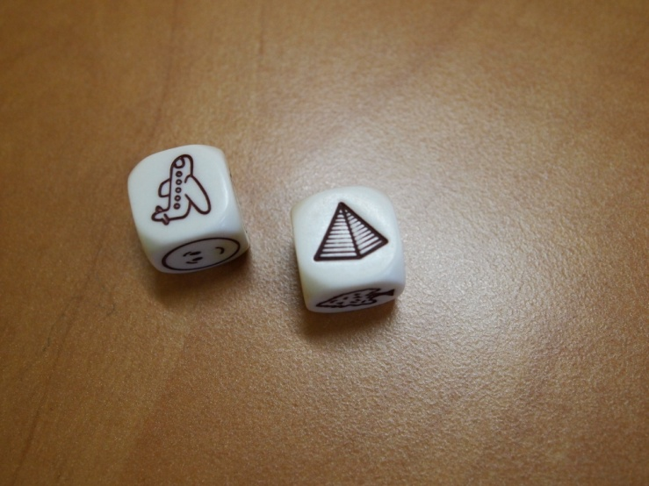
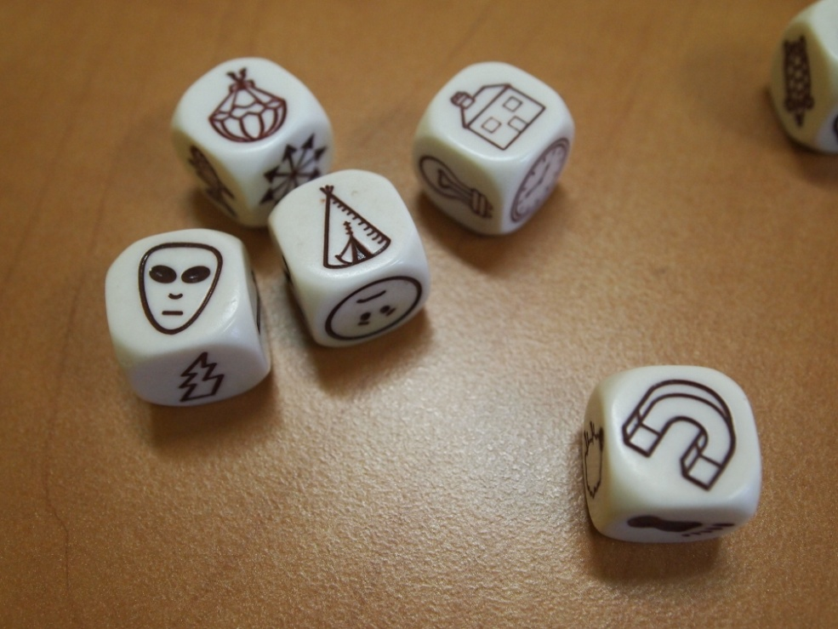

Slide 10
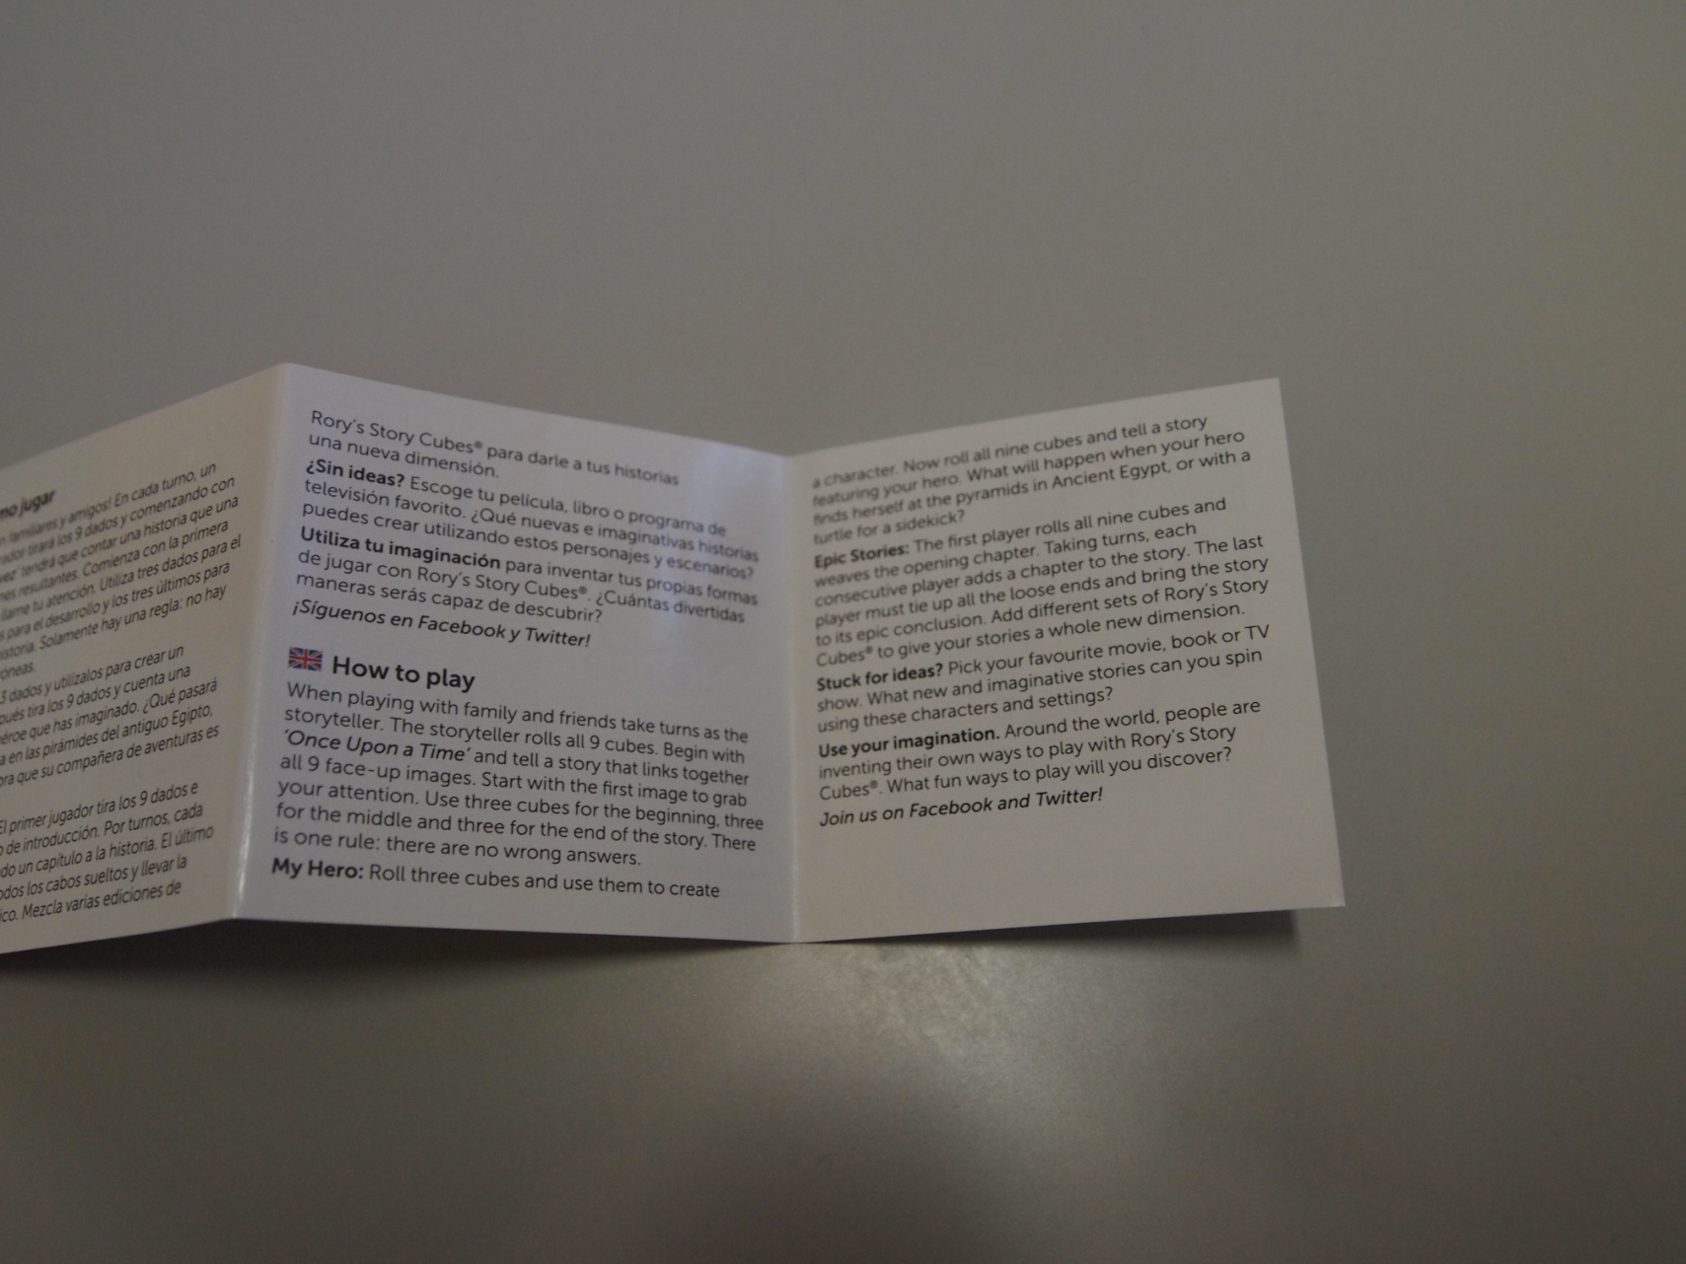

Slide 11
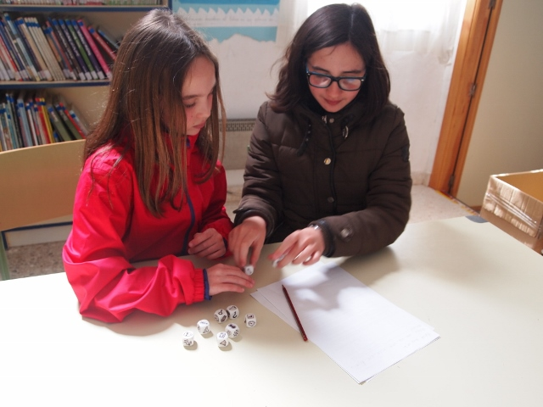

Slide 12
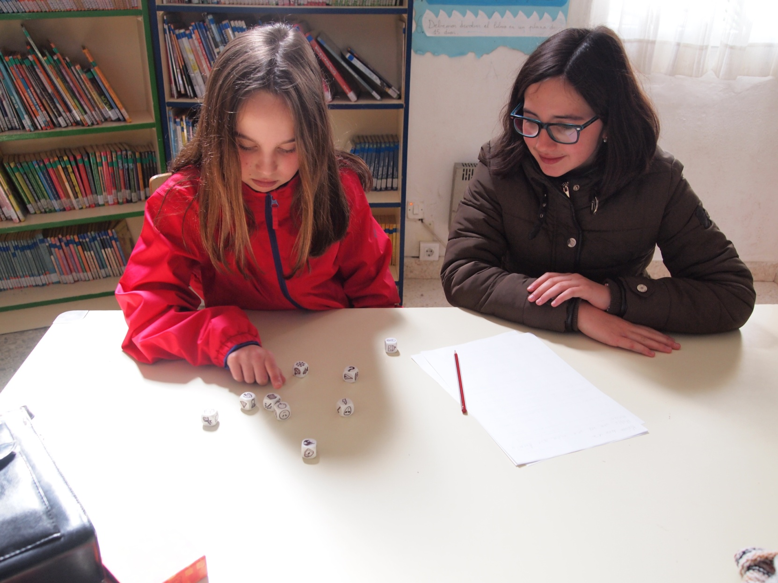

Slide 13
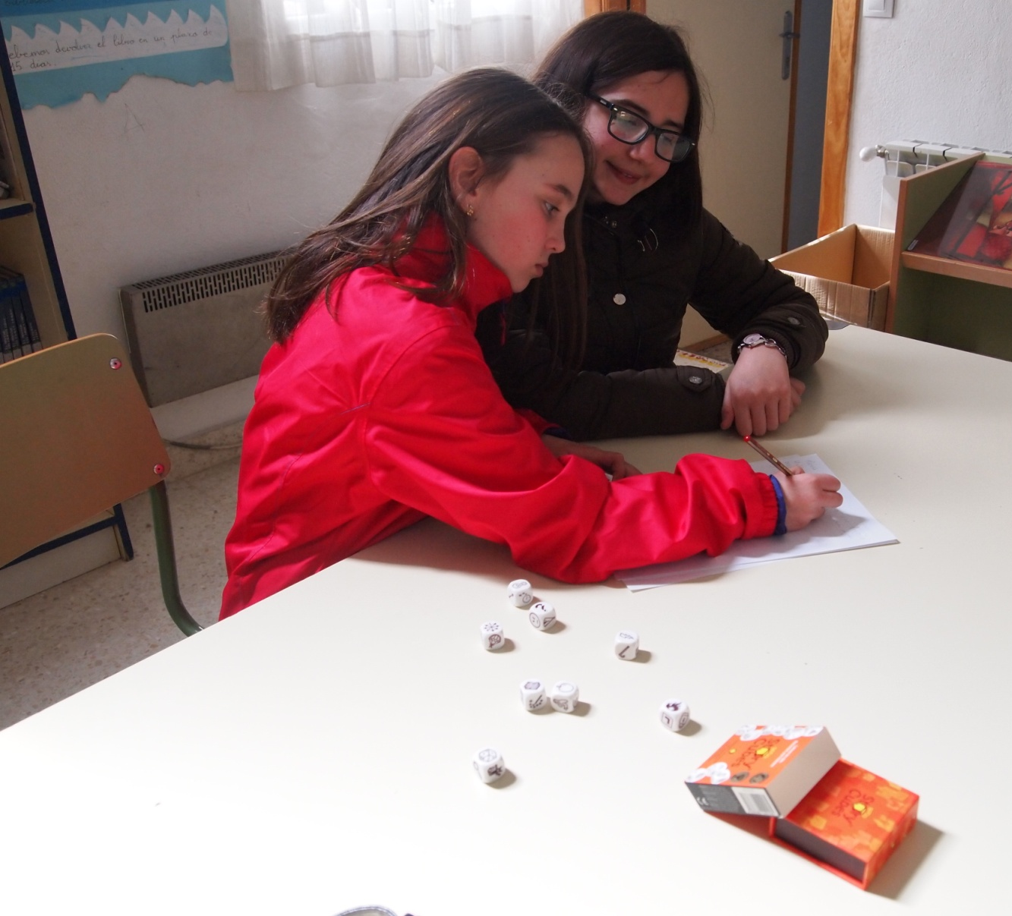

Slide 14
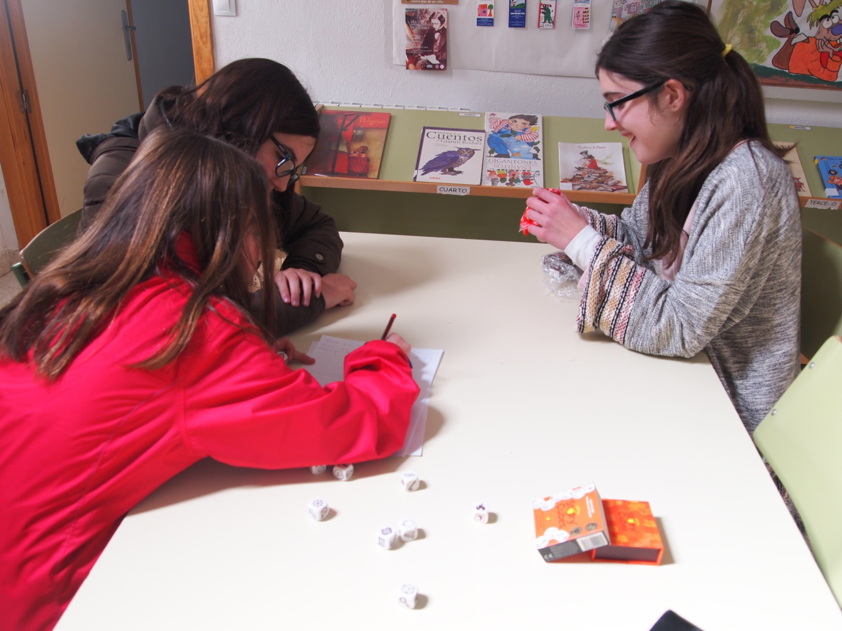

Slide 15
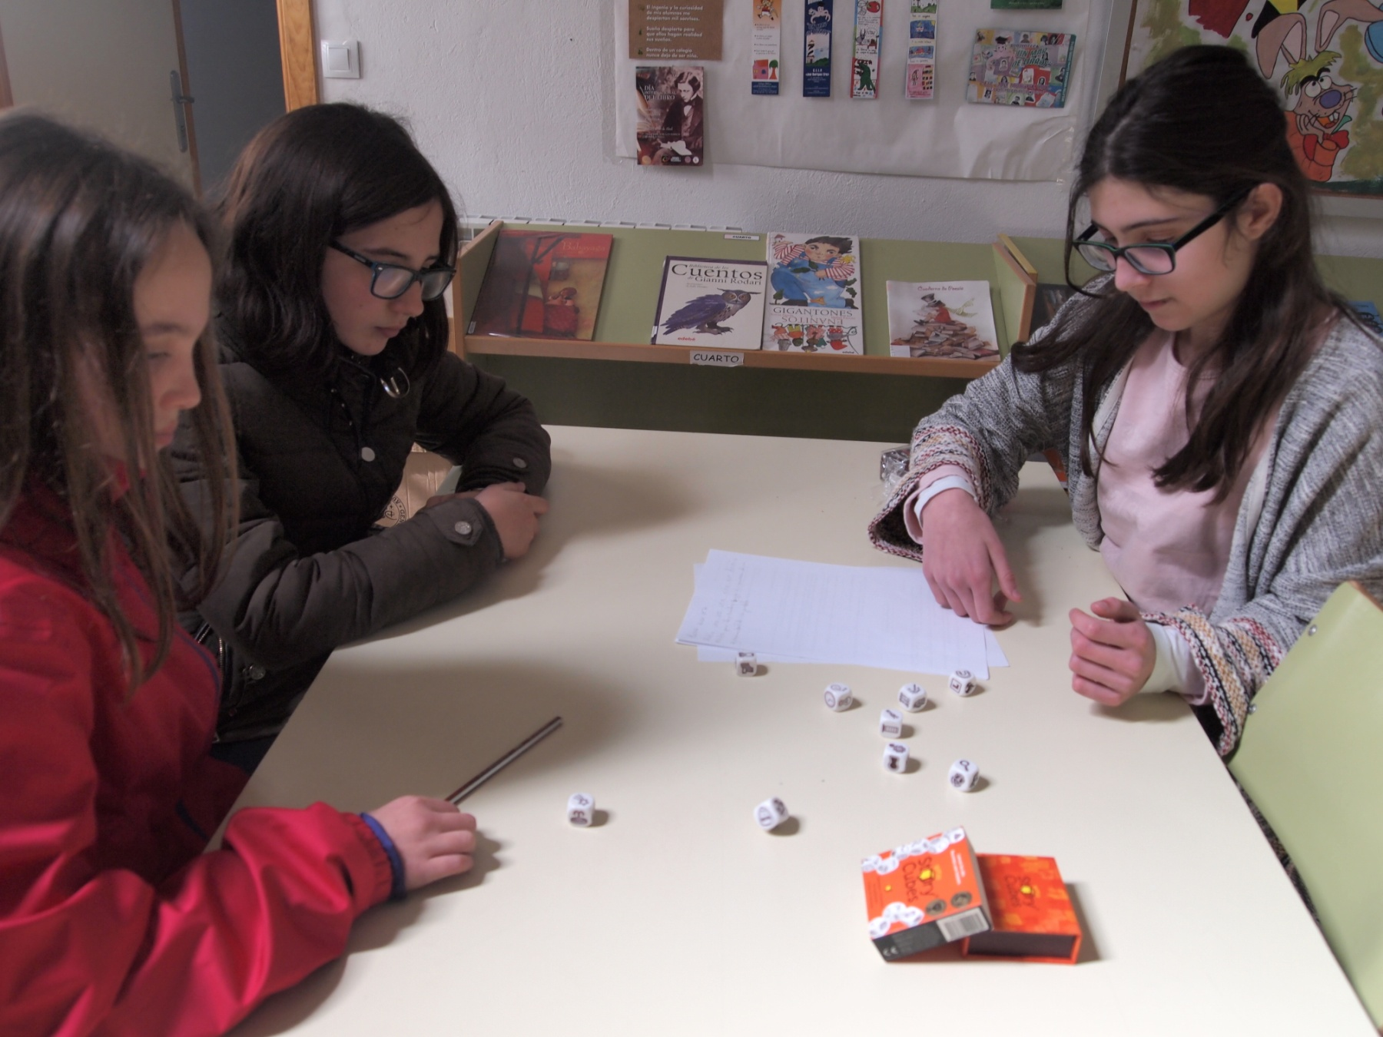

Slide 16
C.E.I.P. JOSÉ RODRÍGUEZ CRUZ
VILLAFRANCA DE LOS BARROS
SPAIN
SCHOOL YEAR 2015/2016

