Slide 1
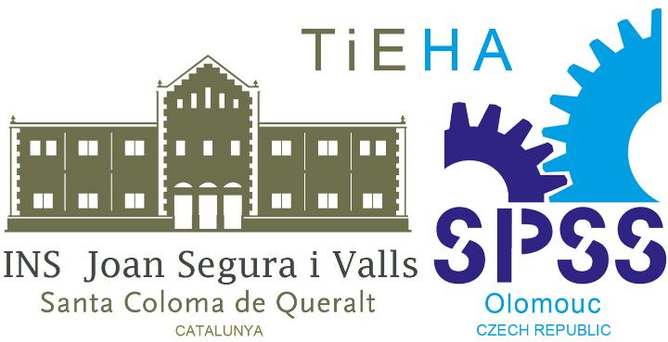
Architectural styles in Czechia

Slide 2
Index:
Romanesque architecture
Gothic
Renaissance
Baroque
Neo-classicism and Romantism
Art-Nouveau
Czech Cubism and Rondocubism
Functionalism
Socialist Realism
Postmodern architecture

Slide 3
1/ Romanesque architecture
10 century – half of the 13 century
main features: Roman semi-circular arch, very thick walls, dressed stone, groin vaults, for arcades, barrel vaults (for roofs), arcades, large towers, west-facing entry, large murals, groin vault, barrel vault, semi-circular arch

Slide 4
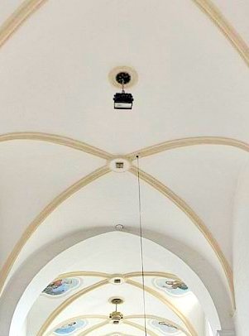
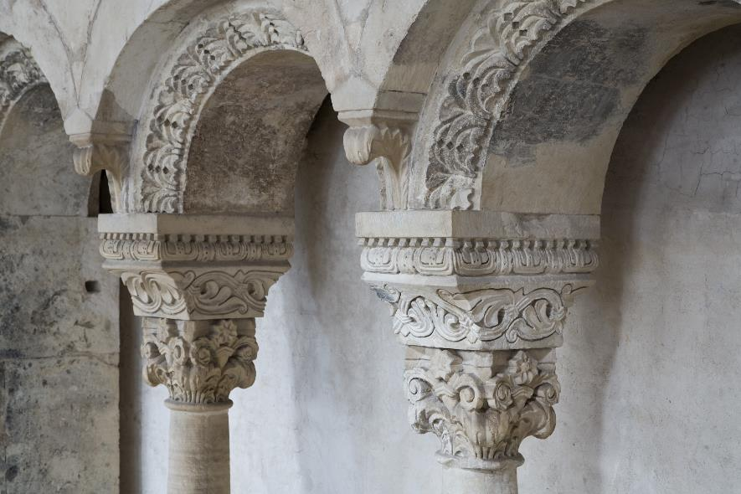
Romanesque Main features
groin vault
semi-circular arches

Slide 5
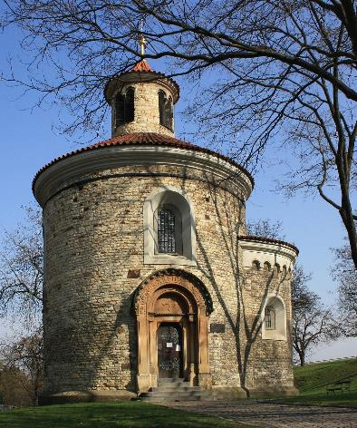
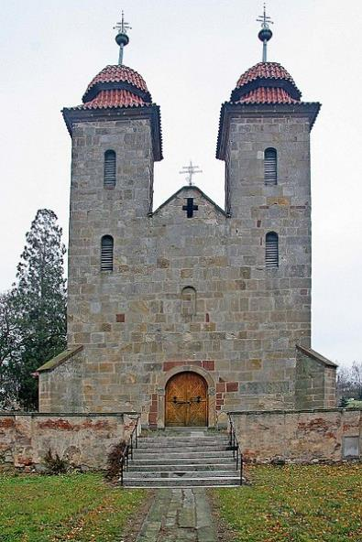
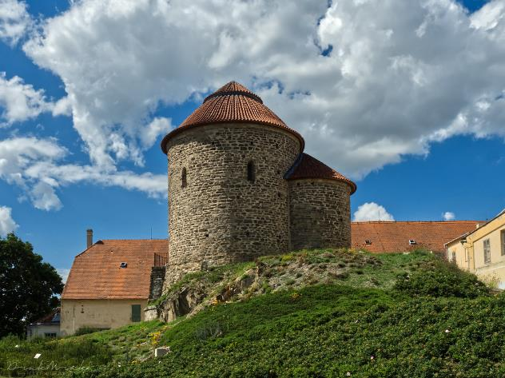
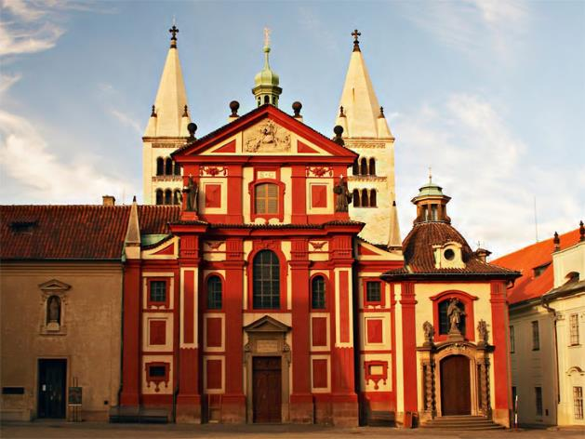
Romanesque buildings
Rotunda of St. Martin in Prague
Basilica in Tismice
Rotunda of St. Catherine in Znojmo
St. George Basilica in Prague

Slide 6
2/ Gothic architecture
half of the 13 century– end of 15 century, periods:
early Gothic – Přemyslid Gothic (13th and early 14th century)
high Gothic – Luxembourg Gothic (14th and early 15th century)
late Gothic – Jagiellonian Gothic (approximately 1471–1526)
Main features: rib vault, pointed arch, clustered columns, large windows, verticality, external buttresses

Slide 7
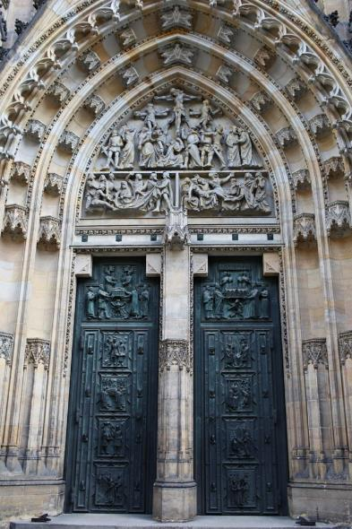
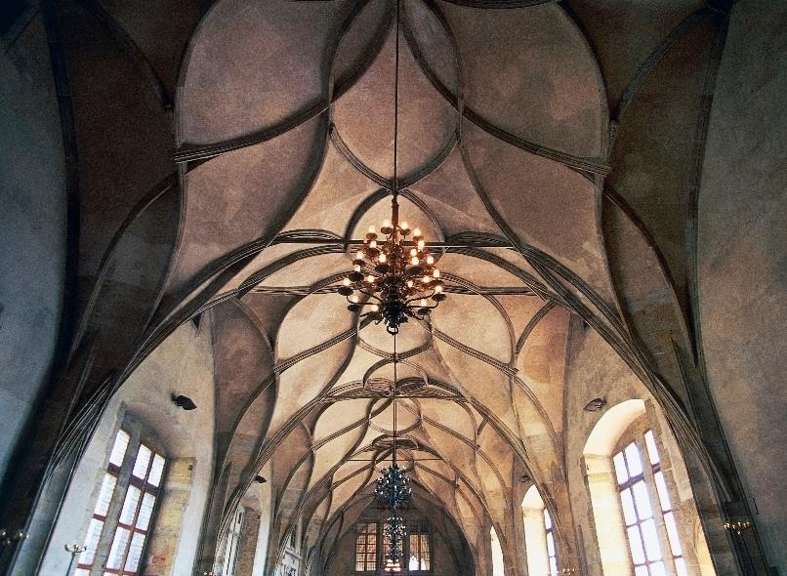
gothic Main features
pointed arch
rib vault

Slide 8
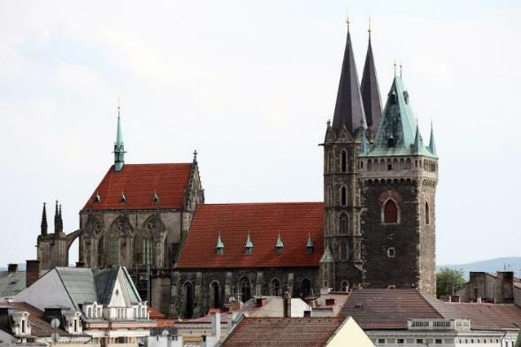
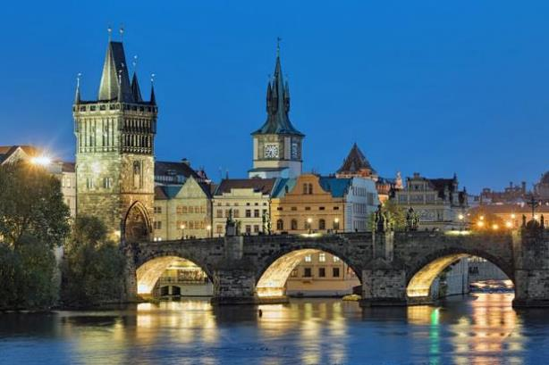
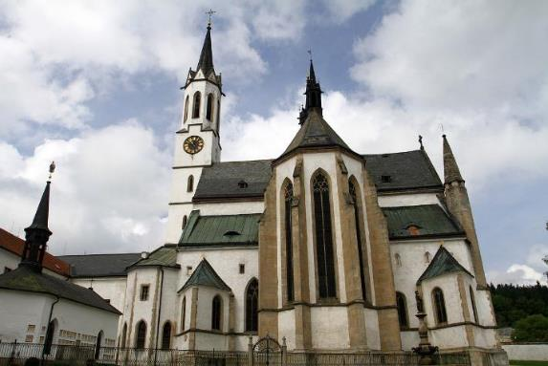
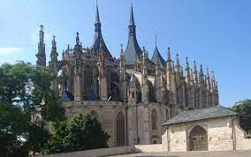
gothic buildings
Charles Bridge in Prague
Church of St. Bartholomew in Kolín
Church of St. Barbara in Kutná Hora
Church of Vyšší Brod Monastery

Slide 9
3/ Renaissance
turn of the 15 and 16 century – beginning of 17 century
periods: Jagiellonian period, Habsburg period
main features: sgraffito (figural or ornamental) facade, big rectangular windows, arcade courtyards, geometrically arranged gardens with fountains and statues, antique collumns

Slide 10
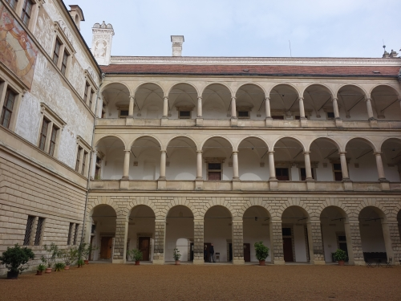
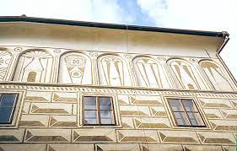
Renaissance Main features
arcade courtyards
sgraffito

Slide 11
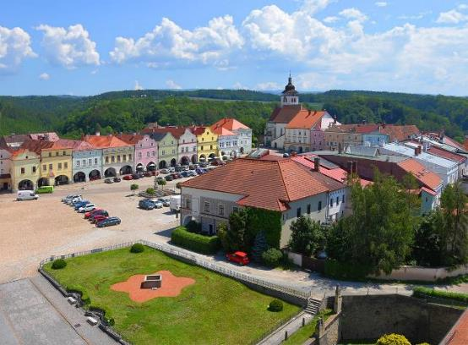
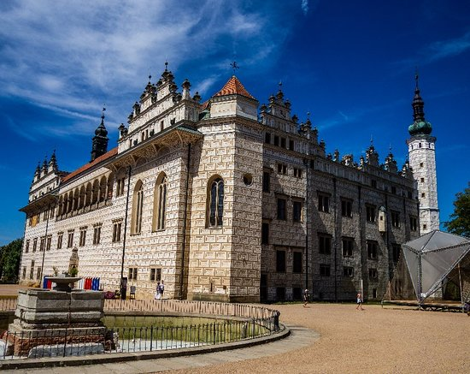
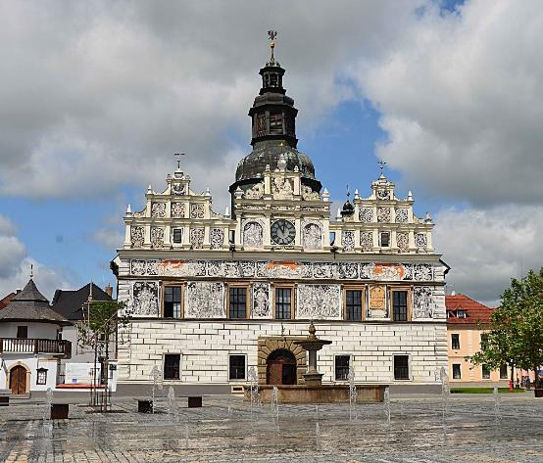
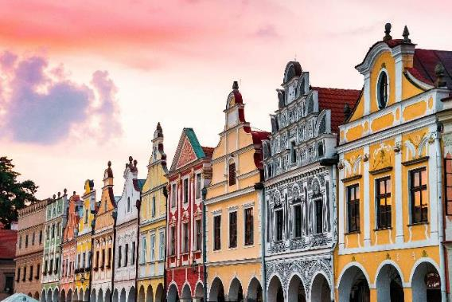
Renaissance building
Rennaissance houses in Nové Město nad Metují
Chateau Litomyšl
Town Hall in Stříbro
Rennaissance houses in Telč

Slide 12
4/ Baroque
beginning 17 century – end 18 century, periods: early, high, late
main features: domes, facades with massive central adornments, illusory decoration as general art, ceilings heavily stuccoed or frescoed, emphasis on colour and light both internally and externally, external moldings and figures (stucco or covered wood)

Slide 13
BAROQUE MAIN FEATURES
examples of Baroque gables and windows

Slide 14
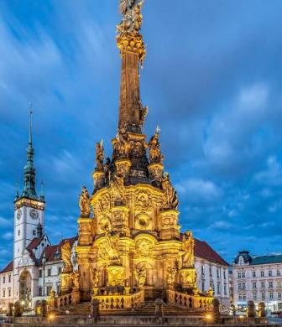
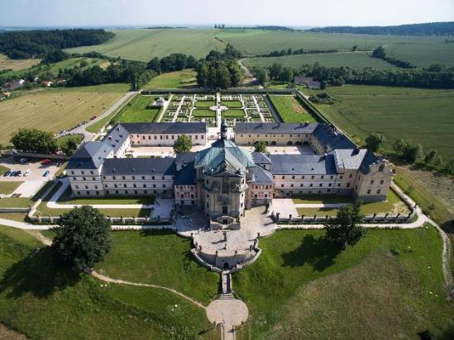
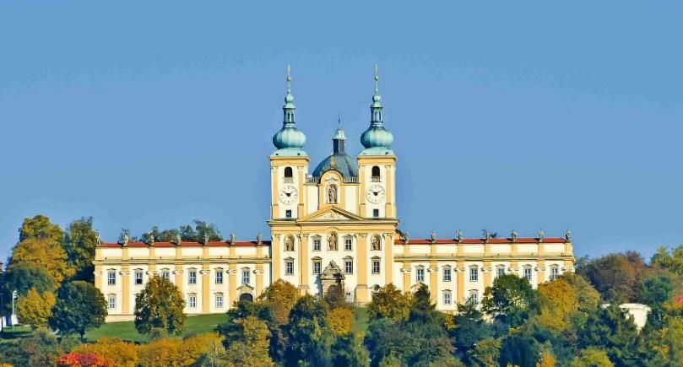
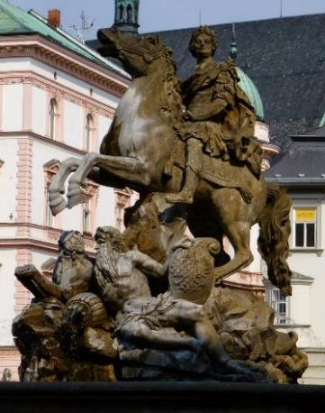
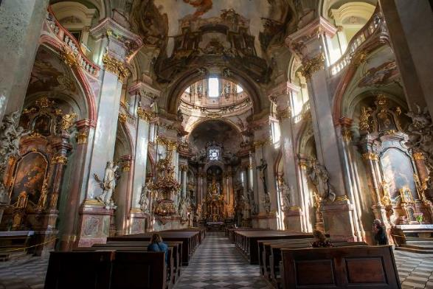
baroque buildingS
Holy Trinity Column in Olomouc
hospital in Kuks
Church of Visitation of Virgin Mary – Olomouc- Sv. Kopeček
Baroque fountain in Olomouc
St. Nicholas Church in Prague

Slide 15
5/ Neo-clacissicism and Romantism
end of 18 century – end of 19 century
main features: defined by symmetry, simple geometry, triangular pediments, columns and pilasters with clacissist ornaments

Slide 16
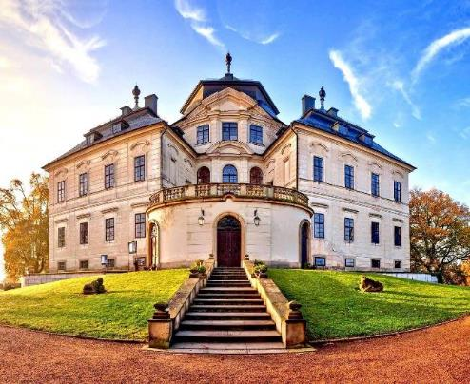
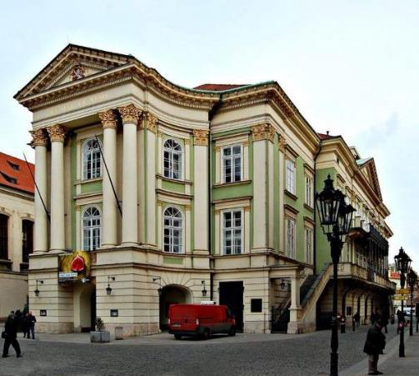
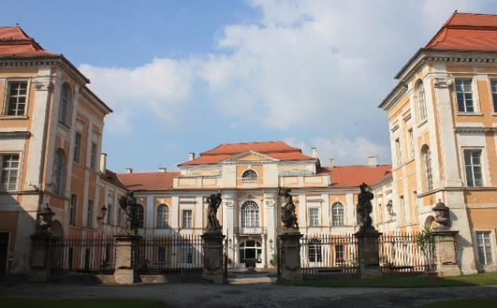
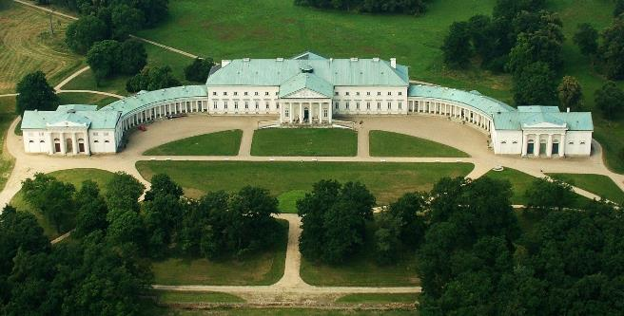
Neo-clacissicism and Romantism buildings
Karlova Koruna Chateau in Chlumec nad Cidlinou
Stavovské Theatre in Prague
Duchcov Chateau
Kačina Chateau

Slide 17
6/ Art-Nouveau
end of 19 century – cca 1910
main features: organic decorative features – trees, flower, fruit decorated facades and balconies, the emphasis on the line curved forms, lightness, light

Slide 18
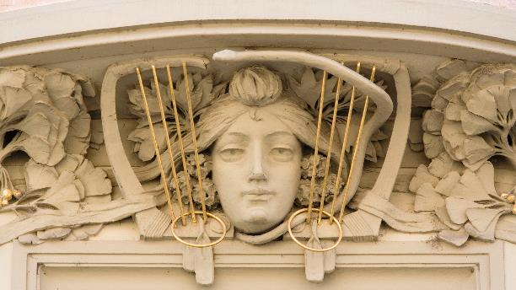
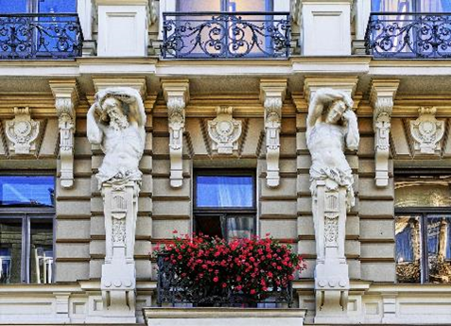
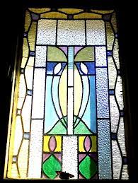
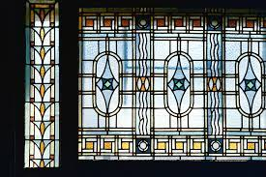
ART-NOUVEAU MAIN FEATURES
decorated facade
decorated balcony
Art-Nouveau windows

Slide 19
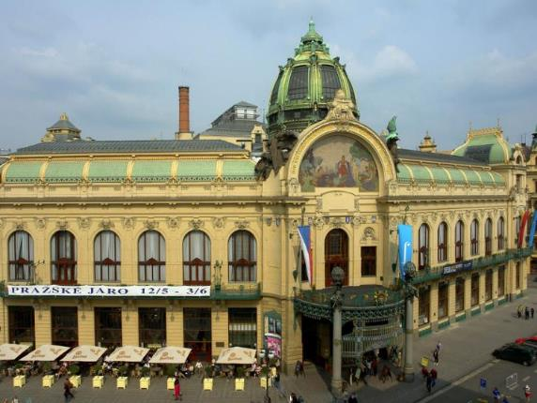
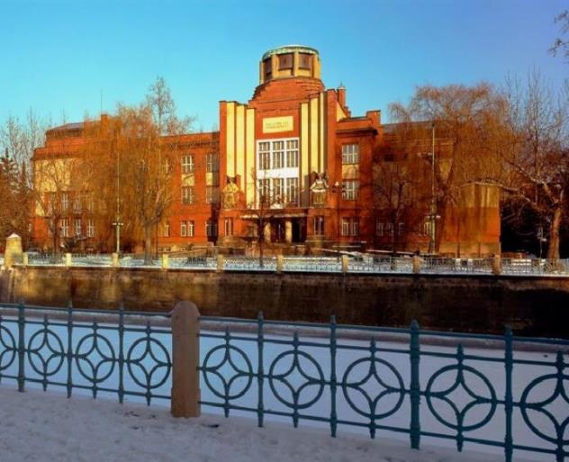
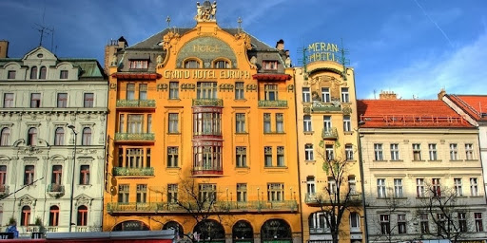
Art-Nouveau buildings
East Bohemian Museum in Hradec Králové
The Municipal House in Prague
Grand Hotel Evropa in Prague

Slide 20
7/ Czech Cubism and Rondocubism
cca 1910 – 1920s
Main features: sharp edges, geometric patterns intersecting planes, crystalline structures

Slide 21
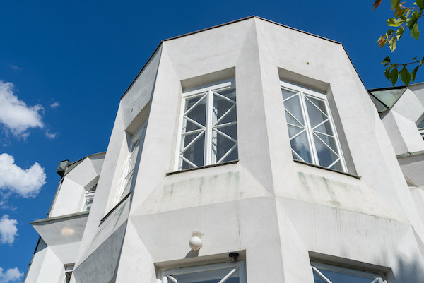
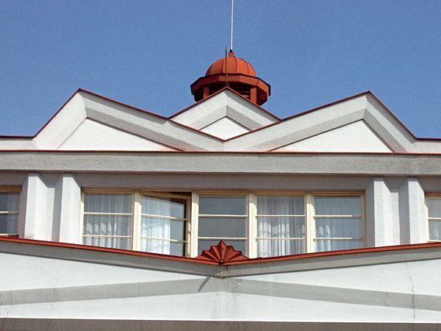
CUBISM AND RONDOCUBISM MAIN FEATURES
sharp edges
geometric patterns

Slide 22
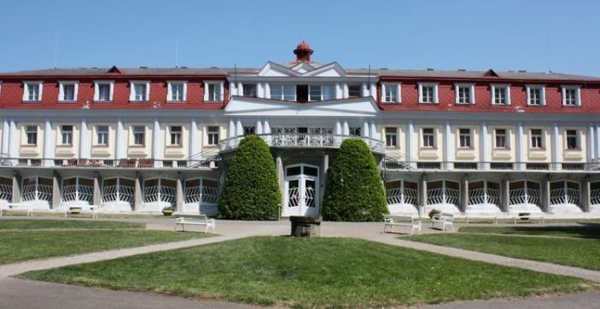
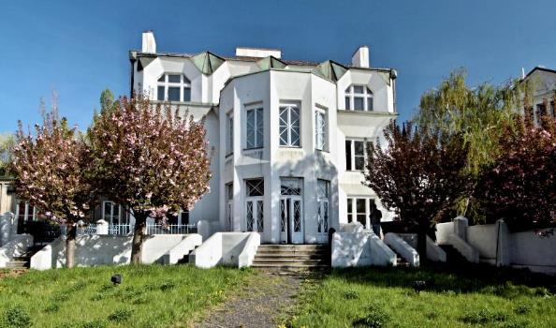
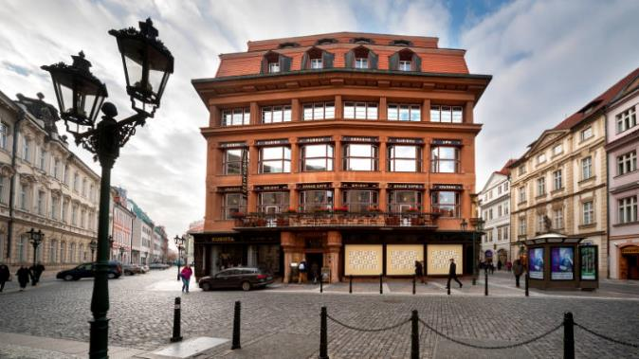
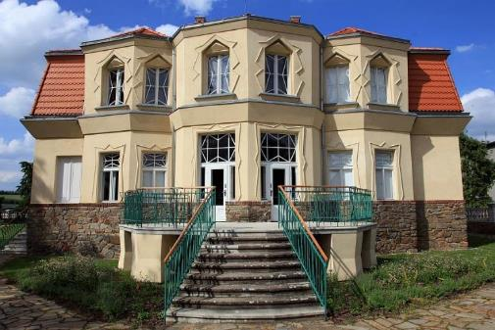
CZECH CUBISM AND RONDOCUBISM BUILDINGS
Thermal Baths in Bohdaneč
Kovařovic Villa in Prague
Bauer Villa in Libodřice
The House at the Black Madonna in Prague

Slide 23
8/ Functionalism
1920s – end of 1930s
Main features: emphasis on the purpose and function, round windows, flat roofs, low levels of ornamentation and decoration, flat concrete slabs, steel sheets, and even wood beams

Slide 24
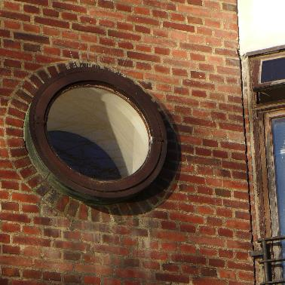
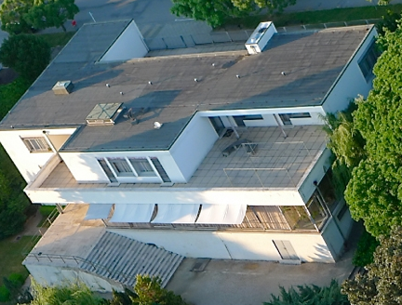
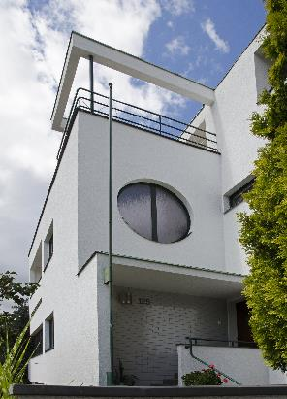
FUNCTIONALISM MAIN FEATURES
round windows
flat roof

Slide 25
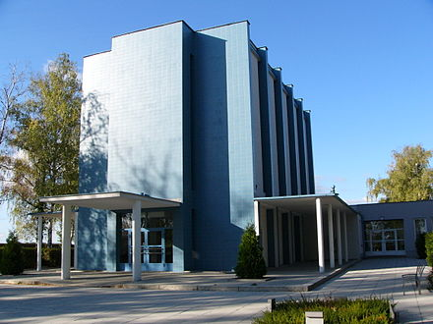
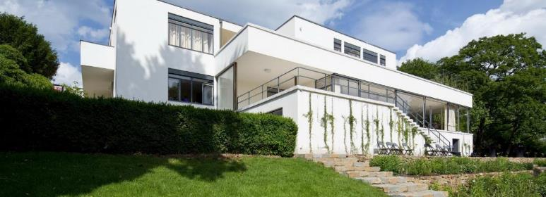
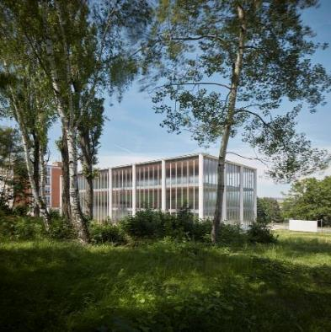
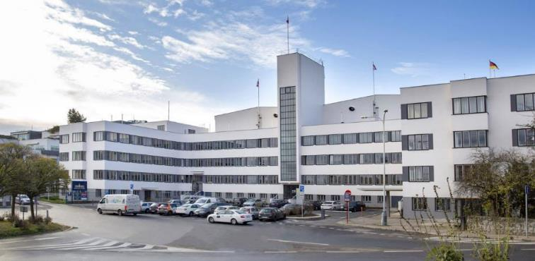
Functionalism buildings
Villa Tugendhat in Brno
Olomouc Crematorium
Barrandov Film Studios in Prague
Tomáš Baťa Memorial in Zlín

Slide 26
9/ Socialist Realism (Sorela)
cca 1950 – end of 1980s
Main features: perpendicular streets and rectangular squares, blocks of flats of the same height and form, Classicist columns and triangular or stepped gables, historicising elements on the facades of buildings celebrating national motifs

Slide 27
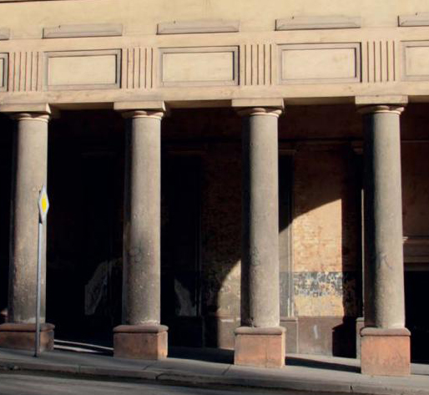
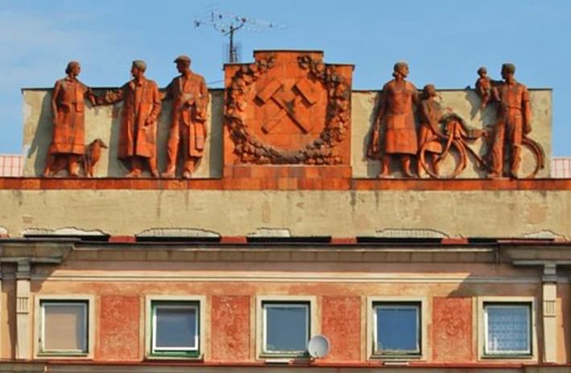
SOCIALIST REALISM MAIN FEATURES
typical decoration of sorela architecture
grey uniformity of sorela blocks of flats
historicising columns

Slide 28
Sorela buildings
Hotel International in Prague
Astronomical clock in Olomouc
A housing estate in Prague
Hotel Thermal in Karlovy Vary

Slide 29
10/ Postmodern architecturE
cca 1990 – now
Main features: curved forms, decorative elements, asymmetry

Slide 30
Main features of postmodern architecture
asymmetry
curved forms

Slide 31
Postmodern Buildings
Main Point in Prague
Congress Centre in Zlín
Dancing House in Prague
The National Library of Technology in Prague

