Slide 1
The issue of migration presented by Polish government

Slide 2
PiS which means ”Prawo i Sprawiedliwość” - ”Law and Justice” is a political party that makes up the majority in the present Polish government.
Both the President and Prime Minister originate from PiS.
The party was created in 2001. Its political slogans consist of: conservatism, solidarity and christian democracy.

Slide 3
REFUGEE CRISIS IN EUROPE
In 2015-2016, refugees and migrants came to the European Union. Over 1 million people came - most of them escaped war and terror in Syria and other countries.
Most of them came to Germany and France.
PIS, which represented Poland, did not agree to take over migrants.
What were their arguments againt accepting imigrants into Poland?

Slide 4
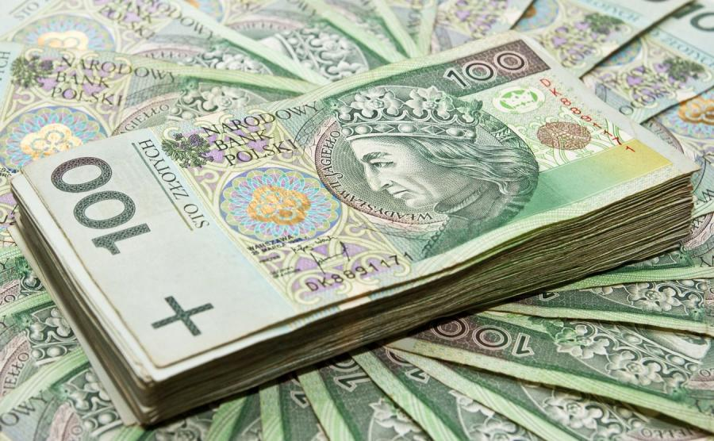
FIRSTLY, PiS argued that a lot of refugees don’t want to work in Poland but they only want to take money from the Polish social system. PiS politicians explained that kind of policy saying that Poland is not wealthy enough to help all of those people.

Slide 5
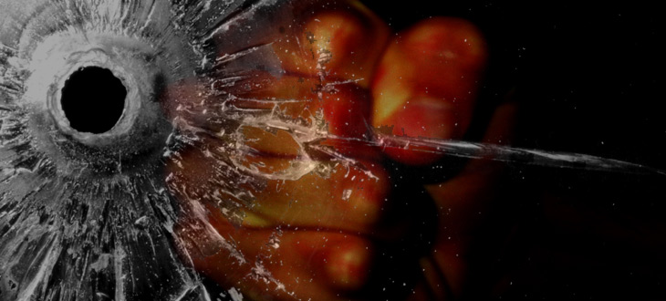
SECONDLY, they also stated that the refugees, who are mostly Muslims, don’t respect European culture. There is a lot of violence, robberies, beating, sexual abuse and even murders in countries which accepted them.

Slide 6
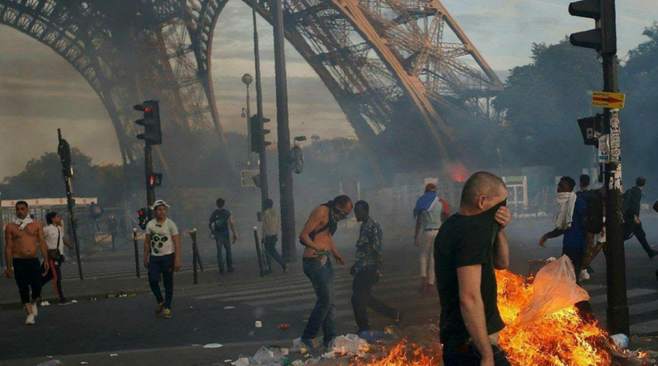
Another issue brought by PiS was that among the imigrants there are a lot of Islamic terrorists who came to Europe in order to kill followers of other religions – consequently, there were many bloody attacks in the Western Europe.

Slide 7
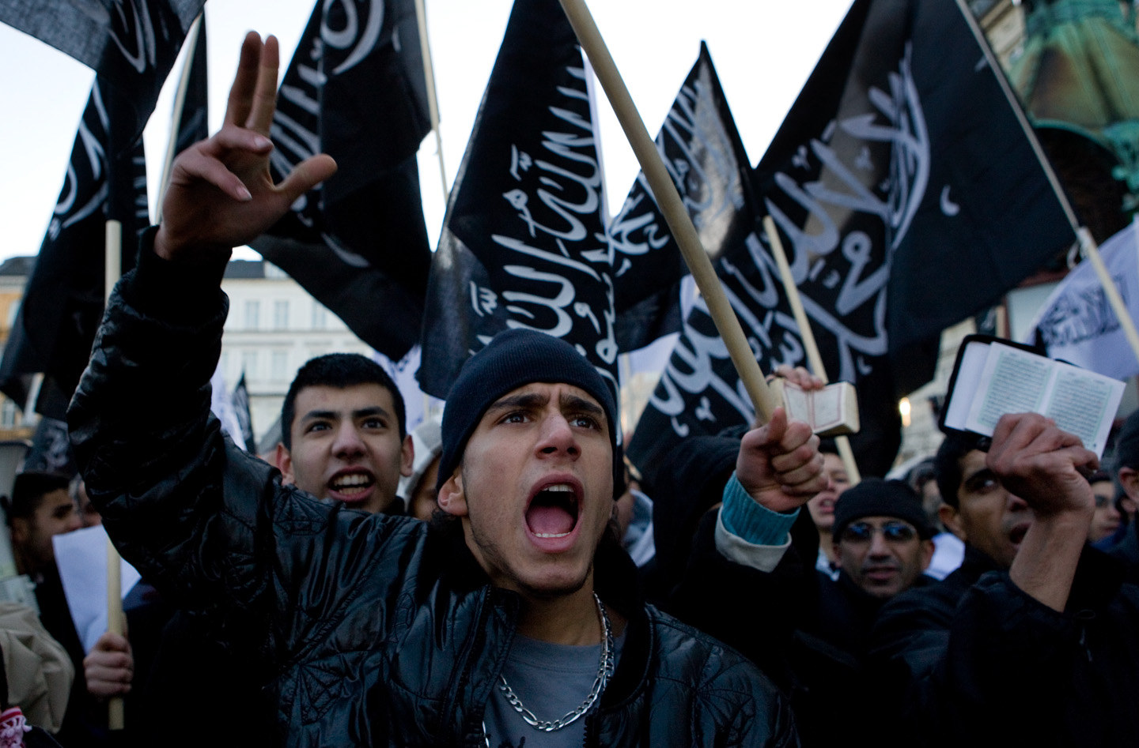
The issue of assimilation was another aspect pointed by PiS. According to the right-wing politicians the refugees don’t assimilate with the community in which they live and they create their own societies where Islamic gangs rule and the Police is not able to control their criminal activities.

Slide 8
FINALLY, the sensitive issue of religion was also used against accepting imigrants.
The main religion in Poland is Christianity and the Islamists are very hostile to Christians which is dengerous and can be the cause of violence and attacks.

Slide 9
Thanks for your attention
Polish team

