Slide 1
Manipulating figures at the local scale : our city’s case
By the French team : Clara Le Driant, Maëlis Fargues, Manon Delas, Crabanat Ilona
For the Meeting in Puerto Real, May 6th to 10th, 2019

Slide 2
TWO FRENCH OFFICIAL INSTITUTES
Notes:
First, we have the National Institute of Statistics and Economic Studies, called INSEE. It is the national statistics bureau of France. It collects and publishes information about the French economy and people.
Then, we have the French Institute for Demographic Studies, called INED. It is a French research institute specialized in demography and population studies in general.

Slide 3
How do the media and the government use figures ?
Quoting incomplete figures
Number of Asylum Seekers accepted in 2017
Source : https://www.elysee.fr/emmanuel-macron/2018/06/15
Déclaration de Didier Leschi, directeur général de l’Office français de l’immigration et de l’intégration (OFII) :
Source : http://www.15h52.net/la-realite-de-l-immanipulation-des-chiffres-de-la-migration-en-europe/
Notes:
A tweet by our President in which he compares asylum seekers in France and in Italy from January to April 2018 : He says that France (with 26000 “twenty-six thousand”) receives more asylum seekers than Italy (18000).
The director of the French Immigration and Integration Office agrees but with different figure : “Italy gave less Refugee papers than France : 33 000 against 40000 for us” he claimed in April 2018. So why do they disagree on numbers ? The President gave a minimized number compared to Leschi but for only 4 months whereas Leschi’s numbers are for the whole 2017 year. Yet when we compare, we can see a huge gap between Germany and France...

Slide 4
Number of asylum seekers accepted by country in 2017
for 1000 inhabitants:
Analysis of the calculation method:
Number of asylum seekers accepted in 2017 : 40 570
French Population in 2017 : 66 770 000
Percentage of asylum seekers accepted compared to the French population :
40 570 × 1 000 / 66 770 000 = 0,60
Notes:
But if we analyse deeper proportionally to the number of inhabitants, we are one of the last European countries to welcome asylum seekers, like Italy. These incomplete statements aim at trying to minimize Italy’s welcoming of migrants in comparison with France and show that we are playing our part in welcoming asylum seekers. Yet, this statement is false compared to the total population number.

Slide 5
Some misconceptions disseminated by politicians
on social networks
Déclaration de Marine Le Pen, le 8 septembre 2015 sur RMC
«Moi, j’ai vu les images des clandestins qui descendaient, qui étaient emmenés en Allemagne de la Hongrie, etc. Eh bien, sur l’ensemble de ces images, il y a 99% d’hommes. Il y a une minorité de familles.
Ces hommes qui quittent leur pays pour laisser leur famille là-bas, ça n’est pas pour fuir la persécution. C’est évidemment pour des raisons économiques »
Sources : https://www.liberation.fr/societe/2015/09/08/non-marine-le-pen-99-des-refugies-ne-sont-pas-des-hommes-ni-des-migrants-economiques
Notes:
On the left, a French politician, Nadine Morano, announces on Tweeter that a large majority of migrants are men which is confirmed on the right, by Marine LePen, on the radio (RMC Channel) insisting on these men fleeing for economic reasons rather than escaping for being persecuted because they left their families in their native countries. Both politicians are right wing the latter being more populist. Let’s check what the figures say :

Slide 6
Immigration flows by sex and age in 2015
Notes:
Once again, these statements are incomplete and lack research. After checking on credible websites, we can see that these are false : there are almost as much women as men. Moreover, according to the UNICEF, children and women now represent almost 60% of refugees and migrants. The aim of the politicians was thus to show that migrants were not asylum seekers but economic migrants thus undocumented and illegal, whereas refugees are protected by Human Rights and must be accepted by European countries.

Slide 7
Based on researches and documents performed previously about manipulating figures :
Who manipulates ?
The media and political movements.
Why ?
To correspond to their wishes and views on this issue.
How ?
By voluntarily missing information or announcing without justification.
Notes:
It’s possible that figures may be manipulated by the media and political movements.
It’s easy to manipulate an audience/public who will be principally focused on the results of figures and less about on those to which they correspond and their origins. That’s why the media rarely have to justify their choices/decisions of definitions.
Sometimes, only by ignorance, figures can be modified because of the lack of information and researches, but generally, they are falsified to match with the wishes of the organizations that disseminates them. That’s why it’s easy to lower or increase figures disclosed to the public.

Slide 8
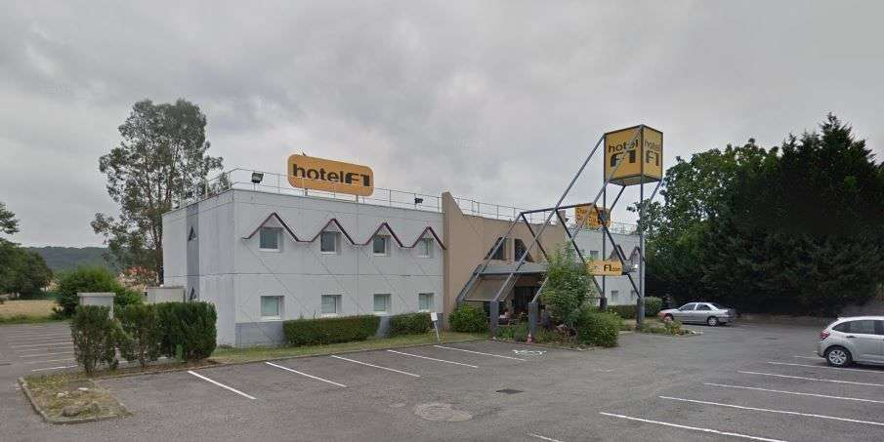
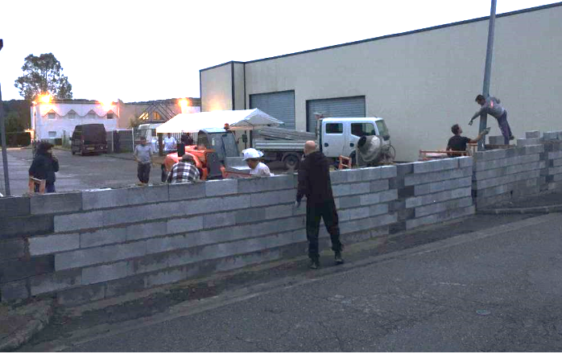
An hotel used as a refuge for migrants
Notes:
In Semeac, a dormitory-town neighbouring Tarbes (where our school is), a hotel is being used as a refuge for migrants. The neighbours first built a wall because they denounced the lack of information.

Slide 9
“ In total, 7700 additional places will be opened “
Notes:
In a local newspaper, numbers have been announced “ in total, seven thousand seven hundred additional places will be opened”. They confused people worrying the neighbours. The numbers announced in that local press were national numbers announced by the government. But at the local scale, those figures were huge and didn’t correspond to what our city or department was actually going to welcome, that’s why people didn’t understand..

Slide 10
Employees’ testimonies:
«Le directeur a été prévenu, par téléphone, le 8 mars, on lui a dit que l'hôtel était vendu, qu'il était licencié et qu'il devait annoncer à son équipe que tout le monde était viré», s'emporte une salariée.
«ça fait 15 ans que je travaille ici et hop, du jour au lendemain, on nous met dehors, comme ça»
«Il paraît que ça va devenir un foyer pour migrants, on n'a rien contre eux, mais franchement, pourquoi dans notre hôtel?
Notes:
The employees do not agree to welcome migrants but they wouldn’t lose their job. They are angry because they denounced the lack of communication from the local authorities.

Slide 11
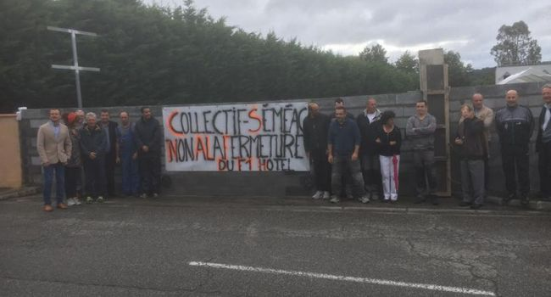
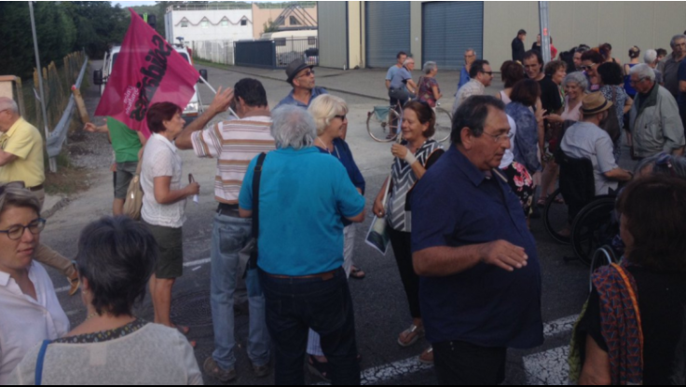
Neighbours’ testimonies
Why are the inhabitants against this project ?
“The collective of Semeac saying “NO TO THE CLOSING OF THE F1 HOTEL”
Notes:
As the employees, the inhabitants were not consulted. For them, it’s a project that was built in a rush.
Also, they say that schools and canteens are too small to accommodate migrants. According to them, the city is not equipped enough for the daily life of both inhabitants and migrants.
That’s why the residents decided to protest against this project and build a wall.

Slide 12
The “National Front ” is a right-wing populist and nationalist political party in France.
Notes:
Now the name has changed and is now called the “Rassemblement National” (you can translate by “National Rally”); The main leader is still Marine Le Pen.

Slide 13
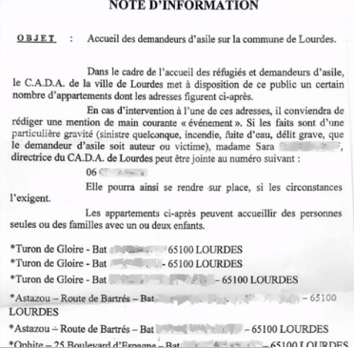
The Front National denounces the supposed instructions given to police officers to make only handrails in case of problems with migrants.
Text that reveals the addresses of migrants.
Notes:
For months now, the Front National has been multiplying its initiatives against the welcoming of migrants. On social issues, the National Front of our department was outraged by the presence of two hundred fifty illegal migrants in the commune of Lourdes. Therefore, its local leaders decided to publish an internal memo, intended for the police, which revealed the addresses of the housing of these alleged migrants. The department secretary of the party said "We do it to inform the people of Lourdes since they pay their taxes. Why should it be hidden.They occupy social housing that should be given to French people. Terrorists can hide among them.” The Prefecture denied the figure of 250 migrants and claimed that only 108 asylum seekers were staying in Lourdes. Here not only figures are manipulated : the difference between the words “migrant” and “asylum seeker” is also relevant of the power of words to manipulate populations who cannot always make the difference between what the choice of words may legally imply.

Slide 14
CONCLUSION
Notes:
Depending on the newspapers and the media, the figures given vary which causes the confusion of the French people. Some may even be wrong. When the numbers are poorly explained, people sometimes do not understand, it can lead to a “rebellion” as for our example in Semeac.
It is better to learn about official sites such as INED and INSEE. We must therefore consult several articles in order to compare them and to know the real information.

Slide 15
Sources of information
https://www.insee.fr/fr/accueil
https://en.wikipedia.org/wiki/Institut_national_d%27%C3%A9tudes_d%C3%A9mographiques
https://www.ladepeche.fr/article/2017/04/30/2565790-l-hotel-f1-va-devenir-un-centre-d-accueil.html
http://www.larepubliquedespyrenees.fr/2017/07/24/semeac-65-des-riverains-murent-l-entree-d-un-hotel-destine-aux-migrants,2143537.php
https://www.sudouest.fr/2017/07/24/hautes-pyrenees-des-riverains-murent-un-hotel-transforme-en-centre-pour-migrants-3642287-4344.php
https://www.lepoint.fr/video/hautes-pyrenees-le-fn-divulge-les-adresses-des-migrants-vivant-a-lourdes-20-10-2016-2077404_738.php
http://www.15h52.net/la-realite-de-l-immanipulation-des-chiffres-de-la-migration-en-europe/
https://www.francetvinfo.fr/replay-radio/le-vrai-du-faux/le-vrai-du-faux-une-tres-grande-majorite-d-hommes-parmi-les-migrants_1845049.html
Notes:
Thank you for your attention !

