Slide 1
Spain

Slide 2
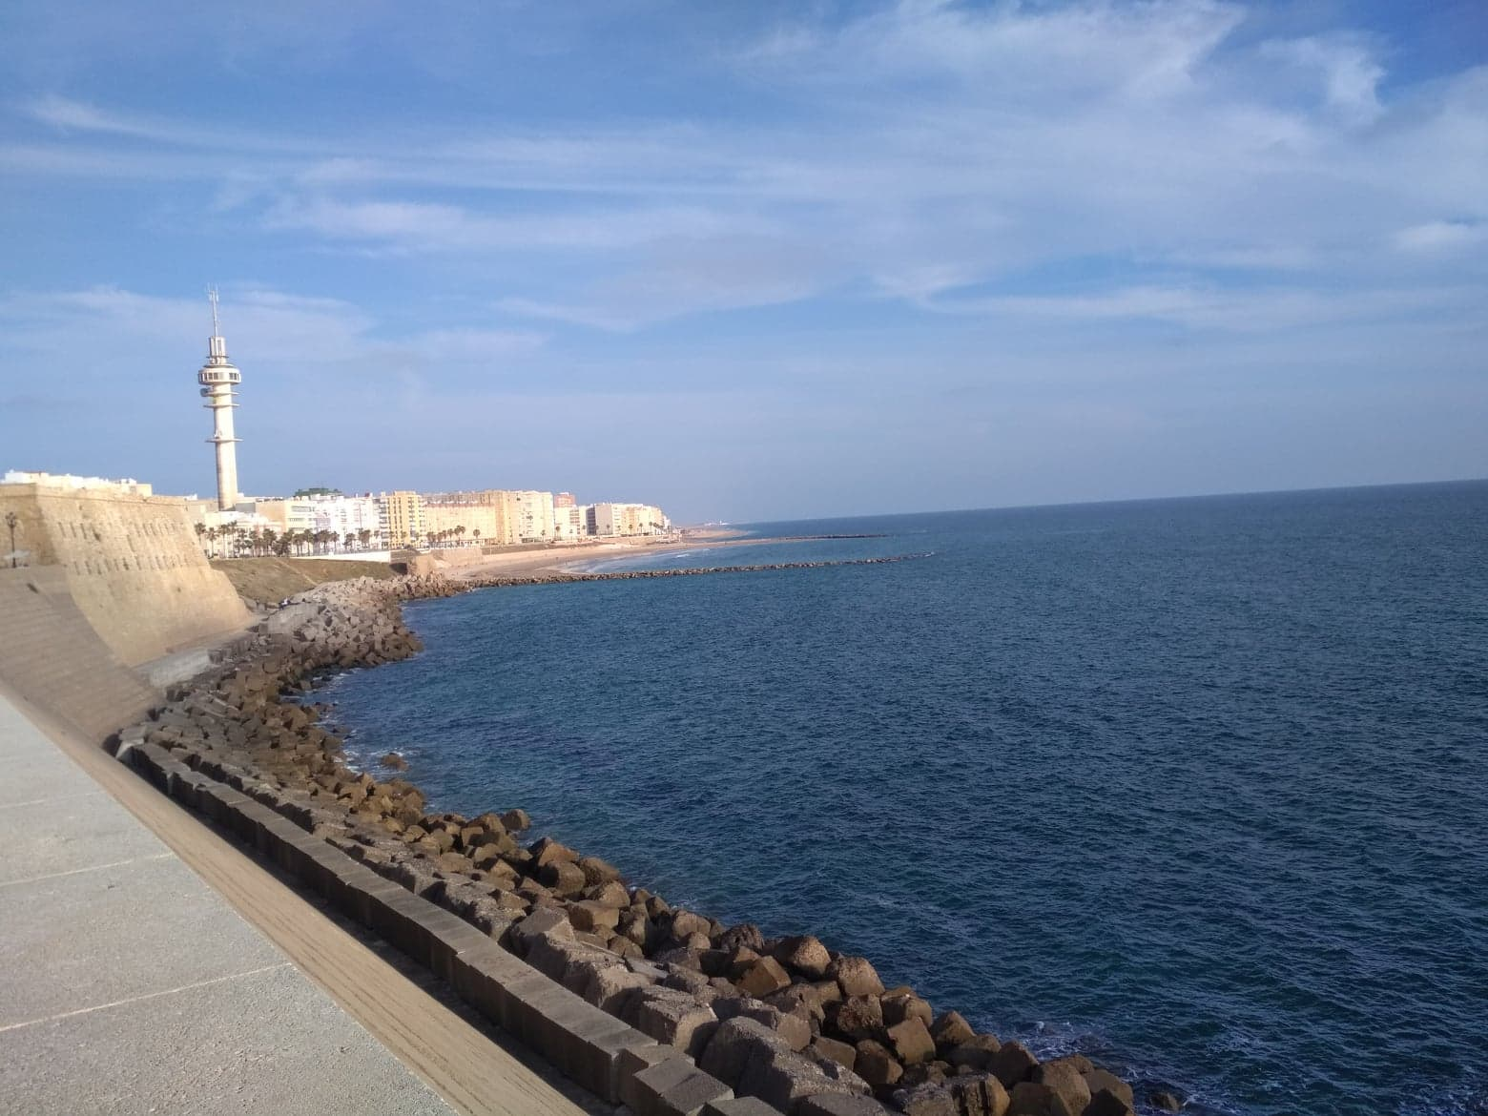
Spain
One of the most beutiful beaches – Playa de Santa Maria, where we spent a wonderful time swimming, sunbathing and chilling.

Slide 3
Spain

Slide 4
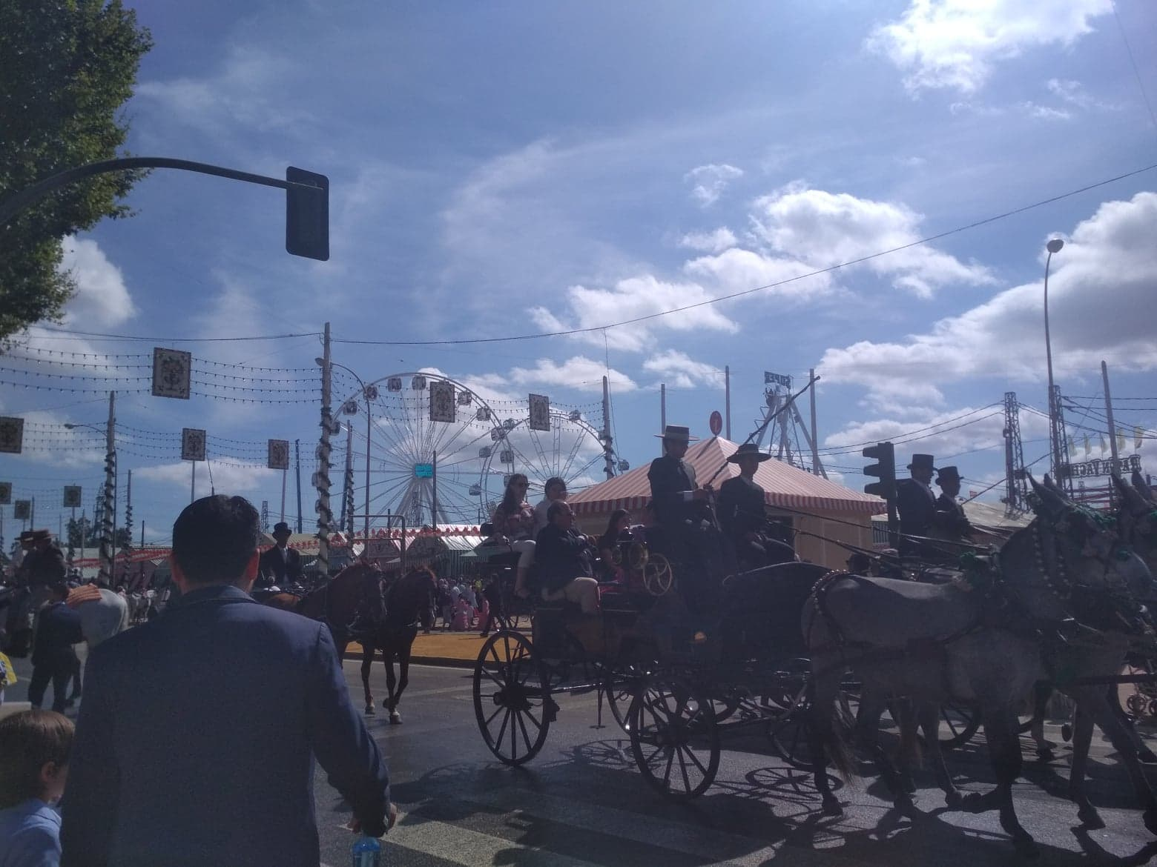
Spain Feria in Seville – spanish festival, going there was an amazing experience.

Slide 5
Spain Cathedral in Seville – impressive building in gothic style, amazing outside and inside.

Slide 6
Spain

Slide 7
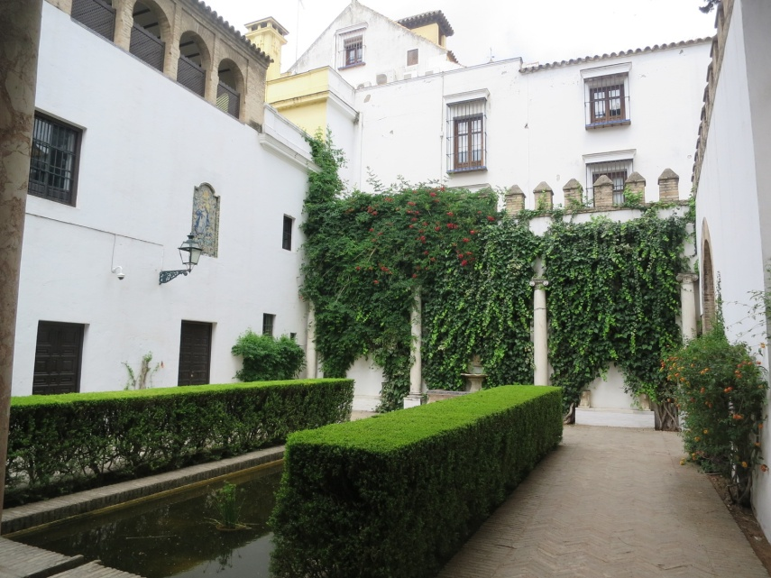
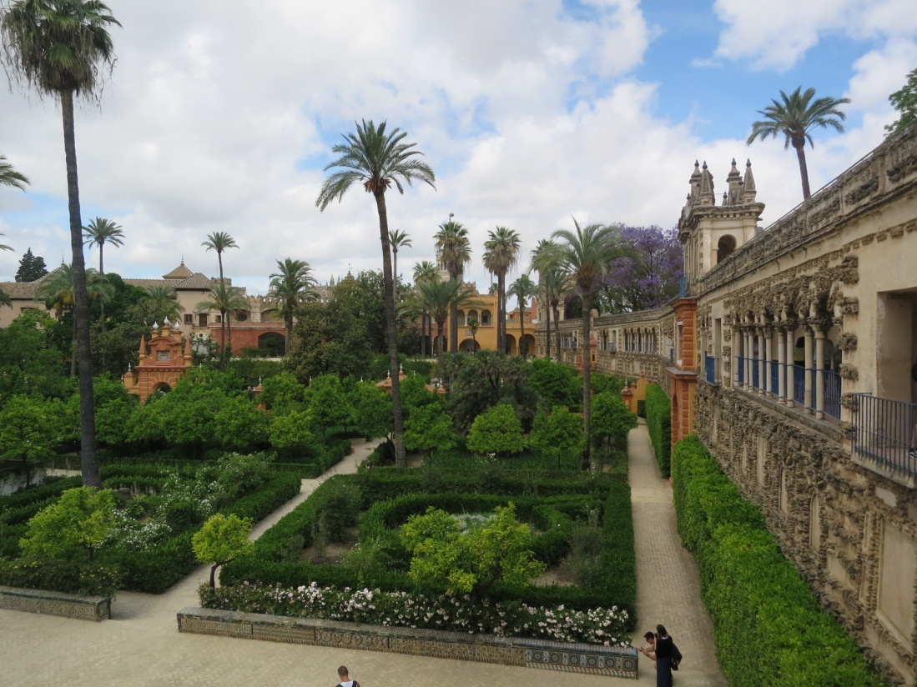
Spain Breathtaking garden in Seville – Real Alcazar de Sevilla, spend there few hours enjoying the oriental view.

Slide 8
Spain Another beutiful view of Spain

Slide 9
Spain Playa de Bolonia in Tariff – known as a most beutiful beach in Spain, unfortunetly that day was very cloudy, but we all had fun anyway.

Slide 10
Spain Bolonia

Slide 11
Spain But what’s the most important – we’ve met a lot of wonderful people which we’ll never forget.

Slide 12
Thank you for the attention

