Slide 1
Lithuanians Abroad & Foreigners in Lithuania

Slide 2
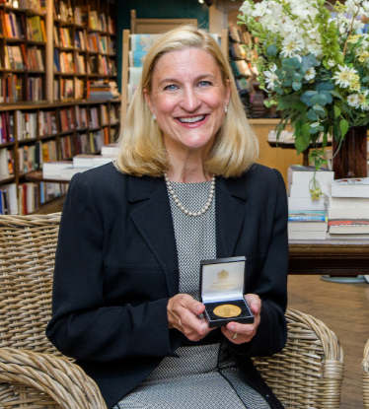
Rūta Šepetys
Rūta Šepetys is a Lithuanian-American writer of historical fiction. As an author, she is a #1 New York Times bestseller, an international bestseller, and the winner of the Carnegie Medal. She is the first American writer of young adult literature to speak at the European Parliament. Her work is published in over fifty countries and thirty languages and is currently in development for two films.

Slide 3
Rūta Šepetys’s most famous book
“Between Shades of Gray”

Slide 4
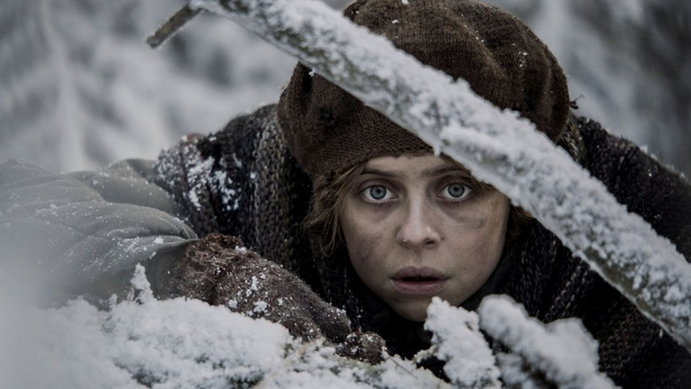
Scenes from the movie “Ashes in the Snow”

Slide 5
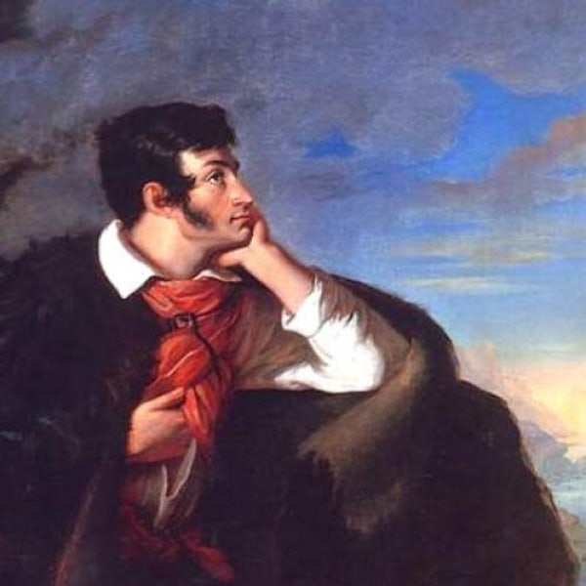
Adomas mickevičius
(1798-1855)
Poet
Publicist
Political figure

Slide 6
He regarded himself as both Lithuanian and Polish

Slide 7
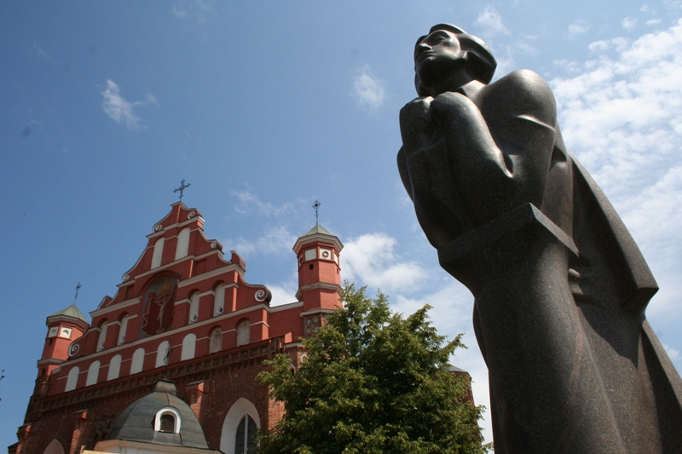
His work inspired Lithuanians to seek independence not only in the XIXth century, but in the XXth century as well

Slide 8
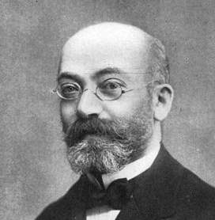
Ludwik Lejzer Zamenhof (1859-1917)
He was a Polish-Jewish optician of the Lithuanian origin.
Best known as the creator of the Esperanto language.

Slide 10
Esperanto- the most successful constructed language

