Slide 1
Influence of emigration in European and Italian arts and architecture
Erasmus meeting in Poland
Końskie, 10th-14th December 2018
Serena Saija
Marica Salvo
Emanuela Perroni
Alessia Seminara

Slide 2
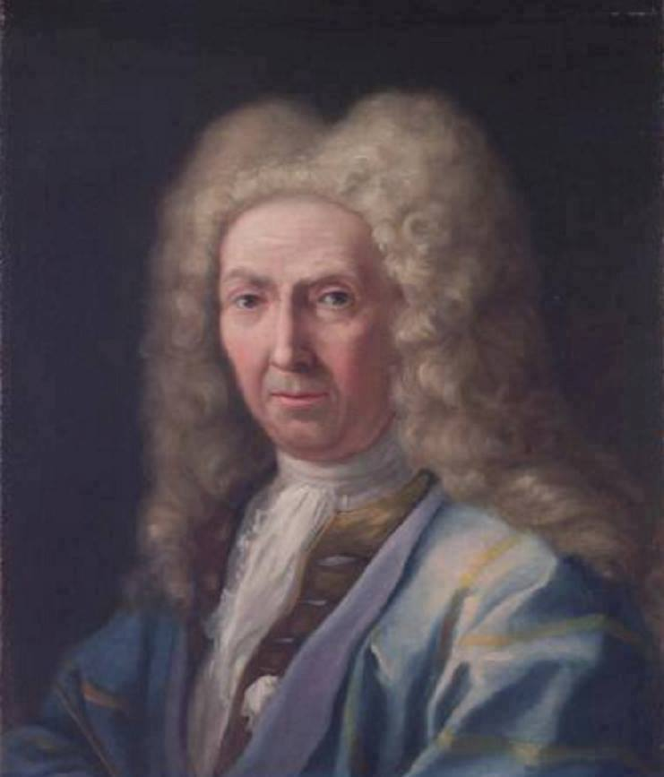
Gaspar van Wittel
Gaspar van Wittel is known in Italy as Gaspare Vanvitelli, or as Gasparo degli Occhiali. He was born in Netherlands, in Amersfoort, but he moved to Rome in 1674 and here he had a long career as painter and draughtsman.
He lived mainly in Rome, but he also toured the country and painted in Florence, Venice, Milan and Naples.
His works are exposed in many Italian and European cities.
We have a big collection of his paintings in Reggia di Caserta, a royal palace near Naples.

Slide 3
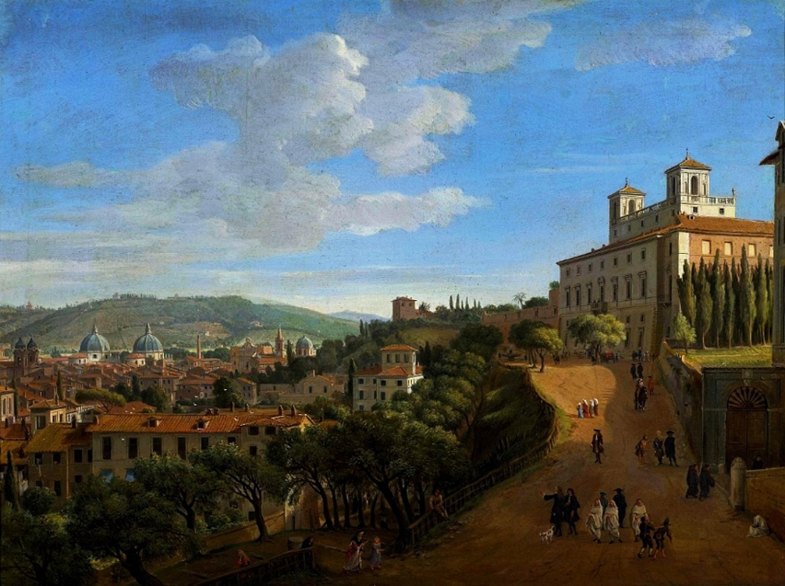
Veduta di Roma da Villa Medici
This is one of van Wittel’s works. It represents a view of the city of Rome, from Medici’s villa.
Today, it’s located at Warsaw National Gallery.

Slide 4
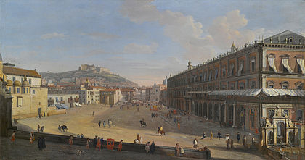
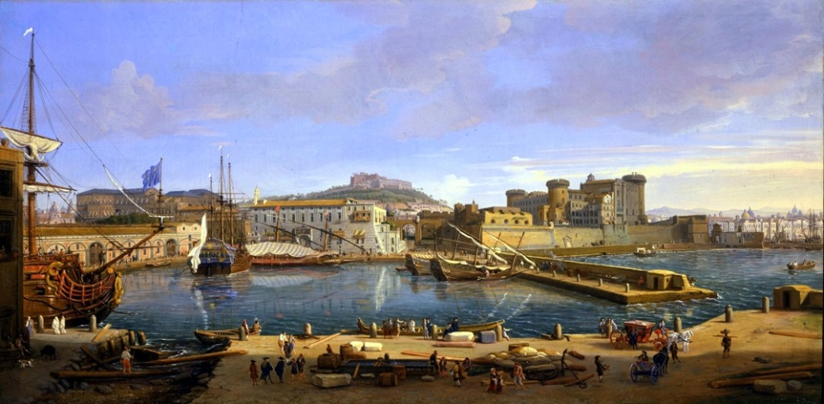
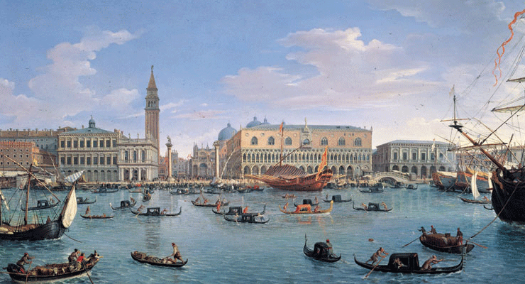
Other works of Gaspar van Wittel
Veduta del Largo di Palazzo, Palazzo Zevallos, Napoli
Vista del porto di Napoli
Il Palazzo Ducale di Venezia visto da San Giorgio

Slide 5
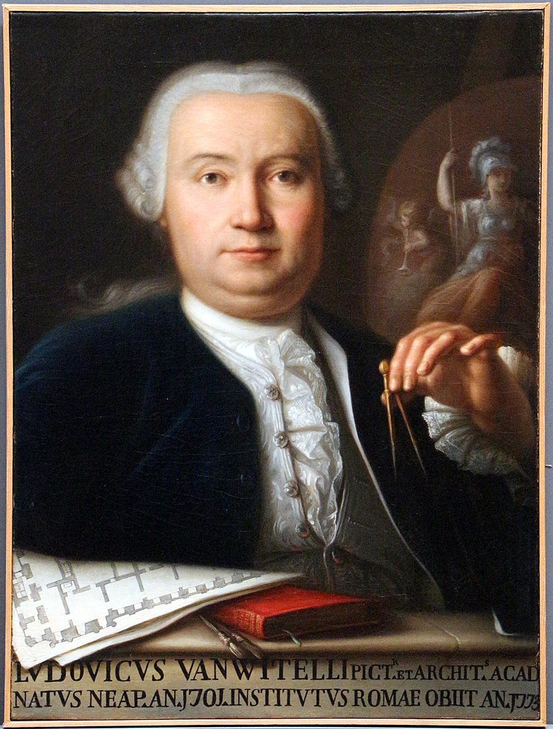
Luigi Vanvitelli
Luigi Vanvitelli is the Italian name of Lodewijk Van Wittel. He’s one of Gaspar Van Wittel’s sons. He was one of the greatest Italian architects between baroque and classicism age. He brought French style to Italy, and we can notice it in the Reggia di Caserta, which is inspired to the Royal Palace of Versailles, in France.

Slide 6
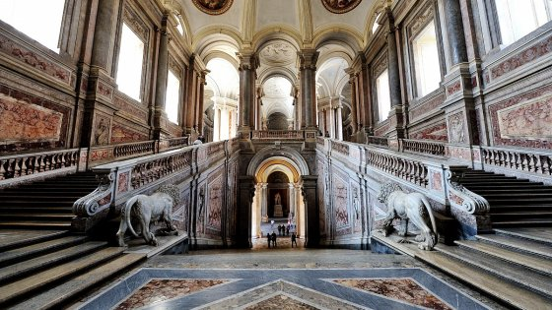
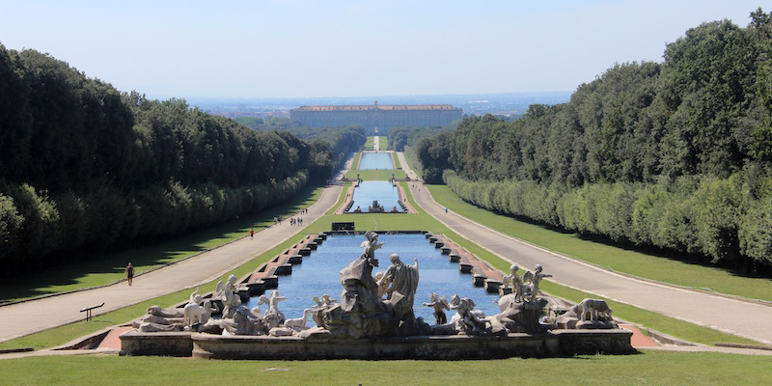
Reggia di Caserta
The Reggia di Caserta is the biggest royal palace in the world. It has 1200 rooms, including Throne Room, that is the largest.
The park surrounding the palace is of great majesty: scenic fountains with waterfalls, bridges, sculptures. Really important is the English Garden, characterized by plants from different parts of the world planted here for the first time.

Slide 7
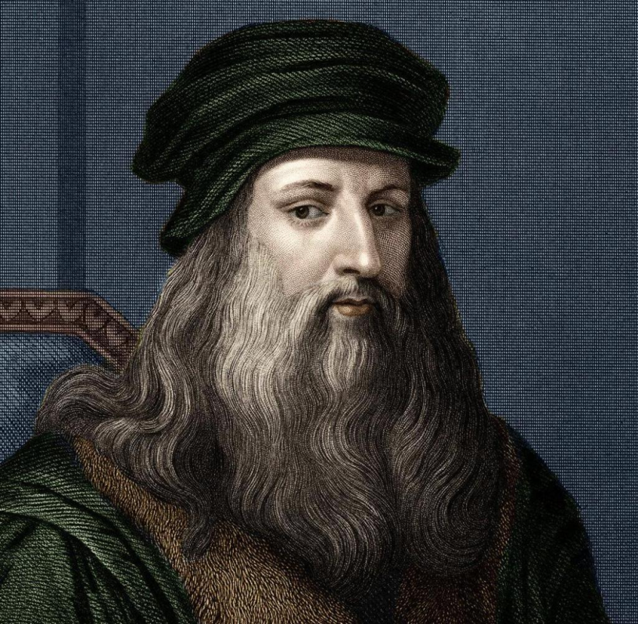
Leonardo da Vinci
Leonardo Da Vinci, was an Italian painter, architect and scientist. He is the one who laid the foundations of the culture of the sixteenth century. He toured around Italy, and, in Florence, he painted “La Gioconda”, the most famous portrait in the world. At end of his life he moved in France, and he took many of his paintings with him.

Slide 8
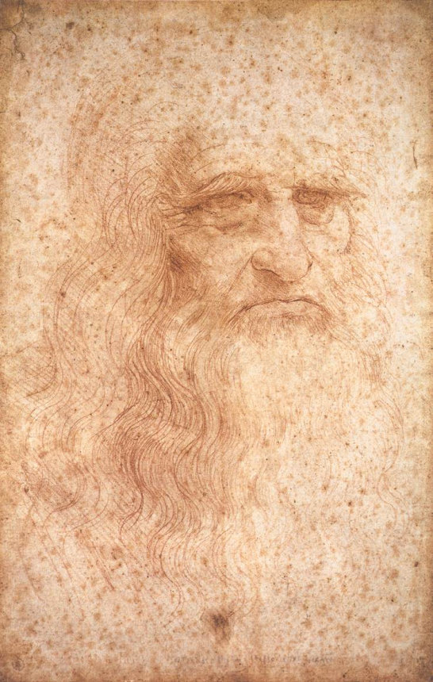
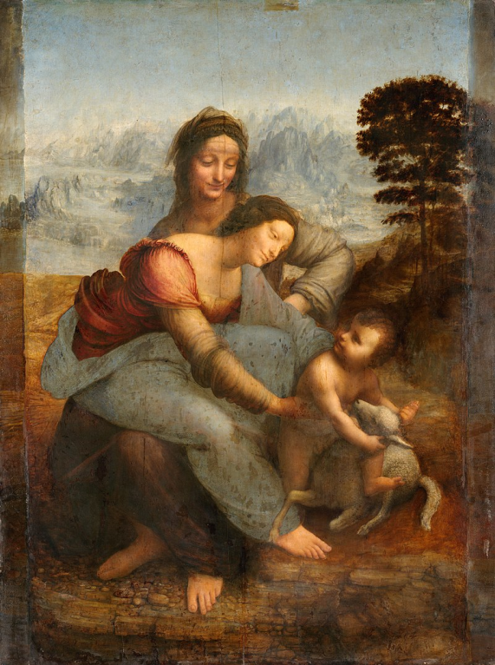
Works made in France by Leonardo
The portrait of a man in red chalk, is accepted as
a self portrait of Leonardo DaVinci.
The portrait was made in France, during the last
years of the artist's life.
The work shows the face of a man with long
hair and long beard with a serious expression.
It is preserved in the in the Biblioteca Reale, Turin.
The Virgin and Child with Saint Anne is an oil painting
depicting St. Anne, her daughter the Virgin Mary and the
infant Jesus. It is preserved in the Louvre Museum
in Paris.

Slide 9
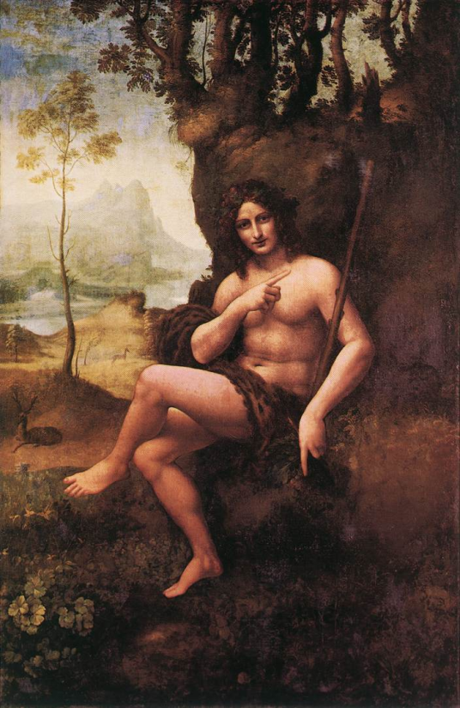
Other masterpieces of Leonardo Da Vinci
St. John the Baptist
Bacchus
Musée du Louvre, Paris, France.
Musée du Louvre, Paris, France.

Slide 10
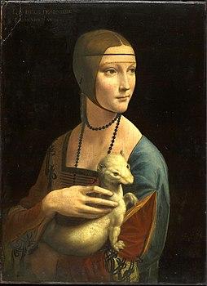
We would like to remember one last work of Leonardo, Lady with an Ermine.
Preserved for years in the Czartoryski Museum in Krakow, the work today is at the National Museum in Krakow.

