Slide 1
Migration Matters
Team Germany

Slide 2
Structure
Refugees in Germany
Number of refugees per year
How can the media influence and manipulate us ?
Strategies of manipulation

Slide 3
Refugees in Germany

Slide 4
Number of Refugees per Year

Slide 5
Refugees in Germany
7 articles about the topic of refugees are published each day
much space for fake news
Journalists don´t control the politics, they control the behaviour of the society
Journalists constantly fail because they develop a false opinion in some people‘s mind instead of provoking a discussion

Slide 6
Strategies to Manipulate
If you control the media, you also control the people!
1. trivialization: Trivializing terms are used to play down certain events.
2. exaggeration: Exaggerations are used to highlight events in a targeted way and to bring people's opinions in a desired direction.
3. repetition: Consciously repeating lies all the time is a very effective way of injecting a desired opinion into the population.
4. allegations: Unverifiable claims serve to put a target group in a bad light and to spread a theory as truth.

Slide 7
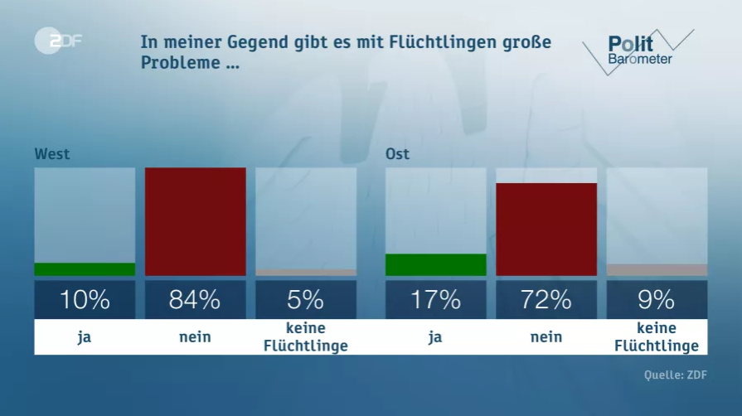
strategies to manipulate

Slide 8
strategies to manipulate
In order to create a clear survey you have to…
1. ask for clearly questions, no generalisation
some people could have harmless problems e. g.
that they don´t have enough language courses
in their town
a false image is created

