Slide 1
Spain
6-10th April 2019

Slide 2
Monday

Slide 3
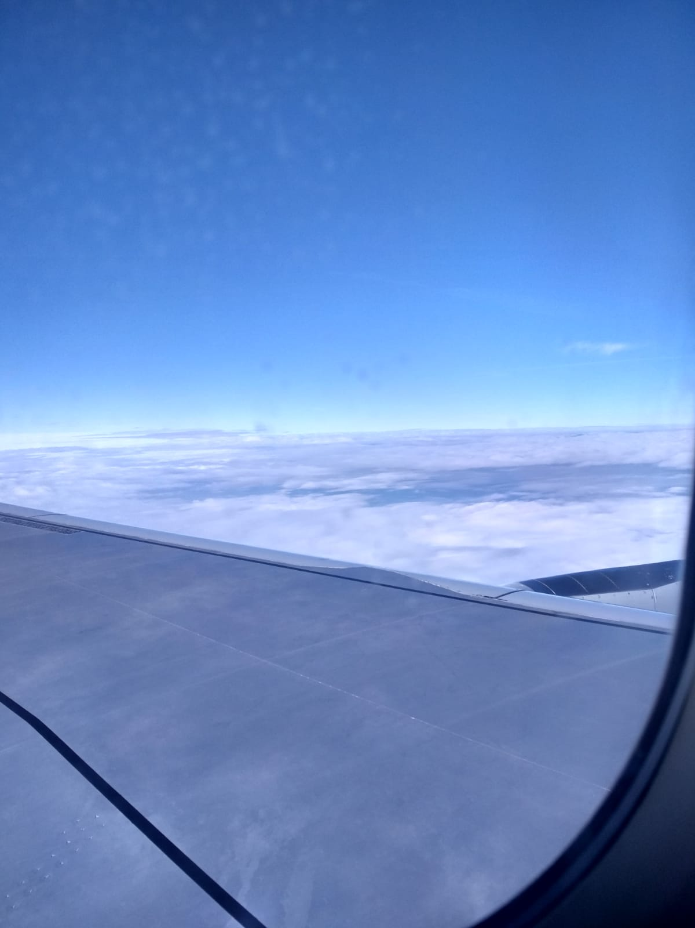
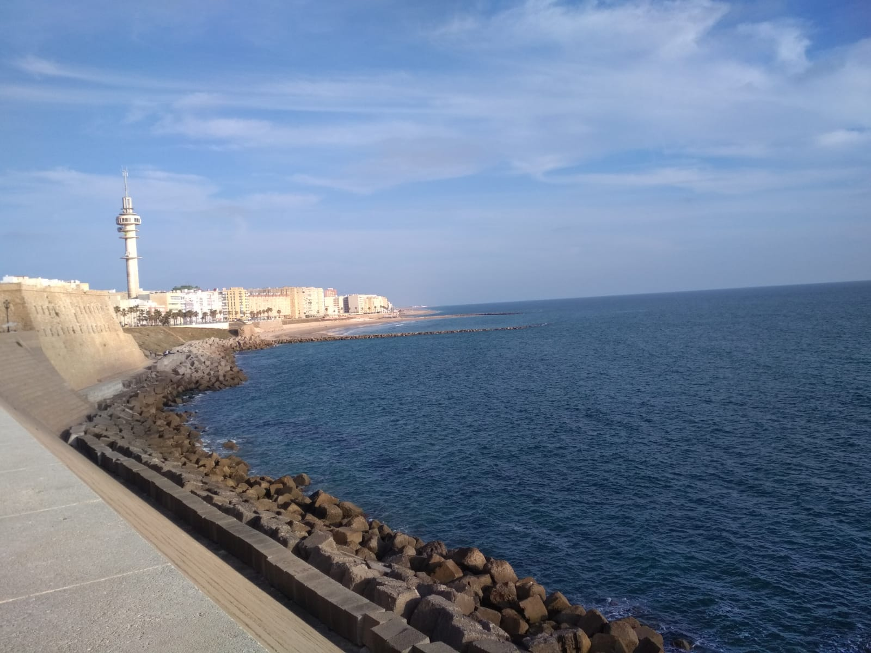
It was a long and tiring night. After 2am we went to the airport and then, after a long wait, we flew from Warsaw to Brussels and then directly to Sevilla. As it turned out, there wasn't one of our suitcases at the airport. It took a little time to master the situation. However, after arriving by train to Puerto Real our good moods returned, because we met our hosts.

Slide 4
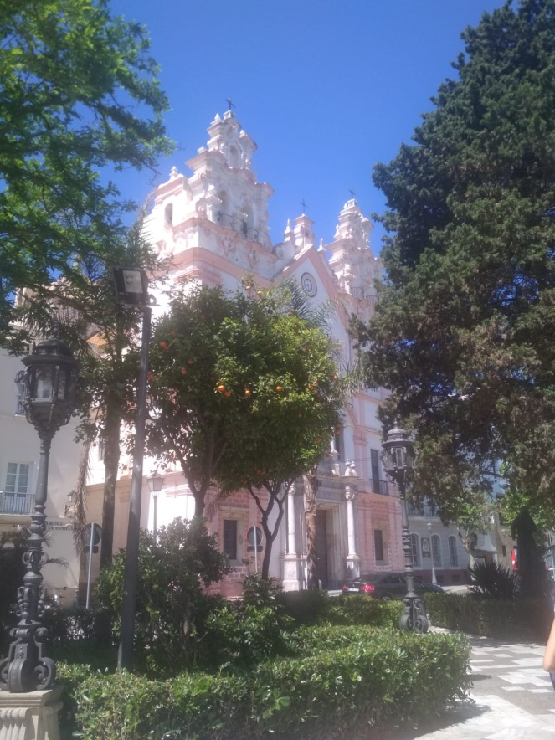
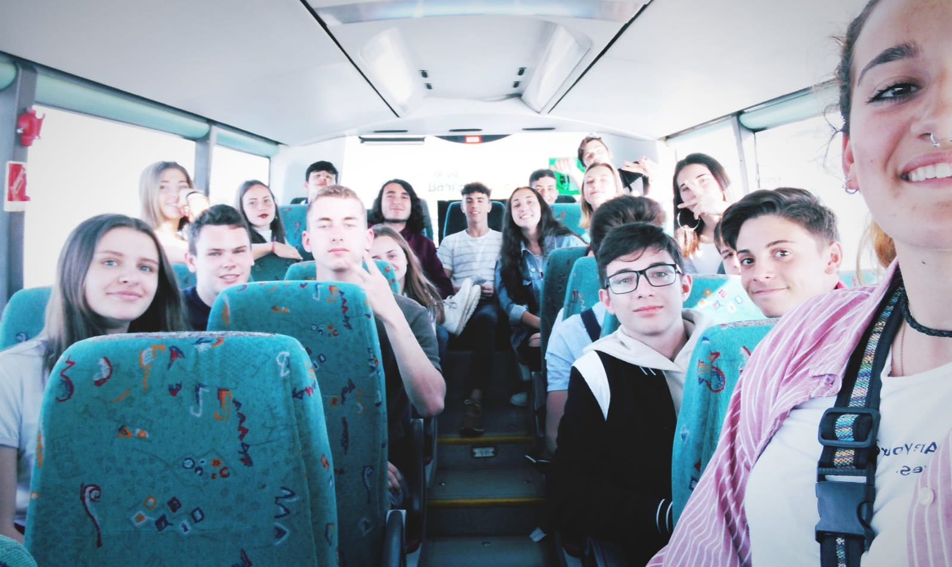
After getting acquainted with our temporary residence and host families, we decided to go to Cádiz with people from Erasmus and spend time exploring the city and eating dinner there. We had a lot of fun!

Slide 5
Tuesday

Slide 6
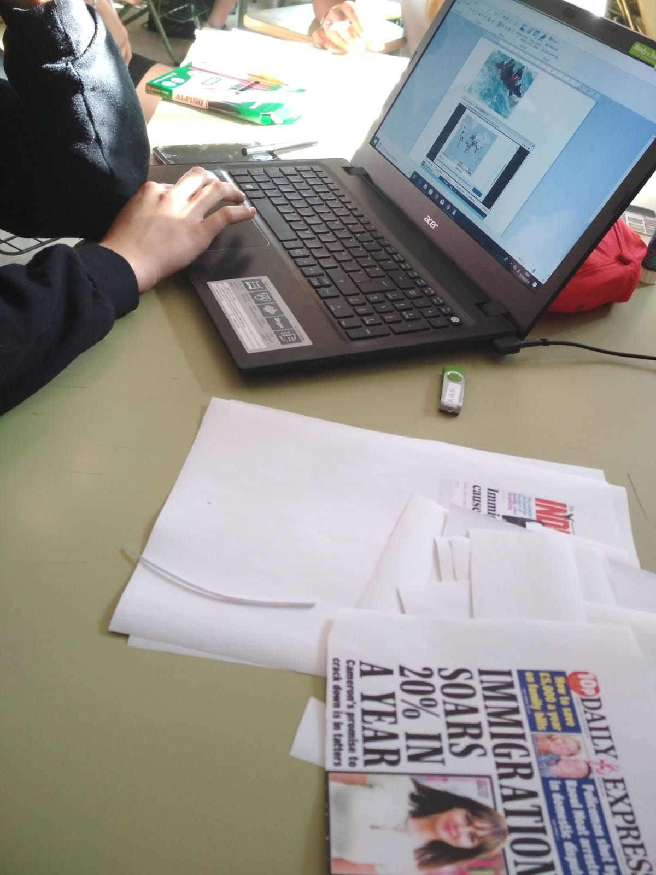
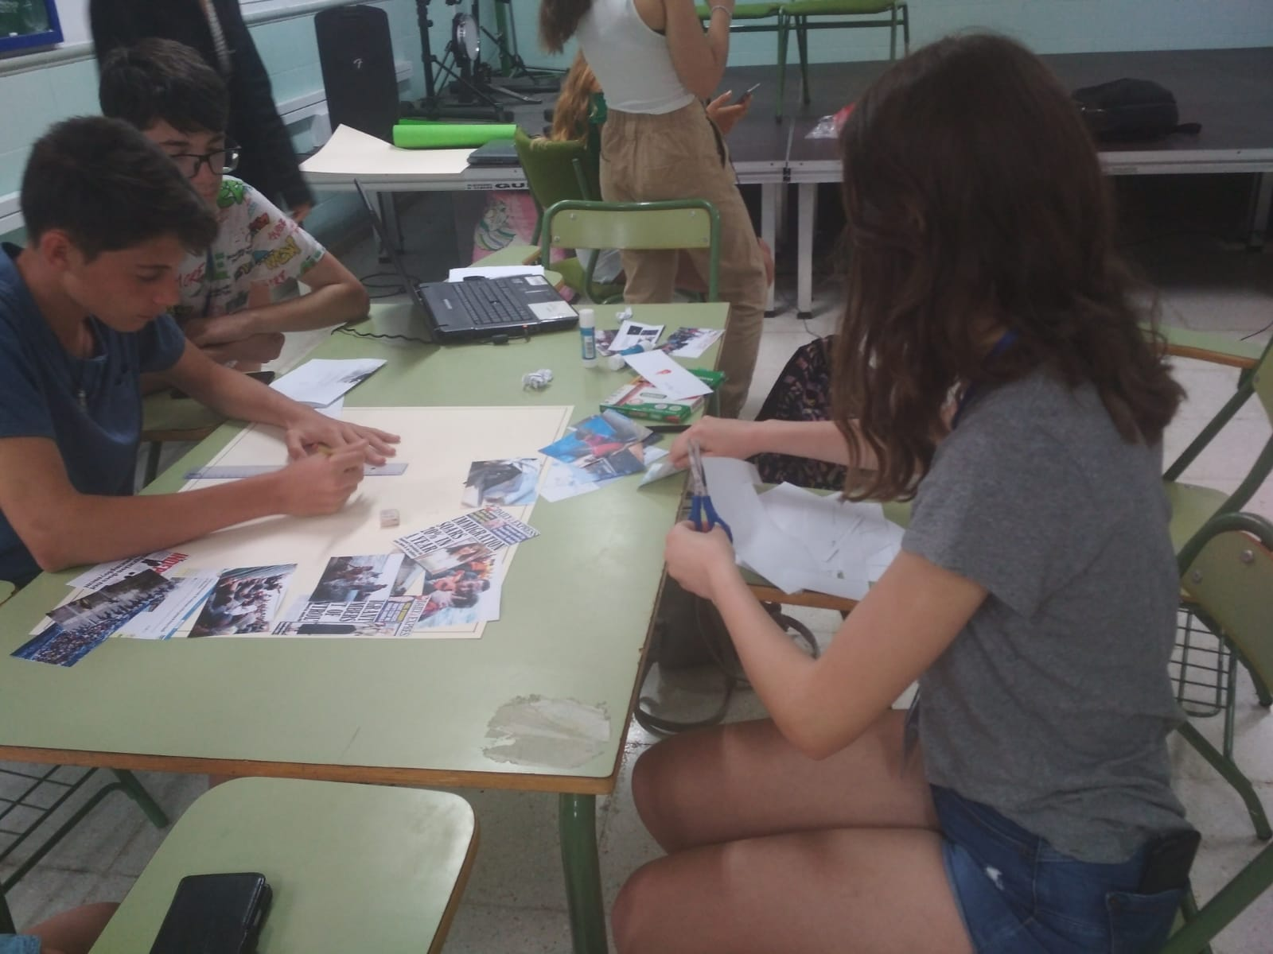
The next day was more exciting. First, we went to school with our hosts and we could see what the lessons in Spain look like. Although we didn't understand anything, it was quite interesting. Then, everyone gathered in one room and in groups we made various posters, whose topic was, of course – migrations.

Slide 7
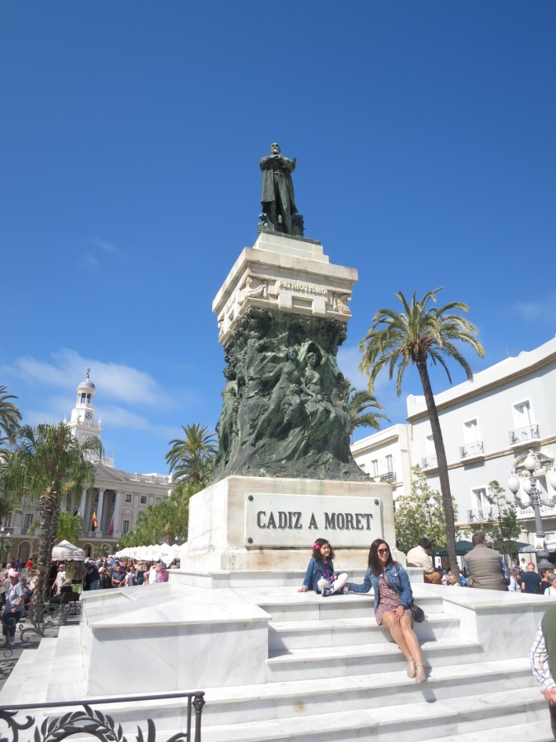
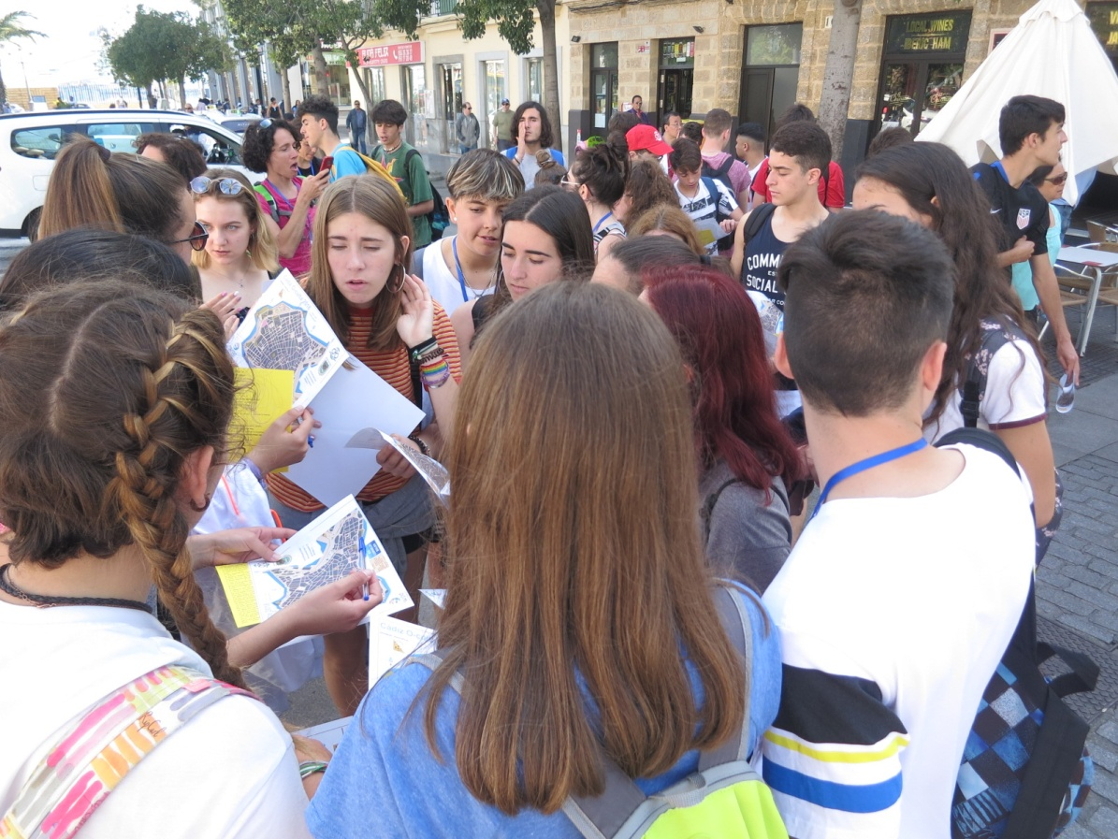
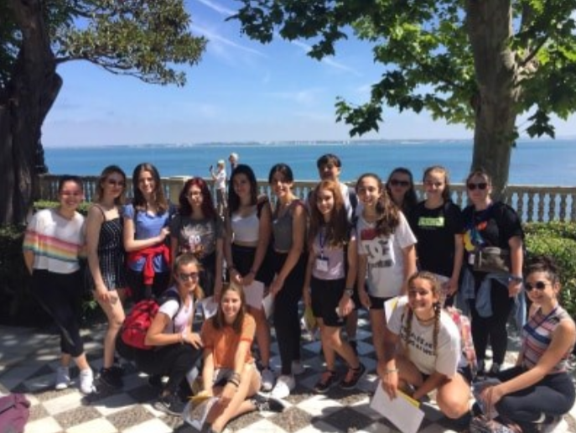
Then the main point of the day began - a trip to Cadiz. On the spot we all got maps and tasks that we had to do at a particular time. Walking around the city was really tiring but everyone had a great time.

Slide 8
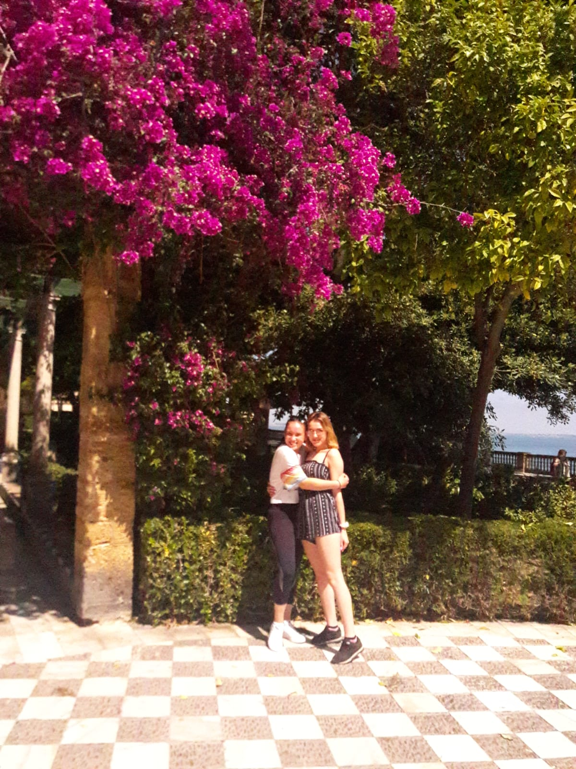
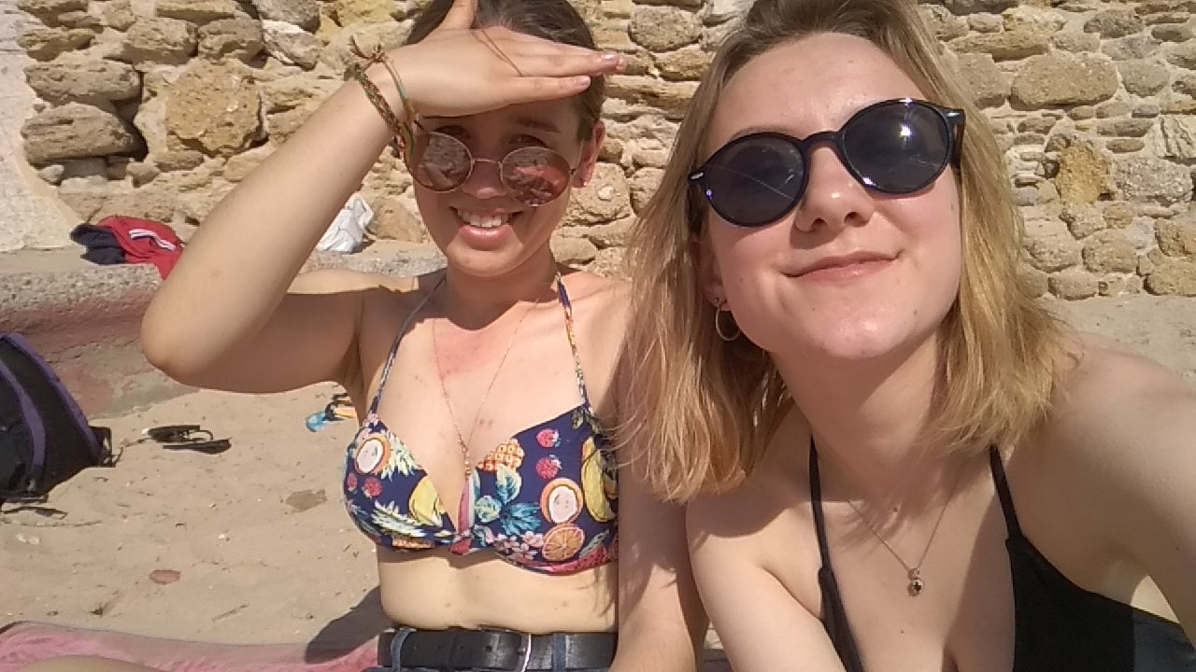
Then we had free time, so everyone decided to go out for a dinner (we ate traditional food, for example tortilla) and then - to the beach. Spanish beaches are the most beautiful!

Slide 9
Wednesday

Slide 10
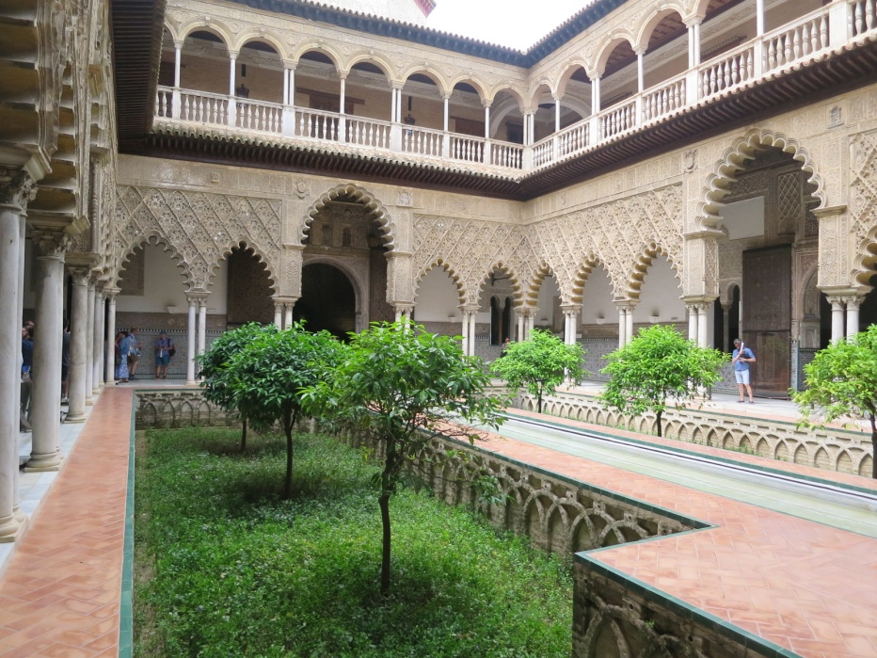
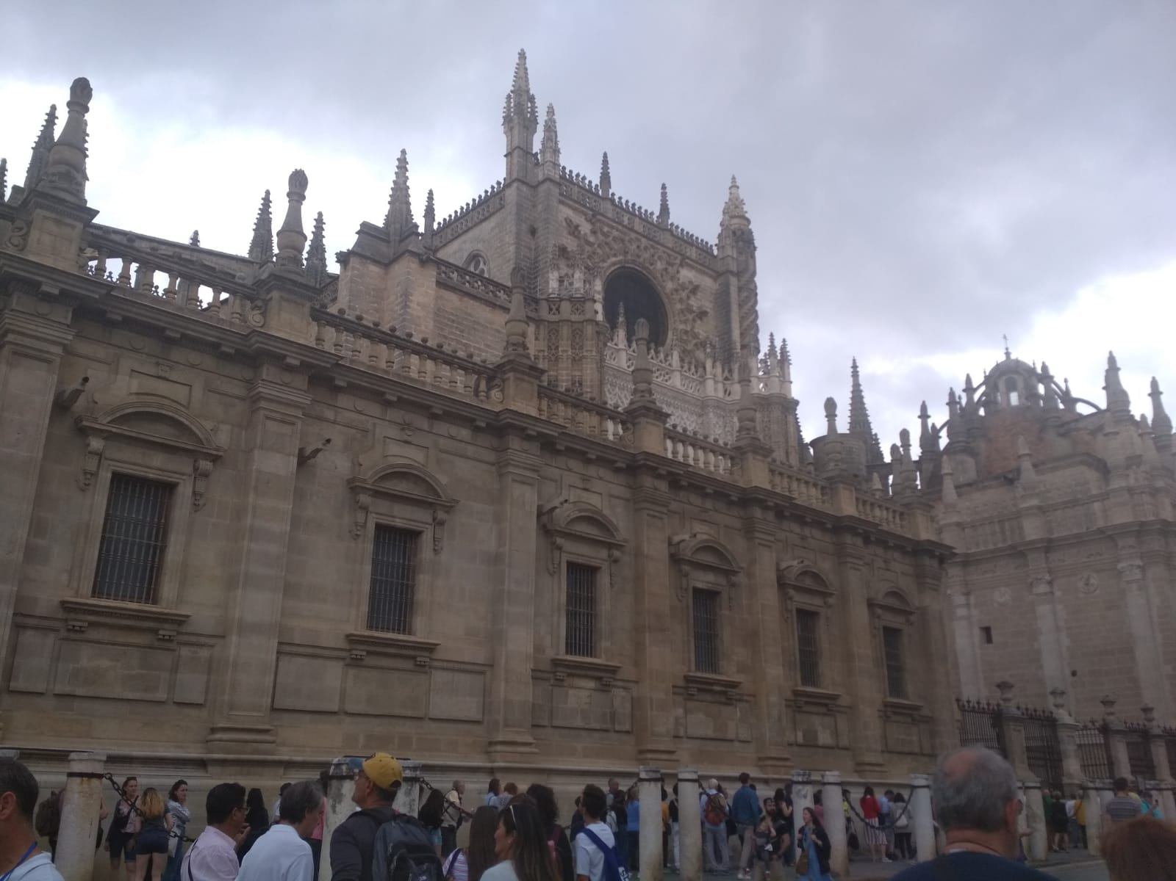
The next day we went on a trip to the larger city – Seville. It's a such beautiful place! City is amazing, palms are everywhere and the small streets in the city are simply magical. We visited a lot of monuments - Cathedral, Giralda Tower and finally the Old Town. Although the weather wasn't favorable at the beginning (it was cloudy and windy), finally the sun came out.

Slide 11
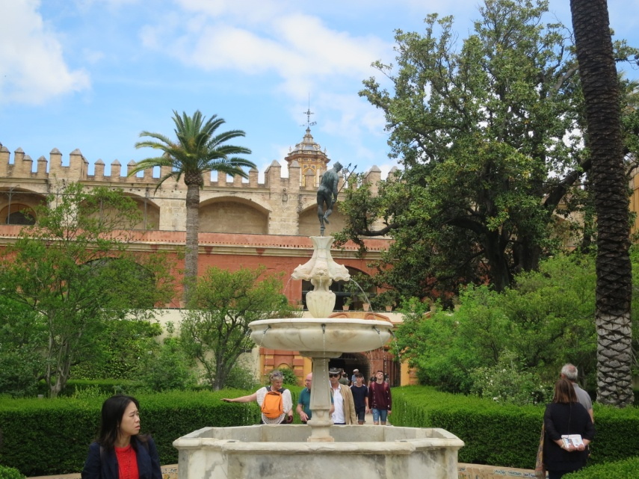
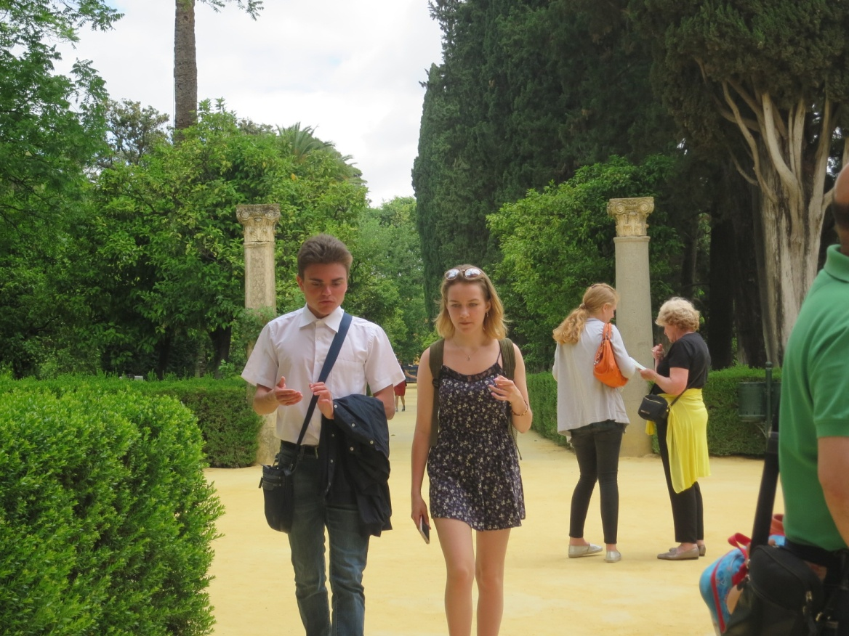

Slide 12
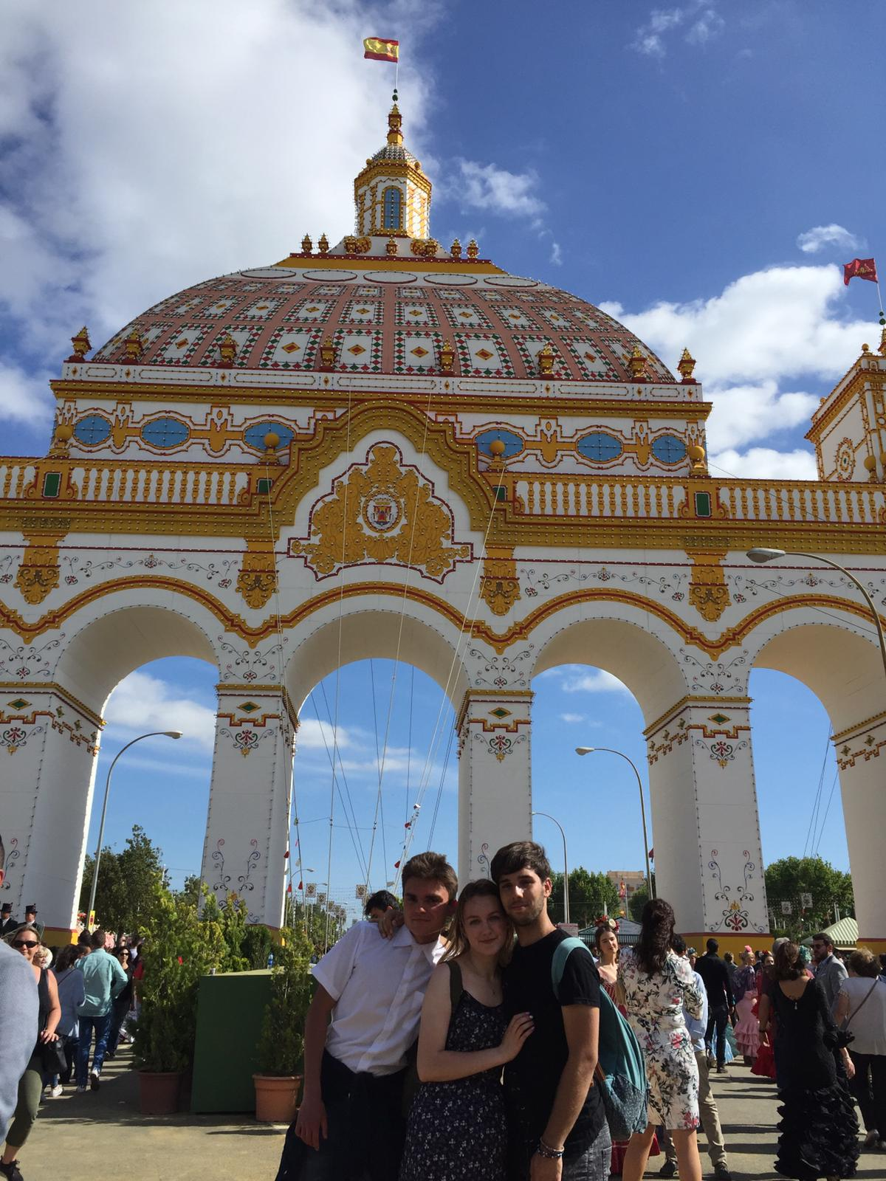
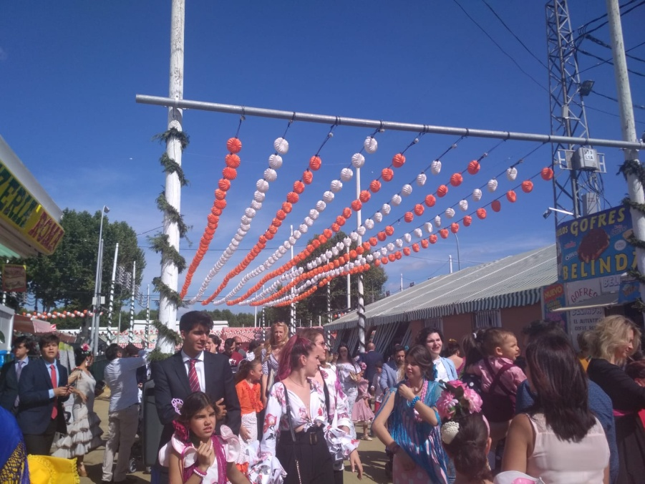
In the city, at that time, there was a traditional Spanish holiday - Feria. On the large square there were a lot of people who sang, danced,ate traditional dishes and simply had fun. There were many stalls, a funfair. Men were elegantly dressed - in shirts, and women in traditional, colorful dresses. Everyone looked unearthly. The place was very colorful and it looked magnificient.

Slide 13
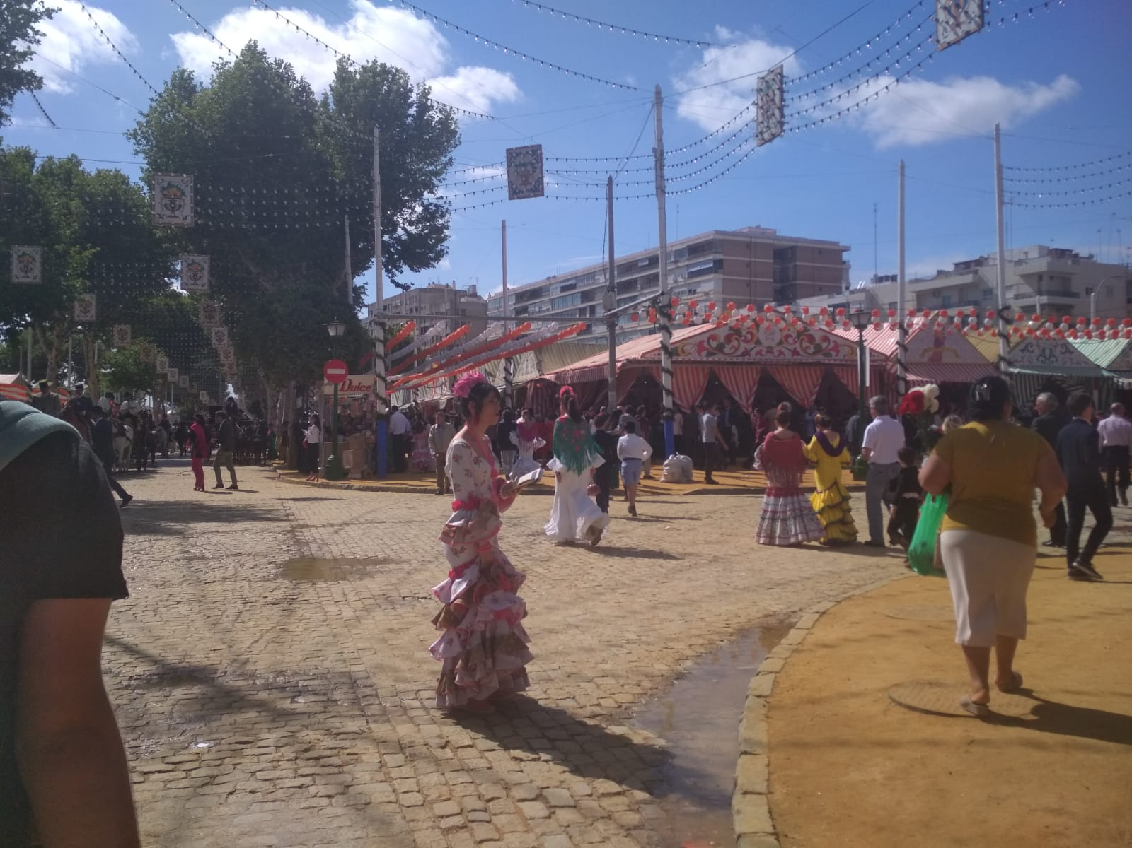
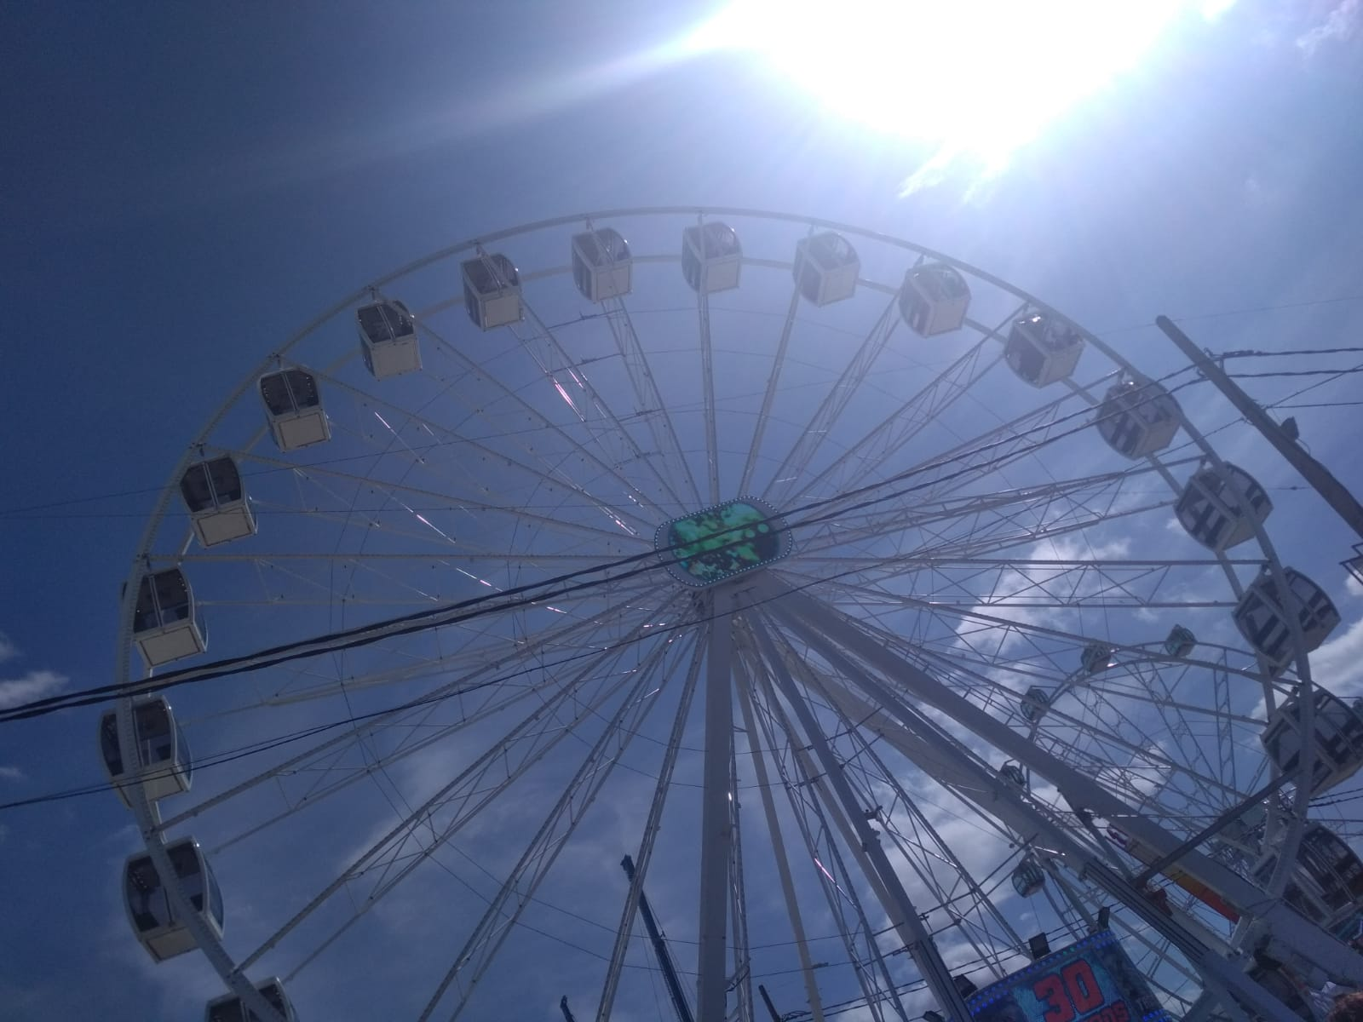
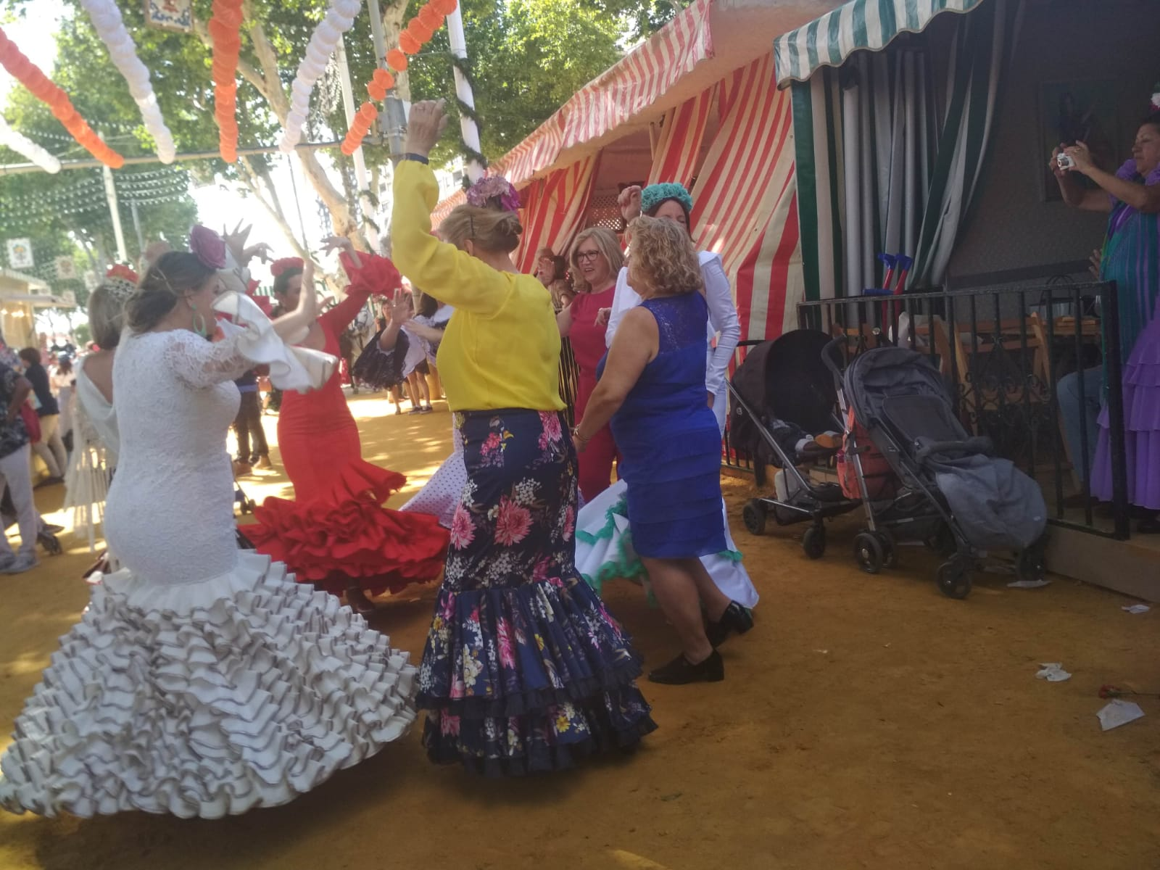

Slide 14
Thursday

Slide 15
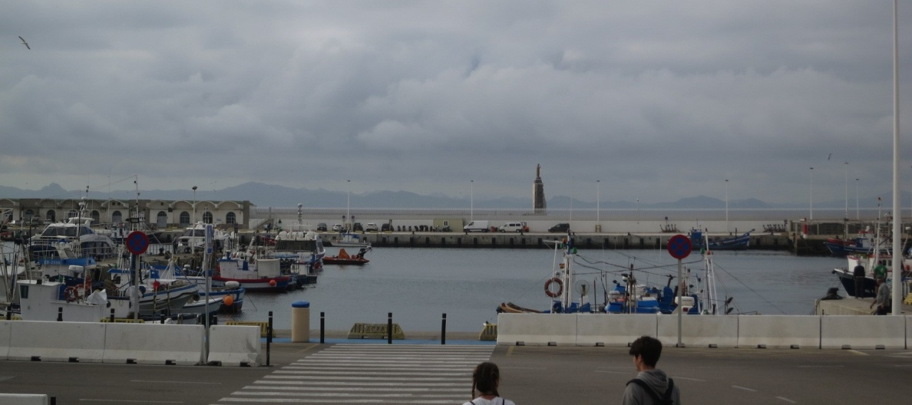
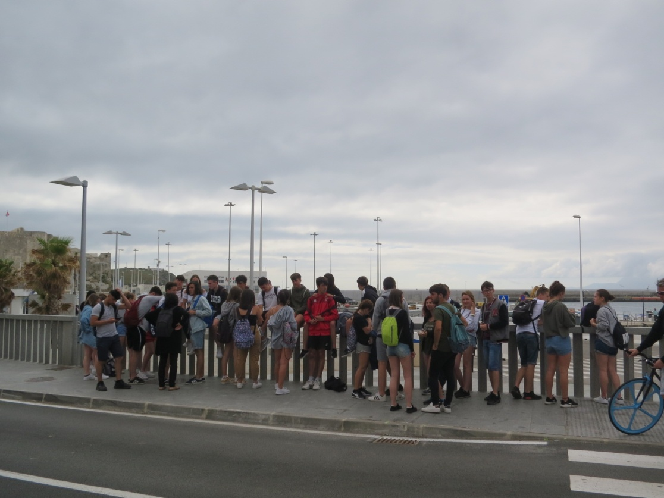
This day started with a trip to Tarifa, what is very special place, because from there we could have seen a part od Africa. We left at 8 am with all the teachers and students.
The trip took about one hour by bus. When we got there, we went to take a look from the coast – everyone was inpressed and surprised how close is the other continent.

Slide 16
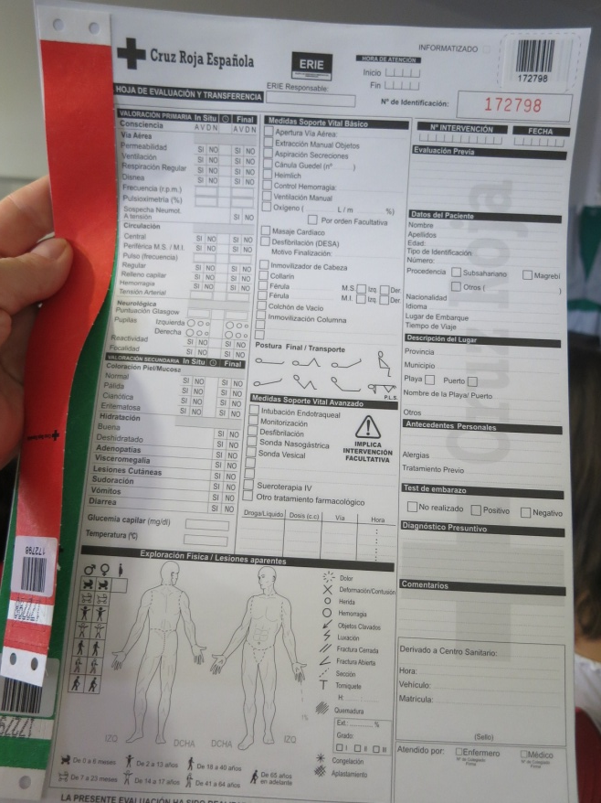
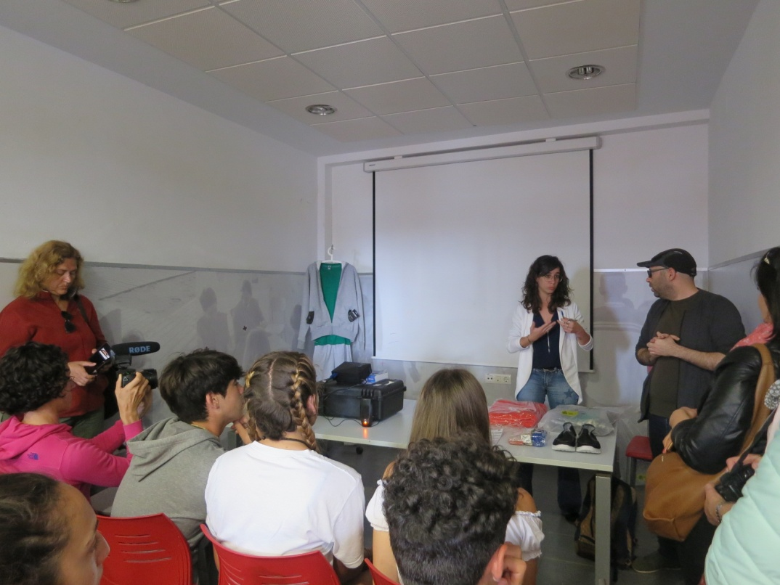
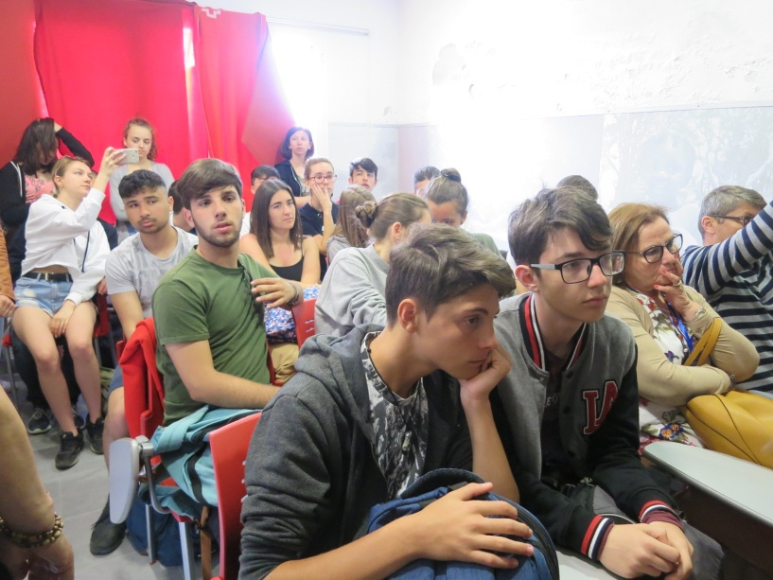
Soon after we arrived we were participating in activities with a NGO’s worker. That was very interesting and educating meeting when we could learn more about the Res Cross in Spain and how this fundation helps.

Slide 17
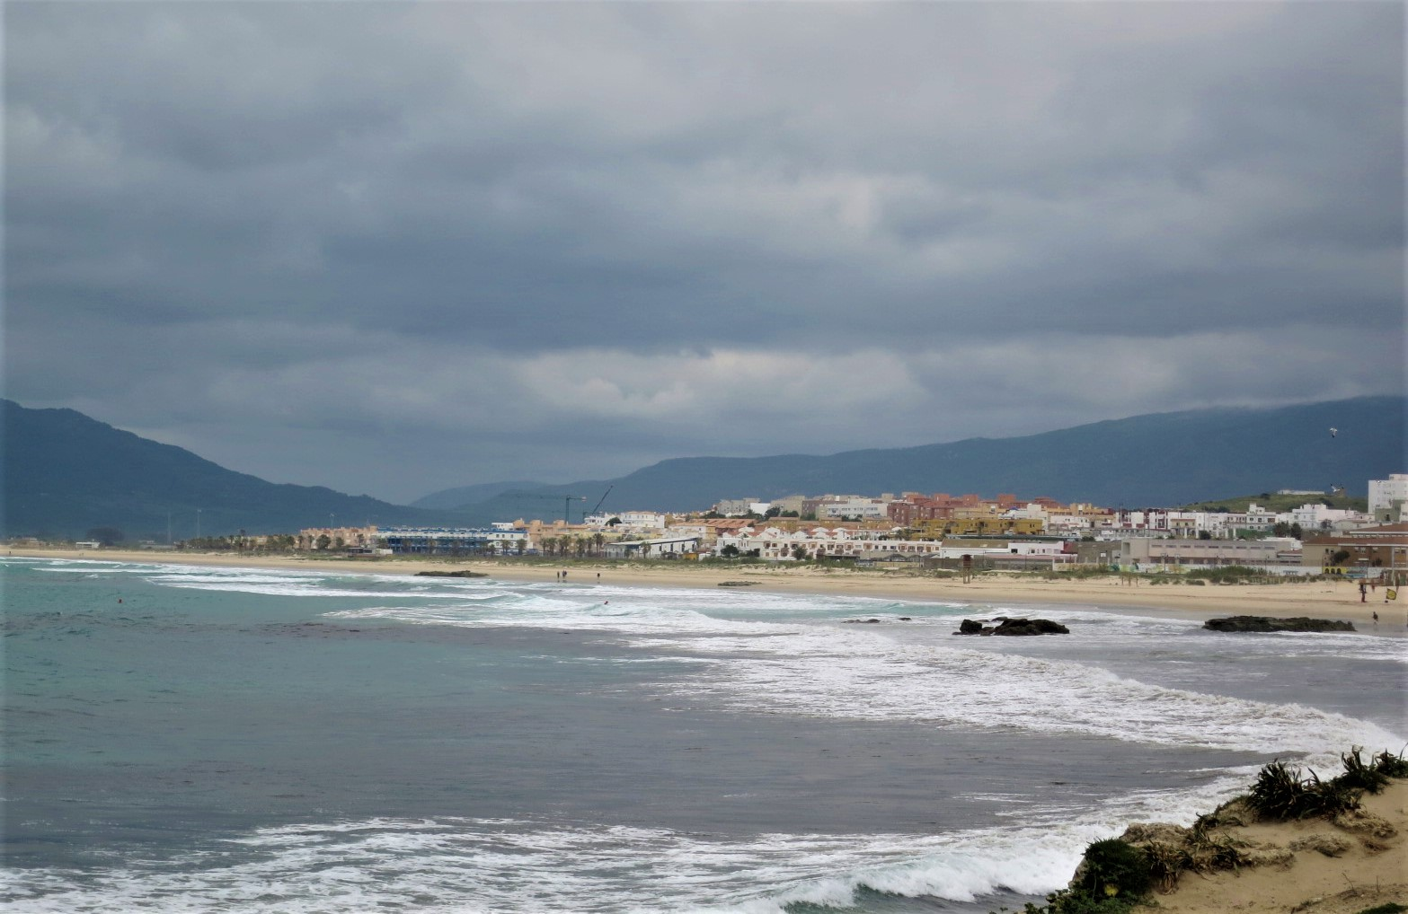
We also visited Playa de Bolonia, known as the most beautiful beach in Spain. We spent the free time there on talking and chilling. Even though the weather wasn’t perfect for swimming and sunbathing, we had a lot of fun together.

Slide 19
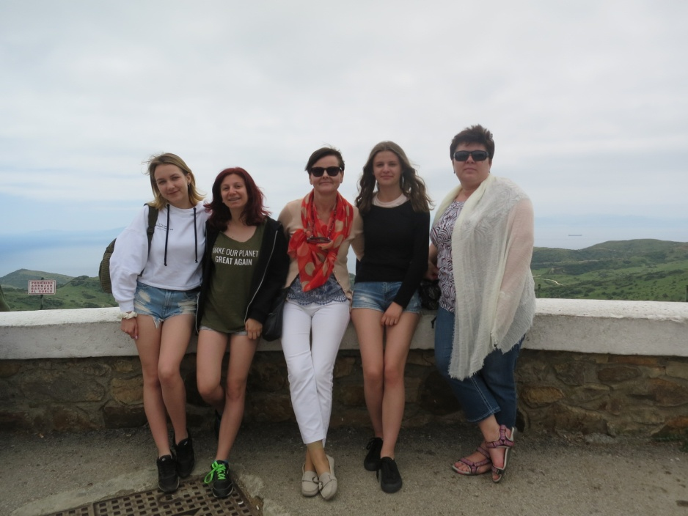
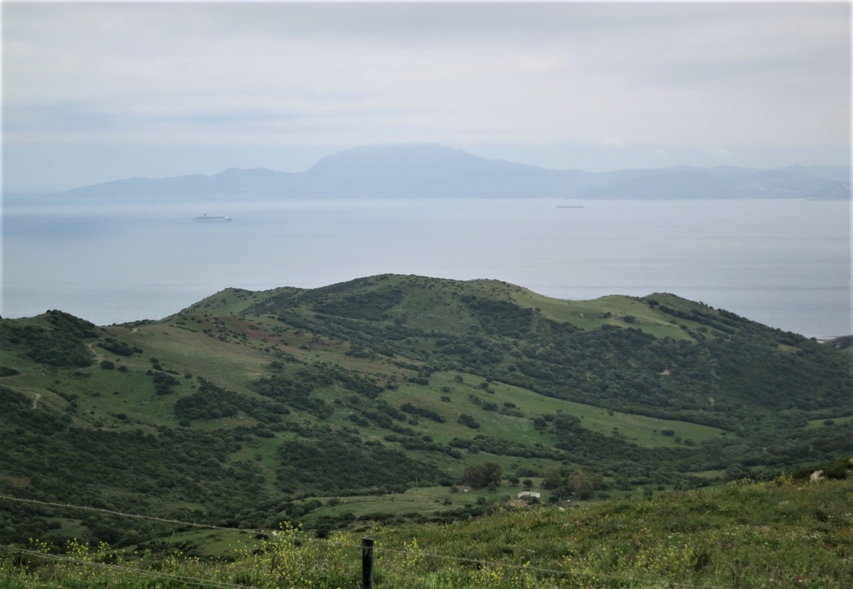
After Bolonia we all went to eat a dinner in an resteurant. While going there we stopped at a viewpoint, where we could have enjoyed the breathtaking view.

Slide 20
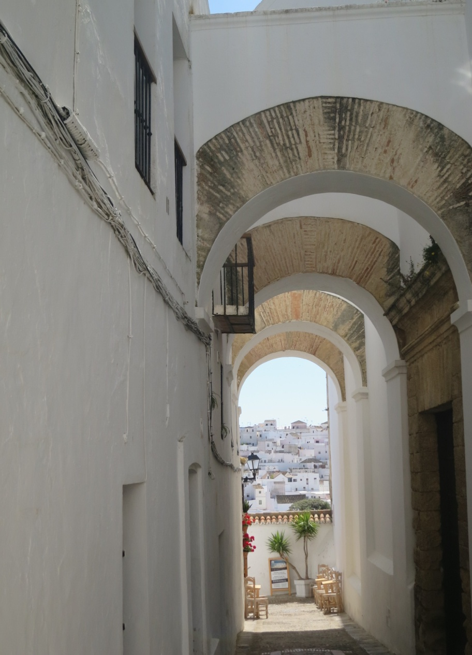
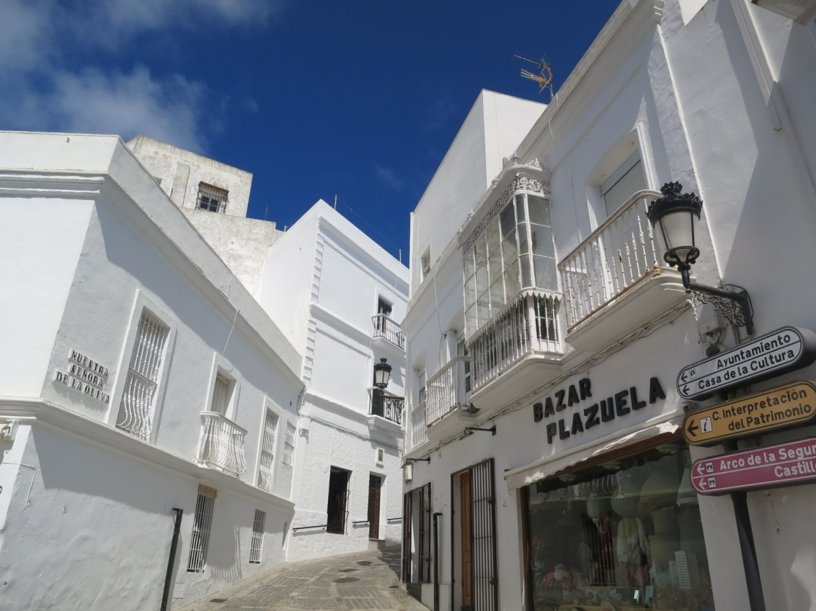
Next attraction of this day was Vejer de la Frontera. It was amazing, town which was characterized by a lot of narrow streets between white houses in the centre of the town.

Slide 21
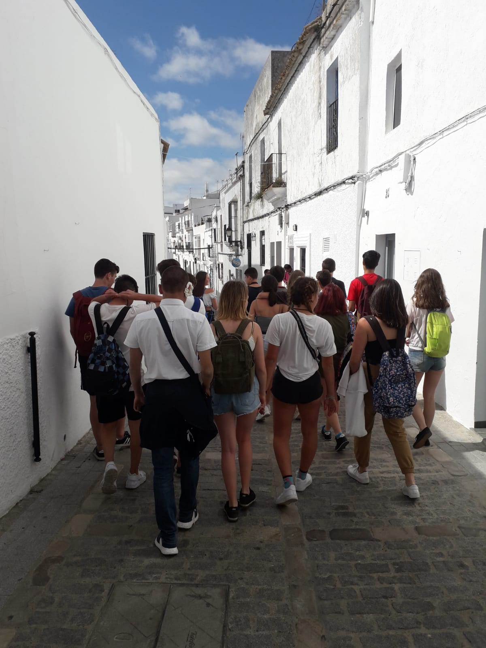
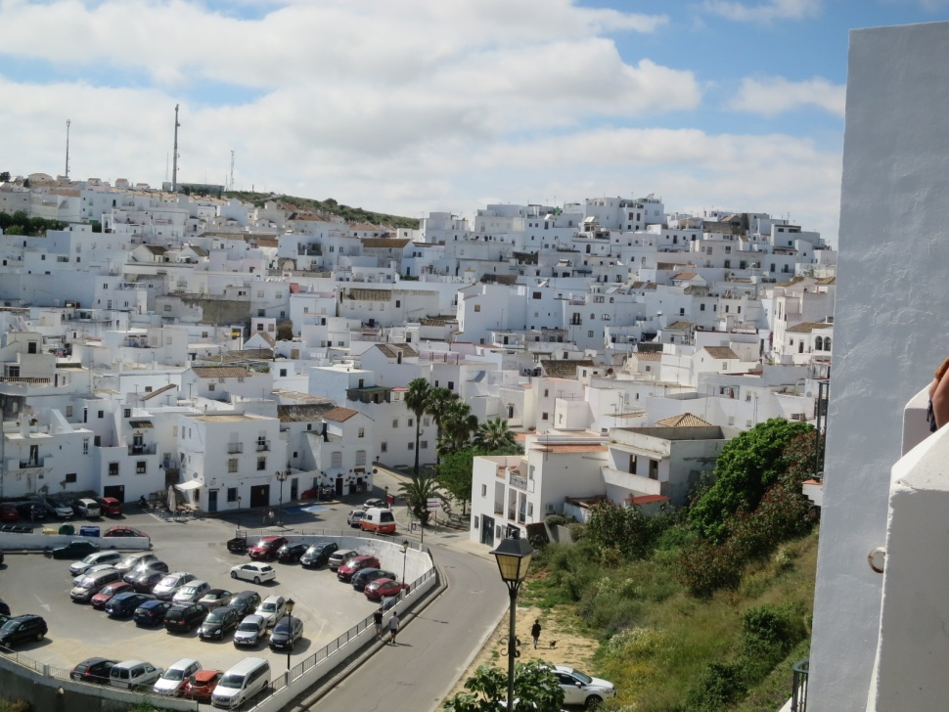

Slide 22
Friday

Slide 23
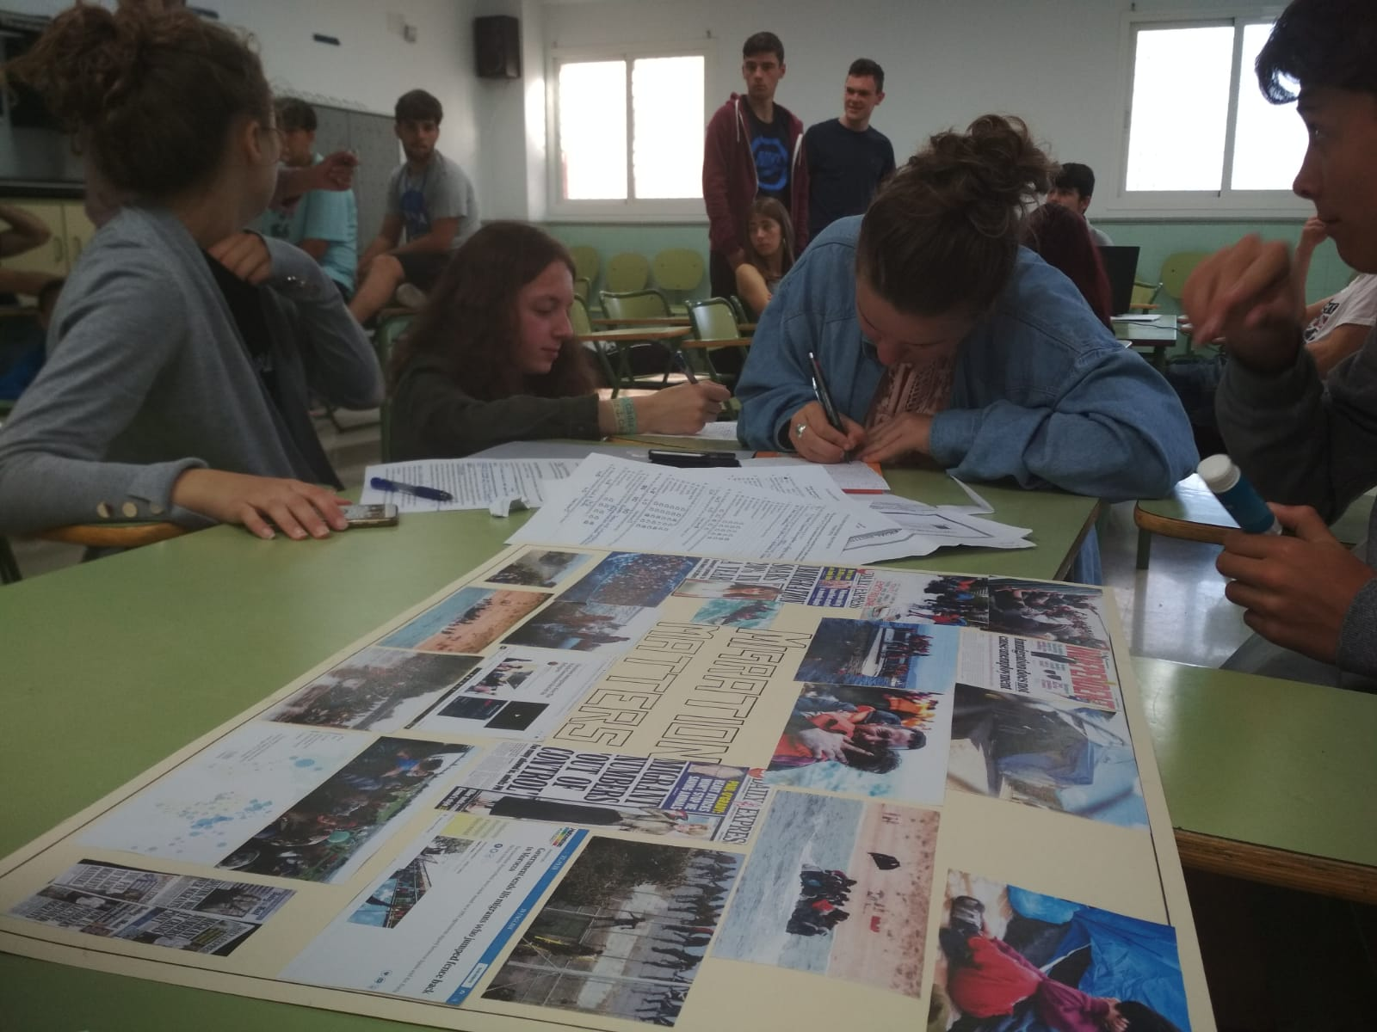
Friday started at 8 pm with activities in school in Puerto Real. We were making a poster about imigrants and refugees.

Slide 24
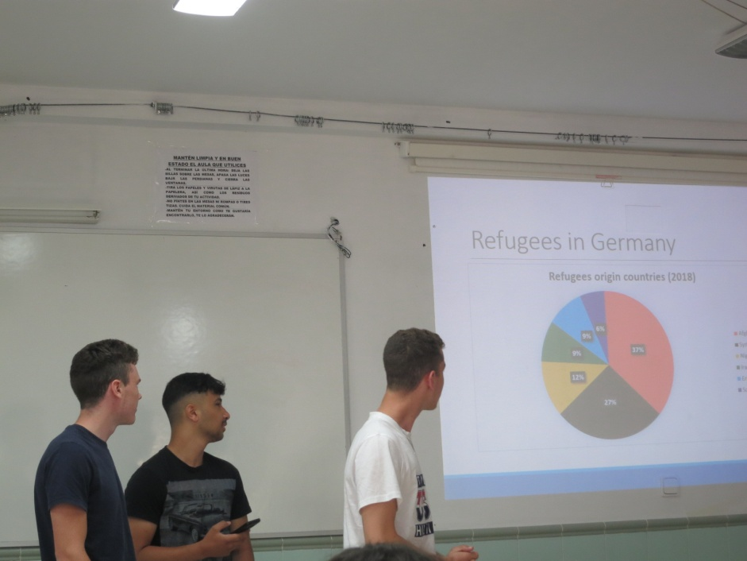
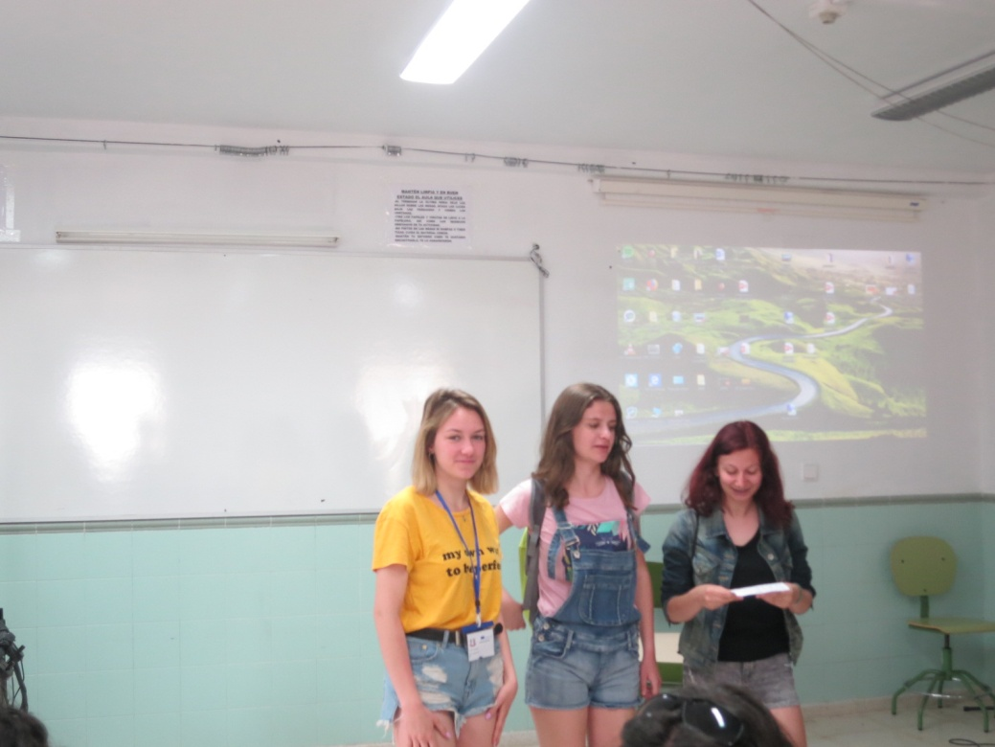
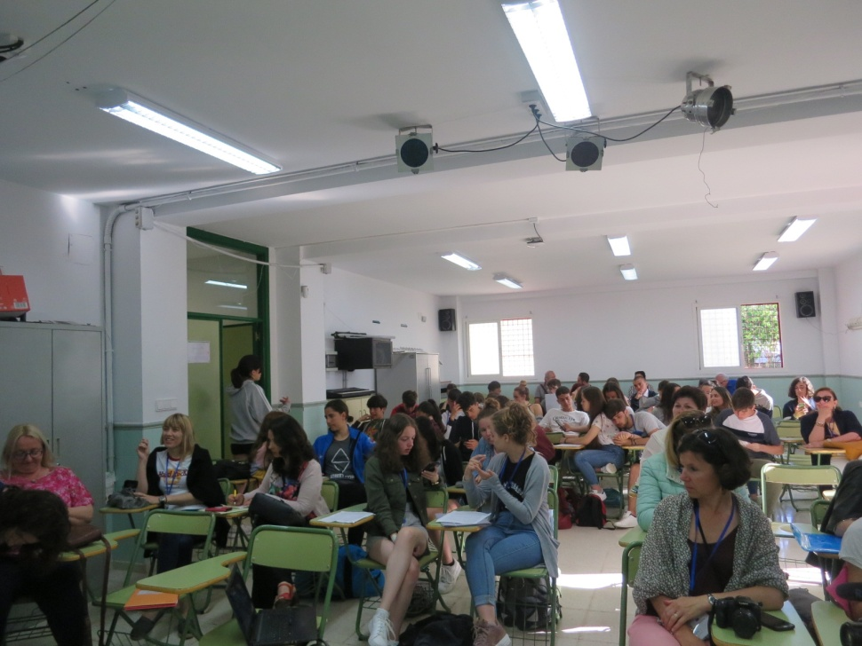
Then, presentations took place. Students from every country presentated problems of migrations in their country. That way we learnt about how it looks in other european countries – not only in ours, what let us looked differently on this modern world issue.

Slide 25
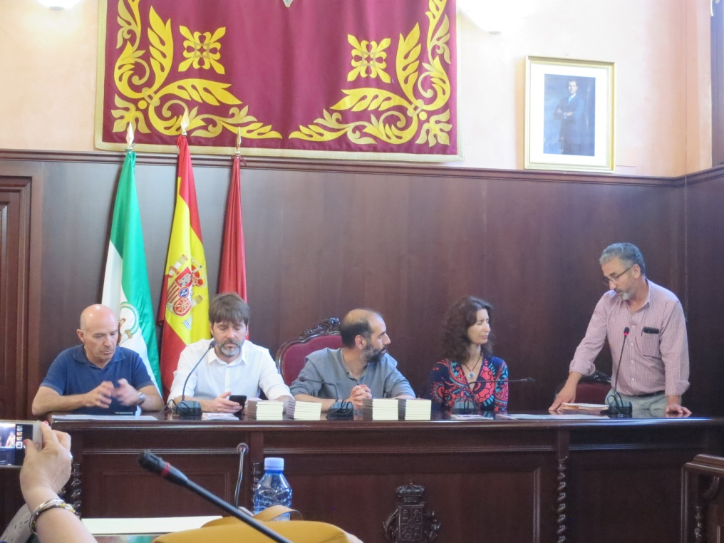
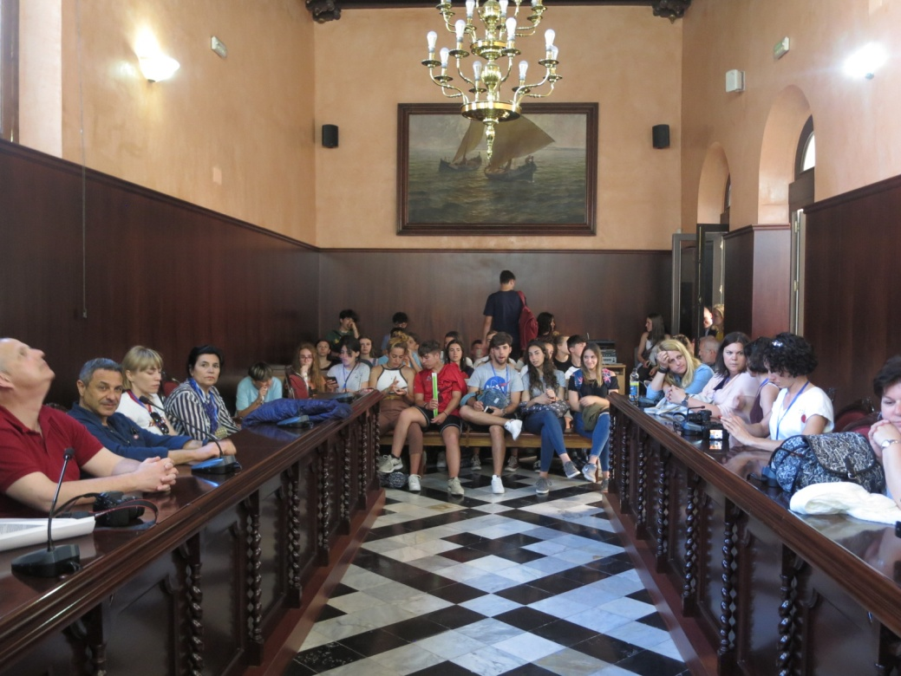
After school we went to a town hall, were we were warmly greeted in language of every country which took part in the project. Every student also got a nice gift.

Slide 26
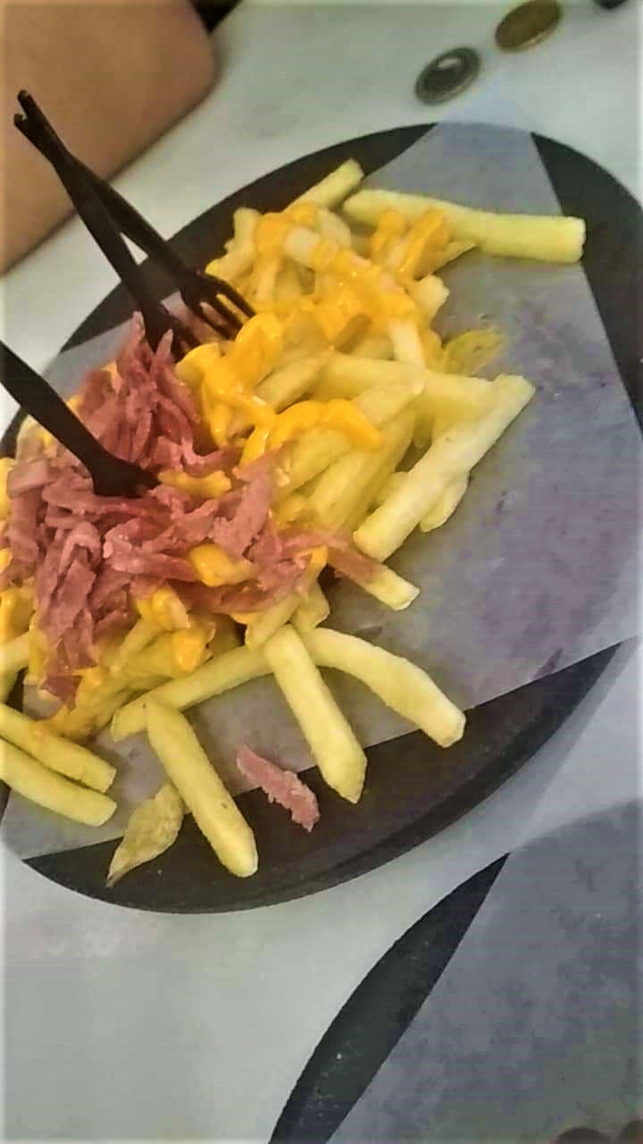
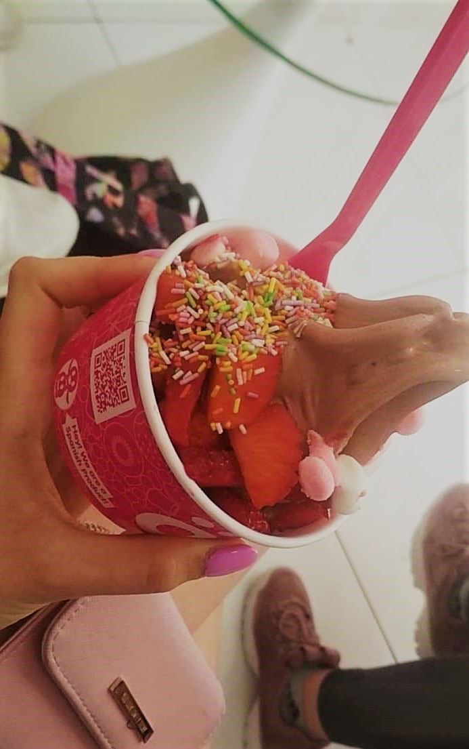
After school and the visit in the town hall we had time to eat a lunch together with our hosts and their families. We tried spanish dishes and snacks.

Slide 27
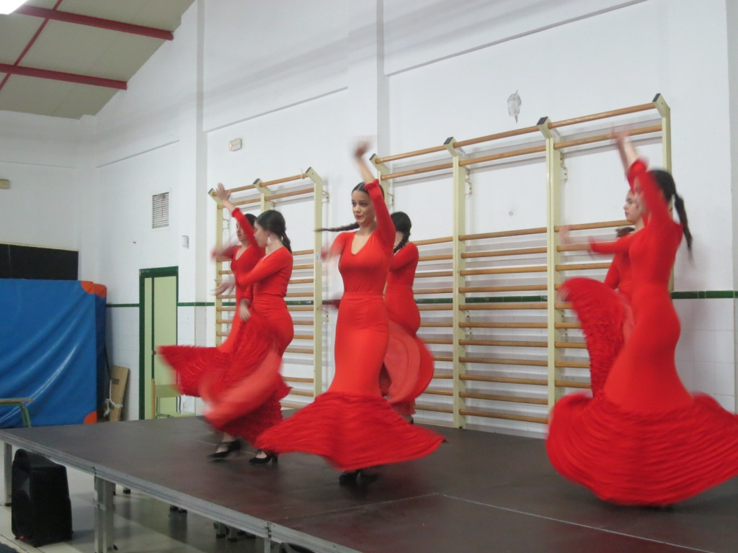
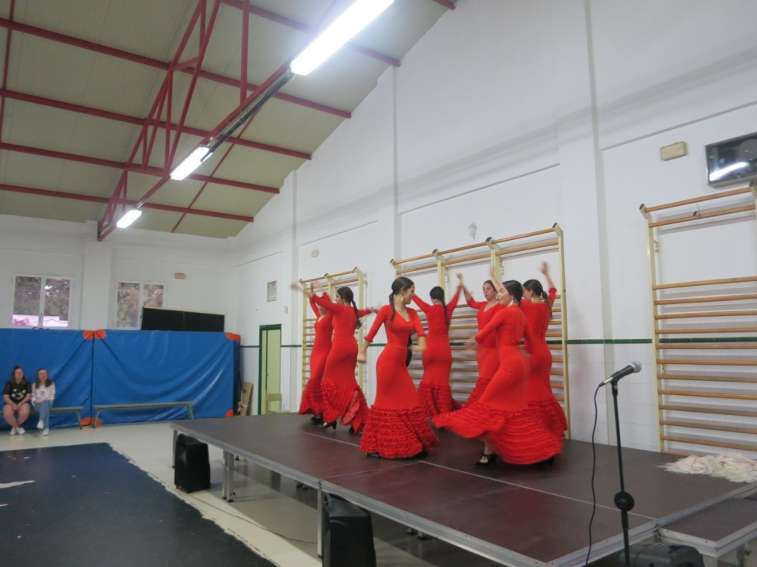
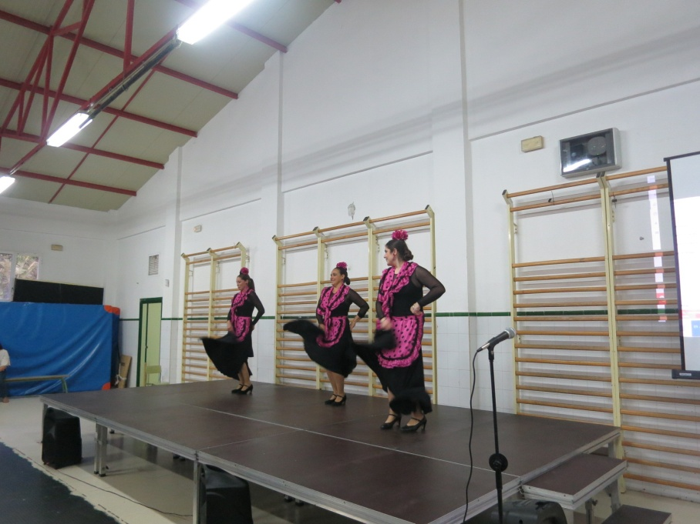
The main event of Friday was school party with students, teachers and host’s families. We also saw them amazing dancing performers. We had so much time singing and dancing witch each other.

Slide 28
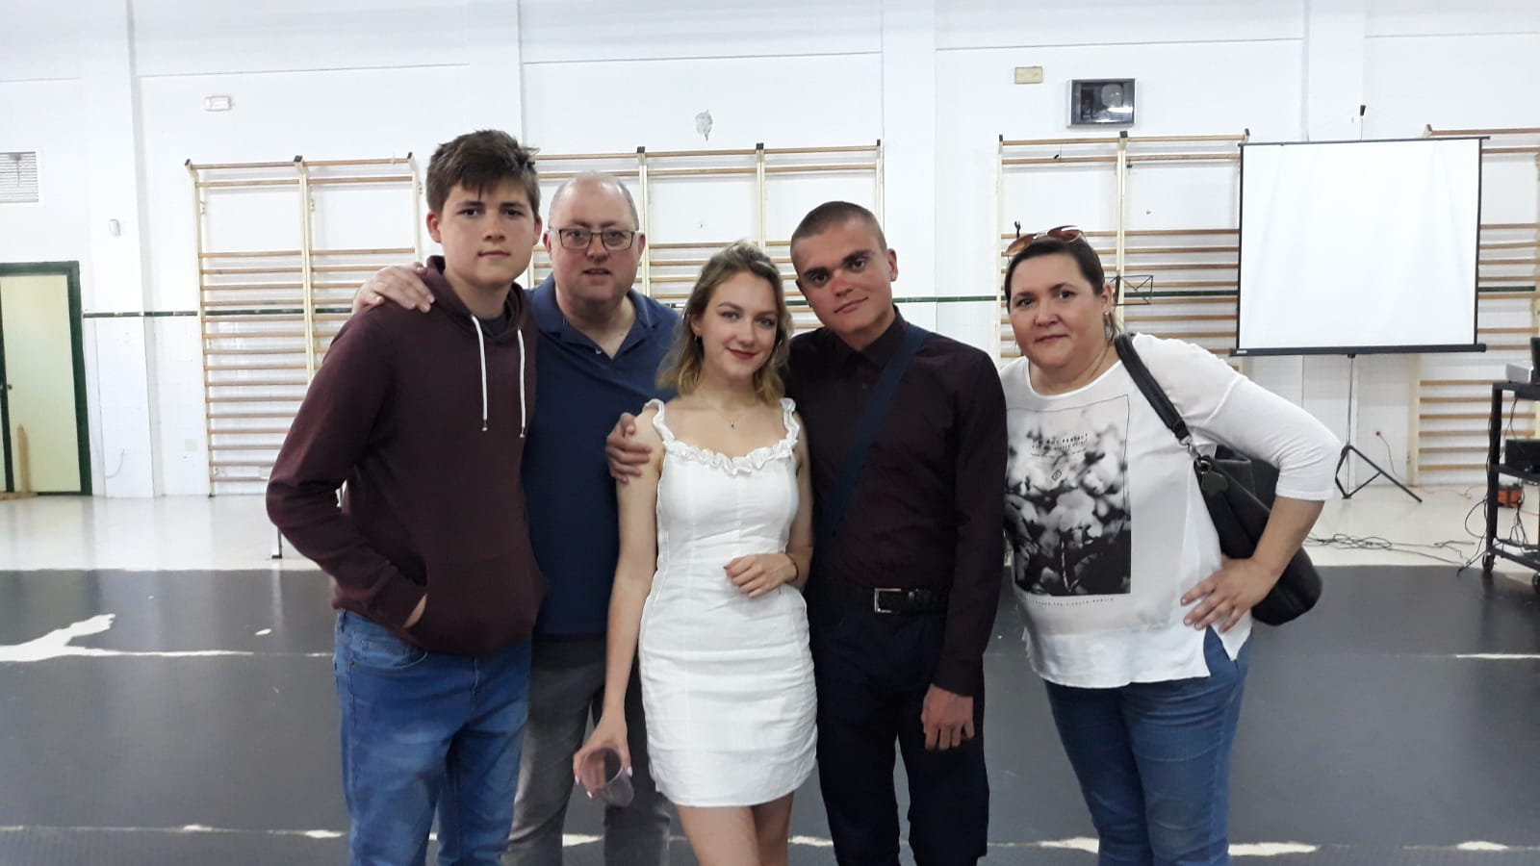
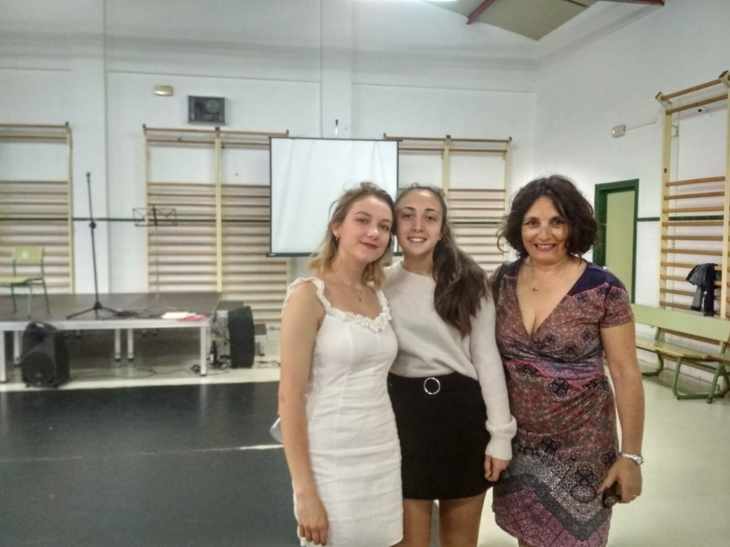

Slide 29
Saturday

Slide 30
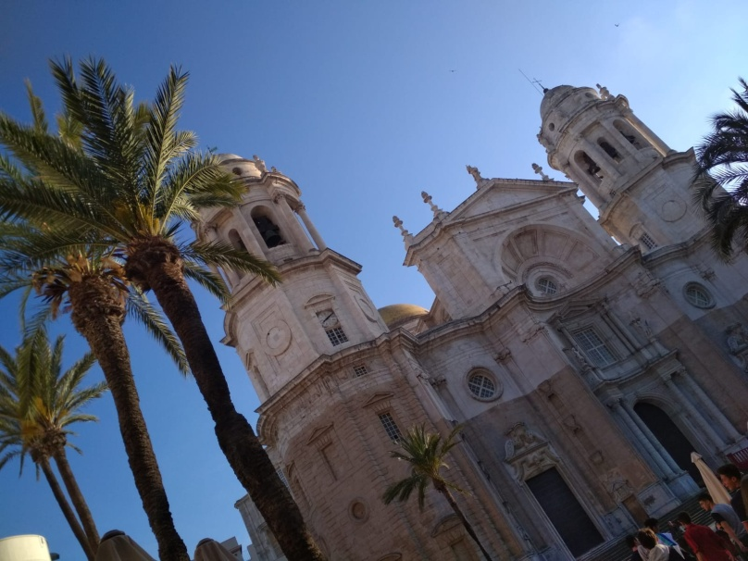
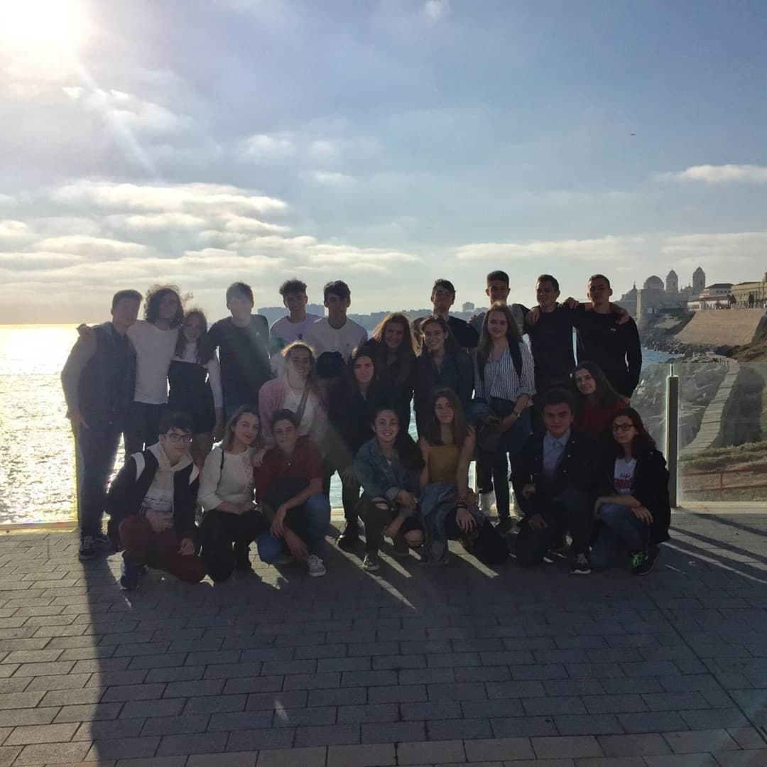
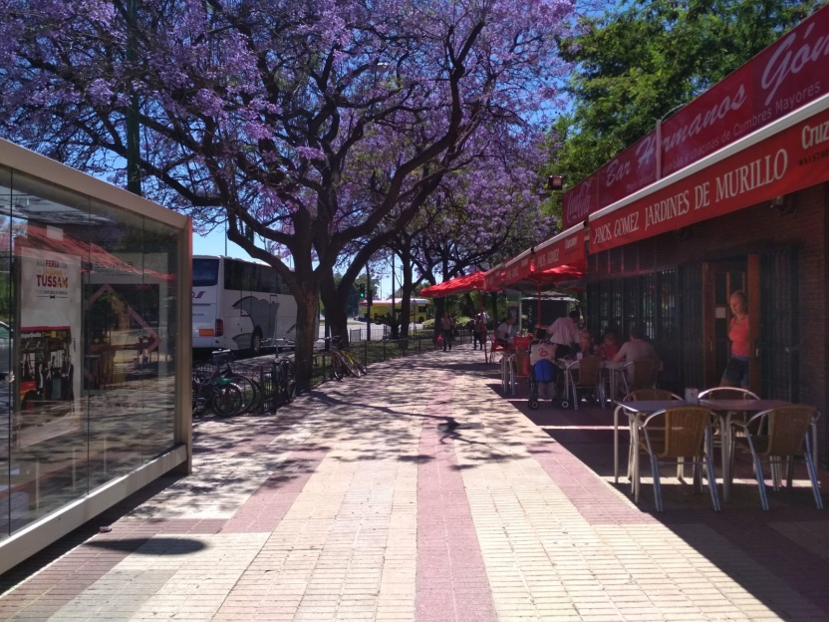
The last day. We took a train to Seville where we spent couple of hours sightseeing while waiting for our plain. At evening we had to leave Spain, but we were leaving with many new experiences, wonderful memories and new friends.

Slide 31
Julia Kamińska
Dominika Majchrzak

