Slide 1
PARTNERSHIP MEETING N°5

Slide 2
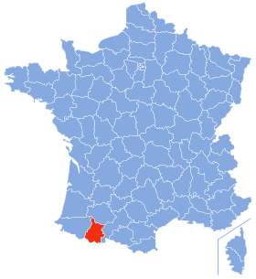
NEXT MEETING WHERE - WHEN?
FRANCE : http://theophile-gautier.entmip.fr/
City = Tarbes
Closest airports :
Lourdes TLP (only Milano, Stansted(London), Paris)
Toulouse
Bordeaux
DATES : from October 15th to October 19th
Arrivals : Oct. 14th
Departures : Oct, 20th

Slide 3
WHAT ABOUT?
From the Application form, we should deal with:
JOURNEY MEN, TRAVELLERS, AMBULANT – ITINERANT PROFESSIONS, etc.
According to this document, in France, students will :
CREATE/ILLUSTRATE E-BOOKS

Slide 4
WHAT TO DO THEN ?
Please, interview people related to Journeymen:
On board : sailing seas, flying the air, driving trucks…
Season workers : agricultural pickers/workers CR, PORT, Pol
ski/sea-resort workers, building industry SP
On stage : PORT Art workers, circus, musicians, play-actors…
Volunteers, social workers for humanitarian causes, military men LT, …
Bloggers, touristic agents (Lithuanien, Pol
Religious purposes : Pilgrims, Missionaries (Priests, Monks…) Pol
Diplomats, administrations
The option « housewives » can be an additional interview you can make if you’ve interviewed her husband (who is in one of the categories above). Hence we will have the two points of views which is also interesting.

Slide 5
INTERVIEWS
He/she should:
Introduce himself (name-age-status)
Explain what his/her job consists in
Tell positive things about his/her job
Tell negative aspects of it
Conclude saying if he/she would recommend it.
Add an anecdote (+ or -) he/she remembers in his/her career and why he/she chose that one to tell you.
Add any other ideas you/she/he’d like to !!!

Slide 6
WHAT? For WHEN ?
Choose as many « Journeymen categories » (p.5) as you bring students.
For example, you bring 3 students in France:
You can choose a pilot, a musician and a soldier
You can’t choose a pilot, a captain and a blogger
As soon as you decide, please fill in :
https://goo.gl/forms/H8igOM95ZJTMMaiH2
Interview them.
You can make a video but the most important is to have the script in France. The video is optional but can be nice on e-twinning…
Take a picture of each interviewee.
Take a picture of your team coming to France.
Upload them on e-twinning: « Preparing the meeting to France »
DEADLINE: SEPTEMBER 30TH

Slide 7
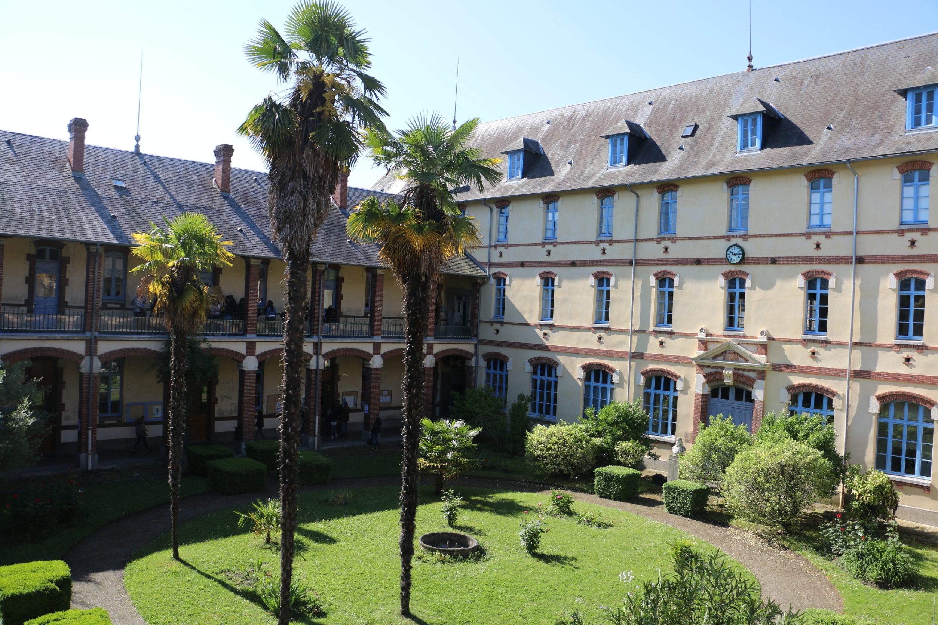
THANK YOU !!!
See you all in France !

