Slide 1
ERASMUS+
Greece Athens 2018

Slide 2
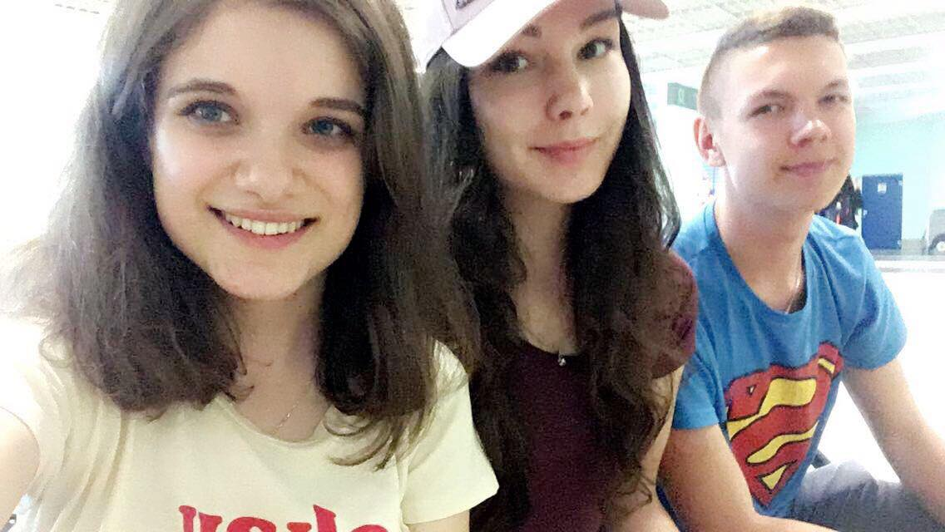
Set off on a journey

Slide 3
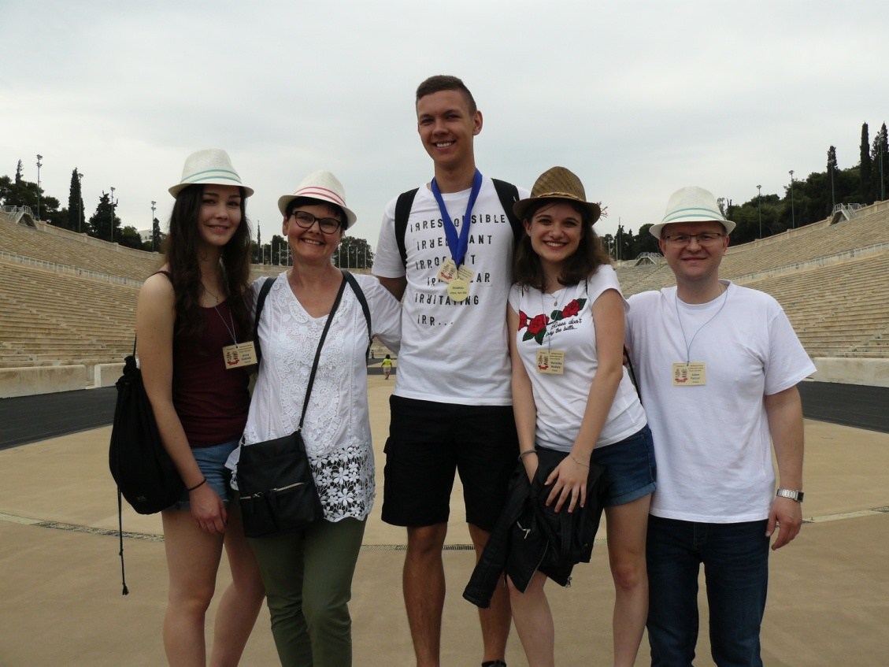
Sightseeing of Panathenaic Stadium…

Slide 4
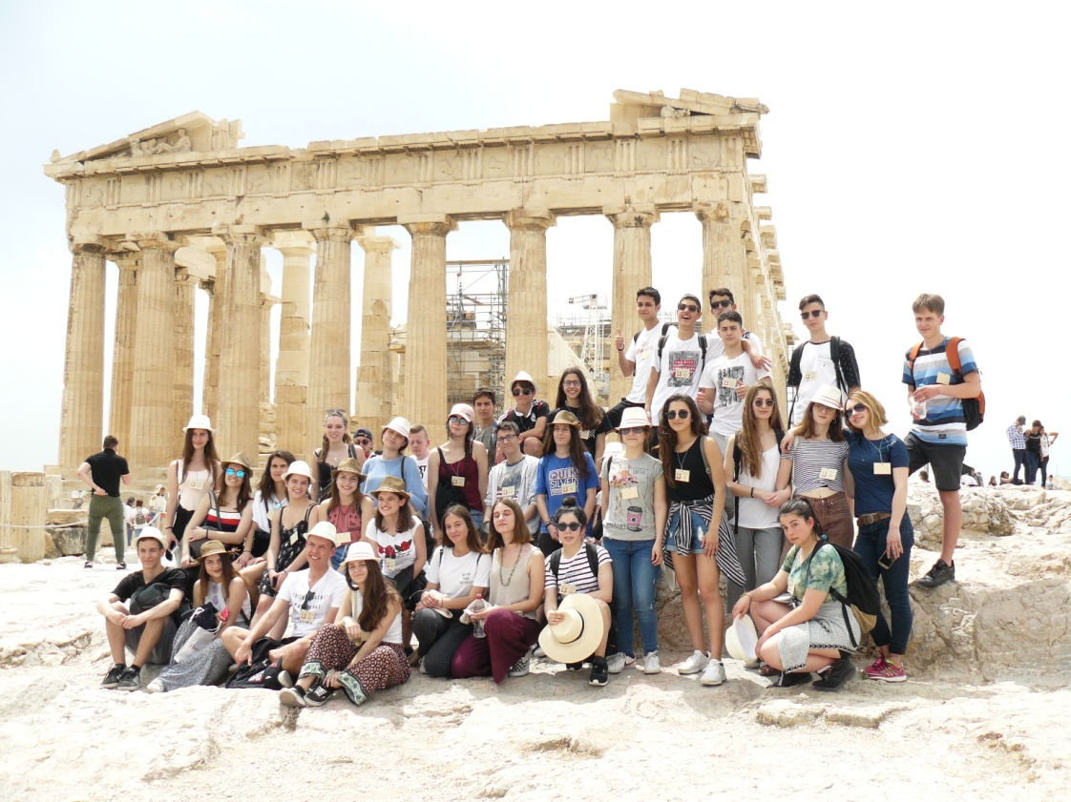
… and Acropol Museum

Slide 5
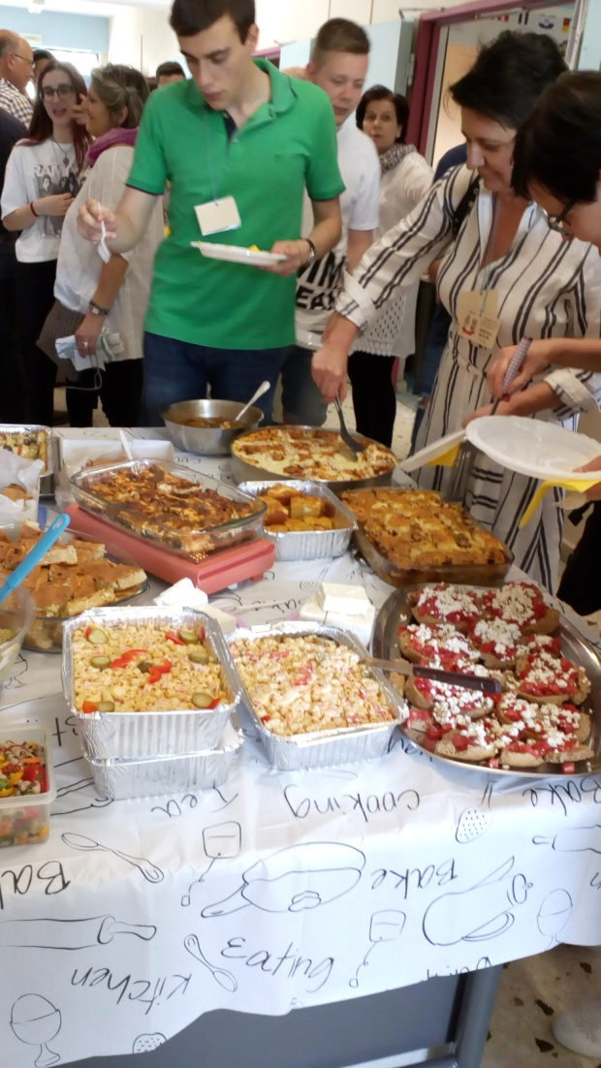
Integrative games and trying typical Greek food

Slide 6
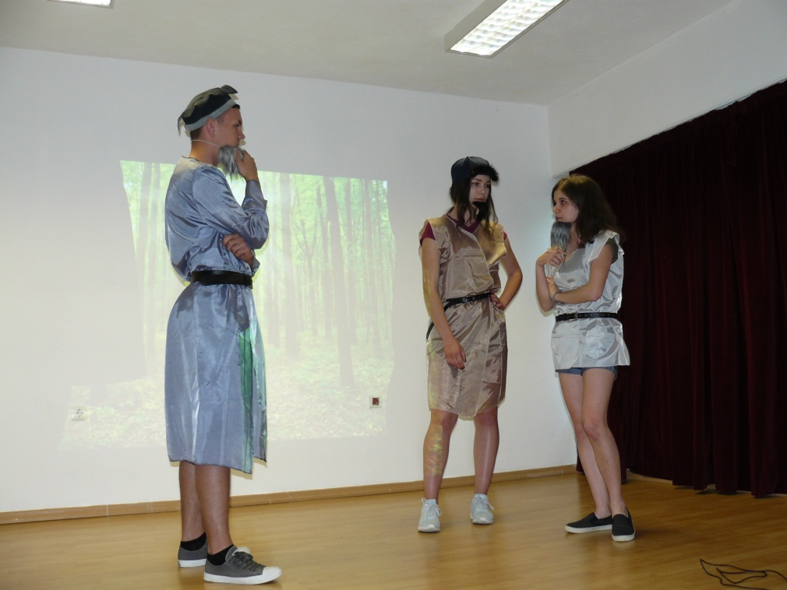
… and presenting native myths ☺

Slide 7
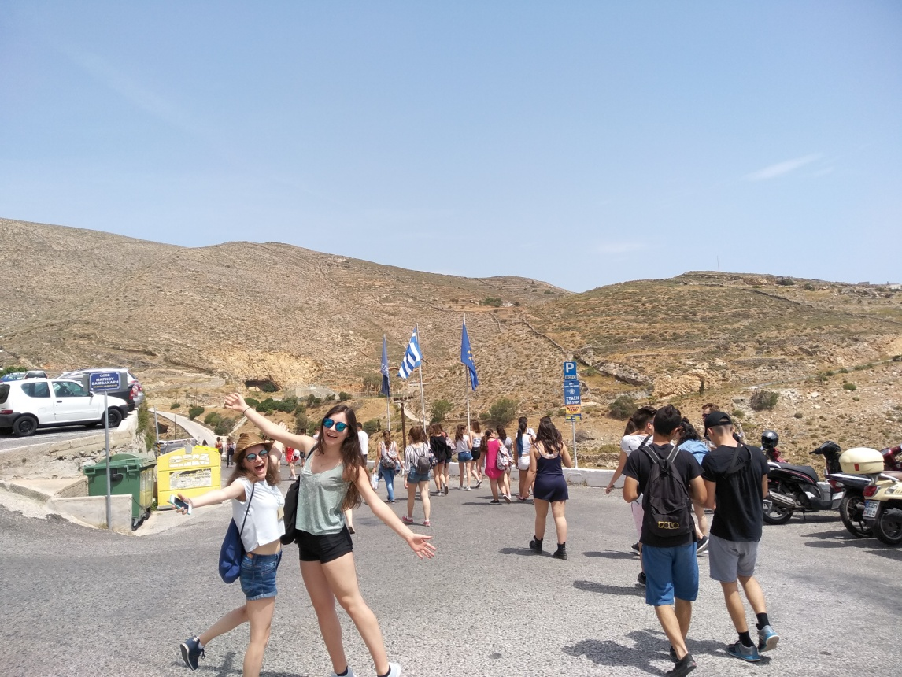
Greek island - Syros

Slide 8
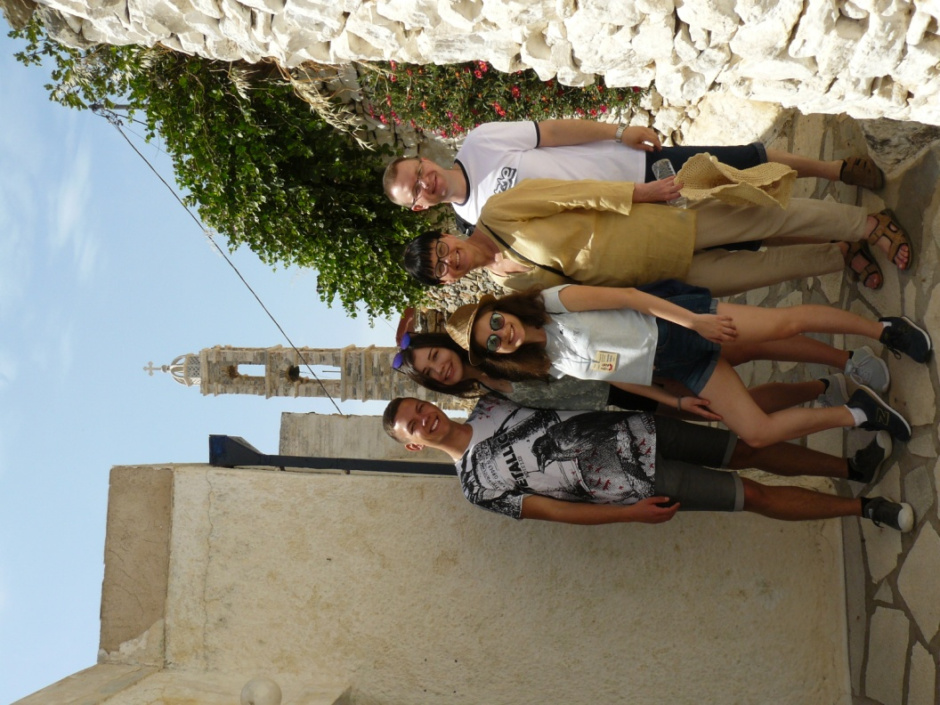
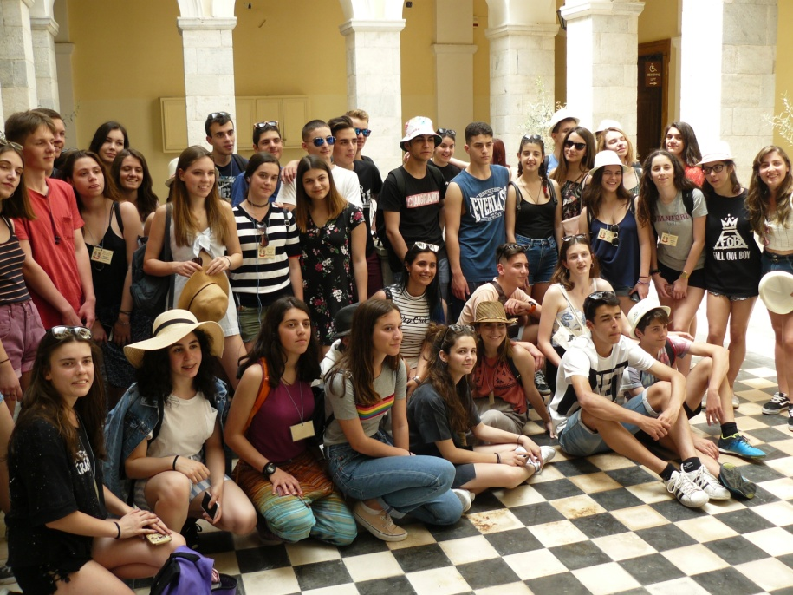

Slide 9
Thank you for your attention!

