Slide 1
FAMOUS POLISH EMIGRANTS

Slide 2
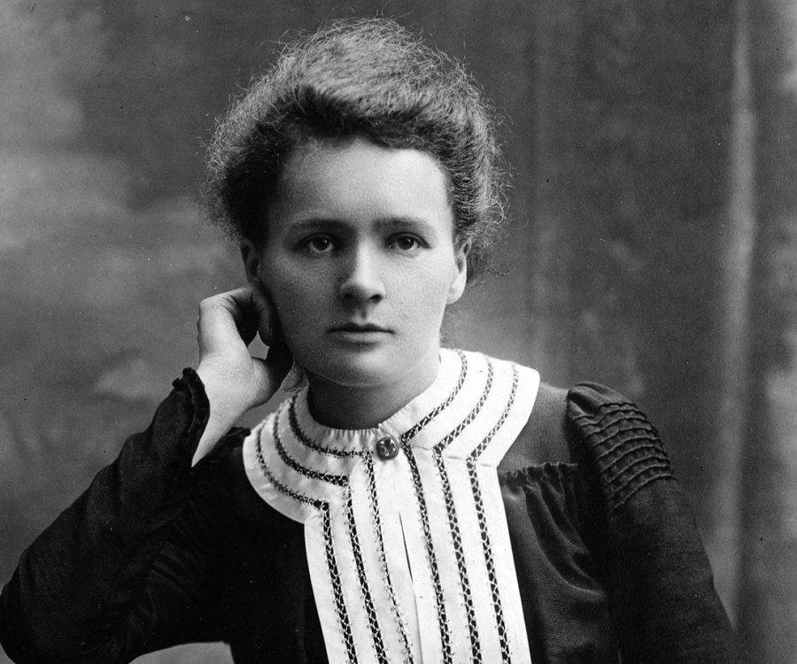
7 November 1867 – 4 July 1934
MARIA SKŁODOWSKA-CURIE
She was a Polish and naturalized French physicist and chemist who conducted pioneering research on radioactivity.
She was the first woman to win the Nobel Prize, the first person and the only woman to win it twice, the only person to win the prize in two different scientific fields: physics and chemistry.
She was also the first woman to become a professor at the Sorbonne University of Paris.

Slide 3
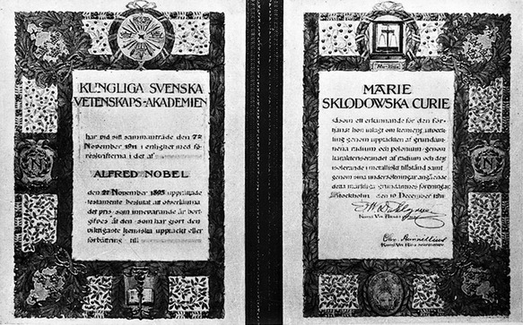
Maria Skłodowska-Curie left Poland and went to Paris because she wanted to learn.
She met Pierre Curie with whom she married. They were both scientists and they successfully worked together on radioactivity.
Maria discovered two new chemical elements: Radium and Polonium (which she named to honour her homeland – Poland).

Slide 4
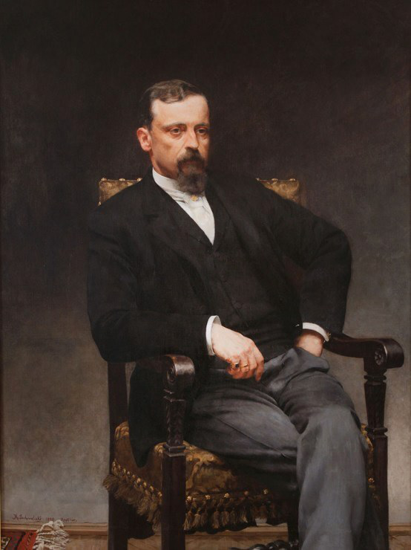
Henryk Sienkiewicz
5 MAY 1846 – 15 NOVEMBER 1916
One of the most popular Polish writers in 19th and 20th centuries.
Journalist and publicist: „Letters from Africa”, „Letters from a journey”.
Short-story writer: „Za chlebem”(For bread), „Janko muzykant”, „Sachem”.
Novelist: „Teutonic knights”, „Połaniecki’s family”, „In the desert and the wilderness”.
The Nobel Prize winner!
He received it for lifetime achievement in 1905.

Slide 5
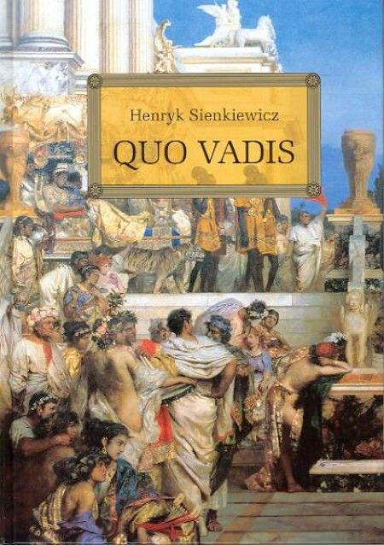
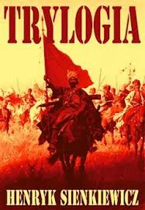
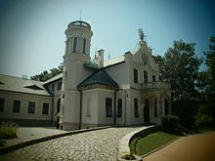
He is best remembered for his historical novels, especially for his internationally known bestseller ”Quo Vadis” (1896).
In Poland Henryk Sienkiewicz is best known and loved for his "Trilogy”, a set of three historical novels written to cheer the hearts of the Polish people.
In 1900 Henryk Sienkiewicz was honored by the Polish nation and received a manor house in Oblęgorek. It was a gift from the nation.

Slide 6
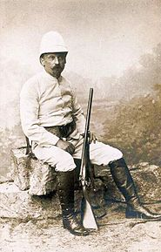
TRAVELLER
Henryk Sienkiewicz spent many years on travelling abroad to many places on many continents: Europe (Swirzeland, France, United Kingdom), North America (United States) and Africa.
His travels resulted in writing few works: „Charcoal Sketches”, „On a Single Card” and more famous „In the Desert and the Wilderness”

Slide 7
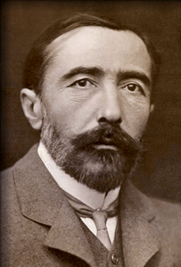
JOSEPH CONRAD
3 DECEMBER 1857 – 3 AUGUST 1924
Born as Józef Teodor Konrad Korzeniowski, Joseph Conrad was a Polish-British writer regarded as one of the greatest novelists to write in the English language. Though he did not speak English fluently until his twenties, he was a master prose stylist who brought a non-English sensibility into English literature. Conrad wrote stories and novels, many with a nautical setting, that depict trials of the human spirit in the midst of what he saw as an impassive, inscrutable universe.

Slide 8
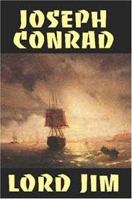
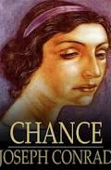
JOSEPH CONRAD’S WORKS
Conrad's creativity is an unique phenomenon in world literature, combining the trend of romanticism with positivism. His the most popular novels: „Almayer’s Folly”, „Chance”, Heart of Darkness”, „Lord Jim”, The Secret Agent”.

Slide 9
Thank you
Polish team
Projekt „Migration Matters”- współfinansowany w ramach programu Unii Europejskiej Erasmus+
Publikacja odzwierciedla jedynie stanowisko jej autorów i Komisja Europejska oraz Narodowa Agencja Programu Erasmus+ nie ponoszą odpowiedzialności za jej zawartość merytoryczną.

