Slide 1
FAKE NEWS
.

Slide 2
“There are too many immigrants”
False. According to the latest data from the INE (National Institute of Statistics) in Spain reside 4,719,418 foreigners, which represents 10.1% of the total population. Most of them are extra-community, 59.5%, compared to 37.7% of foreigners coming from the union. The Moroccans (769,050), Romanians (673,017) and British (240,934) are foreigners with greater presence. Although the figures do not lie, a study by Amnesty International ensures that the percentage of the foreign population perceived by the natives exceeds 20%.

Slide 3
"Immigrants hoard social aid and collapse health"
False.
In specific figures, only 16% of the users of the social services are foreigners, despite the fact that 2,010,634 people not born in Spain are affiliated to the Social security, according to the Ministry of the Interior, published in October 2018. In addition, foreigners assume less than 1% of pension beneficiaries.
As for health services, the estimate of public health expenditure employed in the immigrant group is 6.5% of the total. Foreigners go 7% less to the GP than nationals and 20% have not visited a doctor in the last year, compared to 14% of those born in Spain. The chronically ill are in 61% Spanish, by the 39% immigrant, a difference that also remains in the pharmaceutical cost, where the first attend an expenditure around 374 euros per person, while the seconds do not exceed 74 euros.

Slide 4
“The immigrants take away our jobs”
False. In October 2018, the unemployment rate in Spain stood at 14.8%, compared to the 23% that the foreign population supports (reached 39% in the hardest years of the crisis), of which only 11% are charging some kind of benefit. What's more, migrants suffer the most from the consequences of lack of occupation.
In addition, the immigrant population assumes undesirable work for nationals, especially in the field of care and especially in the case of women. Amnesty International estimates that 80% of domestic carers are foreign-born and the vast majority work in poor condition.

Slide 5
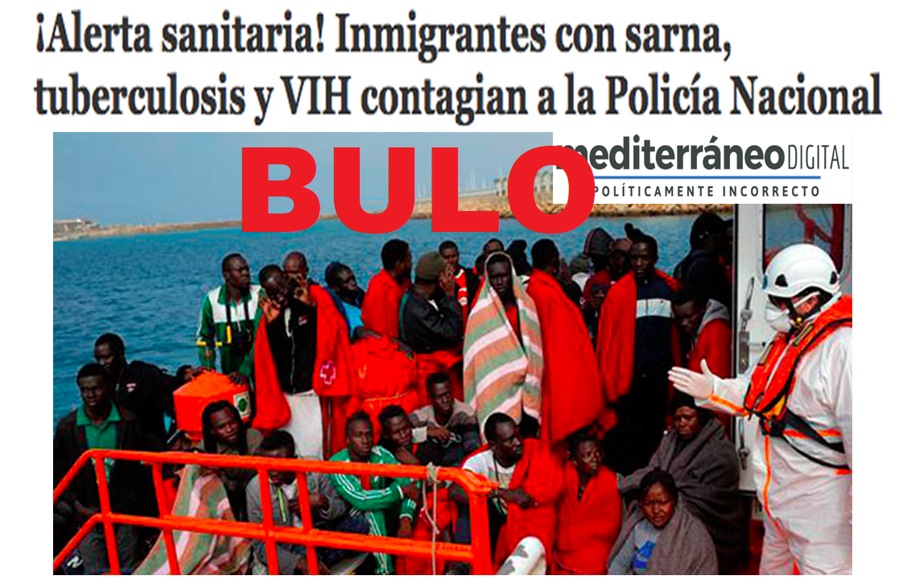
“Health alert and the spread of HIV or tuberculosis from immigrants to police”
We are confirmed by the national police that there has been no HIV infection or tuberculosis detected. Nor is there any health alert: We are confirmed by the Ministry of Health. Yes, there's been a scabies contagion in Motril. Neither HIV nor tuberculosis.

Slide 6
The video of "cannibalism" with the message: "These are the ones that invade us"
The video runs through the networks with the message "These are the ones that invade us". In it we see a pot with apparently human remains and people prepared to eat it. It's not real. It is a scene from the Nigerian film ' Omambala They're special effects.

Slide 7
Muslims poisoning dogs in Lleida
It is a hoax that runs at least since 2017 and has returned. It has more than 85,000 interactions on Facebook. The city council denied us that there was any complaint or knowledge of any case.

