Slide 1
Wednesday
Trip to Crakow
Trip to Krakow
Wednesday

Slide 2
The Old Town guided tour

Slide 3
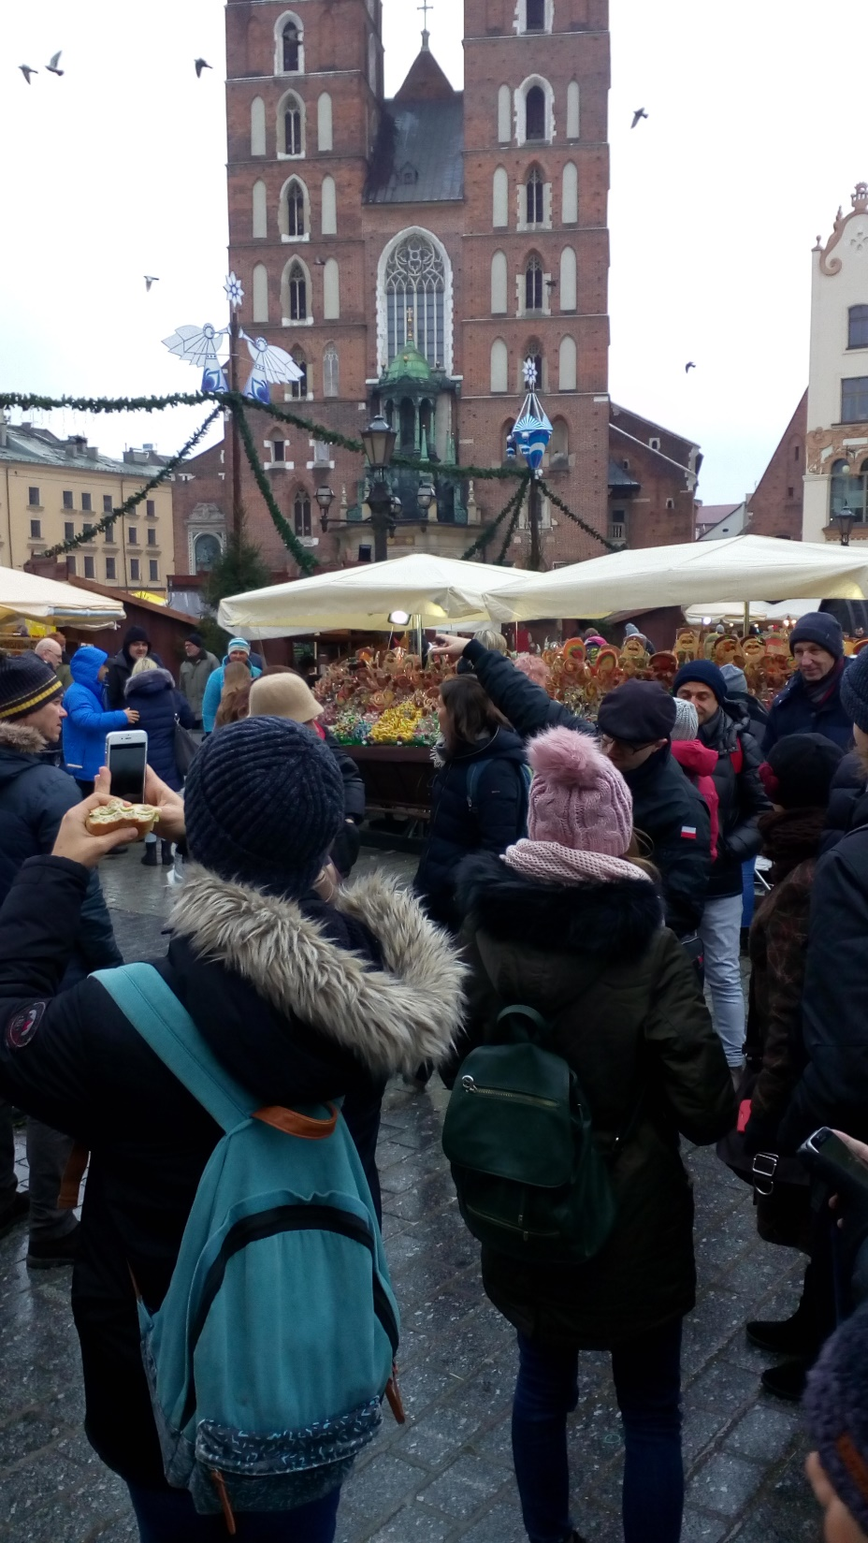
We had free time for lunch and shopping in the Christmas market

Slide 4
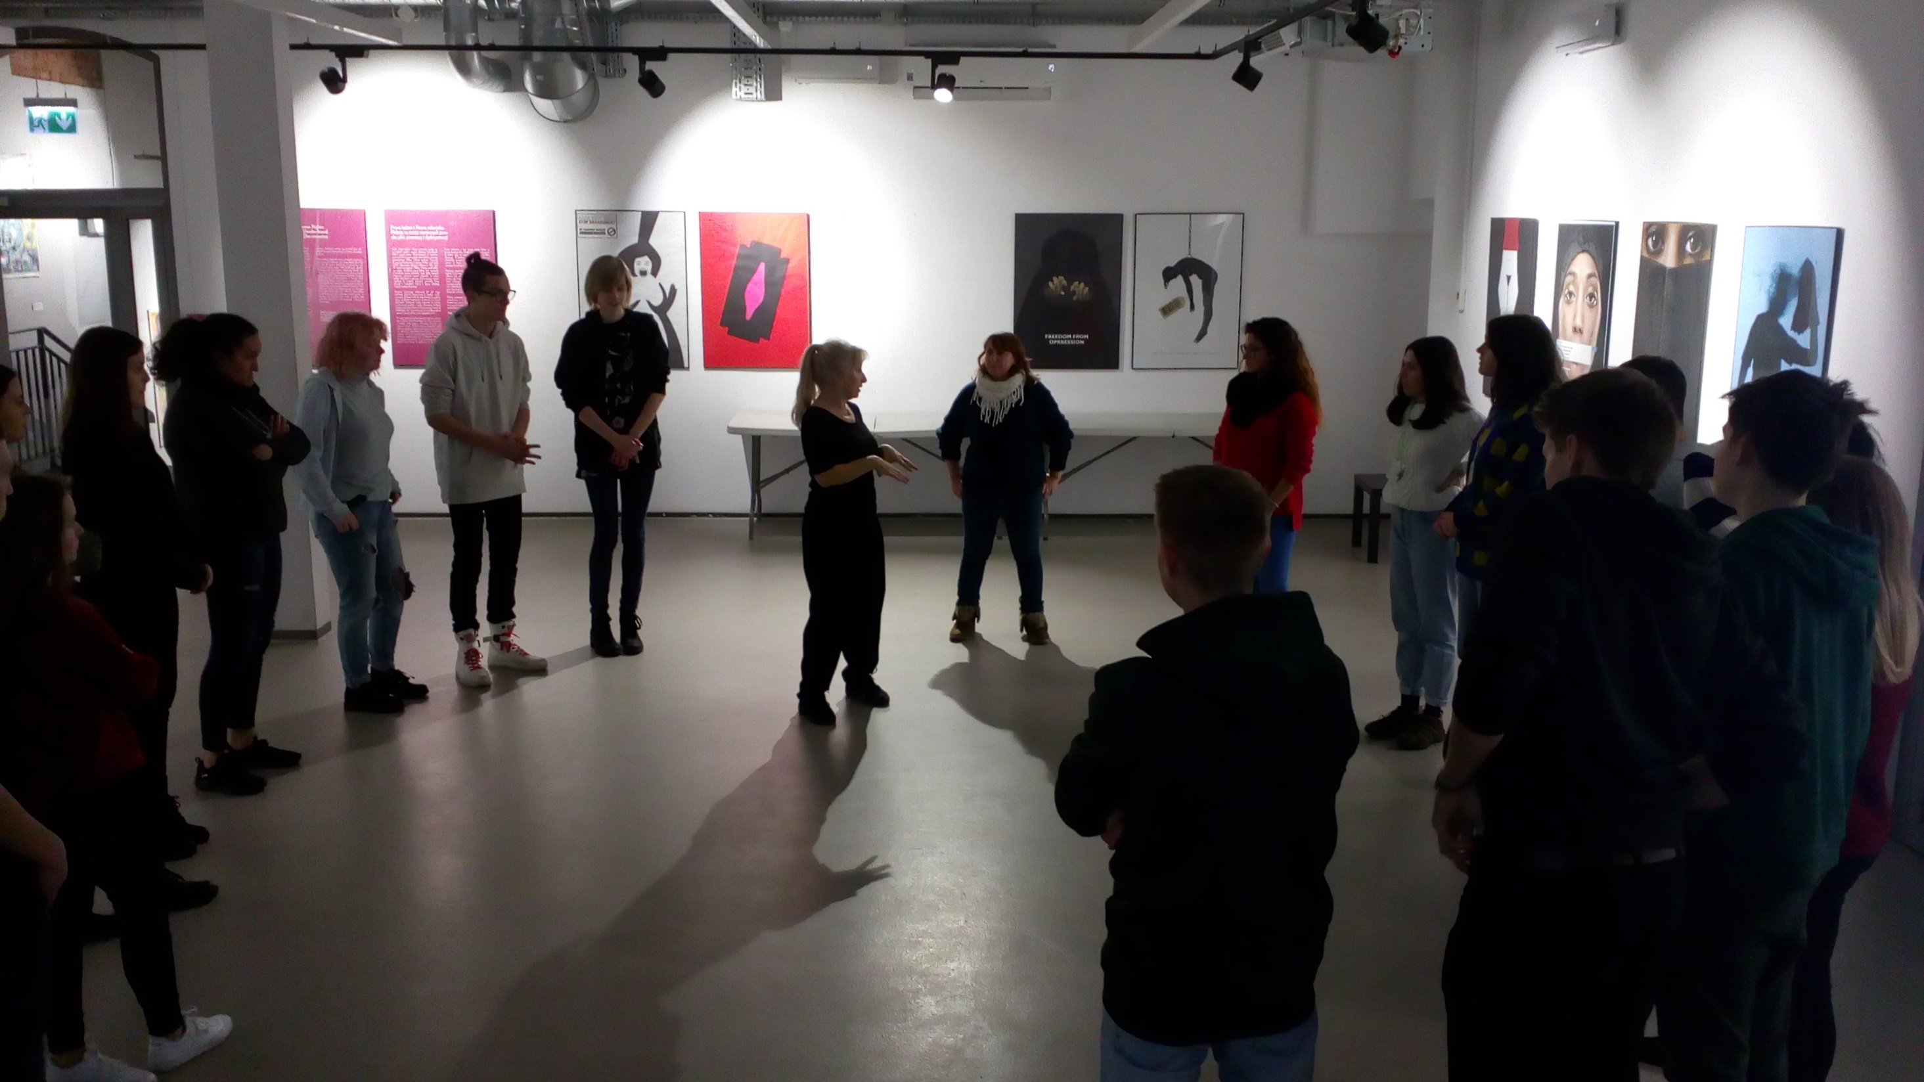
Dancing workshop in Galicja Museum

