Slide 1
Tuesday
Migration matters

Slide 2
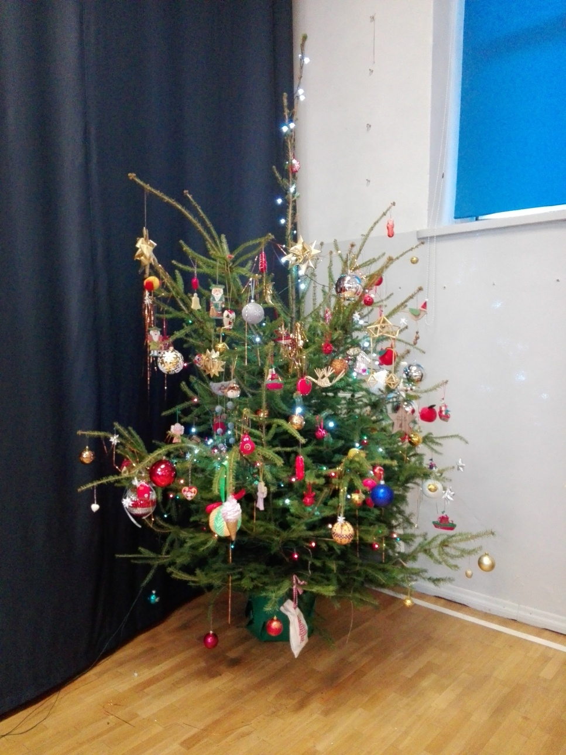
Decorating the christmas tree
At first, we had to put some ornaments on the Christmas Tree.

Slide 3
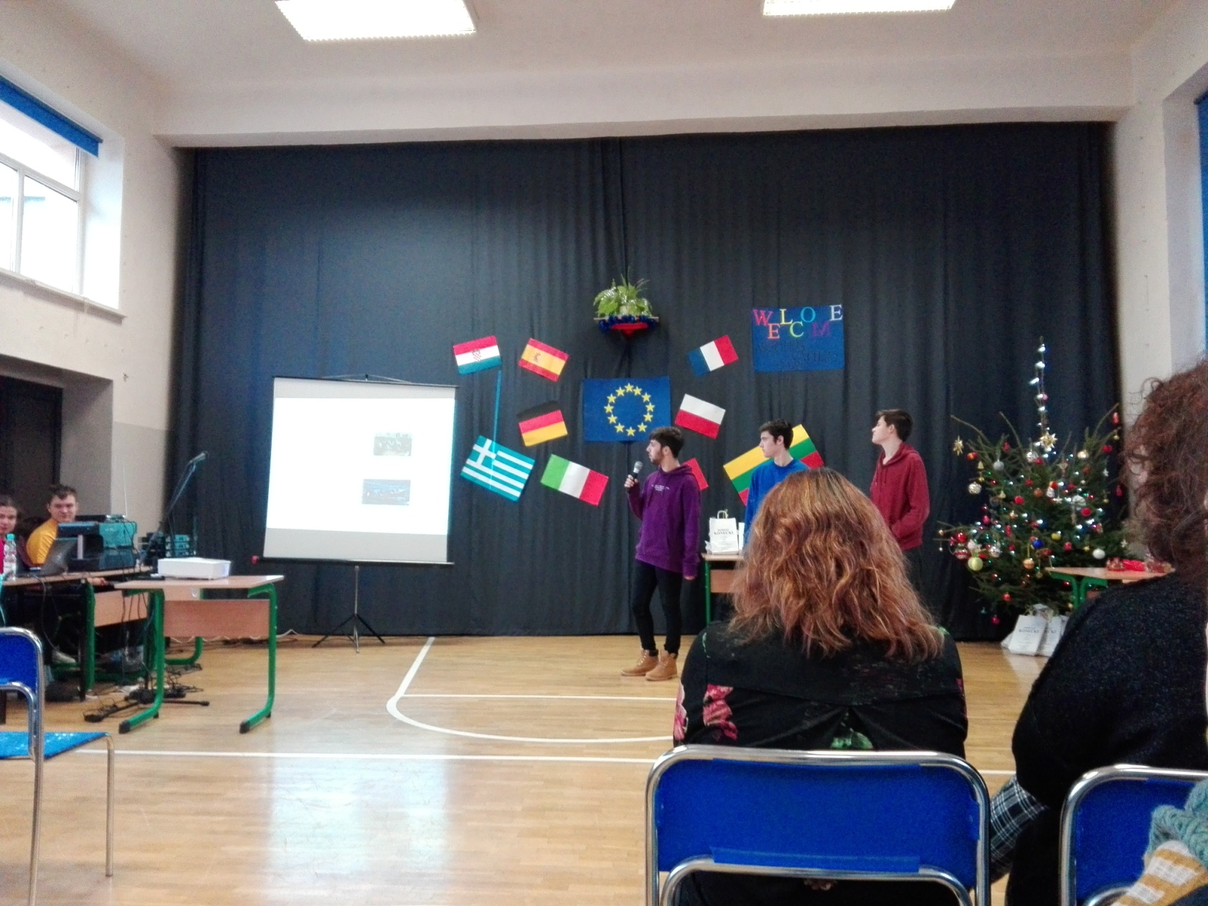
presentations

Slide 4
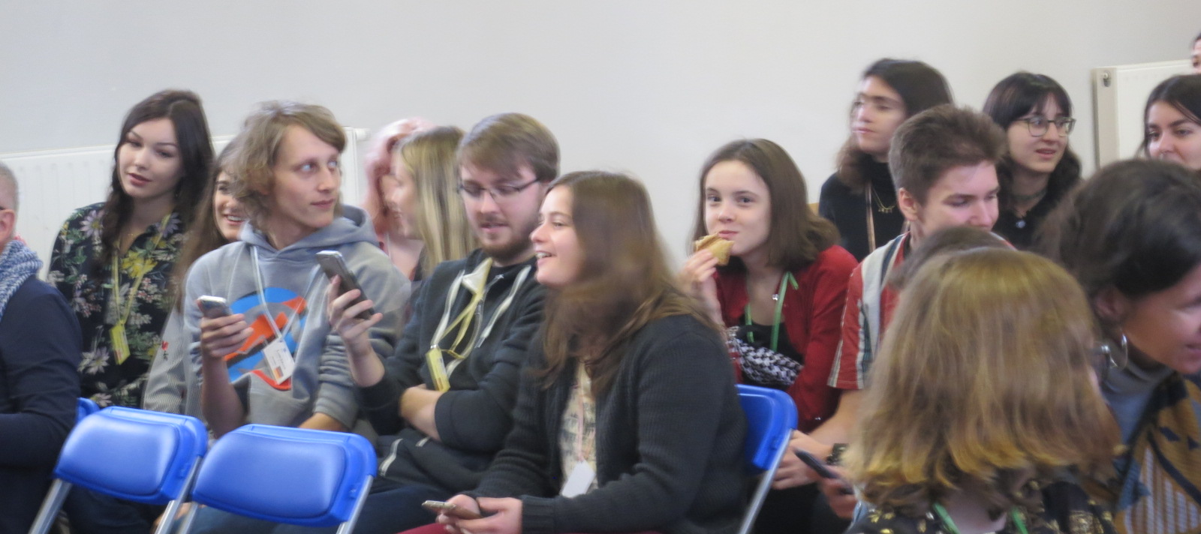
Other activities
Our guests were taking part in a quiz. Then we were singing a christmas carol.

Slide 5
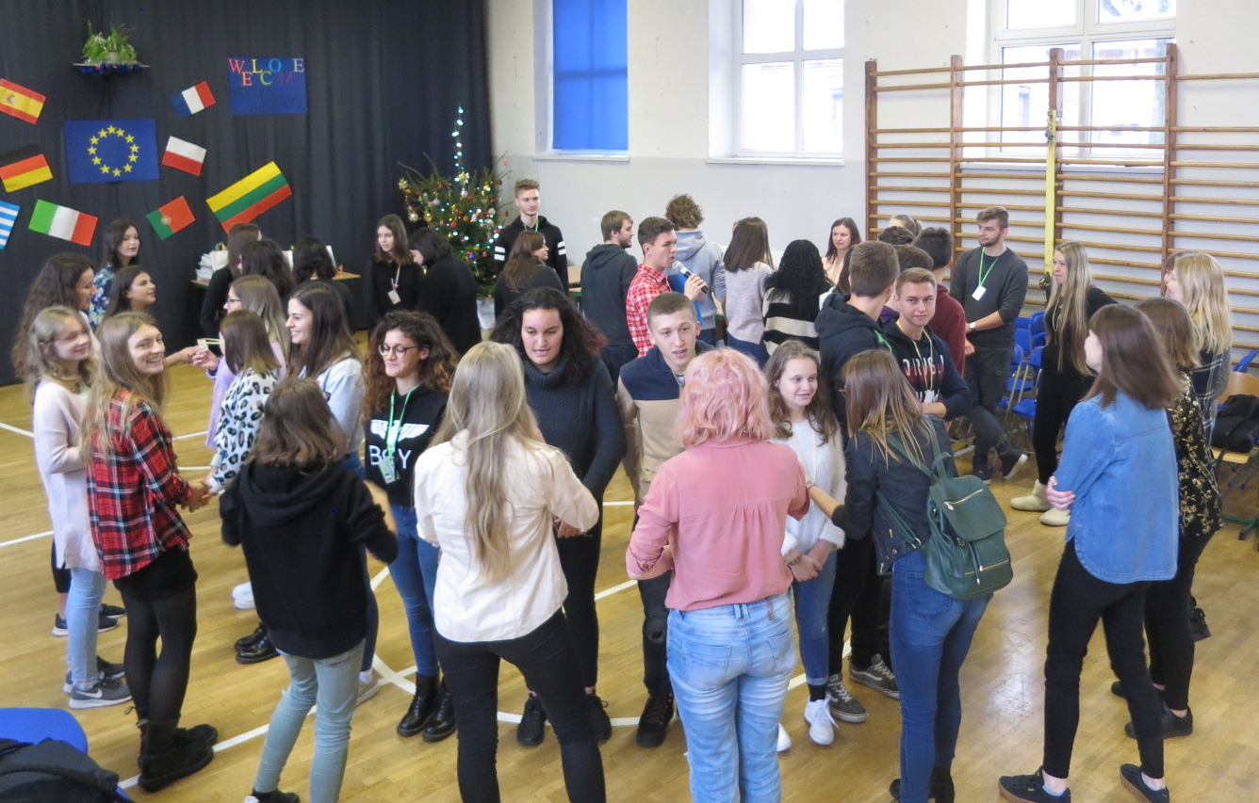
Ice breaking
We were playing ice breaking game. We learned a lot about each other.

Slide 6
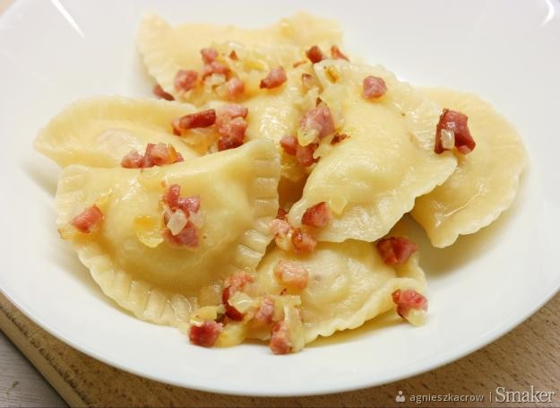
Lunch time
Our guests were tasting traditional polish dish – pierogi.

Slide 7
Group project
Our group was preparing a collage.

Slide 8
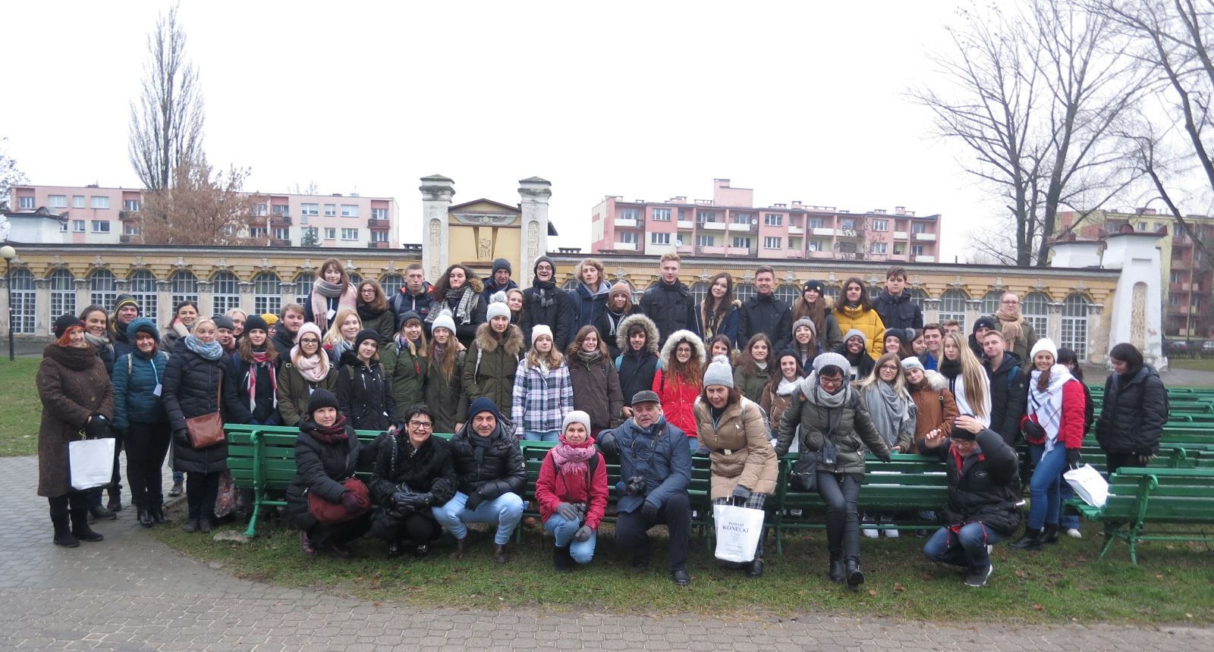
Walk around Końskie

Slide 9
Thanks for your attention

