Slide 1
"We are looking for migrants in our surroundings."
Opracowały: Agata Wróbel Natalia Miedzińska

Slide 2
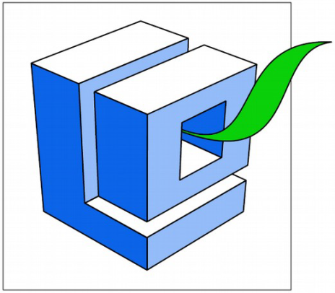
Projekt „Migration Matters”- współfinansowany w ramach programu Unii Europejskiej Erasmus+
„Publikacja odzwierciedla jedynie stanowisko jej autorów i Komisja Europejska oraz Narodowa Agencja Programu Erasmus+ nie ponoszą odpowiedzialności za jej zawartość merytoryczną”.

Slide 3
Let’s get to know a story of Ales…
Ales Giorgio was born in Italy in Sicily in Palermo. Giorgio's family moved to Belgium after the war because of poverty in his country. Ales was 6 years old then but he still has got Belgian's citizenship.
He finished school and he worked in the mine. He speaks foreign languages fluently. He speaks Italian, French and Dutch. He is still learning the Polish language.

Slide 4
…and Hanna.
His wife is Hanna. Hanna is from
Poland - Końskie. She lived
in Belgium for a few years.
They met in Belgian's cafe when
she went to visit her friends.
They came to Poland together.
Hanna showed Poland to
her husband, especially Polish
mountains and the sea. They used
to travel a lot.

Slide 5
Ales fell in love with the Polish woman and Polish landscape.
They moved to Poland on 5th April 2005.
They planned to move on 2nd April but they stayed,
because they wanted to pray and watch the
transmission from the funeral of John Paul II.
They have lived in Poland for 12 years.

Slide 6
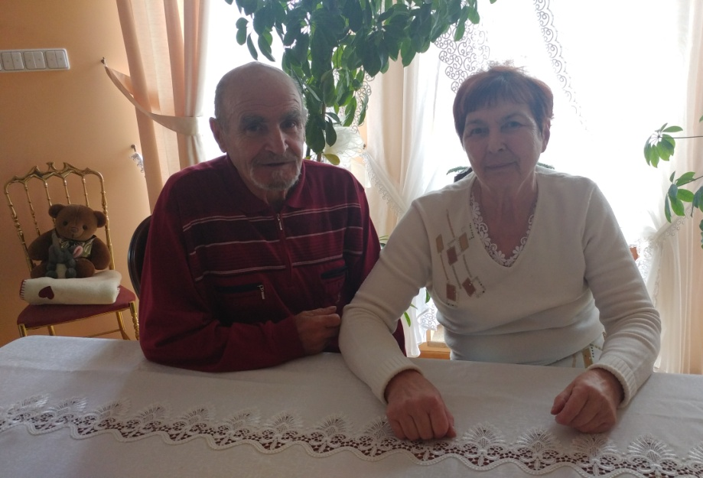
Ales and Hanna

Slide 7
Ales dreamed of having his own house and garden, so they settled down in Koczwara.
Hanna is 68 years old and Ales is 78 years old now.
They have been very active in life of our local community…
…and they are very happy!
The End!

Slide 8
Thank you for watching!

