Slide 1
GIMNAZIJA METKOVIĆ
IS GEOGRAPHY DESTINY?
Erasmus + Project

Slide 2
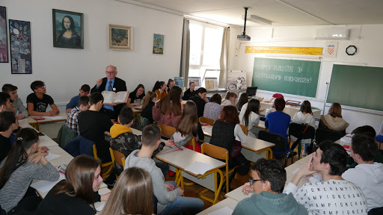
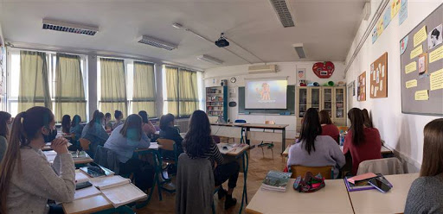
ABOUT THE SCHOOL
Gimnazija Metkovic is a state secondary school with 330 students age 14-19 and 40 teachers.
There are three main courses – language-oriented, STEM-oriented and comprehensive.
The curriculum is highly academic with around 15 compulsory subjects each year, plus several electives.
All pupils go on to higher education at university. Students have consistently scored high in numerous competitions and national final exams.

Slide 3
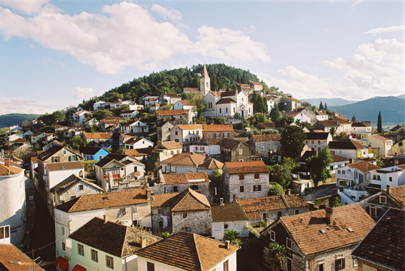
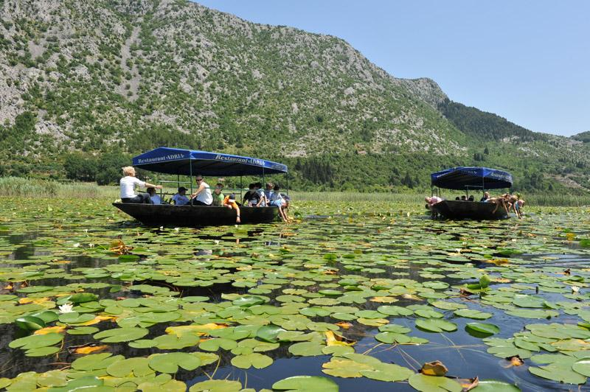
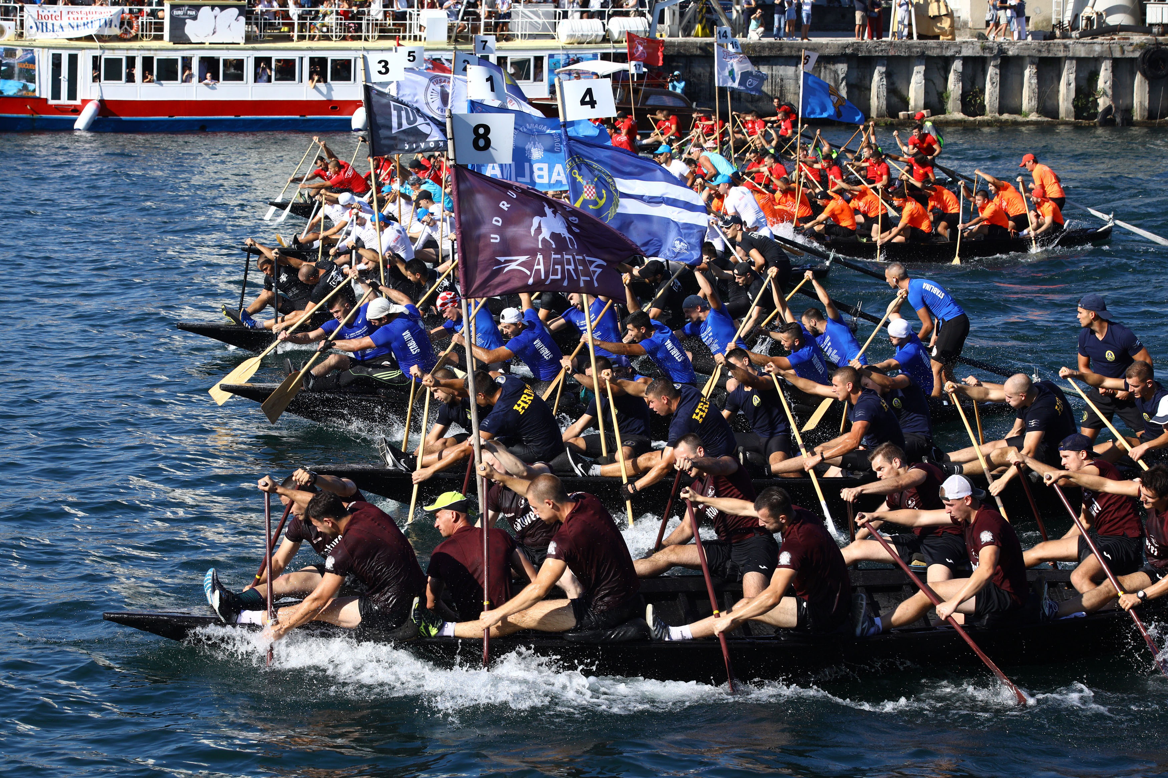
LOCATION
The small town of Metković is situated in the southernmost region of Croatia, in the county of Dubrovnik-Neretva, in the valley of the Neretva River.
The main focus of business in Metkovic is agriculture (citrus fruits), tourism, and administration.
The geographical features of the area are mainly marshland and karst landscape. The climate, the flora and fauna are typically Mediterranean, as well as the local cuisine.

Slide 4
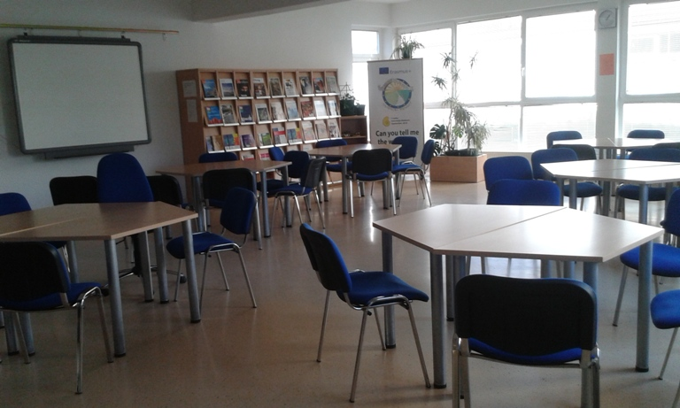
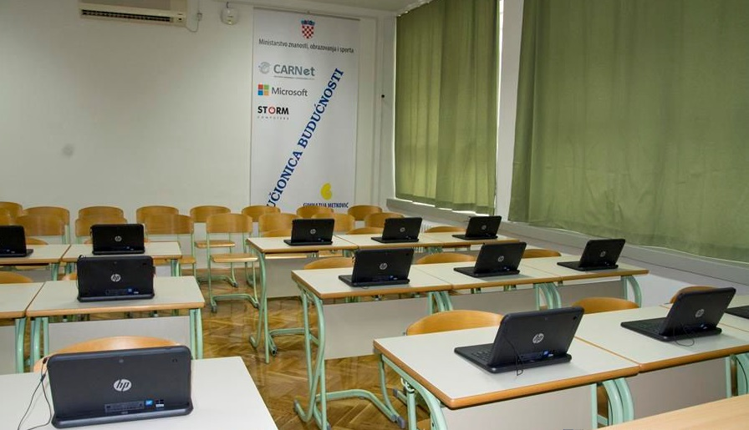
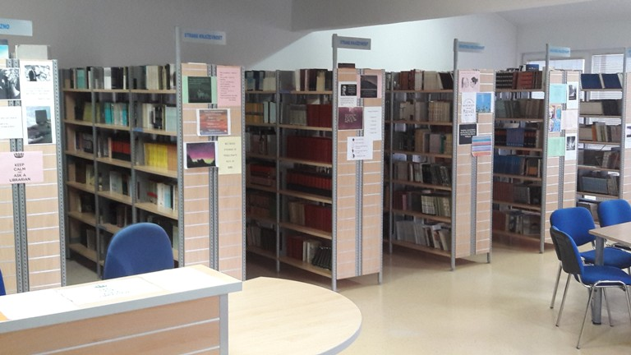
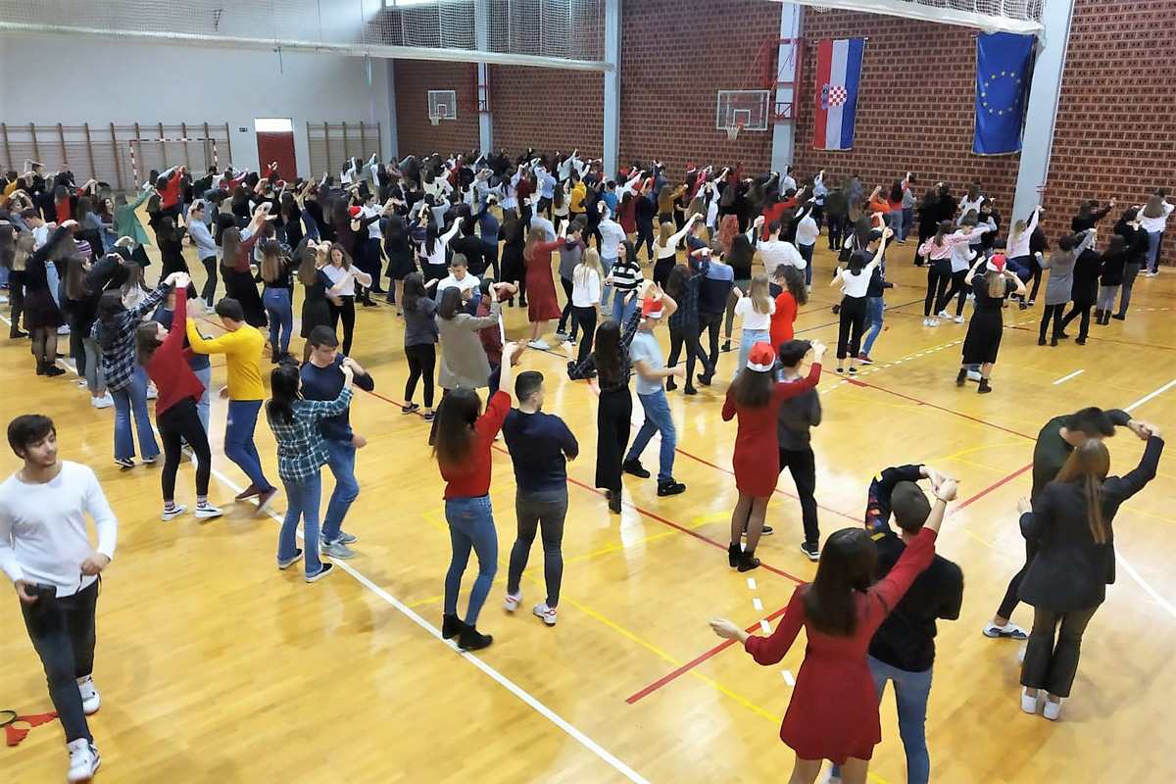
FACILITIES
The building of the school is situated in the town centre and has recently been renovated for energy efficency.
There are 20 classrooms, equipped with projectors and/or smartboards, a physics and chemistry lab, library, reading room, STEM classroom and staff rooms.
Adjacent to the school building is the school gymnasium for PE classes and other sports and events.
The school is surrounded by a lush garden and two other schools (another secondary and a primary school).

Slide 5
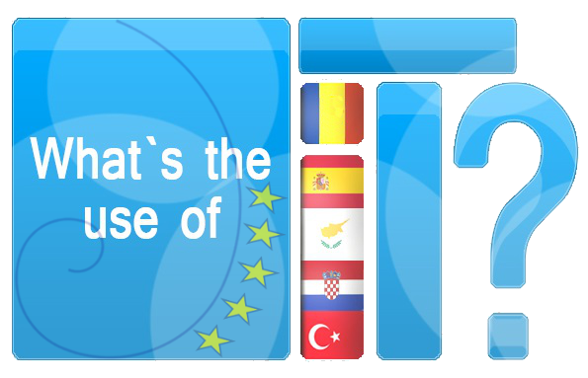
SCHOOL PROJECTS: ERASMUS +
Gimnazija Metković has participated in Erasmus plus since 2013., and there have been numberous partnerships with schools all over Europe.

Slide 6
SCHOOL PROJECTS: ERASMUS +
Finished KA2 partnerships:
„What’s the Use of it” (math), „Following the Footprints of Emperors” (history), „Can you Tell me the Way to...?” (hiking trails), „Math Routes around Europe” (math), „Digital Mapping of Traditional Jobs in Europe” (career orienteering)
Current KA2 partnerships:
„Is Geography Destiny?” (geography), „Groundwaters: Learning to Preserve our European Underground Environment” (biology), „Sea in Sight” (marine biology), Happy Schools 2020 (psychology), „Lecker und Gesund” (German language)

Slide 7
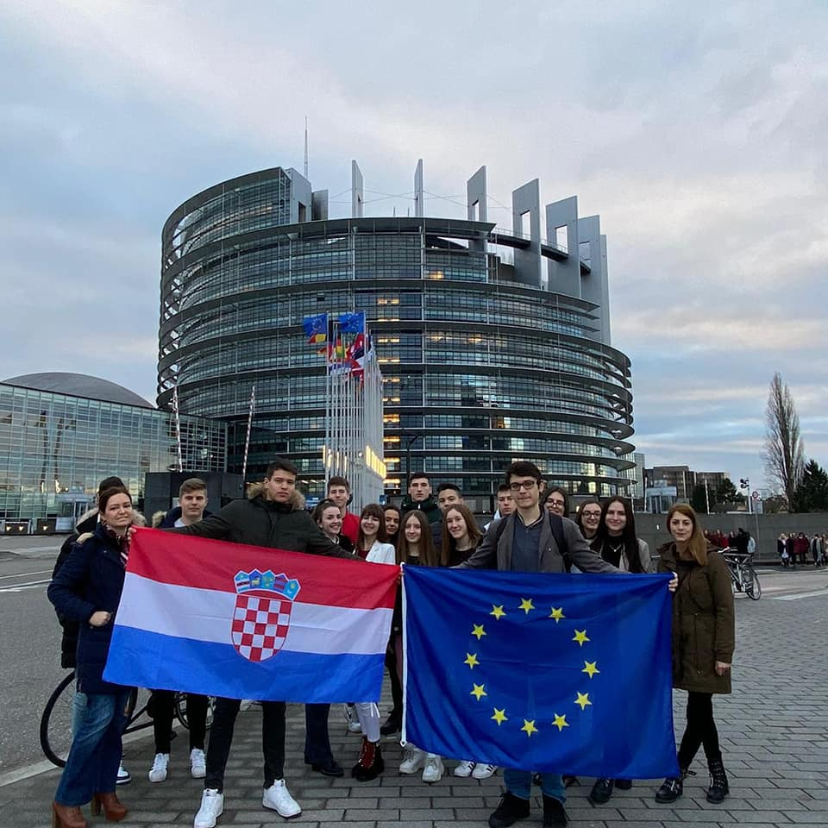
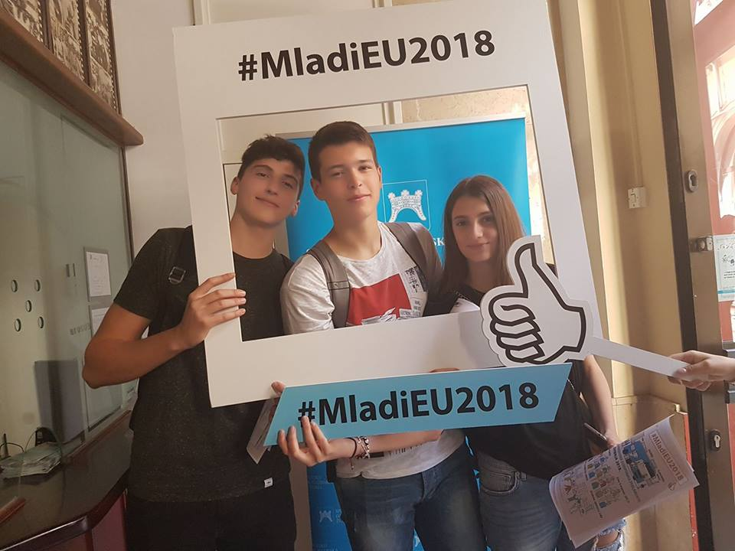
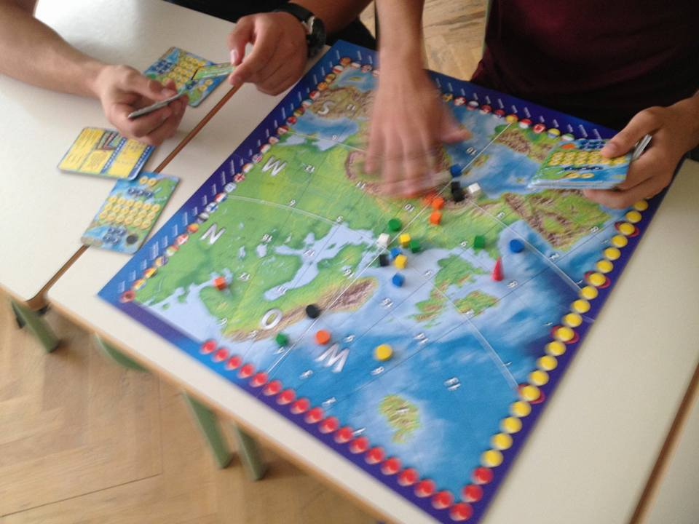
SCHOOL PROJECTS: EUROPEAN PARLIAMENT AMBASSADOR SCHOOL
Since 2016 Gimnazija Metković has been part of the EPAS programme, where students teach their peers and the local communities about the work of European institutions and the meaning of European citizenship.

Slide 8
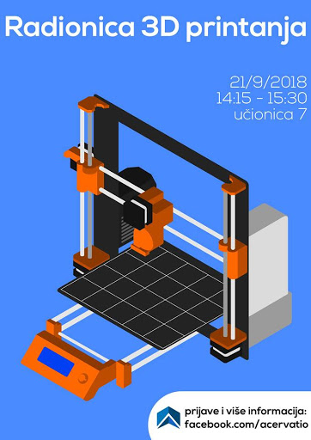
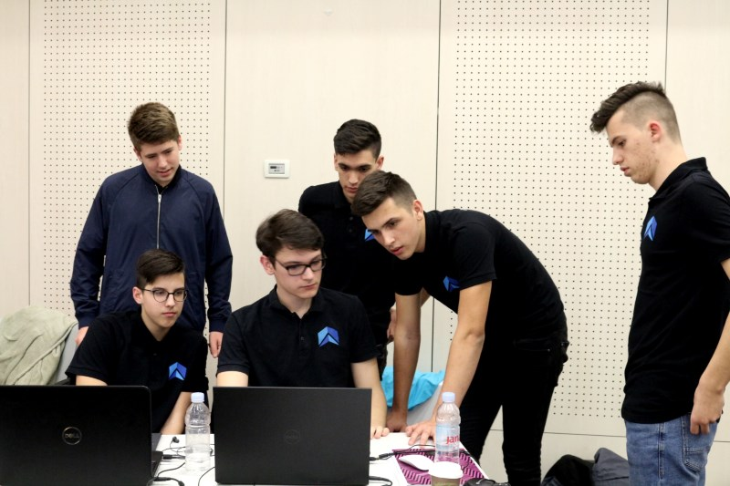
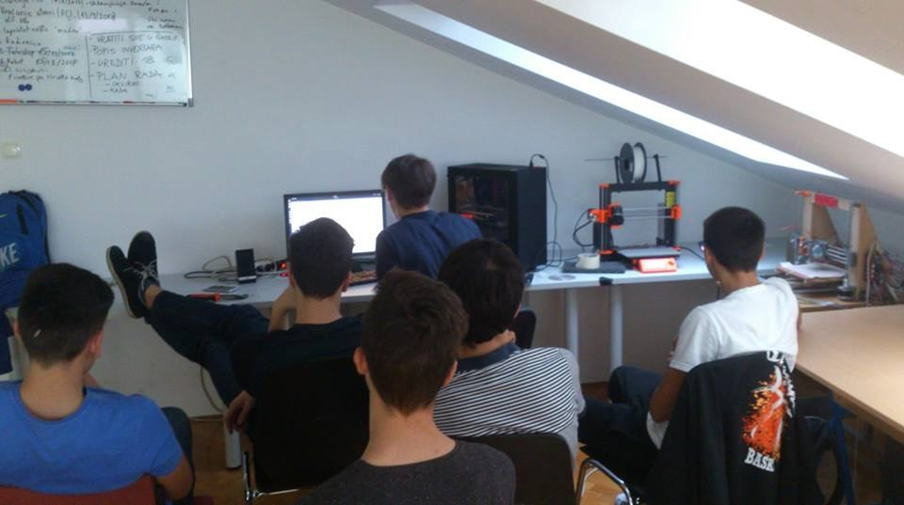
SCHOOL PROJECTS: ACERVATIO
The school’s STEM cabinet is set up as a workshop for students in the „Acervatio” group, who are involved in 3D printing, editing, graphic design, programming, scientific research, filming, drone-filming etc.

Slide 9
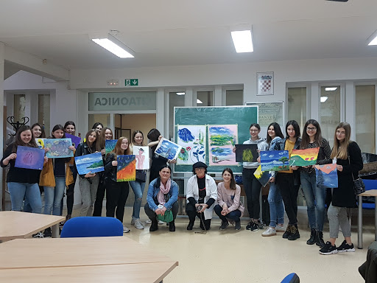
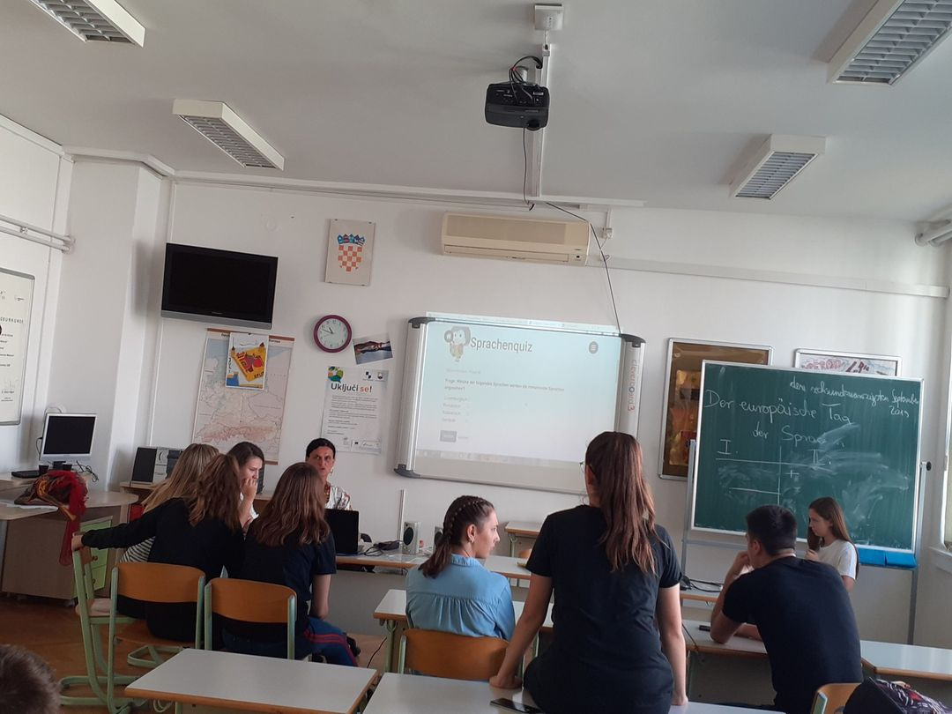
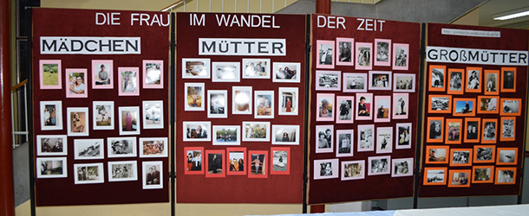
SCHOOL PROJECTS: PASCH
German language is learned at Gimnazija Metković
as a compulsory subject in all four grades, at levels from A1 to B2.
In cooperation with the German cultural insitute Goethe Institut, we have been part of the Europe-wide PASCH network of schools which cooperate in teaching the German language through projects, workshops, creative activities and student exchanges.

Slide 10
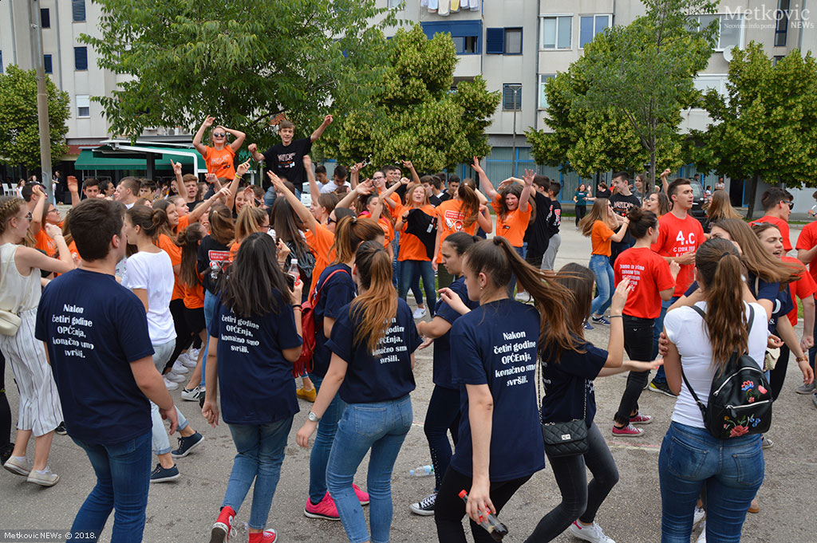
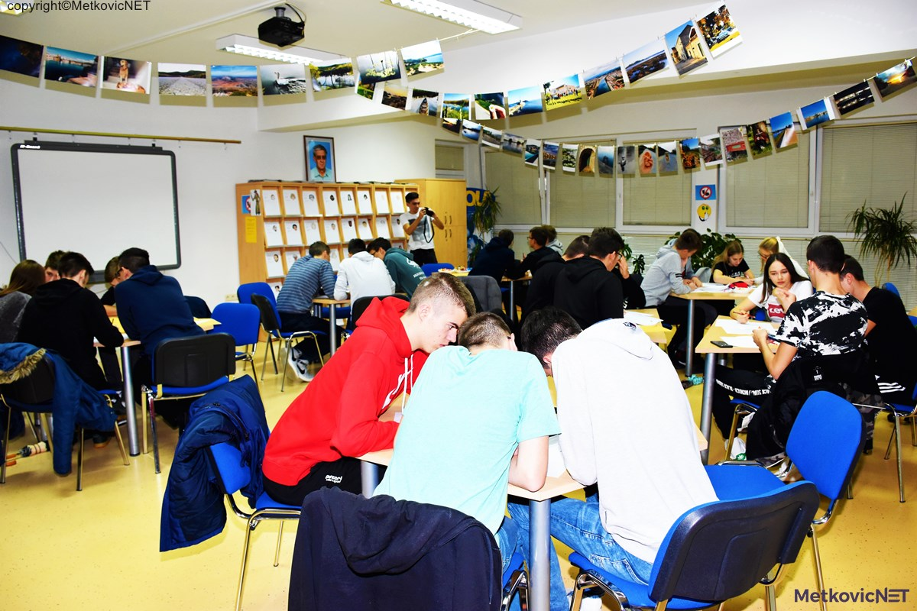
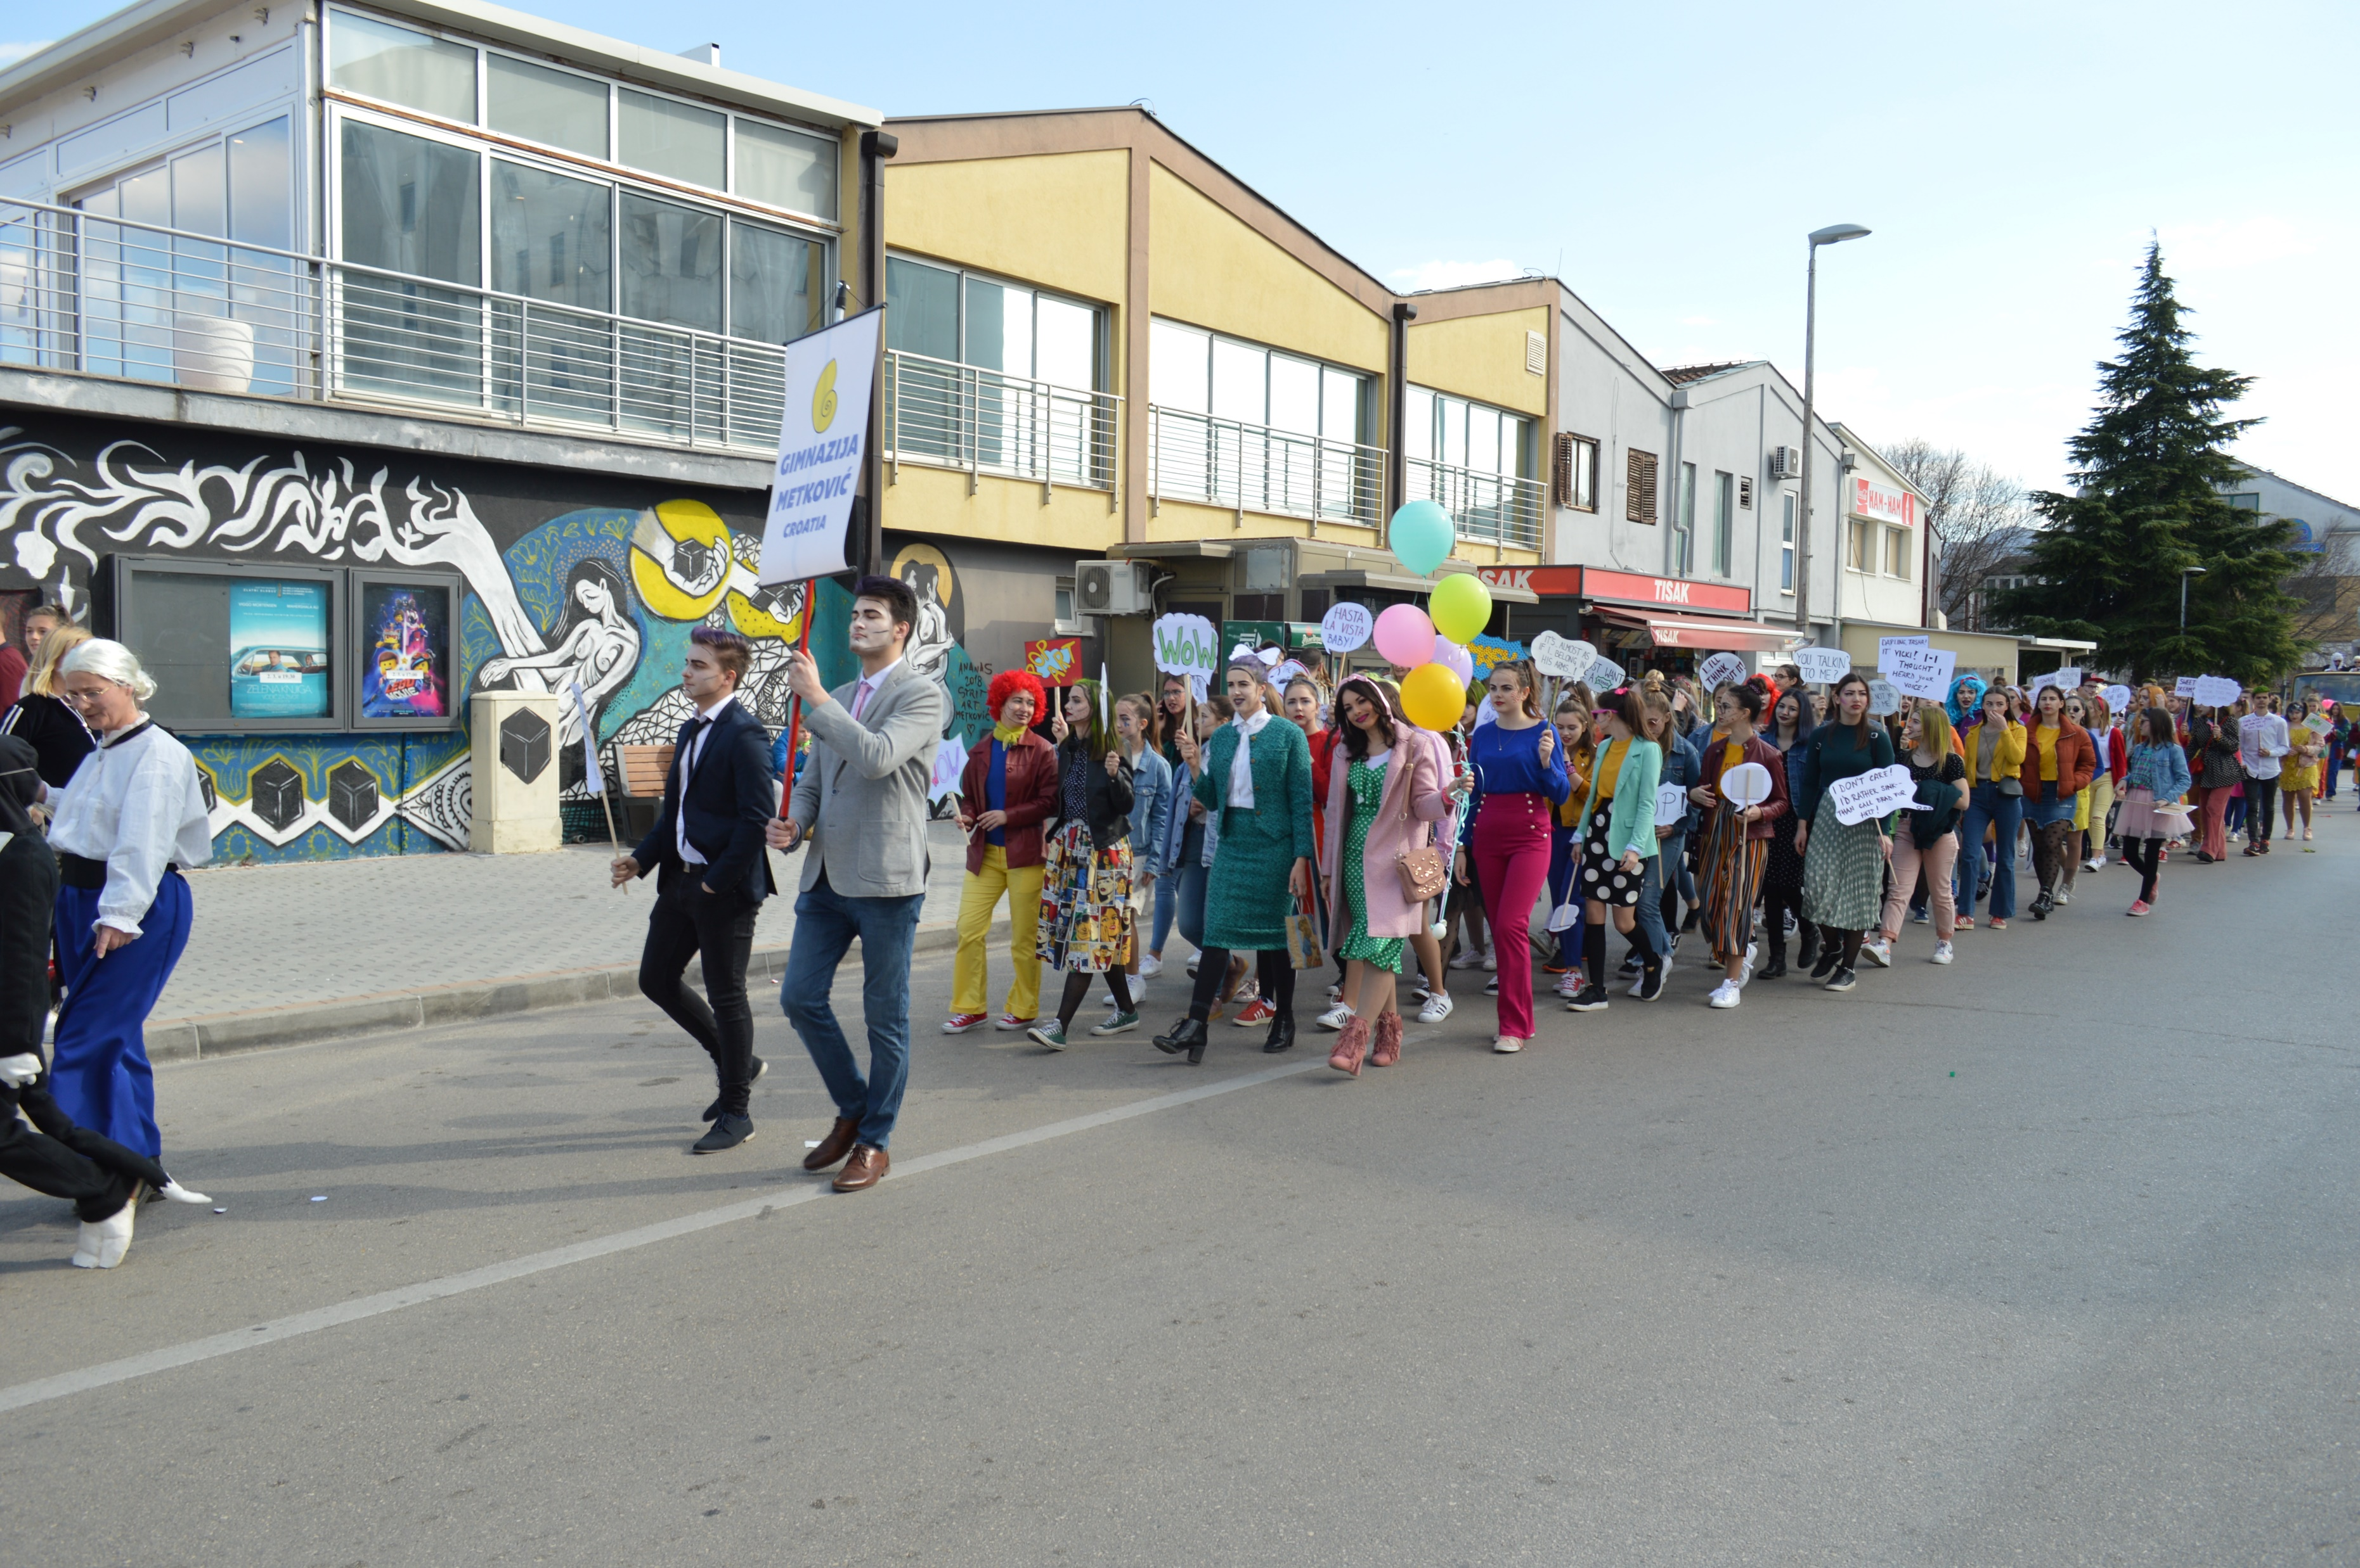
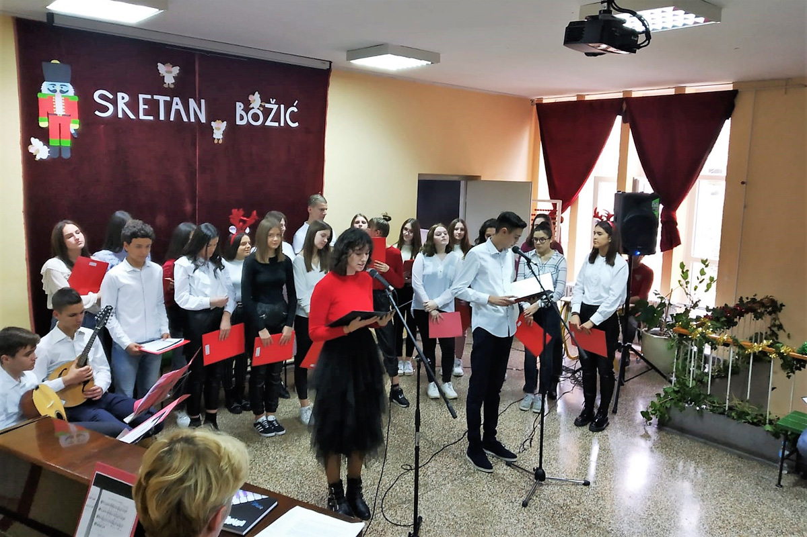
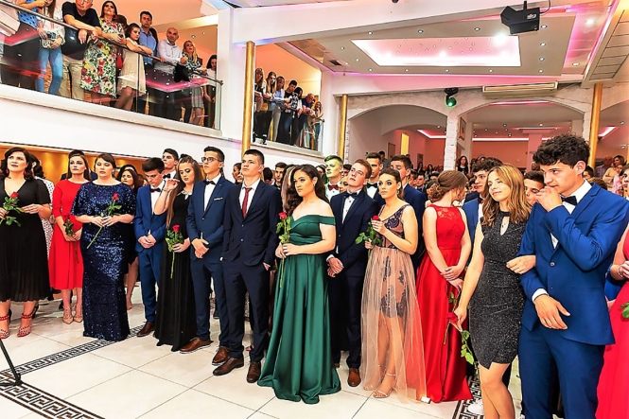
ACTIVITIES THROUGH THE SCHOOL YEAR...
„Daily dose of Physics”
Last day of school dance
„Math nights”
Prom night
Carnival
Christmas concert

Slide 11
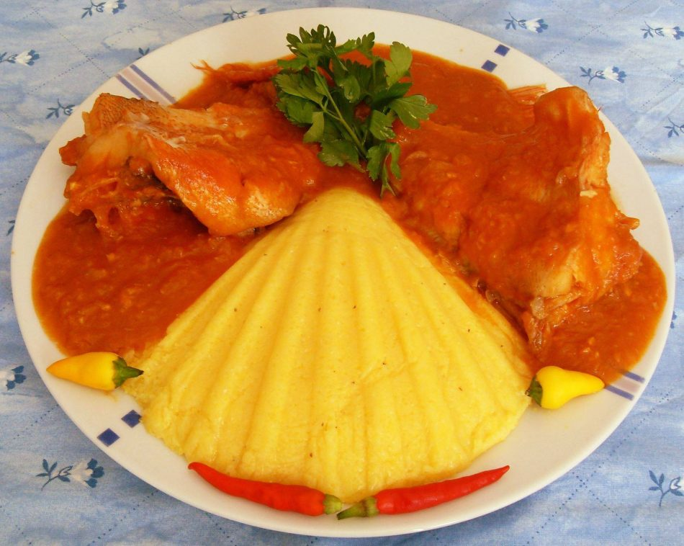
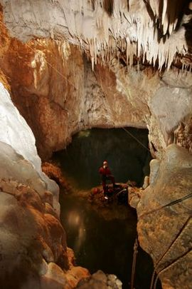
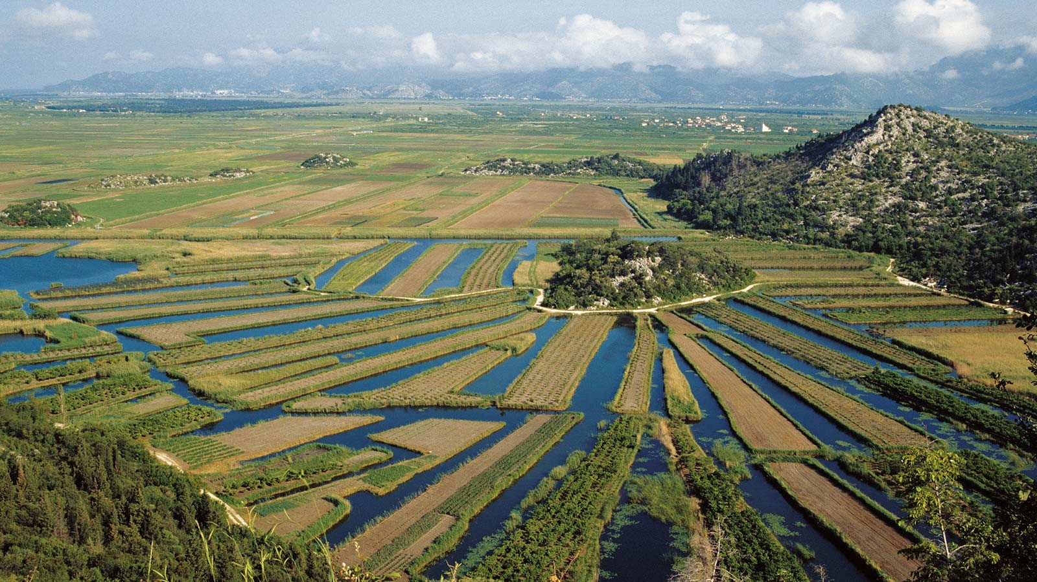
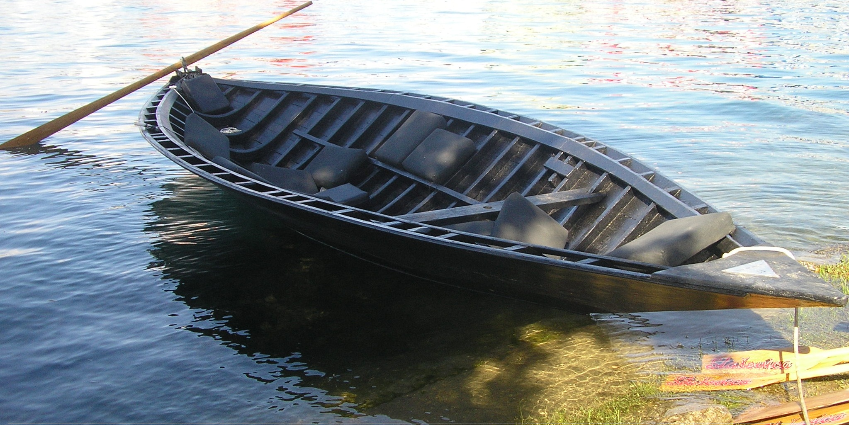
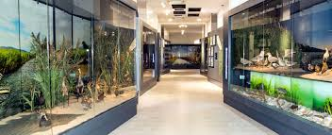
LET’S MEET IN METKOVIĆ SOON!

