Slide 1
Ozone Layer Depletion

Slide 3
Importance of the ozone layer
Absorbing UV rays
Prevents harmful radiations from entering the Earth’s atmosphere

Slide 4
Causes of Ozone Depletion
Chlorofluorocarbon(CFC)
Refrigerants
Aerosols
Plastic products

Slide 5
Global Ozone levels

Slide 6
Impact on humans
Increased risk of developing skin cancer (malignant melanoma, basal and squamous cell carcinoma)
Photo keratitis, cataracts
Weakened immune system
Difficulty in breathing, chest pain, throat irritation
Photoallergy

Slide 7
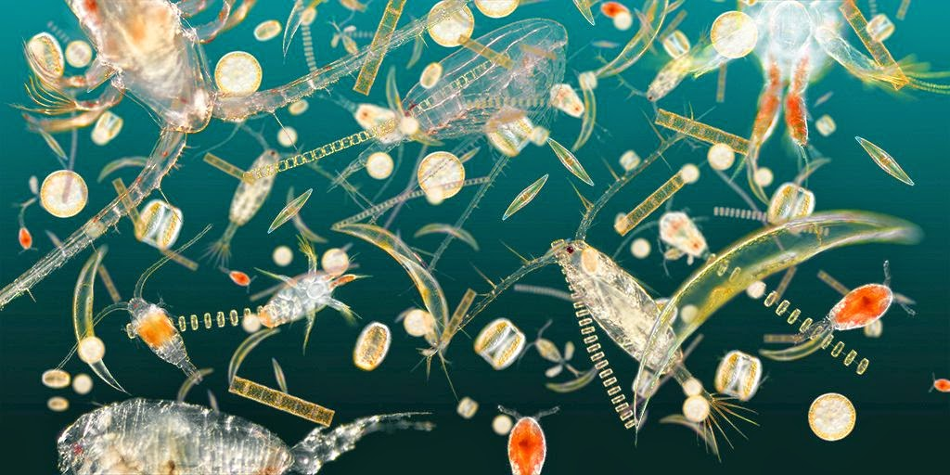
Effects on amphibians and marine life
Decline of amphibian species
Changed behaviour and habits
Decreased immunity
Death of plankton

Slide 8
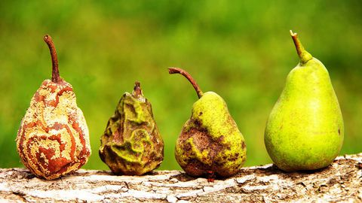
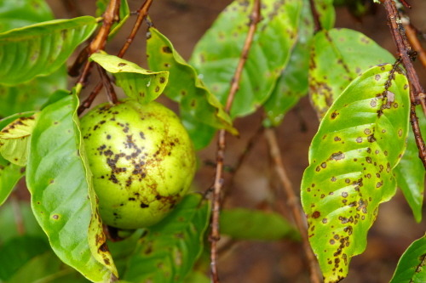
Impact on plants
Affected plant growth and production
Plant diseases
Disturbed environmental balance

Slide 9
Thank you for the attention!
Maria Milenova,XII d - FLS, Pleven, Bulgaria

