Slide 1
The food chain in the sea By: Yiğit

Slide 2
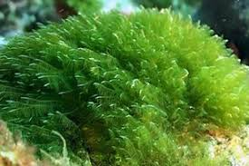
What are the creatures that produce their own food in the sea?
Sea algae are creatures that produce their own plants in the sea.

Slide 3
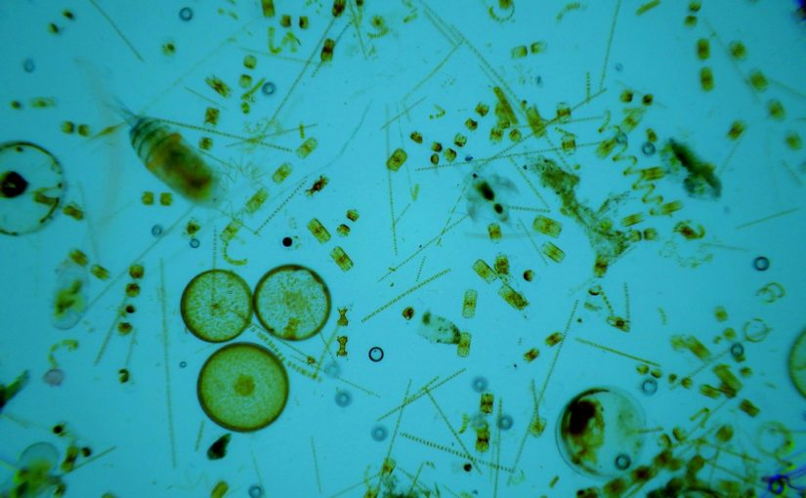
Phytoplankton
Phytoplanktons are one-celled organisms.
They catch the sun’s energy and does photosynthesis.
At the end, they produse food, nutrients and carbon dioxide into organic compounds.
This picture shows the aquarium phytoplankton:

