Slide 1
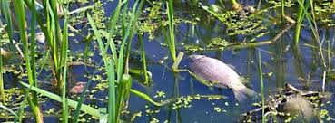
Water pollution
-people throw rubbish to sea.
Pl: -plastic
-poison
-metal
-pape
-tire

Slide 2
The water pollution
Water pollution occurs when chemicals,
Waste or other particles cause a body of water to become harmful to every one.
There are different reasons of water pollution pl:
-ship gas
-thrown into the water
-the wind blows into it

Slide 3
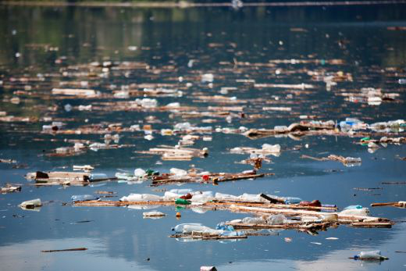
Protect your environment

