Slide 1
All living things need water to survive
Every living thing needs water to survive.
Organisms can use water not only for drinking, but also as a habitat.
For example, fish provide habitat for fish, sharks, and many other aquatic organisms.

Slide 2
Drink 2-3 liters a day
It is important that our body is always be hydrated.
Because if we don’t drink enough water, there’s a chance of dehydration.
Or if we drink a lot of water we will have a lot more energy.

Slide 3
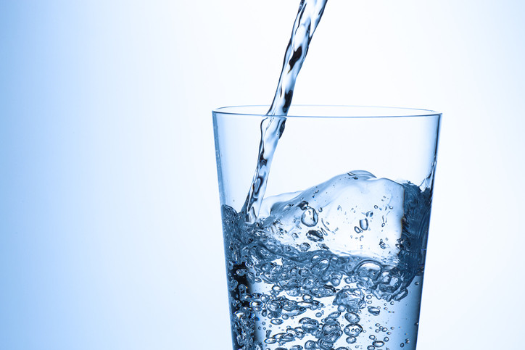
A person can live 3 days without water
The body needs lots of water to carry out many essential functions, such as balancing the internal temperature and keeping cells alive. As a general rule of thumb, a person can survive without water for about 3 days.

